Slide 1
6.1040 Visual Design Study
By: Yabetse Gebrewold

Slide 2
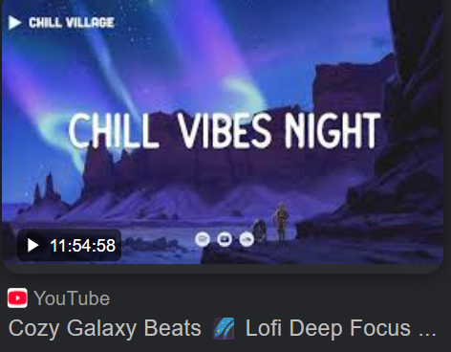
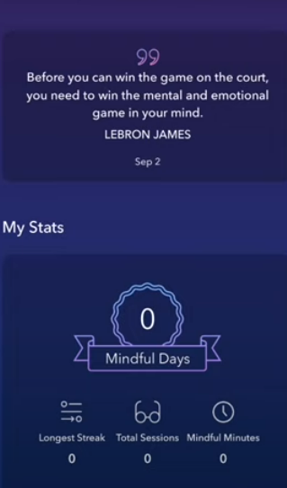
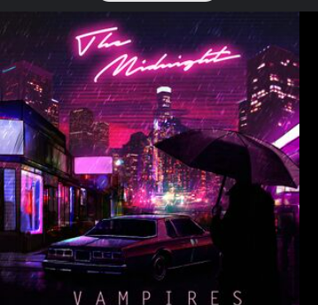
Color
Also see white text which is also more calming than a solid black color font and contrasts well against the dark blue and purple color hues
Words like “Chill” “Night” and “Cozy” are associated with this dark blue and purple gradient once again
Calm app UI: Gradients between a navy and violet hue provide a calming background suited for sleep.
Color pallete of navy and lavender purple match well together

Slide 3
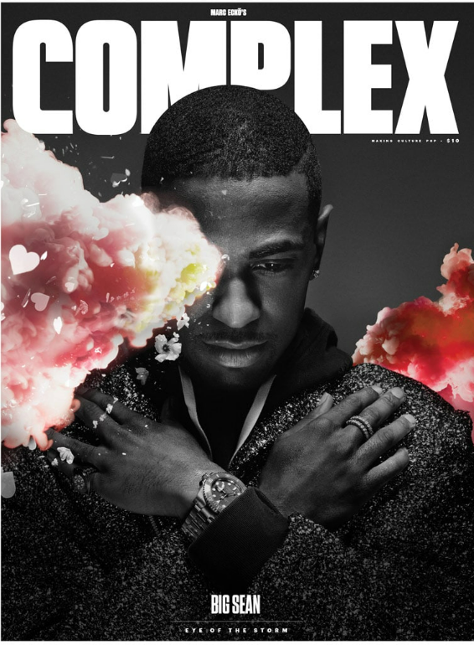
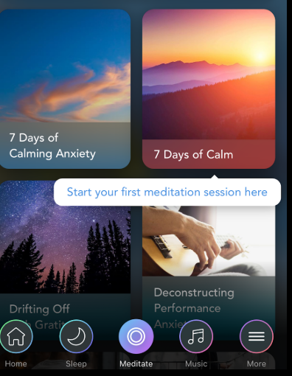
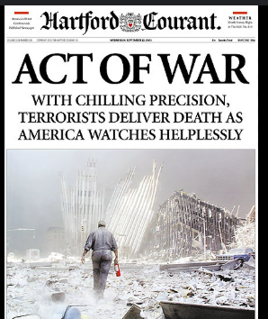
Typography
This shows how to combine rounded text with all caps and making letters close to each other keep a calm vibe but also extract excitement and importance. I can use this for the Competition page for my app which brings excitement into growing healthy sleep habits.
Calm app UI uses rounded sans-serif which supports a calm mood that is less tacky and mechanical but more human
It is important to understand contrast here. As both are large and bolded text but the one to the left brings out danger and anxiety because of how sharp the text is. So large text must remain rounded to maintain calmness while also bringing out excitement

