Slide 1

Jobbery
A deadline-based job plan for office workers whose jobs AI is replacing
Domain 1: Aiversecity Future-Ready Workforce
Team #slaynergy · SDC Hackathon 2026
Notes:
We are team slaynergy, and this is Jobbery: a deadline-based job plan for office workers whose jobs AI is replacing.

Slide 2
Clerical jobs are slipping, and no one tells
a laid-off clerk by when
Clerical roles, as a share of Malaysia’s online job ads
of a general office clerk’s tasks already show up in real AI use
workers had applied for unemployment benefits by mid-July 2026
9.9% → 7.3%
43%
52,607
ILO puts data entry clerks in its top exposure band (0.70 on a 0 to 1 scale).
All of 2025 saw 74,841. The Job Search Allowance lasts 3 to 6 months.
DOSM Job Market Insights, 2022 Q2 to 2026 Q2 (published 18 Aug 2026). Down 27% from the peak; the quarterly series is noisy.
Anthropic Economic Index, release of 10 Feb 2025 (9 of 21 O*NET tasks). ILO Working Paper 140, 2025 scores.
SAYS Malaysia reporting, 2026; PERKESO Job Search Allowance terms.
The gap: today’s career tools give advice with no dates, no sources and no track record.
Notes:
Meet a 27-year-old bank clerk, laid off in November, with three to six months of allowance. In Malaysia, clerical roles were almost ten percent of online job ads in 2022. They are 7.3 percent now. And Anthropic’s Economic Index finds 43 percent of a general office clerk’s tasks already show up in real AI use. Career tools tell her what to do, but with no dates, no sources, and no track record. That is the gap.

Slide 3

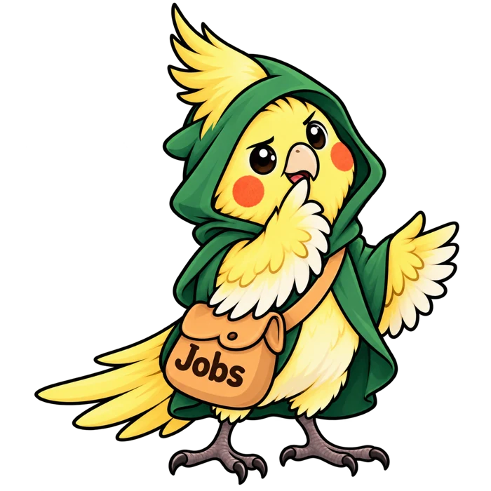
Two users: the worker and the advisor
The worker
The advisor
A finance or admin clerk, 22 to 35, in the first week after being laid off.
An employment counsellor who meets each worker once.
3 to 6 months of allowance: a real deadline
Needs to know which skills expire, which jobs are within reach, and what to learn this week
Sees the worker’s profile, plan and the futures behind the advice
Writes advice that lands on the worker’s plan
Notes:
Two users. The worker, who needs to know which skills expire and what to learn each week. And the advisor, who meets each worker once and sees their profile and plan.

Slide 4
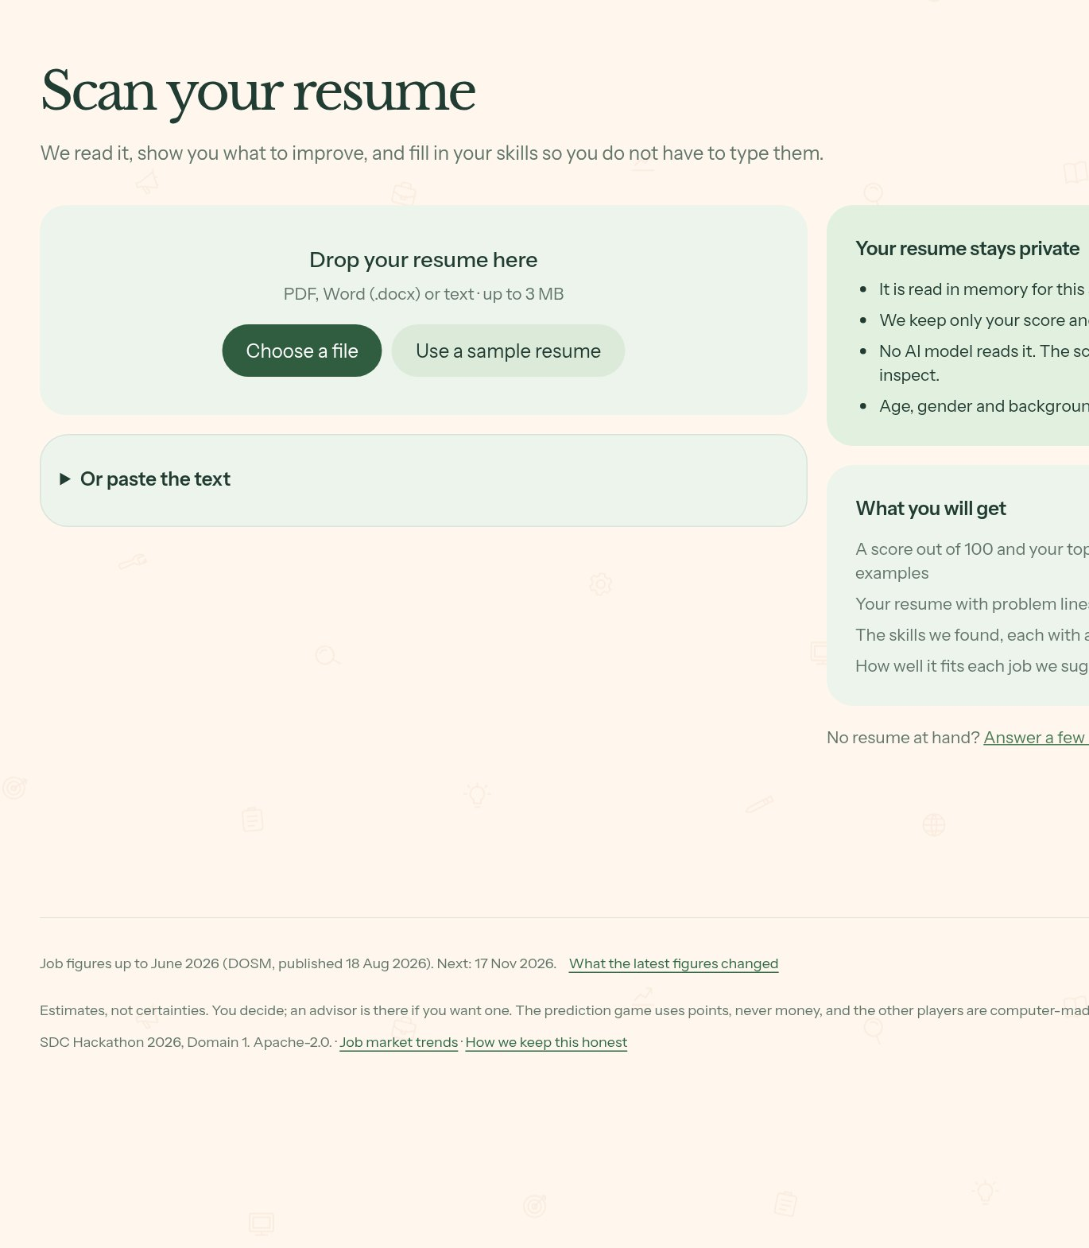
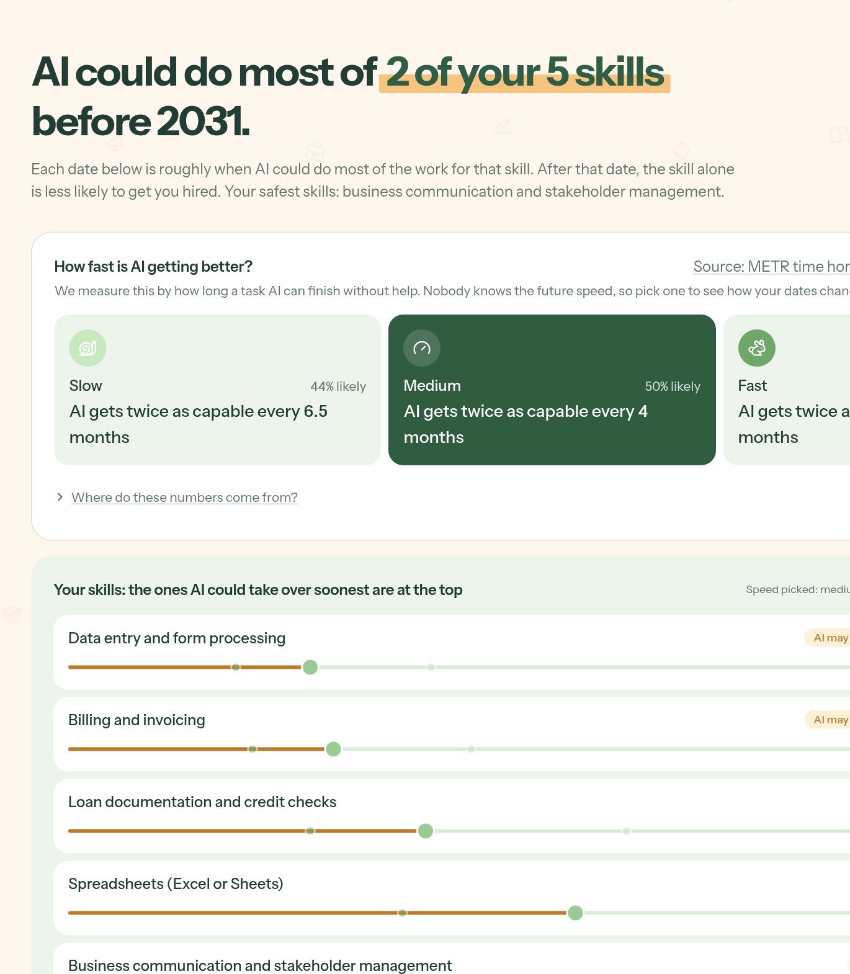
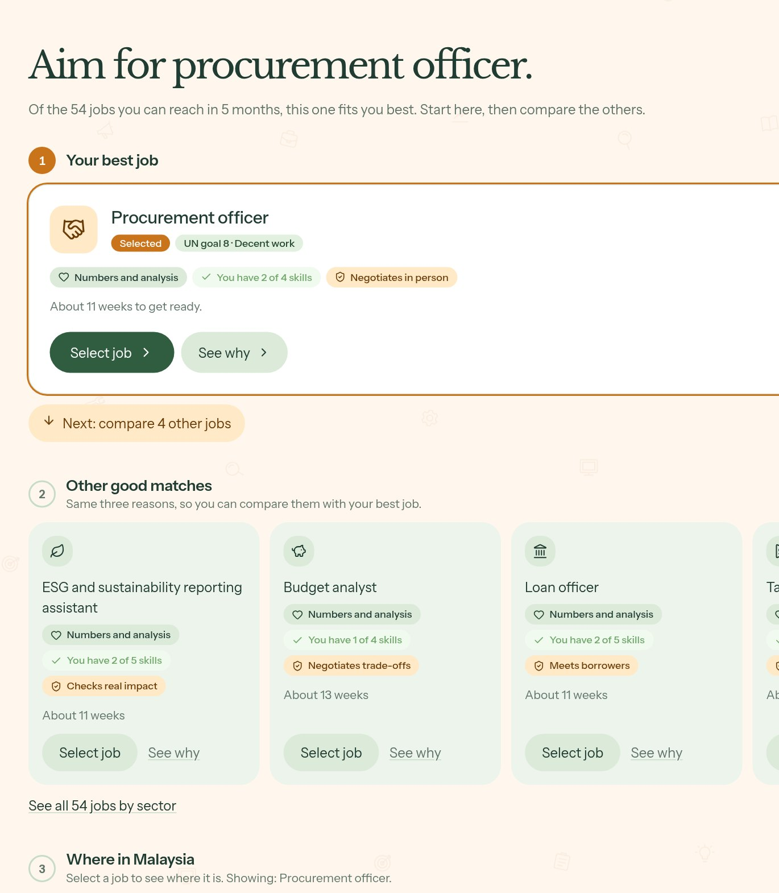
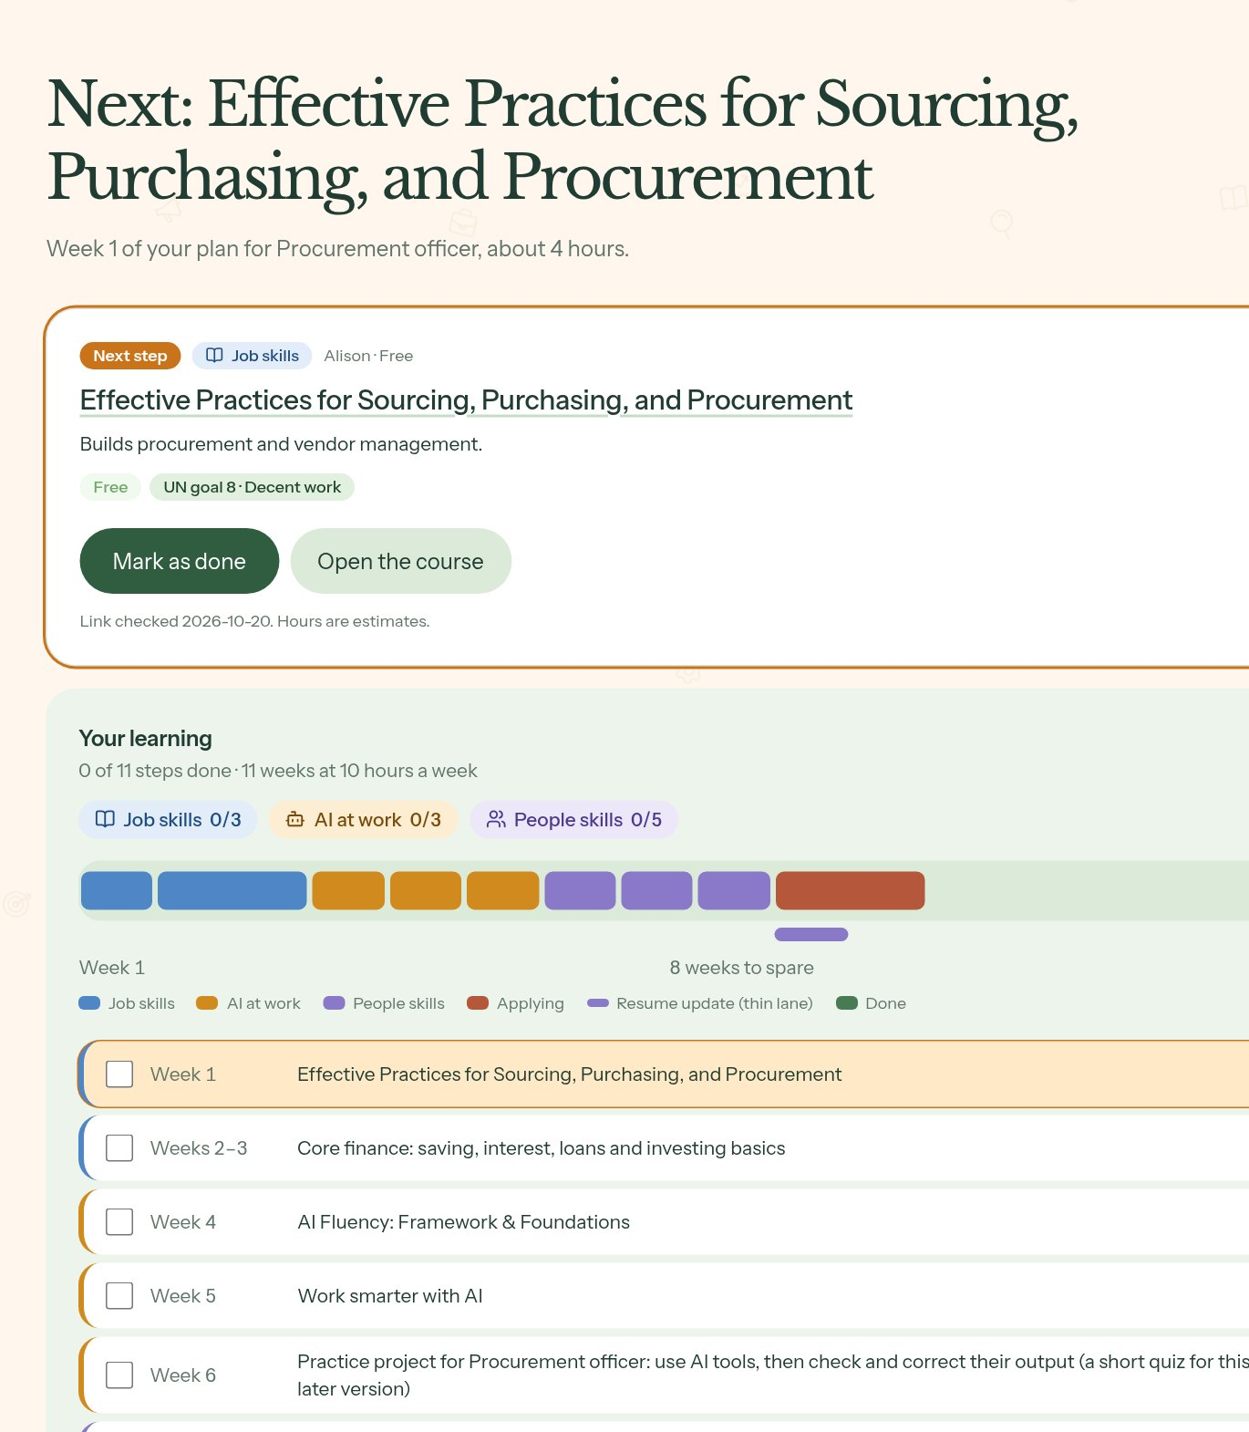
Four steps from laid off to a dated plan
›
›
›
You
Skills
Scan a résumé or answer eight questions. Nothing is stored.
Jobs
Every skill gets an expiry date, under slow, medium and fast AI.
Plan
Roles you can reach before your deadline, with a score you can open.
Week by week, with free courses, ending in a booked advisor meeting.
Notes:
Four steps. You: scan a résumé or answer eight questions. Skills: every skill gets an expiry date under slow, medium and fast AI. Jobs: eighty-nine roles, ranked by what you can reach before your deadline. Plan: week by week, with free courses and an advisor meeting.

Slide 5
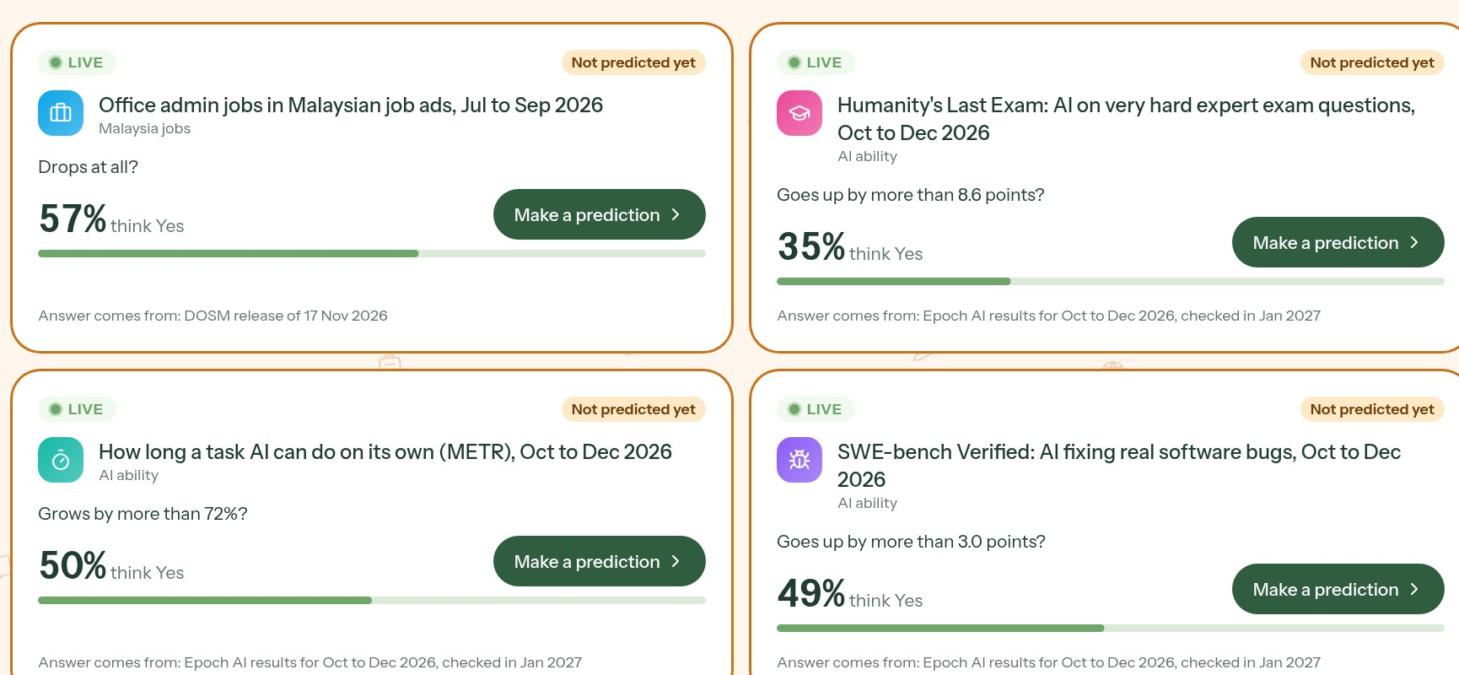
Forecasts graded against real data
Settled by official releases. Each question closes on a public release: DOSM on 17 Nov 2026, Epoch AI in Jan 2027.
Forecasters with a record. About 200 simulated forecasters built track records by replaying 66 real past releases. Always labelled simulated.
A hash log, not a blockchain. Every guess and settlement is chained, and the fingerprint is committed to GitHub.
This is not a chatbot.
Today’s odds for the three futures, set by the market
Slow 44%
Medium 50%
No AI model runs inside Jobbery. Scores and plans come from tested code: same inputs, same answer.
The small slice is Fast: 5%. No future ever drops below 5%. Points only, never money.
Notes:
What makes it different is the prediction market. Nobody knows how fast AI will move, so we run three futures and let forecasts set the odds. Each question settles against a real public release, like DOSM’s on 17 November. About two hundred simulated forecasters, clearly labelled, built track records by replaying sixty-six real past releases. A hash log, not a blockchain, keeps the record tamper-evident. And this is not a chatbot: no AI model runs inside Jobbery.

Slide 6

All six must-haves, each on a named screen
Skills intake
Onboarding and résumé scan
AI-trend signal layer
Dated public sources
You
Trends · Sources
Role matching and skills gap
89 roles across 10 sectors
Reskilling pathway
Week by week, free courses
Jobs
Plan
SDG mapping
Goals 4, 8 and 10
Multiple scenarios
Slow, medium and fast AI
Goals · Plan
Futures
Notes:
All six must-haves, each on a named screen: intake on You, the trend layer on Trends and Sources, matching on Jobs, the pathway on Plan, SDG goals four, eight and ten on Goals, and the scenarios on Futures.

Slide 7
Every source is dated and replaceable
Source | What it feeds | Latest release in the app | Next
ILO | How much of each job generative AI could do | 2025 exposure scores (WP 140) | Next edition
Anthropic Economic Index | Which tasks people really use AI for | Release of 10 Feb 2025 | Newer release queued
METR / Epoch AI | How fast AI is improving | Models to 15 Oct 2026 | Jan 2027
DOSM | Job ads by occupation, every quarter | 2026 Q2, published 18 Aug 2026 | 17 Nov 2026
MyCOL | Hard-to-fill occupations in Malaysia | 2024/2025 list | Queued, not loaded yet
O*NET | Role codes and task lists for 89 roles | As bundled in the Feb 2025 Index | With the next Index
One command
Drop in the next workbook and run the build. Open questions settle, the futures re-weight, and every plan recomputes.
Notes:
Every source is dated and replaceable. Drop in the next DOSM workbook, run one command, and expiry dates, rankings and plans recompute.

Slide 8
A small, tested stack anyone can rerun
Public releases
Data pipeline
Engine, pure TypeScript
Next.js 16 app
Replit
DOSM workbooks, Epoch AI data, ILO and Anthropic indexes
Node scripts turn raw downloads into dated JSON snapshots in the repo
View · expiry dates, matching, plan
React 19, API routes, a hand-drawn SVG map of Malaysia
Hosted with Postgres and signed sessions. No GPU needed
›
›
›
›
Tape · live trades and history replay
Market · LMSR prices, settlement, futures weights
81
0
Open source, Apache 2.0
tests pass: fairness, market maths, futures, replay, matching, plan and log
AI models at run time. Rules you can read and rerun
github.com/yabgzichien/SDCHack-slaynergy
Notes:
Next.js on Replit, a TypeScript engine with a view, a tape and the market, and a pipeline from raw releases to dated snapshots. Eighty-one tests pass, all open on GitHub.

Slide 9
People stay in control at every step
You choose your path
An advisor, on your terms
Jobbery ranks and explains. It never picks a job for you. Swap any course, switch futures, choose the goals you care about.
Book a 30-minute meeting any time. The advisor’s advice appears on your plan, and nothing waits for anyone’s approval.
Your call
30-minute slots
Résumés are never stored
Fair by test
Read in memory for the scan, then dropped. Only the score and the skills you confirm are kept.
Age, gender and background are never inputs. 42 of 42 profile pairs gave identical rankings and scores.
Never saved
Tested on every run
Notes:
People stay in control. Jobbery ranks and explains, but you choose. An advisor can be booked any time, and nothing waits for approval. Résumés are never stored. And a test checks that age and gender never change the results.

Slide 10
The hardest risks, and the fallback for each
Official data comes out rarely
DOSM publishes once a quarter and Epoch AI about as often, so a live market could sit idle.
Replay real history
66 past releases, 2021 Q1 to 2026 Q1, give every forecaster a track record on day one.
›
Only a few real forecasters exist so far
A market with a handful of players tells you little.
Clearly labelled simulated forecasters
About 200 fill the market, marked as simulated on every screen. Real ones join in the final round.
›
One quarter is hard to call
In replay the market beats a coin flip only just: Brier 0.242 against 0.25.
The market re-weights, never replaces
Expiry dates start from public exposure and adoption data. The three futures stay on screen, labelled as estimates.
›
Notes:
The hardest risk: official data is rare. So we replay sixty-six real past releases, and we label our simulated forecasters everywhere. And we are honest: in replay the market only just beats a coin flip, so it re-weights the futures and never replaces the data.

Slide 11

Who benefits, how we will know, how it grows
4
8
10
Every role and skill is tagged to an SDG target, and the goals a worker picks change which jobs rank first.
Quality education
4.4 Skills for decent jobs
Decent work
8.5 Full employment for all
Reduced inequalities
10.2 Inclusion for everyone
Who benefits
How we measure it
How it grows
Laid-off clerks reskill inside their allowance window
Workers who may move compare jobs, pay and unemployment across 16 states
Advisors spend a meeting on advice, not intake
Plans finished before the deadline
Weeks from layoff to first interview
Advisor meetings booked per plan
Forecast accuracy, scored in public
More occupations beyond finance and admin
English, Bahasa Malaysia, 中文 and தமிழ் already built in
Agency advisors and real forecasters
Notes:
Clerks reskill inside their allowance window, and advisors spend meetings on advice. We will measure plans finished before the deadline and time to first interview. It maps to SDGs four, eight and ten, in four languages.

Slide 12
Next: real forecasters, more jobs, real workers
Final round
Then
Team #slaynergy
Real forecasters replace the simulated ones
Practice tasks for the other nine sectors
Automatic re-planning when someone falls behind
More occupations beyond today’s 89 roles
MyCOL and the next Economic Index loaded
Low-bandwidth mode for older phones
Domain 1: Aiversecity Future-Ready Workforce
Open source on GitHub, Apache 2.0
Live demo next, 3 minutes
Help us put Jobbery in front of real laid-off workers and real forecasters.
Demo: 3 minutes
github.com/yabgzichien/SDCHack-slaynergy
Notes:
In the final round, real forecasters replace the simulated ones, and we add the other nine sectors. We are team slaynergy. Help us put Jobbery in front of real laid-off workers. Now, the demo.

