Slide 1




01 / 14
DOMAIN 1: AIVERSECITY FUTURE-READY WORKFORCE
Jobbery
Where Humanity Begins Its Journey to Its Next Evolution
Team #slaynergy · SDC Hackathon 2026

Slide 2


Jobbery · Domain 1: Aiversecity Future-Ready Workforce
02 / 14
PROBLEM STATEMENT
697,000
Jobs expected to be highly affected by AI and digitalisation:
Workers are at risk of losing jobs to AI if upskilling is not done.
With the advent of AI, the job landscape is changing faster than ever before.
Rather than feared, AI should be wielded to build a brighter future.

Slide 3

Jobbery · Domain 1: Aiversecity Future-Ready Workforce
03 / 14
Jobbery’s Audience
TARGET GROUP 01
TARGET GROUP 02
Primary Audience
Secondary Audience
High-skilled, employed workers at risk of future job-displacement due to inadequate knowledge of AI
Fresh graduates
Unemployed high-skilled workers
Discouraged high-skilled workers

Slide 4
Jobbery · Domain 1: Aiversecity Future-Ready Workforce
04 / 14
End-to-end human connection
The worker
The advisor
Learns to grow with AI
The final, innately human, step of the reskilling
Uploads a resume to explore future career paths & skills needed
Adds personalized guidance to worker’s plan
PERKESO officers support workers who need further guidance
The primary user: High-skilled, employed workers who desire to keep up in an ever-changing world
A real person to keep an eye on you, rather than just having an AI on you.

Slide 5


Jobbery · Domain 1: Aiversecity Future-Ready Workforce
05 / 14
Main Features of Jobbery
Skills intake
AI-trend signal layer
Role matching and skills gap
Reskilling pathway
SDG mapping
Handling uncertainty

Slide 6

Jobbery · Domain 1: Aiversecity Future-Ready Workforce
06 / 14
● LIVE
Live Demo
Team #slaynergy · SDC Hackathon 2026

Slide 7


Jobbery · Domain 1: Aiversecity Future-Ready Workforce
07 / 14
Sources used
SOURCE
WHAT IT FEEDS
LATEST RELEASE IN THE APP
NEXT
ILO
How much of each job generative AI could do
2025 exposure scores (WP 140)
Next edition
Anthropic Economic Index
Which Economic Tasks are Performed by AI
Release of 10 Feb 2025
Newer release queued
METR / Epoch AI
How fast AI is improving
Models to 15 Oct 2026
Jan 2027
DOSM
Job ads by occupation, every quarter
2026 Q2, published 18 Aug 2026
17 Nov 2026
MyCOL
Hard-to-fill occupations in Malaysia
2024/2025 list
Queued, not loaded yet
O*NET
Role codes and task lists for 89 roles
As bundled in the Feb 2025 Index
With the next Index

Slide 8













Jobbery · Domain 1: Aiversecity Future-Ready Workforce
08 / 14
Tech stack
FRONTEND
BACKEND
LLM API
Next.js
React
Node.js
Groq
TypeScript
Tailwind CSS
PostgreSQL
Runpod
Framer Motion
SQLite
KrackedDev
GITHUB
https://github.com/yabgzichien/SDCHack-slaynergy

Slide 9
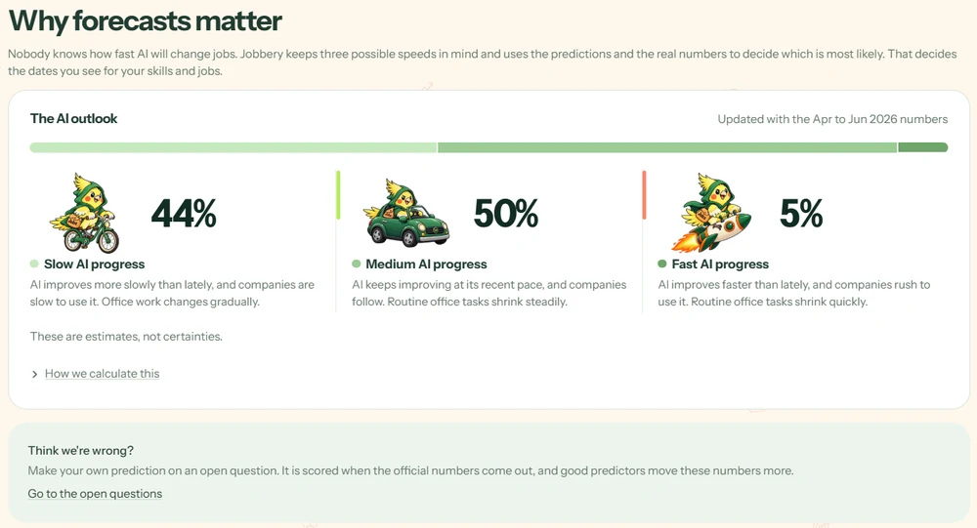
Jobbery · Domain 1: Aiversecity Future-Ready Workforce
09 / 14
JOBBERY · FORECAST · AI-SKILL FORECASTING PAGE
The Forecast:
Prediction Market
Three futures, with odds.
Slow, medium, and fast AI progress.
Votes of the forecasters create estimates, not certainties.

Slide 10

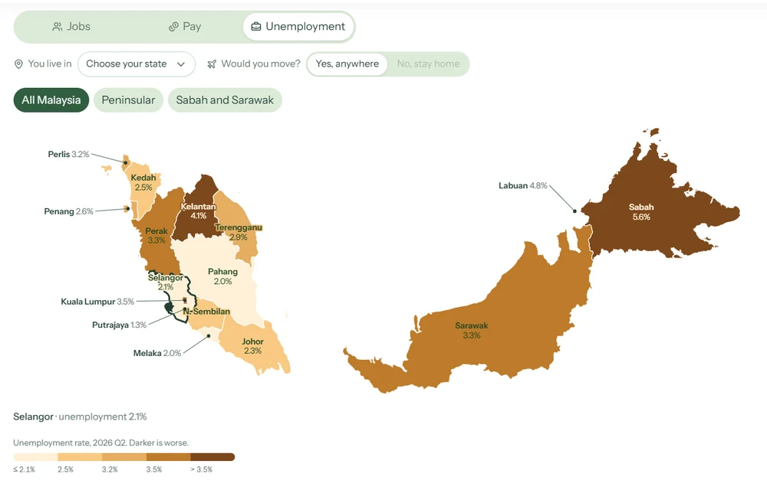
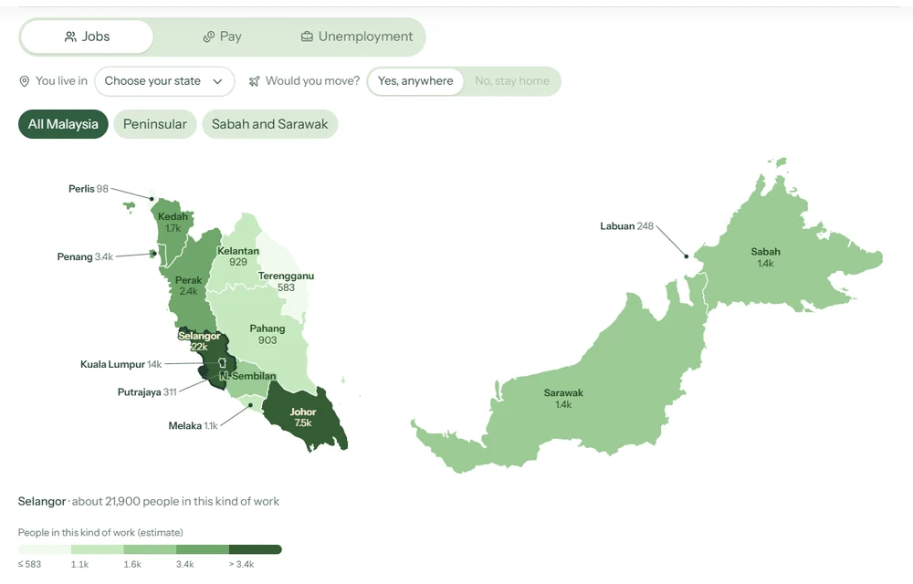
Jobbery · Domain 1: Aiversecity Future-Ready Workforce
10 / 14
JOBBERY · JOB MAP · THE MALAYSIAN JOB MAP
Heat map
Jobs distributed around Malaysia
Those willing to relocate can make smart decisions based on job abundance, salary and unemployment rates.

Slide 11
Jobbery · Domain 1: Aiversecity Future-Ready Workforce
11 / 14
Economics
MACROECONOMIC PILLAR 01
MACROECONOMIC PILLAR 02
Structural Unemployment
Frictional Unemployment
Occupational immobility
Weekly reskilling plan
Workers lack timely info
Target opportunities
Geographical immobility
Job + Salary Map
Suitable jobs are hard to find
Increased human capital
Changes in the structure of the economy
Transferable-skill pathways

Slide 12





Jobbery · Domain 1: Aiversecity Future-Ready Workforce
12 / 14
UN’s Sustainable Development Goals
4.4 Increase the number of people with relevant skills for financial success
5.7 Equal rights to economic resources, property ownership, and financial services
8.5 Full employment and decent work with equal pay
9.2 Promote inclusive and sustainable industrialisation
10.3 Ensure equal opportunities and end discrimination
Why workers don’t upskill:
56% professionals use AI tools at work
26%received formal training
AI panic breeds disdain and widens the skill gap

Slide 13







Jobbery · Domain 1: Aiversecity Future-Ready Workforce
13 / 14
Limitation and Future Works
Limit
Limit
The prediction market is a simulation
The AI speed progression are estimates
No real human predictors yet.
Estimates from past public data and mathematical modelling
Limit
Limit
The resume AI runs on outside models
Living costs are from household data
If AI is left on, its text is sent once to a hosted AI service.
The living costs per person are derive from household spending data.
Future
Future
Our own local models
Expand to other countries
Host local models on our own infrastructure.
The same plan for workers abroad, using each country’s own job, wage and cost-of-living data.
Notes:
Jobbery is a prototype, and we want to be clear about its limits. The prediction market is a simulation: practice points, no real money. The AI speed dates are estimates, so treat them as a range, not a promise. Living costs are state averages, worked out per person from household spending data. Today the resume reader can use an outside AI service, and a resume is never stored. In future, we want to move the reader onto our own local model so a resume never leaves our side, and then take the same plan to other countries using their own data.

Slide 14
Jobbery · Domain 1: Aiversecity Future-Ready Workforce
14 / 14
Thank You
Jobbery · Team #slaynergy · SDC Hackathon 2026

