Slide 1
PROBLEM STATEMENT 03 · QDRANT EDGE
FieldMind
Memory for field technicians that works with no network, and knows what it is allowed to share.
Team Compilers
github.com/yabhinav1/fieldmind
Notes:
FieldMind is an offline-first memory for people who work where the network is unreliable. It runs on Qdrant Edge, syncs with Qdrant Server, and decides on the device what may leave it.

Slide 2
The most useful field knowledge is created where the network is worst
1
2
3
No signal
Mixed notes
Drift
Plant floors, basements and remote sites drop the connection for hours.
One note can hold a fault the fleet needs and a name that must not leave.
Devices that work apart come back with different versions of the truth.
02
Notes:
Three things make this hard. The network is not there when the knowledge is created. A single note mixes what should be shared with what should not. And devices that work offline disagree when they reconnect. A local vector database alone solves none of these.

Slide 3
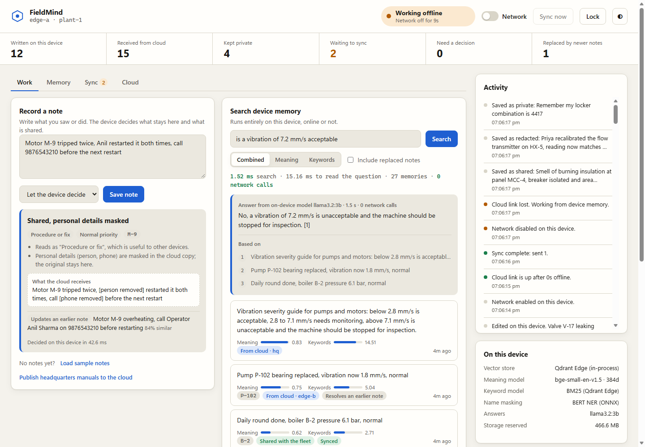
The device that keeps working
1
Record
Write what you saw. The device shows what it will share before you save.
2
Find
Search your notes and headquarters manuals in about a millisecond.
3
Ask
Get a cited answer written on the device. No cloud call.
03
Notes:
This is the real dashboard with the network switched off. On the left, a note is being typed and the device shows that two details will be masked in the cloud copy. On the right, a question is answered from a headquarters manual that was downloaded earlier, with zero network calls.

Slide 4
One device process, one cloud collection
Edge device
Qdrant Server
Local shard
Replica shard
Push
Shared notes
Masked notes
Headquarters manuals
Written here, private too
Copy of cloud knowledge
compare and swap
Policy engine
Embeddings
Decides what may leave
bge-small and BM25
Pull
Journal
Answer model
diff or snapshot
Outbox and conflicts
llama3.2 3B, optional
Other devices sync here too
04
Notes:
Qdrant Edge runs inside the app, so there is no database server on the device. We keep two shards. The local shard holds what this device wrote, including everything private. The replica shard is a disposable copy of cloud knowledge that can be rebuilt at any time without touching a private note. Uploads are compare-and-swap writes. Downloads use a small diff, or a full shard snapshot when the device is far behind.

Slide 5
The device decides what leaves
What the technician wrote | What happens
Pump P-102 bearing vibration high at 7.2 mm/s | Shared
Smell of gas near compressor K-4 | Shared, urgent, sent first
Suresh and Priya replaced the coupling, call 9876543210 | Shared, names and number masked
Technician Ravi Kumar reported chest pain | Private, stays on the device
SCADA panel login password is … | Private, cannot be overridden
Decided in about 20 ms on the device by a name recognition model, pattern detectors and a semantic classifier. Vectors for a masked note are computed from the masked text.
05
Notes:
This is the answer to "dynamically decide what stays local". Every note gets one of three outcomes: private, shared, or shared with personal details masked. The third one matters most: the fleet still learns about the fault, and the original with the names stays on the device. We also embed the masked text, not the original, so the vector cannot leak what the text hides.

Slide 6
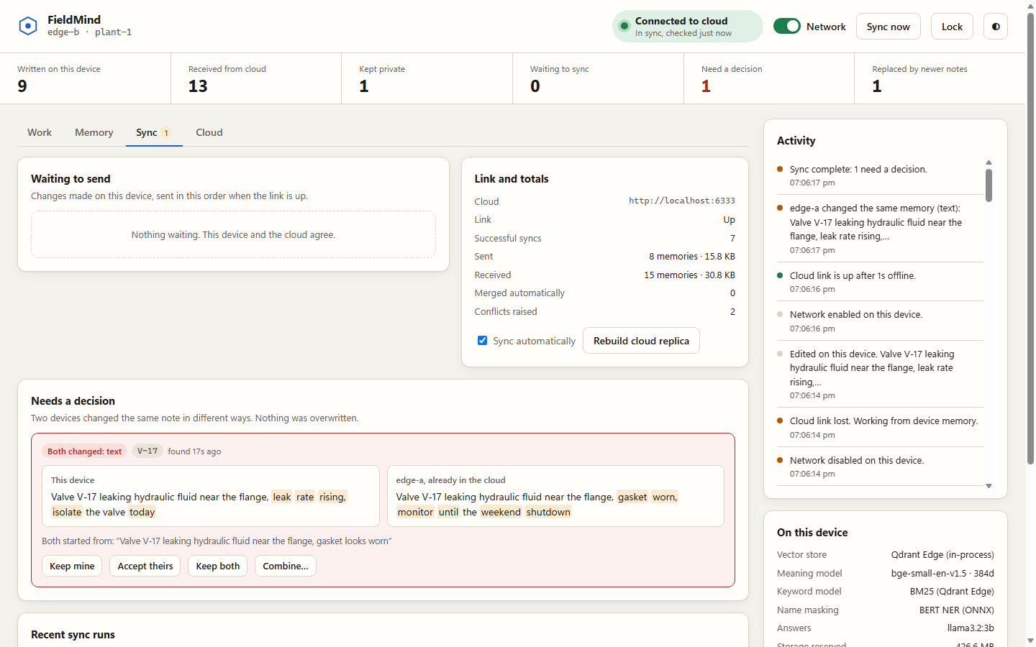
When two devices disagree
1
Nothing is overwritten
An upload only lands if the cloud is still at the version the device last saw.
2
Most edits merge
Changes to different fields combine automatically.
3
A person settles the rest
Keep mine, accept theirs, keep both or combine. Even while offline.
06
Notes:
Here two technicians changed the same note about valve V-17 while both were offline. One said monitor until the weekend, the other said isolate it today. The second device to reconnect does not overwrite the first. It shows both versions and the text they started from, and a person chooses. Follow-up notes are handled separately: a note saying the bearing was replaced automatically supersedes the earlier fault note.

Slide 7
What Qdrant does for us
Qdrant feature | How FieldMind uses it
Edge shards, in process | Two per device: local notes and a cloud replica
Built-in BM25 with IDF | Keyword half of hybrid search, with no server
Dense vectors and filters | Meaning search narrowed by asset, scope and status
Shard snapshots | A device far behind restores its replica from one file
Conditional upsert | Compare and swap, so devices never clobber each other
One schema on both sides | The same dense and sparse vectors on edge and server
qdrant-edge-py 0.8.0 with Qdrant Server 1.19.1
07
Notes:
We use Qdrant on both sides, not just as a local store. On the device: two Edge shards, built-in BM25 and dense search. Between device and server: conditional upserts give us compare-and-swap without any server code of our own, and shard snapshots let a new or long-offline device catch up in one download, which we then trim to its own site and compact to one segment.

Slide 8
Measured, not estimated
1 ms
0
20 ms
hybrid search across both shards
network calls to search or answer
to decide what may leave the device
1–3 s
57
30
for a cited answer from a 3B model
automated tests, run on every push
checks in the live end-to-end run
Ryzen 7 7435HS laptop, RTX 3050 4 GB. Also verified on Linux through a real network disconnect.
08
Notes:
Every number here was measured on the development laptop. Search takes about a millisecond across both shards. Deciding what may be shared takes about 20 milliseconds including name recognition. A generated answer takes one to three seconds once the model is loaded. The test suite runs two devices against a shared cloud, and a scripted end-to-end run checks 30 steps against a real Qdrant Server. A third device on Linux was tested by disconnecting its network for real.

Slide 9
Five moments in the demo
1
Switch the network off and keep working
Next
2
Ask a question, get a cited answer
Encrypt notes at rest
TLS for remote dashboards
Name masking beyond English
3
Watch names get masked before upload
4
Reconnect: urgent notes go first
5
Two devices disagree, a person decides
Team Compilers · github.com/yabhinav1/fieldmind
09
Notes:
These are the five things to watch in the live demo. We are also clear about what is not done: notes are not encrypted on disk, the dashboard session runs over plain HTTP, and the name model is English only. Those are the next three pieces of work.

