Slide 1

PROJECT MANAGEMENT PIPELINE
COMPANY NAME
00/00/0000
Address
Contact Phone
Web Address
Email Address
YOUR
LOGO
PREPARED BY |  | TITLE |  | DATE
APPROVED BY |  | TITLE |  | DATE
PROJECT MANAGEMENT PIPELINE TEMPLATE

Slide 2
TABLE OF CONTENTS
Delivery Timeline
Days per Project
Resource Allocation
Project Financials
Risk Analysis & Risk Total
Open & Pending Actions
Project Report
PROJECT MANAGEMENT PIPELINE | TABLE OF CONTENTS

Slide 3
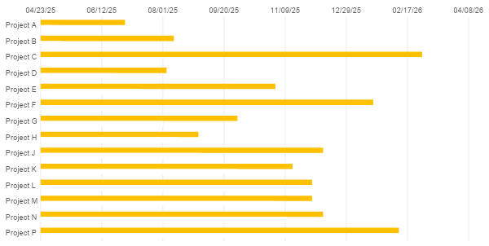
DELIVERY TIMELINE

Slide 4
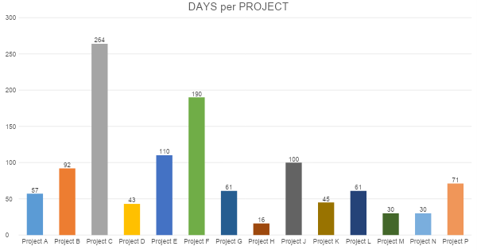
DAYS PER PROJECT

Slide 5
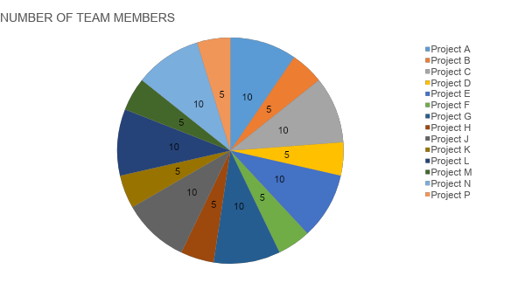
RESOURCE ALLOCATION

Slide 6
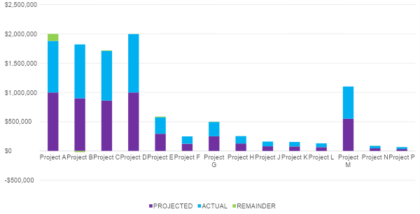
PROJECT FINANCIALS

Slide 7
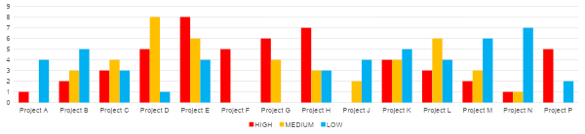
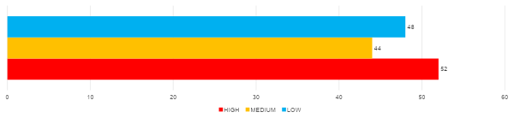
RISK TOTAL
RISK ANALYSIS & RISK TOTAL

Slide 8
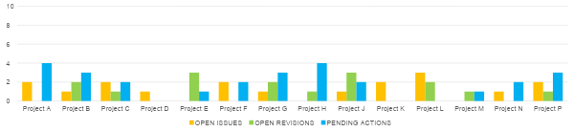
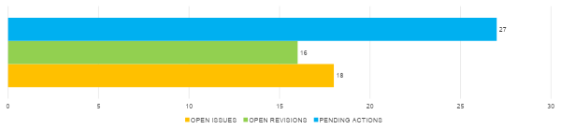
ACTION TOTAL
OPEN & PENDING ACTIONS

Slide 9
PROJECT NAME | SCHEDULE | BUDGET | RESOURCES | RISKS | ISSUES | COMMENTS
Project A
Project B
Project C
Project D
Project E
Project F
Project G
Project H
Project J
Project K
Project L
Project M
Project N
Project P
PROJECT REPORT

Slide 10
DISCLAIMER Any articles, templates, or information provided by Smartsheet on the website are for reference only. While we strive to keep the information up to date and correct, we make no representations or warranties of any kind, express or implied, about the completeness, accuracy, reliability, suitability, or availability with respect to the website or the information, articles, templates, or related graphics contained on the website. Any reliance you place on such information is therefore strictly at your own risk.

