Slide 1
CUSTOMER BEHAVIOR · EXECUTIVE DASHBOARD
Customer Behavior Dashboard
What 3,900 purchases reveal about revenue, loyalty, product demand, and the next growth moves.
Notes:
Open with the scope: 3,900 purchases, the signals they contain, and the growth decisions that follow.

Slide 2

THE DATASET
One dashboard connects the full shopping journey
3,900 purchases
01
18 fields across customers, products, promotions, shipping, reviews, and subscriptions
Interactive controls
02
Subscription status, gender, category, and shipping type filters
Core KPIs
03
Customer count, average purchase amount, average review rating, revenue, sales, and age-group performance
02
Notes:
Frame the dashboard as one connected view: the dataset, the controls, and the KPI layer all work together.

Slide 3
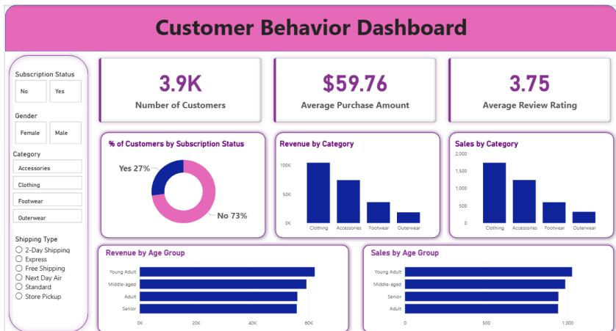
EXECUTIVE SNAPSHOT
The dashboard makes the headline visible in seconds
Use the dashboard as an executive snapshot: 3.9K customers, $59.76 average purchase amount, and a 3.75 average review rating.
FILTER → READ → DECIDE
03
Notes:
Lead with the three numbers an executive can absorb immediately. The dashboard is designed to make that first read fast.

Slide 4
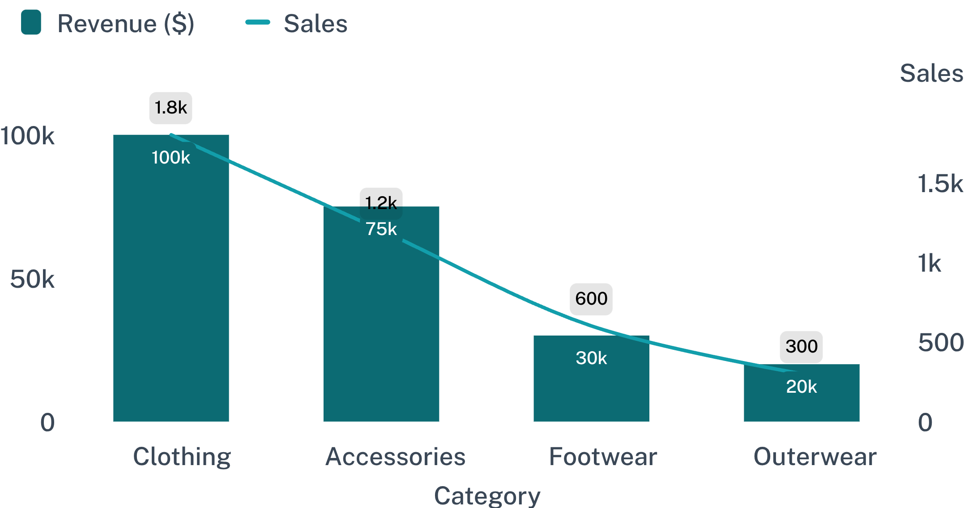
CATEGORY PERFORMANCE
Clothing is the growth engine across revenue and sales
ANCHOR CATEGORY
Clothing leads both value and volume by a wide margin.
Use clothing as the anchor for bundles, cross-sell, and campaign testing.
04
Notes:
Clothing is the clear anchor: it leads revenue and sales. The immediate action is to use it as the starting point for bundles, cross-sell, and campaign tests.

Slide 5
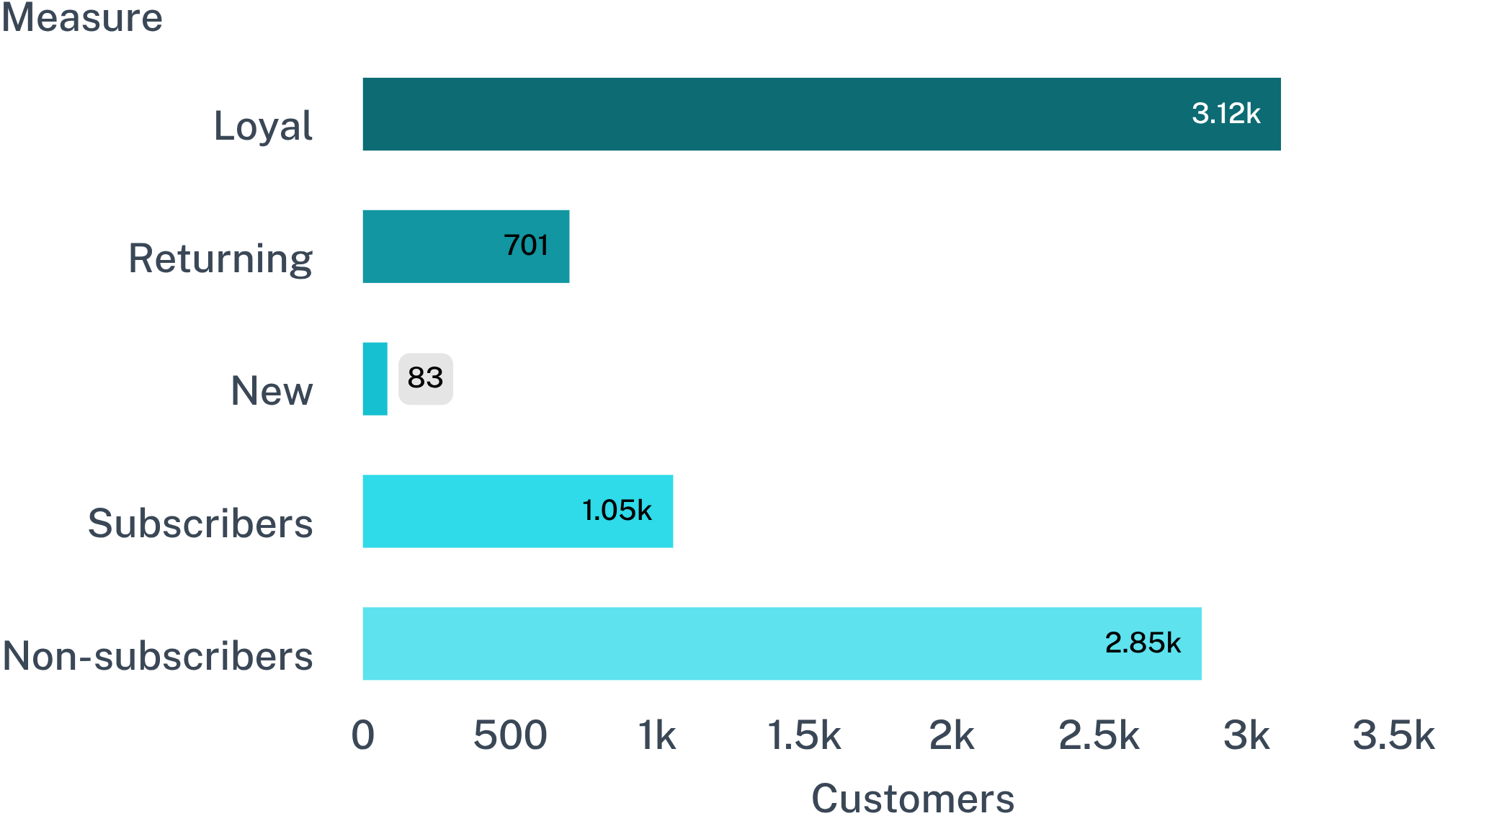
LOYALTY & SUBSCRIPTION
Loyalty is strong, but subscription conversion is the gap
27% SUBSCRIBED
The base returns. The program still has room to convert.
Loyal 3,116; Returning 701; New 83. Subscribed 27% versus 73% not subscribed.
Opportunity: convert repeat behavior into recurring value with exclusive subscriber benefits.
05
Notes:
Separate the two signals: loyalty is already strong, but most customers remain outside the subscription program. That is the conversion gap.

Slide 6
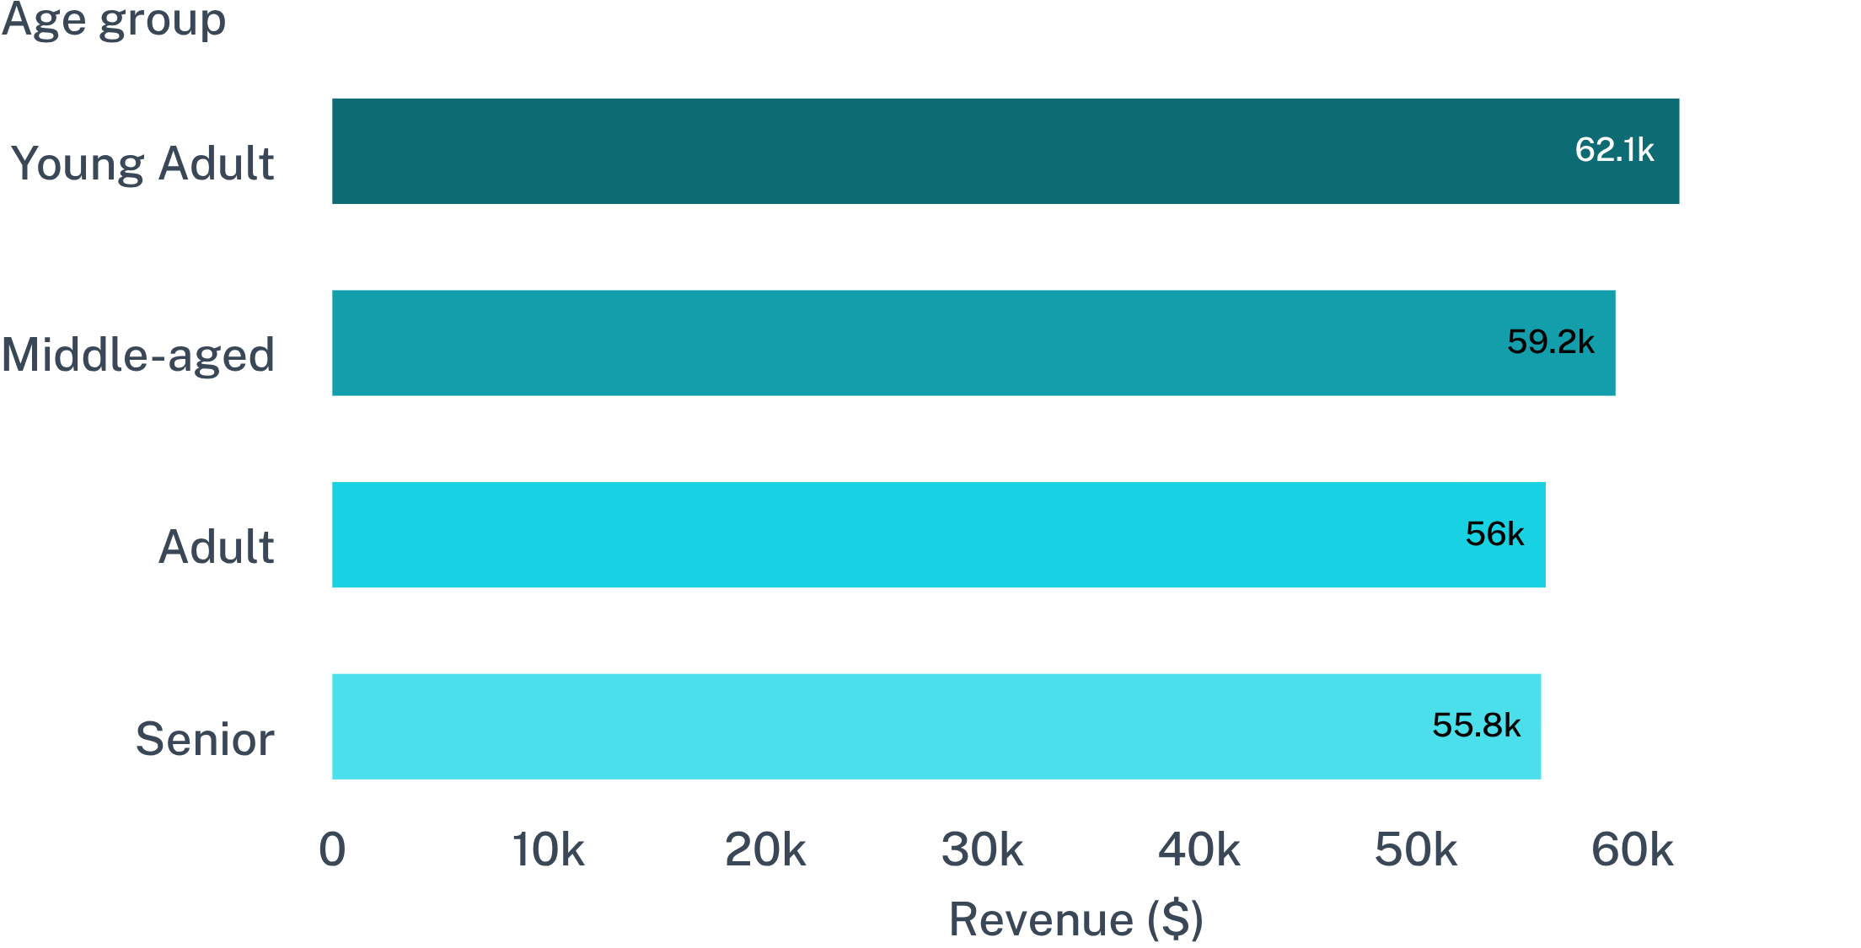
CUSTOMER COHORTS
Young adults lead revenue, but the cohorts are close
NARROW SPREAD
$62,143
Young Adult revenue
Follow the lead, but use differentiated messaging rather than one-segment targeting.
06
Notes:
Young adults lead at $62,143, but the range is relatively narrow. The implication is differentiated messaging across cohorts, not a single-segment strategy.

Slide 7
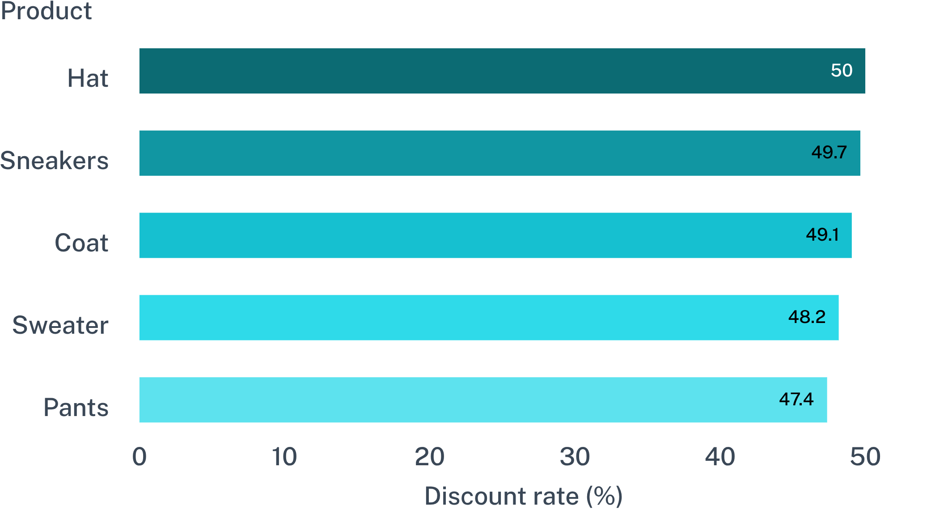
PROMOTION ECONOMICS
Discounts are reaching high-value customers
839
shoppers used discounts while spending above the average purchase amount
Decision: move from blanket discounts to targeted offers with margin guardrails.
07
Notes:
Discounts are not only reaching low-value shoppers: 839 above-average purchasers used them. The five products near 50% create a focused test list, but margin guardrails matter.

Slide 8

EXPERIMENT DESIGN
Product and shipping signals point to easy experiments
Top-rated products
01
Gloves 3.86, Sandals 3.84, Boots 3.82, Hat 3.80, Skirt 3.78
Shipping signal
02
Express average purchase $60.48 versus Standard $58.46
Experiments
03
Feature rated winners, test bundles, and place express upgrades beside higher-value baskets
08
Notes:
These are low-complexity tests: feature products with the strongest ratings, use bundles to connect demand, and test express upgrades where basket value is already higher.

Slide 9
OPERATING RHYTHM
Use filters to turn the dashboard into a decision loop
01
02
03
04
Filter
Compare
Interpret
Act
Choose subscription status, gender, category, or shipping type.
Watch KPI cards and category or age-group charts shift together.
Identify the segment, product, or offer driving the change.
Launch a targeted test and return to the dashboard weekly.
09
Notes:
Make the workflow explicit: filter, compare, interpret, act. The dashboard becomes useful when this loop repeats weekly.

Slide 10
FROM SIGNAL TO ACTION
Five growth moves follow directly from the data
Convert loyal and repeat buyers into subscribers
Protect margins with targeted discounts
Build campaigns around top-rated and best-selling products
Prioritize young adults while tailoring messages for adjacent cohorts
Use express shipping as a value signal for higher-value baskets
Notes:
Close by translating the dashboard into five moves: subscription conversion, margin discipline, product-led campaigns, cohort-aware messaging, and express shipping as a value signal.

