Slide 1

Login to Salesforce
by query strings

Slide 2

1. Access to Login URL
Example:
https://login.salesforce.com/ ?un=john.smith@example.com&pw=FizzBuzz123

Slide 3
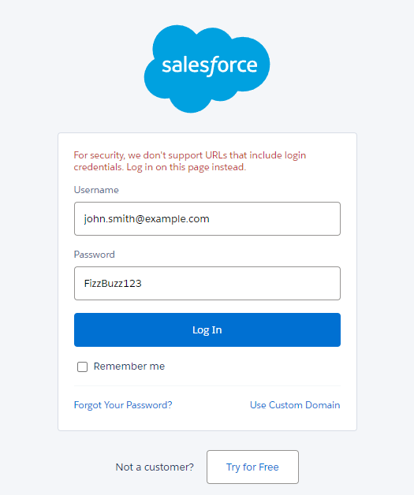

2. Login credentials are automatically filled!
The Login button is also clicked automatically

