Slide 1
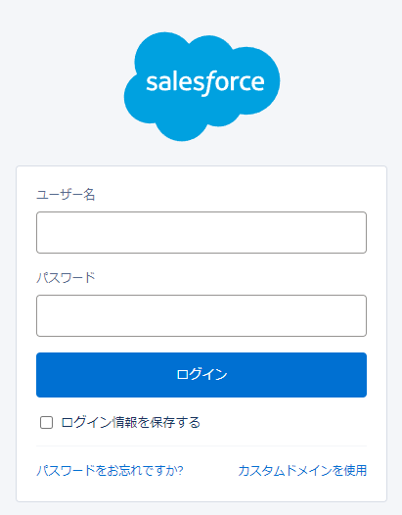
1
https://login.salesforce.com ?un=user@example.com &pw=helloWorld123
user@example.com
helloWorld123
2

