Slide 1
Project: SMS-Machine
Gioia Almer, Mike Müller, Max Reinert and Yanick Spichty

Slide 2
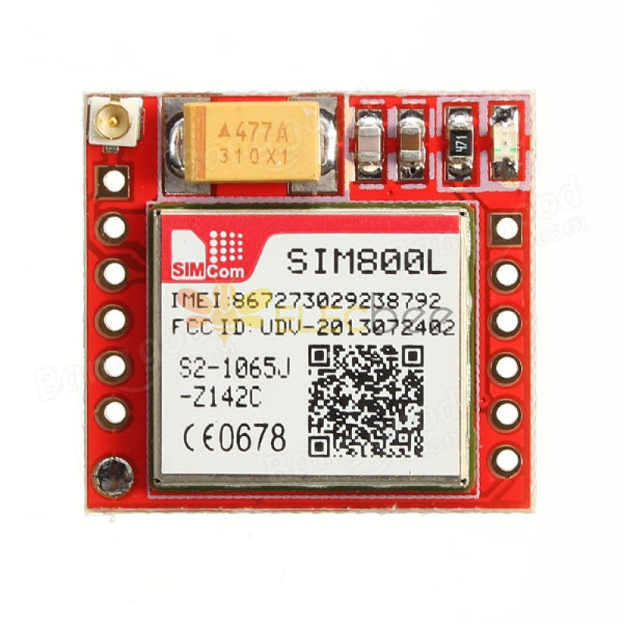
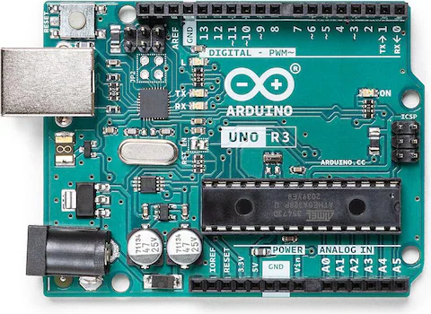
1. Project Goal
Build a functional SMS sender that allows a user to input a message and a phone number, then send the SMS.
Sources:
https://www.digitec.ch/de/s1/product/arduino-uno-rev3-entwicklungsboard-kit-5764177
https://www.elecbee.com/de-17647-SIM800L-GSM-GPRS-Module-Board-MicroSIM-Transfer-Card-Core-Board-Quad-band

Slide 3
2. Requirements
Hardware:
Arduino Uno Rev3
SIM800L GSM GPRS Module
Display
Power Supply, cables, breadboard
Software:
Libraries:
GSM Module: SoftwareSerial.h
Display: LiquidCrystal_I2C.h
Keyboard: Keypad.h
Costs:
CHF 15. – for components not provided by the university

Slide 4
3. Planning
Responsibilities:
Gioia: Firmware and software development
Yanick: User interface design
Max: Testing and documentation
Mike: Hardware integration
Expected Challenges:
Ensuring reliable communication with the GSM module
Power management for continuous operation
Troubleshooting circuit assembly and component integration

Slide 5
4. Tentative Timeline
November 2024: Research, Hardware Selection and Circuit Planning
November – December 2024: Assemble circuit, basic communication testing
December 2024: Firmware Development
December 2024 – January 2025: Testing, Debugging, and Documentation

