Slide 1
Project: SMS-Machine
Gioia Almer, Mike Müller, Max Reinert and Yanick Spichty

Slide 2
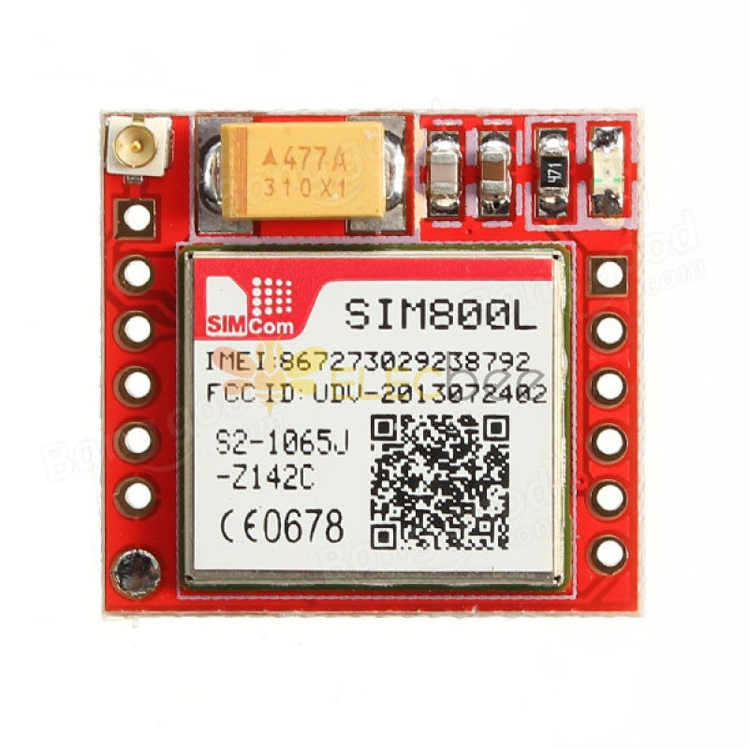
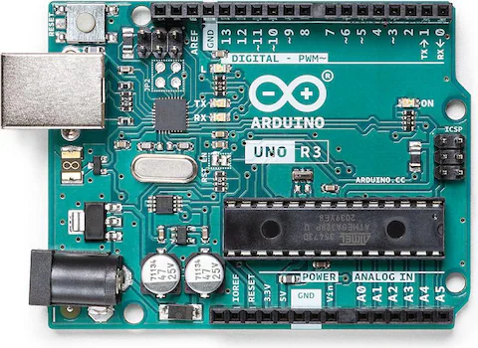
1. Original Project Goal
Build a functional SMS sender that allows a user to input a message and a phone number, then send the SMS.
Sources:
https://www.digitec.ch/de/s1/product/arduino-uno-rev3-entwicklungsboard-kit-5764177
https://www.elecbee.com/de-17647-SIM800L-GSM-GPRS-Module-Board-MicroSIM-Transfer-Card-Core-Board-Quad-band

Slide 3
2. Achieved Project
Created a functional SMS sender and expanded its capabilities to include receiving messages in real-time
Messages are displayed on a touchscreen for easy reading
Integrated a keyboard to enable efficient typing for sending messages
Platzhalter für Bild vom Touchscreen
Platzhalter für Bild von allem

Slide 4
2. Requirements
Hardware | Software
Arduino Mega SIM7600g-h (add correct names) Touchscreen Display Power Supply, Cables | Standard Arduino and C-Libraries: Arduino.h stdio.h stdlib.h string.h Libraries used for the touchscreen: MCUFRIEND_kbv.h Adafruit_GFX.h TouchScreen.h

Slide 5
3. DEMO

Slide 6
4. Challenges and Learnings
Wiring and Connections
SIM Module integration
Component Testing and Integrations
Etc.

Slide 7
Thanks for your Attention

