Slide 1

Detecting Autism spectrum Disorder

Slide 2
Autism spectrum disorder
Autism spectrum disorder is a neurological problem that will have challenges in social, emotional and behavioral skills.
There is often nothing about how people with ASD look that sets them apart from other people , but people with ASD may communicate, interact , behave and learn in ways that are different from most other people.

Slide 3

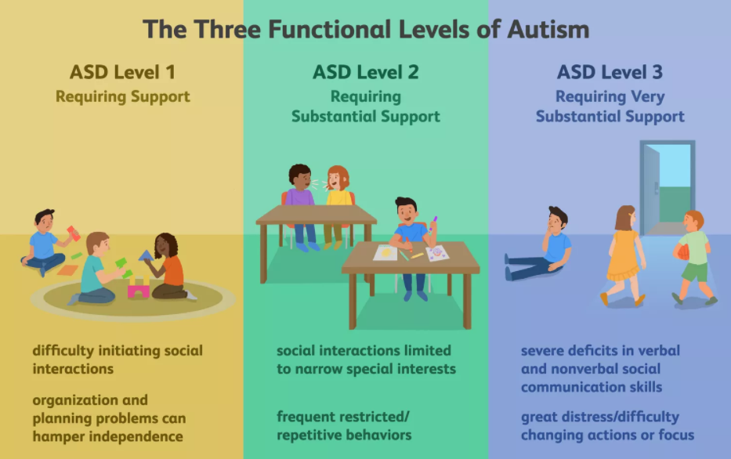
TYPES

Slide 4
Why we need early diagnosis ?
Diagnosing ASD can be difficult since there is no medical test, like a blood test, to diagnose the disorders. Doctors look at the child’s behavior and development to make a diagnosis.
ASD can sometimes be detected at 18 months or younger. By age 2, a diagnosis by an experienced professional can be considered very reliable. However, many children do not receive a final diagnosis until much older. This delay means that children with ASD might not get the early help they need.

Slide 5
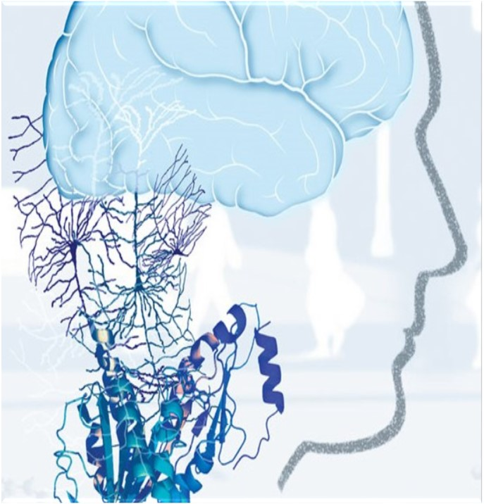
Abstract
Autistic Spectrum Disorder (ASD) is a neurodevelopment condition associated with significant healthcare costs, and early diagnosis can significantly reduce these. Unfortunately, waiting times for an ASD diagnosis are lengthy and procedures are not cost effective. The economic impact of autism and the increase in the number of ASD cases across the world reveals an urgent need for the development of easily implemented and effective screening methods. Therefore, a time-efficient and accessible ASD screening is imminent to help health professionals and inform individuals whether they should pursue formal clinical diagnosis.

Slide 6

The rapid growth in the number of ASD cases worldwide necessitates datasets related to behavior traits. However, such datasets are rare making it difficult to perform thorough analyses to improve the efficiency, sensitivity, specificity and predictive accuracy of the ASD screening process. Presently, very limited autism datasets associated with clinical or screening are available and most of them are genetic in nature. Hence, we propose a new dataset related to autism screening of adults that contained 20 features to be utilized for further analysis especially in determining influential autistic traits and improving the classification of ASD cases. In this dataset, we record ten behavioral features (AQ-10-Adult) plus ten individuals characteristics that have proved to be effective in detecting the ASD cases from controls in behavior science.

Slide 7

DATASET:
We'll be using the "Autistic Spectrum Disorder Screening Data for Adult" public dataset from the UCI repository. The dataset was donated by Prof. Fadi Thabtah, after being published in the article "Autism Spectrum Disorder Screening: Machine Learning Adaptation and DSM-5 Fulfillment". Very few published articles are available online as the dataset has not been out for long and as a result reference to a benchmark model is very rare.

Slide 8

This data contains 704 instances, and contains the following attributes:
age: number (Age in years).
gender: String [Male/Female].
ethnicity: String (List of common ethnicities in text format).
Born with jaundice: Boolean [yes or no].
Family member with PDD: Boolean [yes or no].
Who is completing the test: String [Parent, self, caregiver, medical staff, clinician ,etc.].
Country of residence : String (List of countries in text format).
Screening Method Type: Integer [0,1,2,3] (The type of screening methods chosen based on age category (0=toddler, 1=child, 2= adolescent, 3= adult).
Question 1-10 Answer: Binary [0, 1] (The answer code of the question based on the screening method used).
Screening Score: Integer (The final score obtained based on the scoring algorithm of the screening method used. This was computed in an automated manner).
Featureset Exploration

Slide 9

COMPARING VARIOUS CLASSIFIERS
Random forest
SVM
AdaBoost

Slide 10
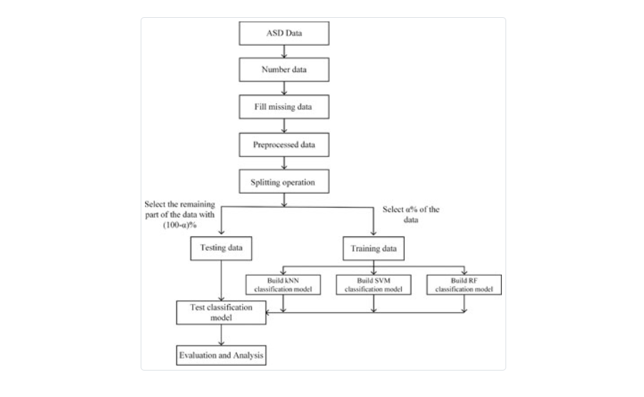
Adaboost

Slide 11
Conclusion
After exploring ASD dataset with different kind of learning algorithms, I have arrived into this conclusion that all of my model work extremely well with the data. I have used three different metric (such as accuracy, AUC score and F-score) to measure the performance of my models, and it seems like all of the metric indicated an almost perfect classification of the ASD cases. Here I think the reason of this high performances with different models is the fact that only one of the feature is predominant over all others which I confirmed with the Feature Importance section.
I think to build a more accurate model, we need to have access to more larger datasets. Here the number of instances after cleaning the data were not so sufficient enough so that I can claim that this model is optimum. As this dataset is only publicly available from December 2017, I think not many works that deal with this dataset is available online.
In that consideration, This models can serve as benchmark models for any machine learning researcher/practitioner who will be interested to explore this dataset further. With this fact in mind, It is very well developed model that can detect ASD in individuals with certain given attributes.

Slide 12
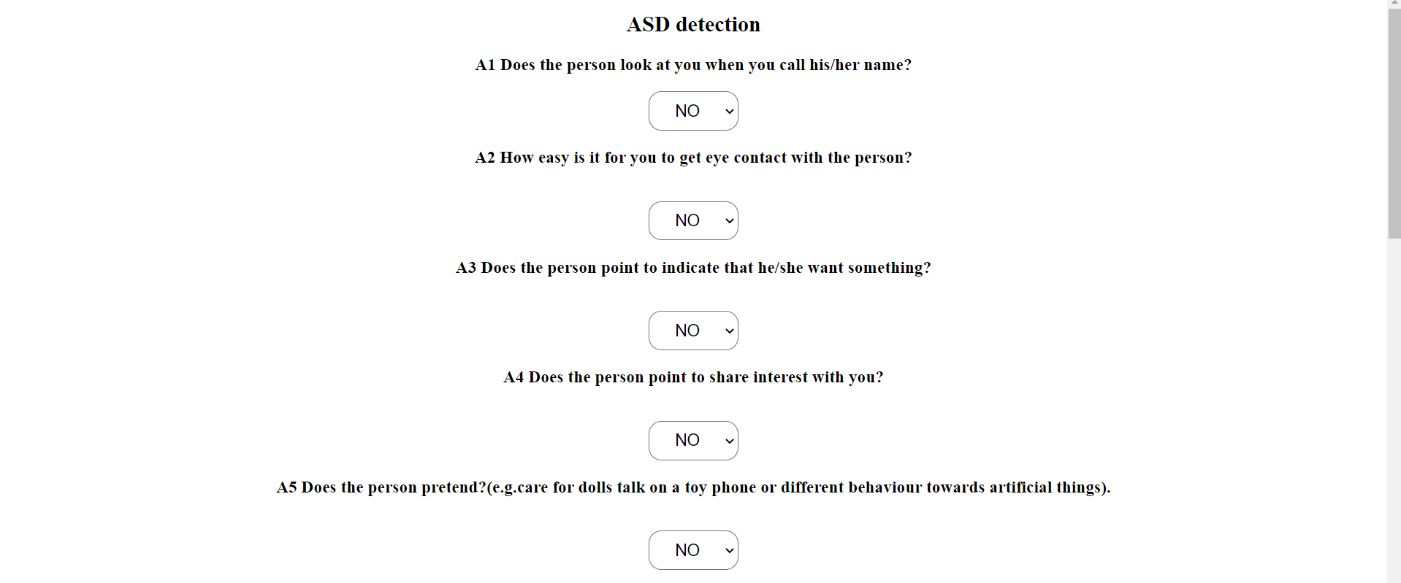
Testing

Slide 13
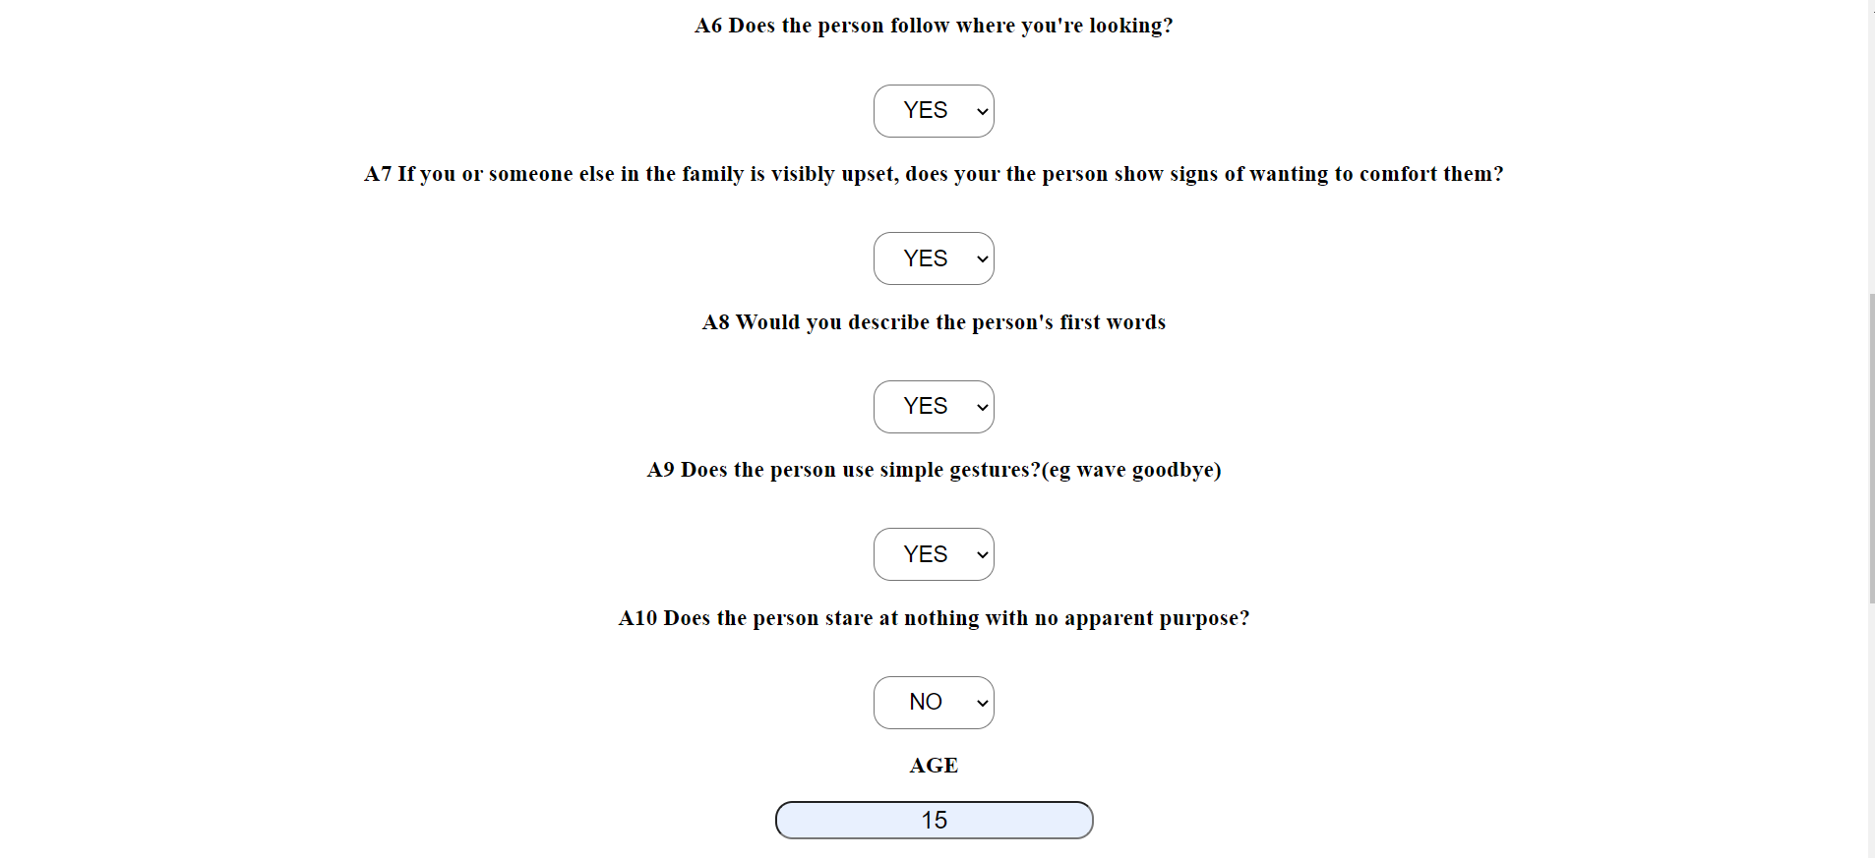

Slide 14


Slide 15
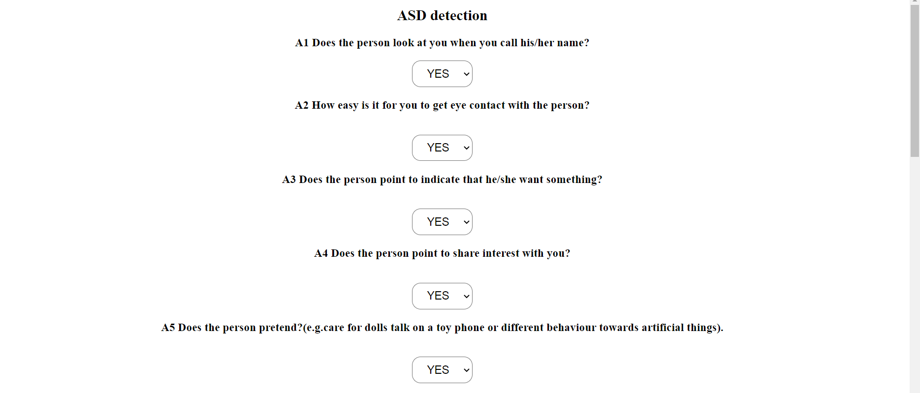

Slide 16
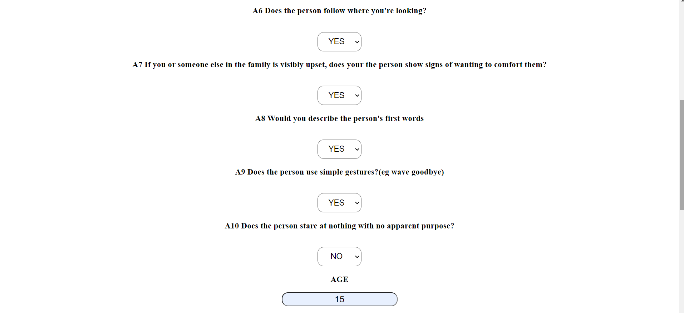

Slide 17
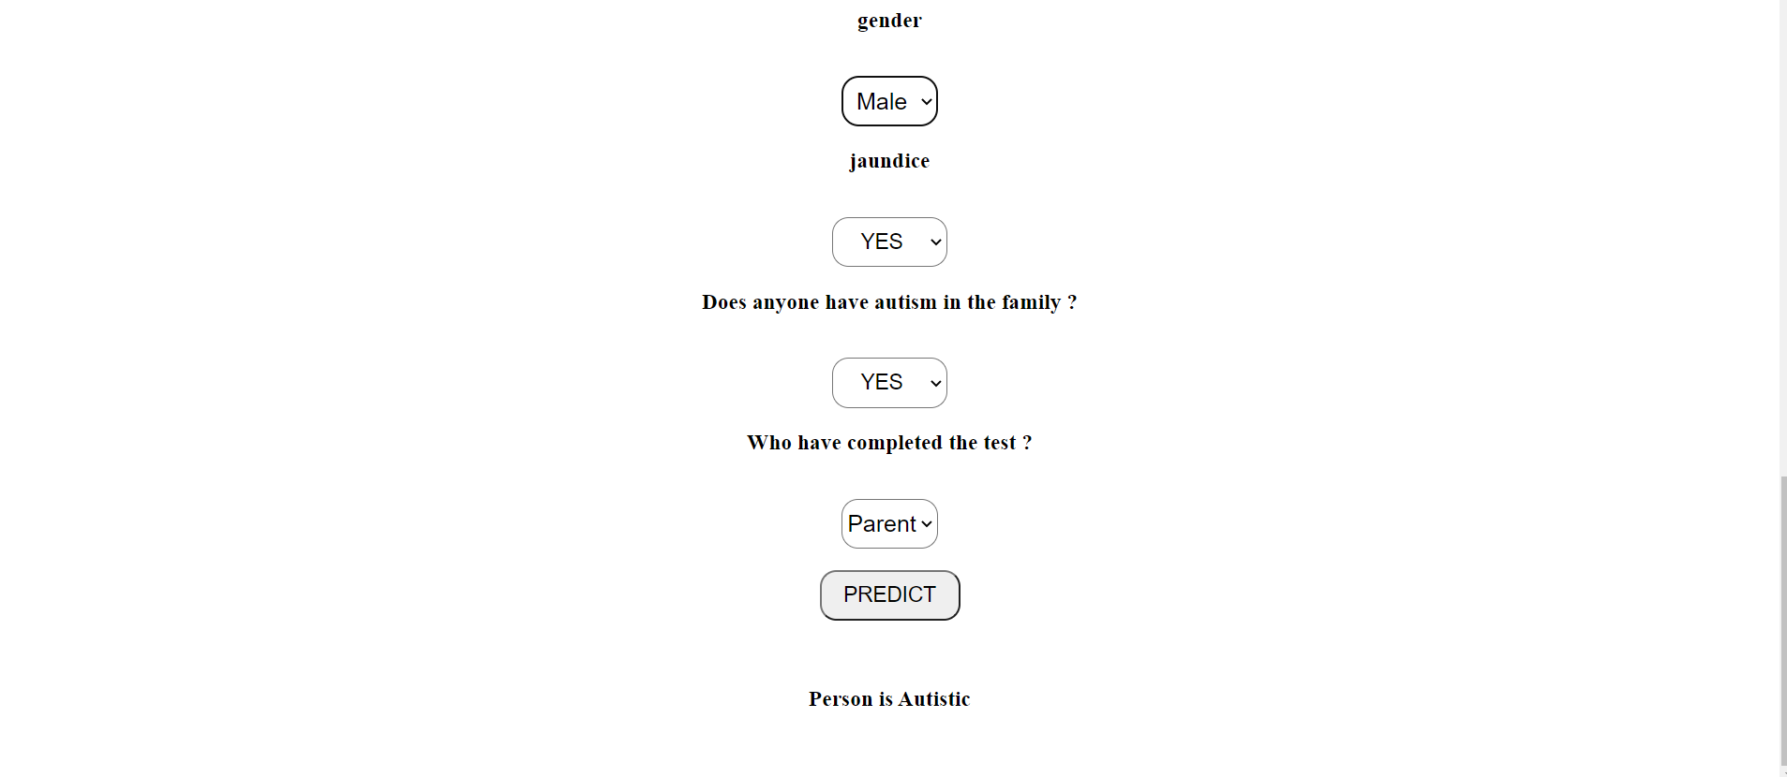

Slide 18
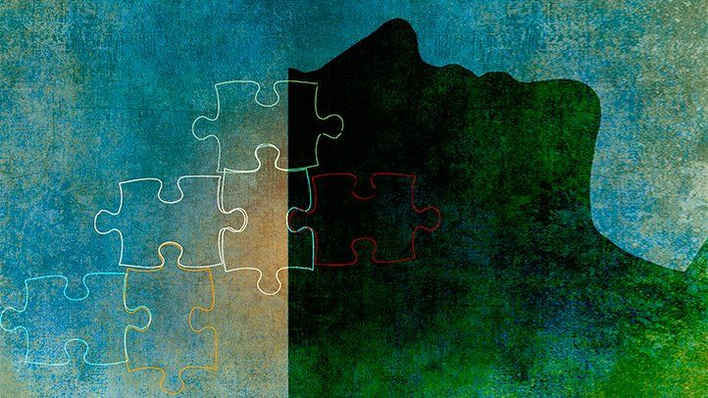
THANK YOU
Thank You

