Slide 1
Artificial Intelligence Course
Outline:
What is AI?
Applications and importance of AI
Common Algorithms, models, frameworks
Careers

Slide 2
What is AI?
Machine Intelligence
Replicate cognitive functions associated with human behavior or human mind.
Learning, problem solving.
Classification, Prediction, decision making, etc...

Slide 3
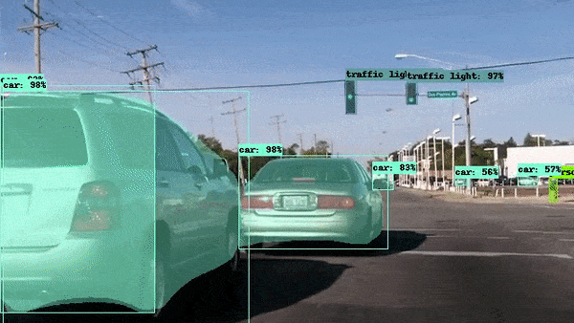
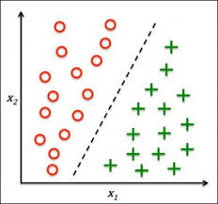
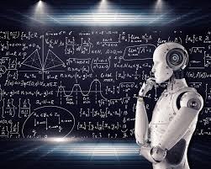
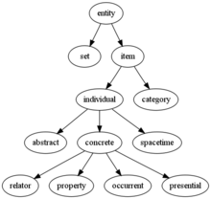
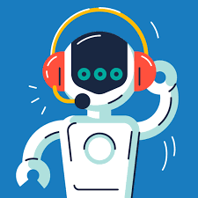
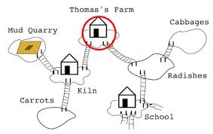
Goals of Artificial Intelligence
Machine Perception
Learning
General Intelligence
Knowledge Representation
Natural Language Processing
Planning

Slide 4
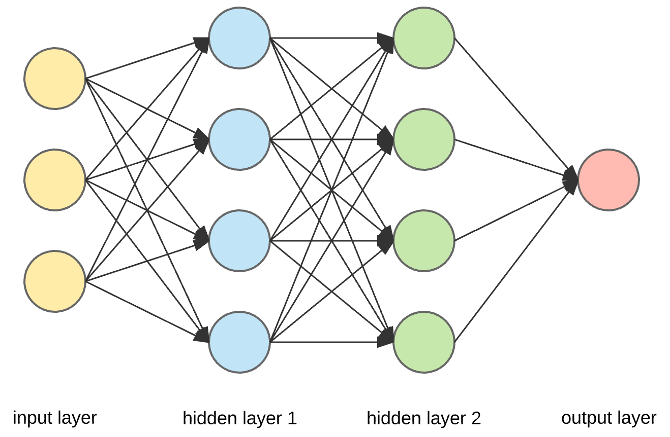
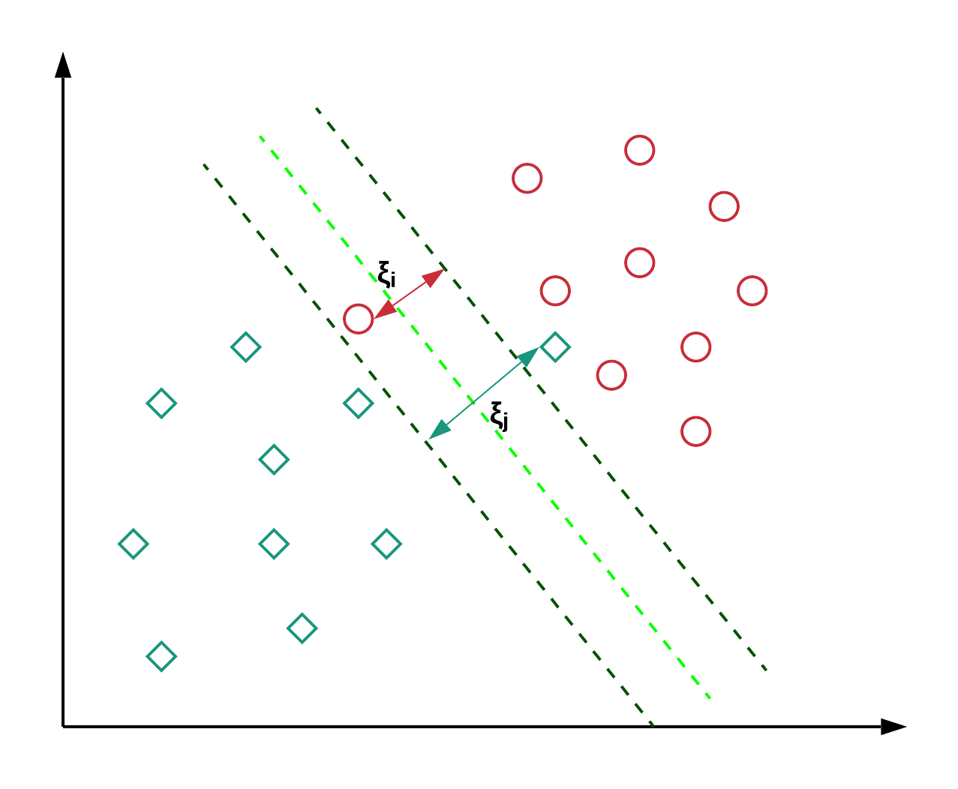
Tools
Classifiers and statistical learning methods
Artificial neural networks
Probabilistic methods for uncertain reasoning
Logic
Searching and planning

Slide 5

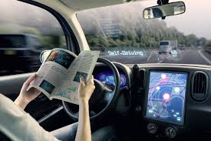
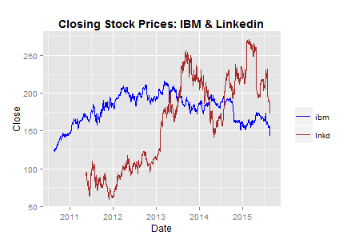

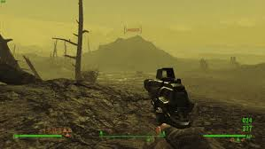
Applications
Healthcare
Automotive
Economics
Security
Videogames
Marketing and Advertising

Slide 6




Frameworks

Slide 7
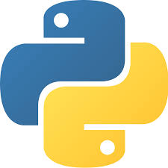
Everything will be in python!

Slide 8



Careers
Human-Centered Machine Learning Designer
4. Business Intelligence Developer
3. NLP Scientist
2. Data Scientist
1. Machine Learning Engineer

Slide 9
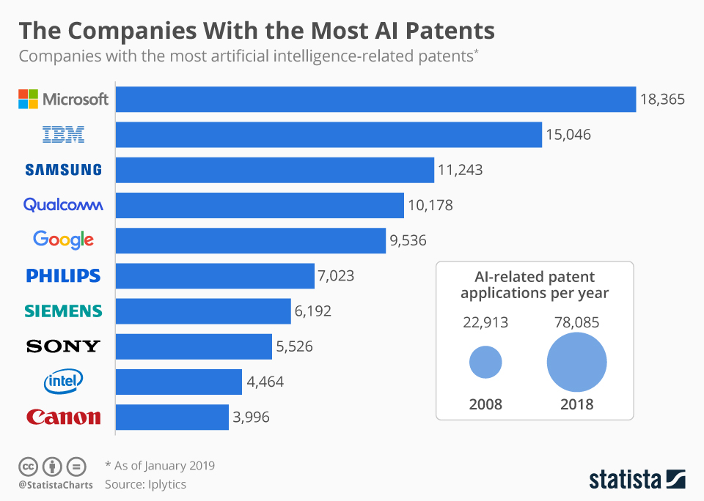

Slide 10
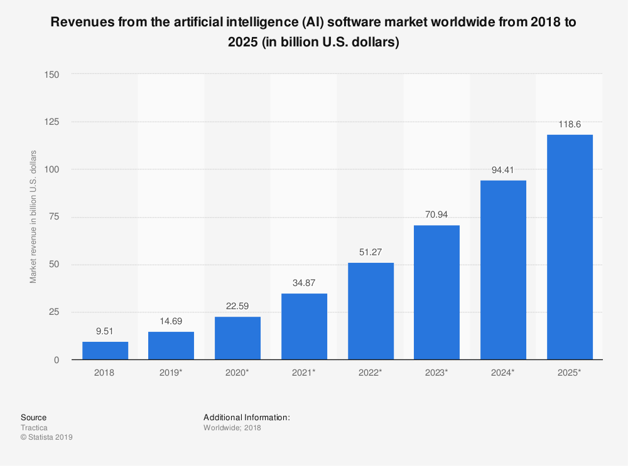

Slide 11
