Slide 1


Computer Vision

Slide 2
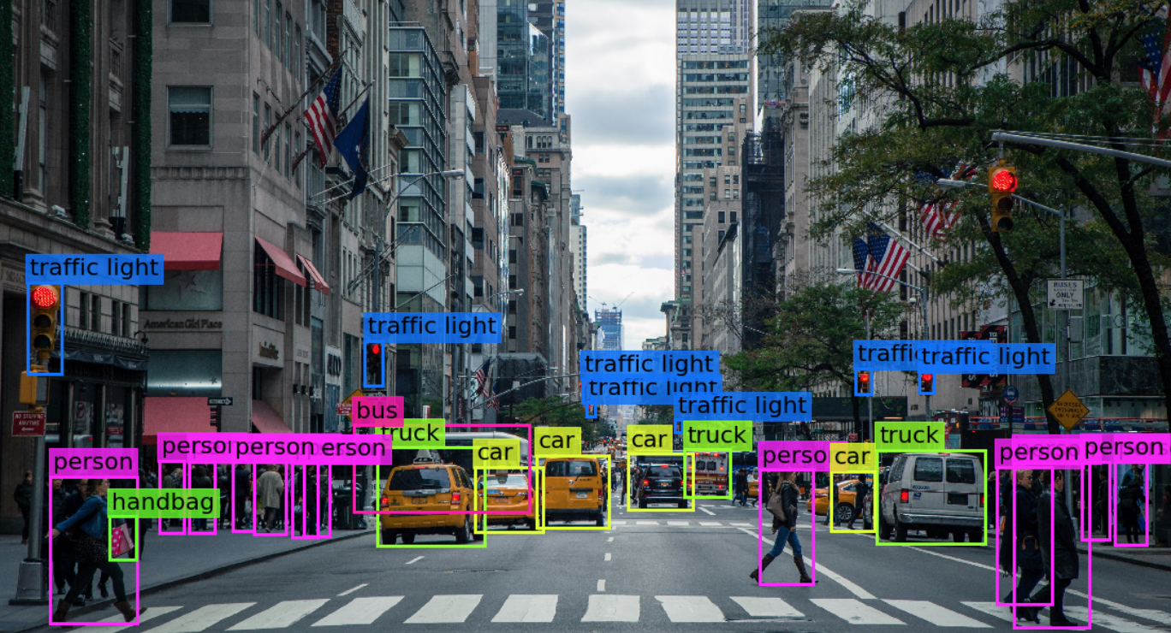
Computer Vision
acquiring
processing
analyzing and understanding.
produce numerical or symbolic information

Slide 3
Convolutional Neural Networks
applications:
  image and video recognition
  recommender systems
  image classification
  medical image analysis
  natural language processing.
relatively little pre-processing
  learns the filters that in traditional algorithms were hand-engineered.

Slide 4
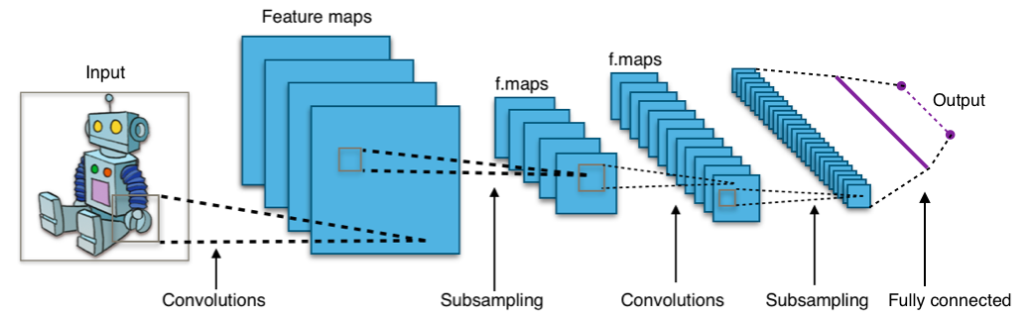
Design
input
output layer
multiple hidden layers.
  convolutional layers
  RELU layer i.e. activation function
  pooling layers
  fully connected layers
  normalization layers.

Slide 5
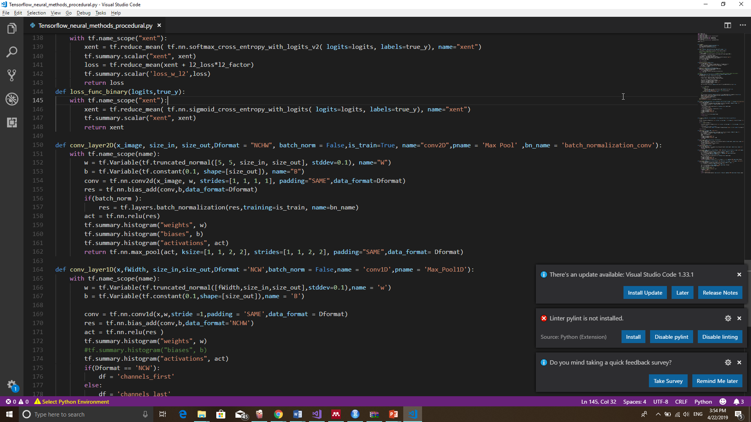
Convolutions
I/O tensor shape : [batch_size,height,width,channels]
Kernel shape: [height,width,in_channels,out_channels]

Slide 6
Pooling
reduce the dimensions of the data by combining the outputs of neuron clusters at one layer into a single neuron in the next layer.

Slide 7
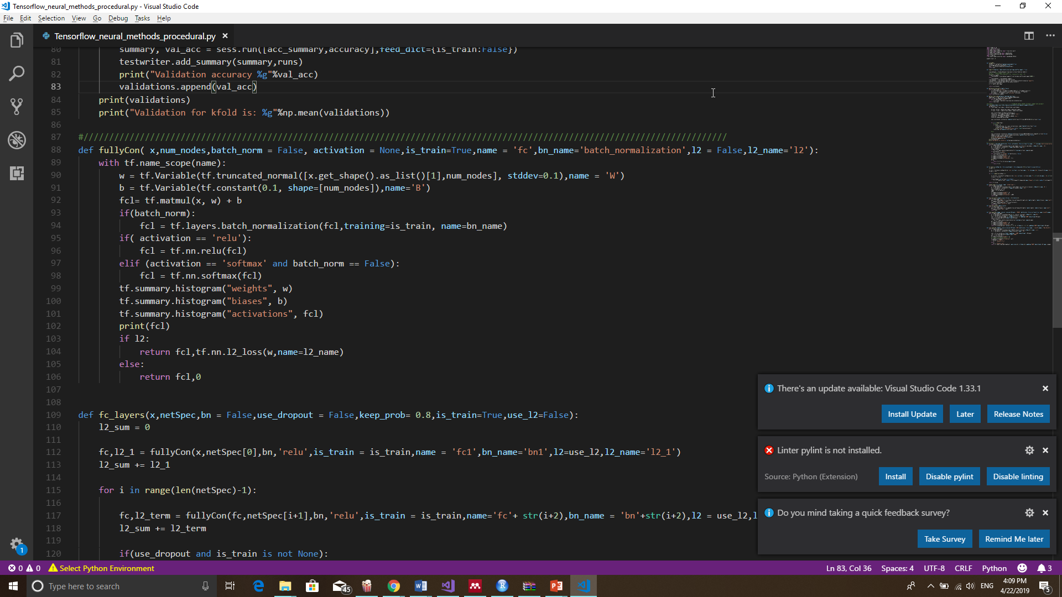
Fully Connected

Slide 8
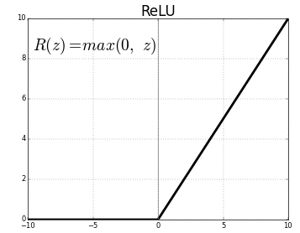
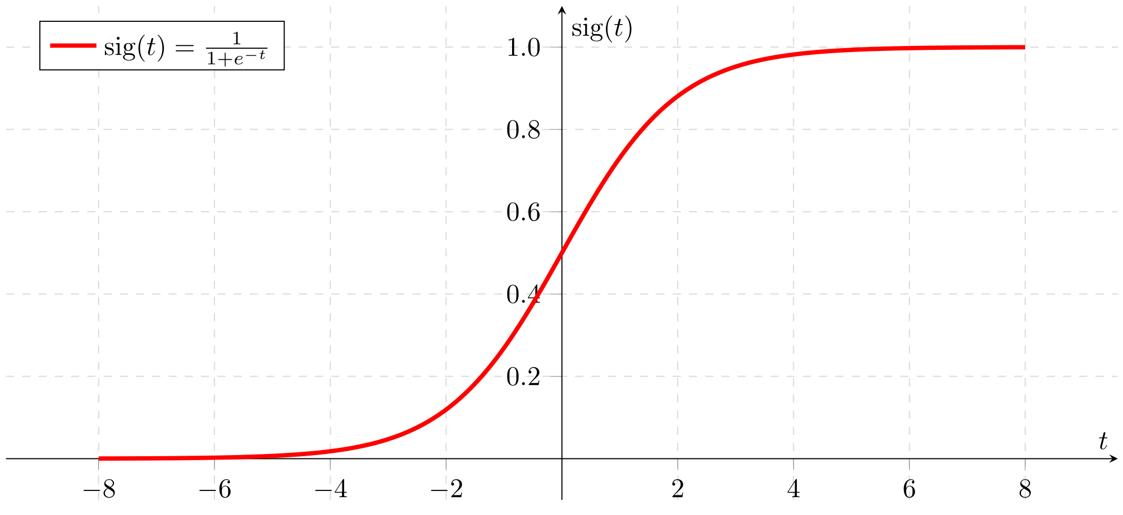
Activation Functions

