Slide 1

OPTIMIZING SUPPLY CHAIN PERFORMANCE THROUGH DATA ANALYTICS

Slide 2
Introduction
Supply chains play a vital role in the success of businesses, ensuring the seamless movement of products from manufacturers to end customers. However, supply chain operations are often complex, involving multiple stakeholders, processes, and variables that can lead to delays and inefficiencies. Late deliveries not only result in dissatisfied customers but also impact the overall profitability and reputation of organizations.
To address this challenge, this project aims to leverage data analytics and predictive modeling techniques to optimize supply chain operations and improve overall efficiency. There are 8 key factors that would be taken into account which will help in determining, days for shipping (real), days for shipment (scheduled), order item quantity, order region, shipping mode, market, order state, and order status. The insights will enable proactive decision-making and process improvements to reduce delivery delays and enhance customer satisfaction.

Slide 3
Project Summary
Identify factors contributing to late deliveries in the supply chain.
Develop a predictive model to assess the risk of late deliveries based on available data.
Enable proactive decision-making by providing insights to supply chain managers.
Optimize delivery time and reduce the number of late deliveries.
Improve customer satisfaction and overall supply chain efficiency.

Slide 4
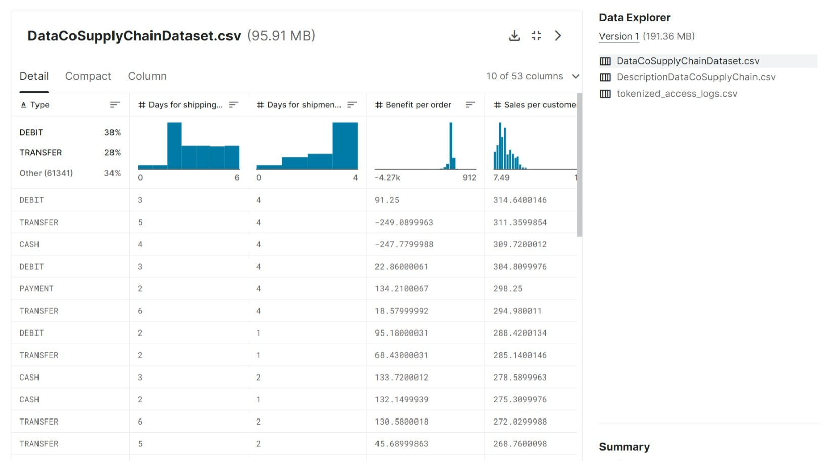
Data Source
( Click Here )

Slide 5
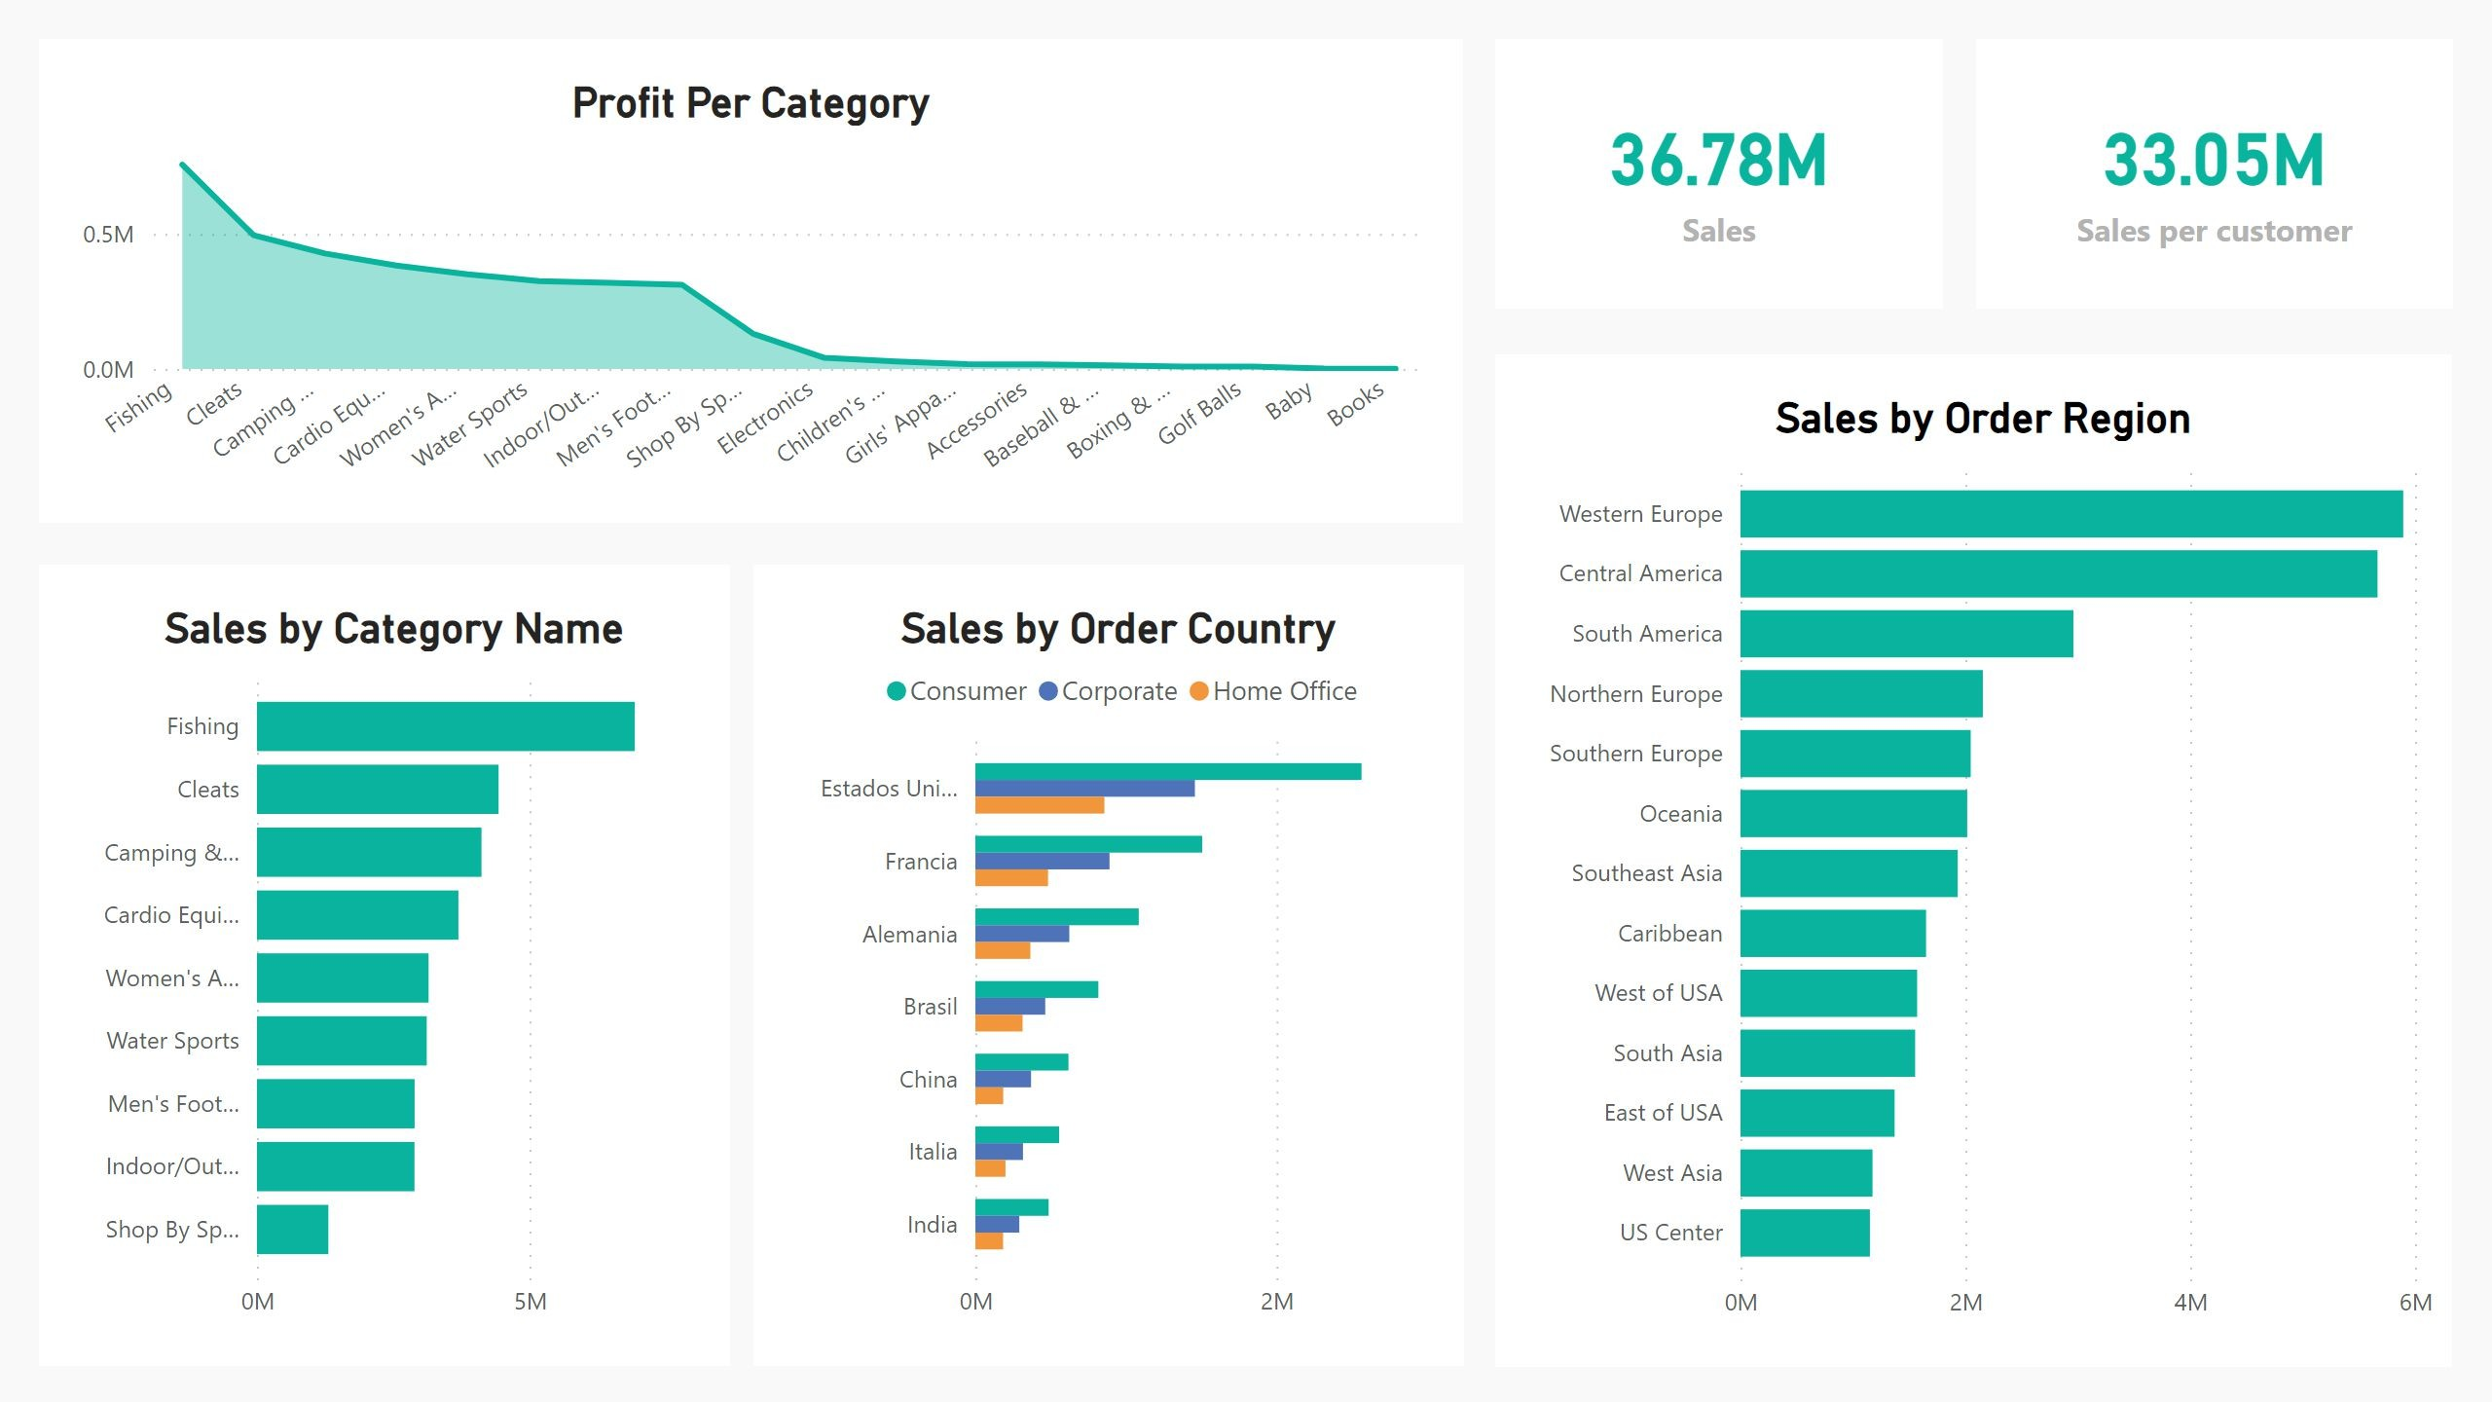
Lets Start the Story Telling
Sales Report
The first section is a sales report, the second section is a delivery report, and the third section is a customer segment report.
The sales report on the first page will likely analyze the sales data contained in the dataset, including variables such as Profit per order, Sales delivery
status, avg of sales per customer by sales and sales per order country many more . The report may identify top-selling products, trends in sales over time, and opportunities for increasing sales and profitability many more.

Slide 6
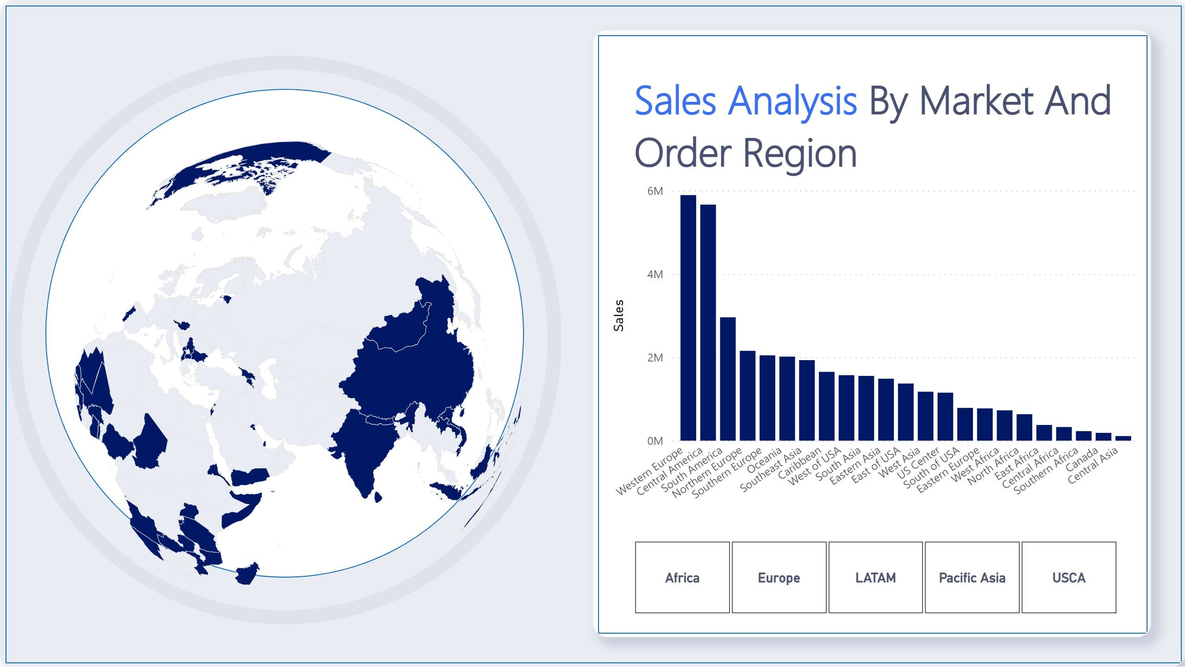
As the saying goes, numbers don't lie. The sales report for the DataCo Global supply chain dataset reveals some fascinating insights into consumer behavior and sales trends.
Looking at the sales by customer segment, it's evident that consumers were the biggest spenders, with a total sales figure of 7,413,629.73, followed by corporate customers at 4,252,647.58 and home office customers at 2,495,321.50. Estados Unidos in the customer segment made up 18.11% of sales, indicating the importance of this market for the company.

Slide 7
The average sales per customer segment reveal a similar trend, with consumers once again leading the way with an average sales figure of 1,482,725.95, followed by corporate customers at 850,529.52 and home office customers at 499,064.30.
When analyzing sales by category name, fishing accounted for a significant portion of order profit per order at 19.06%. Fishing also had the highest order profit per order at 756,220.77, which was 227,464.79% higher than strength training, which had the lowest order profit per order at 332.31.
Interestingly, standard class had the highest average sales figure at 2,675,827.30, followed by second class, first class, and same day. However, standard class also had the highest total sales figure at 13,379,136.51.
Sales trends over time are also worth examining, and the report shows a steady decline in sales figures since 2015, with a 97.31% decrease over the past three years. Despite this, Western Europe still accounted for the highest sales figure at 5,894,380.77, which was 5,266.34% higher than Central Asia, which had the lowest sales figure at 109,839.93.
ate delivery had the highest sales in the delivery report, indicating that customers are willing to pay more for expedited delivery services. This suggests
that timely delivery is critical for customer satisfaction and retention. However, despite the higher sales for late delivery, it is important to note that it may not always be feasible or cost-effective for companies to offer this service.
In terms of payment methods, DEBIT had the highest sales, followed by TRANSFER, PAYMENT, and CASH. DEBIT accounted for the highest percentage of sales at 38.27%. This indicates that customers prefer to pay using debit cards over other payment methods. Companies should consider offering multiple payment options to cater to different customer preferences.
It is interesting to note that DEBIT had the highest sales, with a total of 14,076,857.66, which was 249.94% higher than CASH, which had the lowest sales at 4,022,624.17. The difference in sales between these two payment methods is quite significant and highlights the importance of understanding customer
behavior and preferences when it comes to payment methods.
Overall, the delivery report provides valuable insights into the delivery and payment processes of the company. Companies should use this information to optimize their operations and better meet customer needs, resulting in increased customer satisfaction and sales.
Overall, the sales report reveals some interesting insights into consumer behavior and sales trends, highlighting the importance of customer segments and category performance. It also underscores the need to pay close attention to sales trends over time and the impact of market geography on sales
performance.

Slide 8
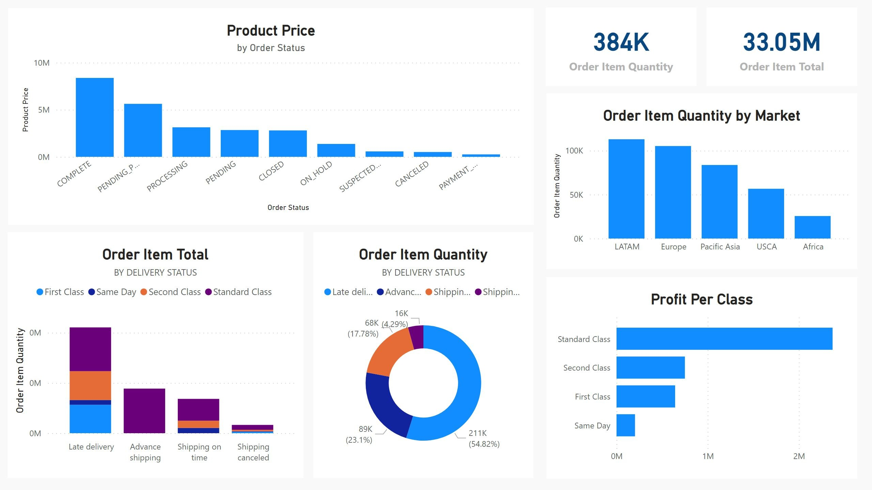
Delivery Report
The delivery report on the second page will likely analyze the delivery data contained in the dataset, including variables such as days for shipping, delivery status, and late delivery risk. The report may identify areas of the supply chain where delays or other issues are occurring and suggest solutions to improve delivery times and customer satisfaction.

Slide 9
When it comes to delivery, every customer wants their package delivered on time and in perfect condition. As a business owner, you need to ensure that your delivery process is efficient, timely, and reliable. Let's take a closer look at some insights from the delivery report and understand how they can help improve your business.
The first insight from the report tells us that Standard Class had the highest total Order Item Quantity, followed by Second Class, First Class, and Same Day. This means that most customers prefer to choose the standard shipping option and are willing to wait a little longer for their delivery. However, it's important to note that Advance shipping in Shipping Mode made up 23.10% of Order Item Quantity, so it's crucial to offer different shipping options to cater to all your customers' needs.
Secondly, the report reveals that Late delivery had the highest Order Item Total, followed by Advance shipping, Shipping on time, and Shipping canceled. This indicates that customers are willing to pay more for expedited shipping and are disappointed when their package arrives late. Therefore, it's essential to have a reliable delivery system in place that can deliver packages on time, every time.
The report also shows that Late delivery accounted for 54.71% of Order Item Total, which is a significant amount. To reduce the number of late deliveries, businesses need to work on improving their logistics and shipment tracking systems. By investing in technology that provides real-time updates on the
status of packages, businesses can reduce the chances of delayed deliveries.
Another important insight from the report is that the Average of Days for shipping (real) is positively correlated with total Days for shipment (scheduled). This means that businesses need to ensure that they accurately estimate the delivery time and set realistic expectations for their customers. Overpromising and underdelivering can lead to dissatisfied customers and ultimately harm the business.
Finally, the report shows that Days for shipping (real) and total Days for shipment (scheduled) vary across different markets. Therefore, it's essential to
tailor your delivery process to suit the needs of each market. By doing so, businesses can improve customer satisfaction and build long-term relationships with their customers.
In conclusion, the delivery report provides valuable insights into the delivery process, highlighting areas that need improvement. By using this information, businesses can optimize their delivery process, provide a better customer experience, and ultimately improve their bottom line.

Slide 10
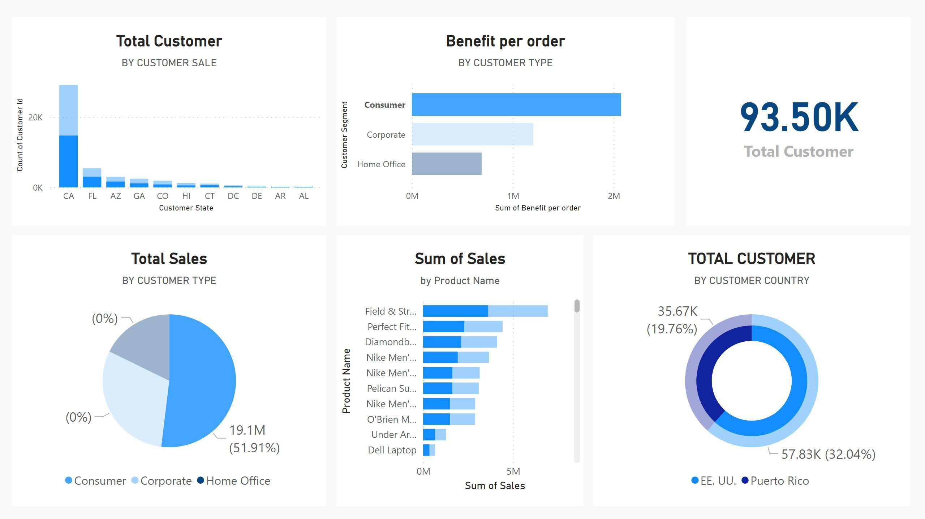
Customer Segment Report
The customer segment report on the third page will likely analyze the customer data contained in the dataset, including variables such as customer city, country, segment, and email. The report may identify different customer segments based on their buying behavior and preferences, such as frequent
buyers or customers who prefer certain types of products. The report may also suggest ways to tailor marketing and sales efforts to different customer segments to improve customer retention and loyalty.

Slide 11
Once upon a time, there was a company that sold various products to different customer segments. They were interested in understanding their sales performance across customer segments to optimize their business strategies. They gathered data on various metrics, and upon analyzing it, they found some interesting insights.
They discovered that the Consumer segment had the highest sales at 19, 095, 790.16, followedbyCorporateat11,168,406.84, and Home Office at
6, 520, 538.02.TheyalsofoundthattheConsumersegmenthadthehighestbenefitperorderat2,073,487.67, which was 200.14% higher than Home Office, the segment with the lowest benefit per order at $690,840.34.
Consumer accounted for 52.27% of benefit per order and had the highest benefit per order followed by Corporate at 1, 202, 574.96andHomeOfficeat 690,840.34. They also noticed that the order customer ID for EE. UU. (111,146) was higher than Puerto Rico (69,373), and PR accounted for 47.18% of order customer ID.
They observed that Field & Stream Sportsman 16 Gun Fire Safe had the highest sales at 6, 929, 653.69, whichwas120.143,147,800.
They also looked at the order status and found that Late Delivery had the highest order item total at $18,082,555.30, followed by Advance Shipping, Shipping on time, and Shipping canceled. Late delivery accounted for 54.71% of the order item total.
Additionally, they analyzed the delivery report and found that Standard Class had the highest total order item quantity at 228,999, followed by Second
Class, First Class, and Same Day. Standard Class had the highest average order item quantity at 57,249.75, followed by First Class, Second Class, and Same Day. Late delivery had the highest order item total at $18,082,555.30, followed by Advance shipping, Shipping on time, and Shipping canceled.
They also noticed that the correlation between days for shipping (real) and total days for shipment (scheduled) was positive. Finally, they found that order customer ID ranged from 3,191 to 69,373 across all 10 customer states.

Slide 12
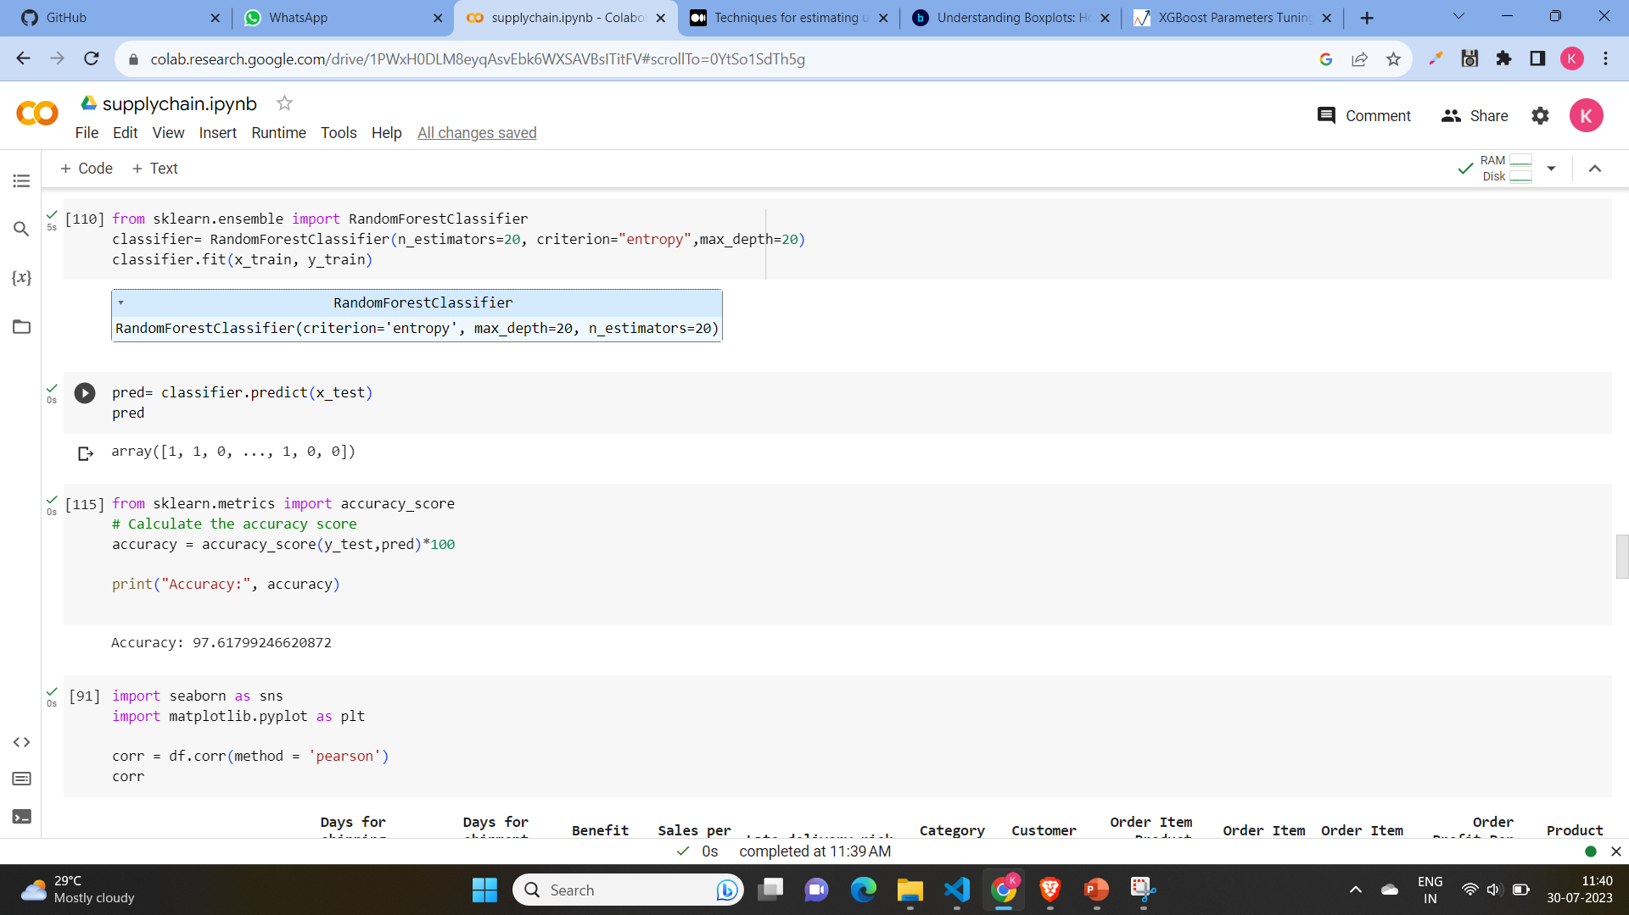
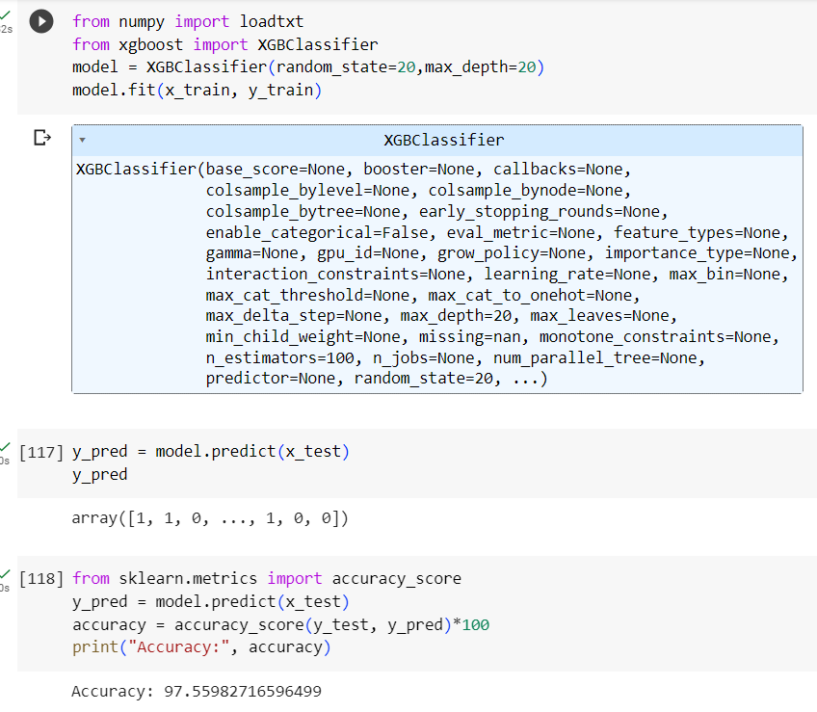
Machine learning model to predict the delivery risk
For predicting the delivery risk we use random forest algorithm and XGBoost algorithm which both give same accuracy around 97%
From below parameter we predict a delivery risk:
Days for shipping (real), Days for shipment (scheduled), Benefit per order, Sales per customer, Category Name, Customer City , Order Item Product Price, Order Item Total, Order Profit Per Order, Product Name
Random forest algorithm
XGBoost algorithm

Slide 13
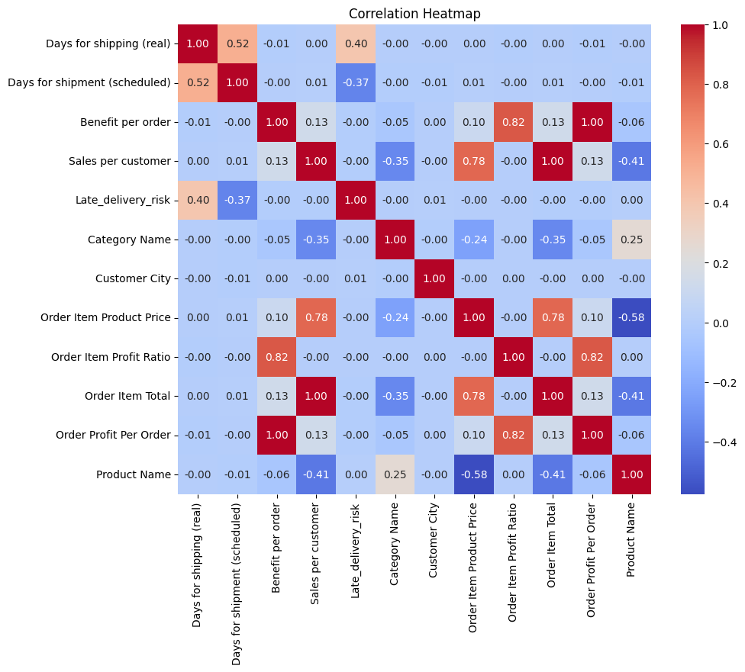
Correlation matrix of independent feature:

Slide 14


