Slide 1
Computer network

Slide 2
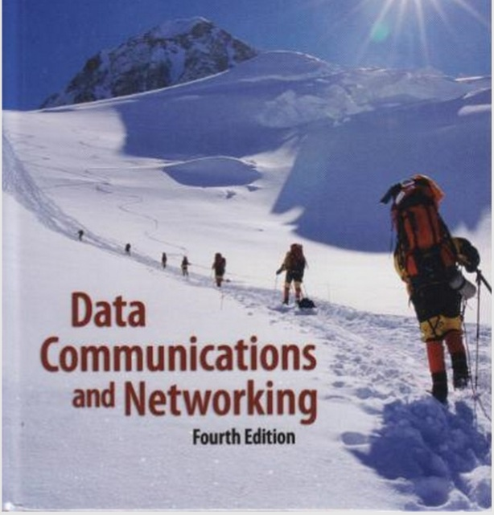


Slide 3
UNIT 1
DATA COMMUNICATIONS
Data communications are the exchange of data between two devices via some form of transmission medium such as a wire cable.

Slide 4
Components
A data communications system has five components.
Message
Sender
Receiver
Transmission medium
Protocol

Slide 5
Message: The message is the information (data) to be communicated. Popular forms of information include text, numbers, pictures, audio, and video.
Sender: The sender is the device that sends the data message. It can be a computer, workstation, telephone handset, video camera, and so on.
Receiver : The receiver is the device that receives the message. It can be a computer, workstation, telephone handset, television, and so on.

Slide 6
Transmission medium: The transmission medium is the physical path by which a message travels from sender to receiver. Some examples of transmission media include twisted-pair wire, coaxial cable, fiber-optic cable, and radio waves.
Protocol :A protocol is a set of rules that govern data communications. It represents an agreement between the communicating devices. Without a protocol, two devices may be connected but not communicating, just as a person speaking French cannot be understood by a person who speaks only Japanese.

Slide 7
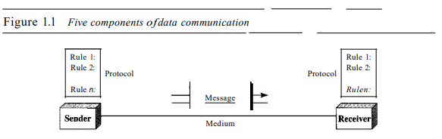

Slide 8
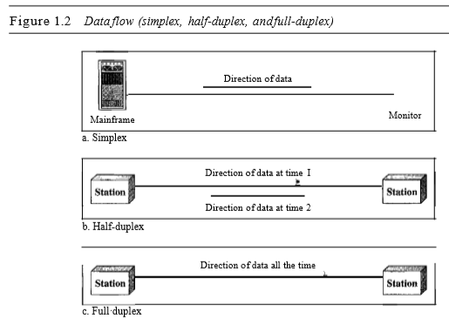
Data Flow
Communication between two devices can be simplex, half-duplex, or full-duplex

Slide 9
Simplex
In simplex mode, the communication is unidirectional, as on a one-way street.
Only one of the two devices on a link can transmit; the other can only receive
Keyboards and traditional monitors are examples of simplex devices.
The keyboard can only introduce input; the monitor can only accept output.
The simplex mode can use the entire capacity of the channel to send data in one direction.

Slide 10
2. Half-Duplex
In half-duplex mode, each station can both transmit and receive, but not at the same time.
When one device is sending, the other can only receive, and vice versa
The half-duplex mode is like a one-lane road with traffic allowed in both directions.
When cars are traveling in one direction, cars going the other way must wait.
In a half-duplex transmission, the entire capacity of a channel is taken over by whichever of the two devices is transmitting at the time.

Slide 11
2. Half-Duplex
Walkie-talkies and CB (citizens band) radios are both half-duplex systems.
The half-duplex mode is used in cases where there is no need for communication in both directions at the same time; the entire capacity of the channel can be utilized for each direction.

Slide 12
Full-Duplex
The full-duplex mode is like a two-way street with traffic flowing in both directions at the same time.
In full-duplex mode, signals going in one direction share the capacity of the link: with signals going in the other direction.
This sharing can occur In two ways:
Either the link must contain two physically separate transmission paths, one for sending and the other for receiving;

Slide 13
EXAMPLE
the capacity of the channel is divided between signals traveling in both directions
One common example of full-duplex communication is the telephone network.
When two people are communicating by a telephone line, both can talk and listen at the same time

Slide 14
NETWORKS
A network is a set of devices (often referred to as nodes) connected by communication links.
A node can be a computer, printer, or any other device capable of sending and/or receiving data generated by other nodes on the network

Slide 15
Distributed Processing
Most networks use distributed processing, in which a task is divided among multiple computers.
Instead of one single large machine being responsible for all aspects of a process, separate computers (usually a personal computer or workstation) handle a subset.

Slide 16
2. Network Criteria
A network must be able to meet a certain number of criteria.
The most important of these are performance, reliability, and security.
Performance: Performance can be measured in many ways, including transmit time and response time. Transmit time is the amount of time required for a message to travel from one device to another.

Slide 17
2. Reliability
In addition to accuracy of delivery, network reliability is measured by the frequency of failure, the time it takes a link to recover from a failure.
3. Security Network
security issues include protecting data from unauthorized access, protecting data from damage and development, and implementing policies and procedures for recovery from breaches and data losses.
Lecture End

Slide 18
Physical Structures
Type of Connection :A network is two or more devices connected through links. A link is a communications pathway that transfers data from one device to another.
There are two possible types of connections: point-to-point and multipoint.
Point-to-Point
Multipoint

Slide 19
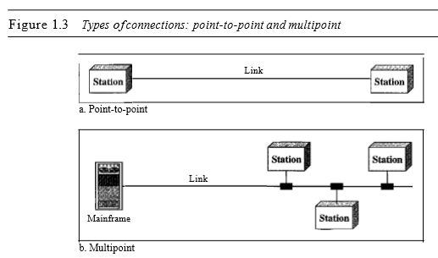

Slide 20
Categories of topology
Mesh : In a mesh topology, every device has a dedicated point-to-point link to every other device.
The term dedicated means that the link carries traffic only between the two devices it connects.
To find the number of physical links in a fully connected mesh network with n nodes, We apply n(n - 1)/2 where n is the number of nodes

Slide 21
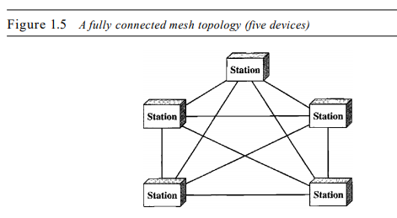
N*(n -1) /2 if n=5, 5*(5-1)/2=5*4/2=5*2=10 links are required
Number of ports = (n-1)*n where n is number of stations
Example if n=5 then number of ports required are : 5*4=20

Slide 22
A mesh offers several advantages over other network topologies
First, the use of dedicated links guarantees that each connection can carry its own data load, thus eliminating the traffic problems that can occur when links must be shared by multiple devices.
Second, a mesh topology is robust: If one link becomes unusable, it does not incapacitate the entire system.
Third, there is the advantage of privacy or security: When every message travels along a dedicated line, only the intended recipient sees it. Physical boundaries prevent other users from gaining access to messages.

Slide 23
The main disadvantages of a mesh are related to the amount of cabling and the number of I/O ports required.
First, because every device must be connected to every other device, installation and reconnection are difficult.
Second, the bulk of the wiring can be greater than the available space (in walls, ceilings, or floors) can accommodate
Finally, the hardware required to connect each link (I/O ports and cable) can be prohibitively expensive

Slide 24
Star Topology
In a star topology, each device has a dedicated point-to-point link only to a central controller, usually called a hub.
The devices are not directly linked to one another.
Unlike a mesh topology, a star topology does not allow direct traffic between devices.
The controller acts as an exchange: If one device wants to send data to another, it sends the data to the controller, which then relays the data to the other connected device
The star topology is used in local-area networks (LANs).

Slide 25
ADVANTAGES
A star topology is less expensive than a mesh topology. In a star, each device needs only one link and one I/O port to connect it to any number of others. This factor also makes it easy to install and reconfigure
Robustness: If one link fails, only that link is affected. All other links remain active.

Slide 26
DISADVANTAGES
One big disadvantage of a star topology is the dependency of the whole topology on one single point, the hub.
If the hub goes down, the whole system is dead.
2. Although a star requires far less cable than a mesh, each node must be linked to a central hub. For this reason, often more cabling is required in a star than in some other topologies (such as ring or bus).

Slide 27
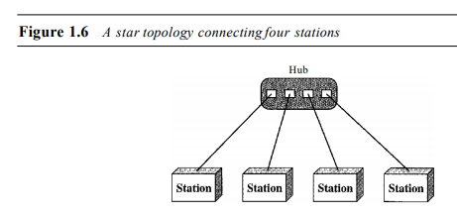
Number of cables required = n where n is number of stations
Number of port required = n where n is number of stations

Slide 28
Bus Topology
The preceding examples all describe point-to-point connections.
A bus topology, on the other hand, is multipoint.
One long cable acts as a backbone to link all the devices in a network.

Slide 29
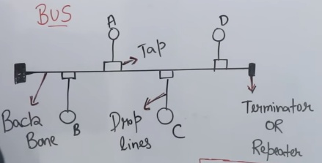
Number of cables = n+1 where n is number of devices and 1 for back bone.
Devices are A,B,C and D
Number of ports= n where n is number of devices
If A and B want to send data then message will also go to C and D also so no security of message.
It is used in LANS

Slide 30
Nodes are connected to the bus cable by drop lines and taps.
Advantages of a bus topology include ease of installation.
In this way, a bus uses less cabling than mesh or star topologies.
Disadvantages include difficult reconnection and fault isolation.
A bus is usually designed to be optimally efficient at installation
Collision will occur if B ,C and A ,D send message to each other.

Slide 31
Ring Topology
In a ring topology, each device has a dedicated point-to-point connection with only the two devices on either side of it.
A signal is passed along the ring in one direction, from device to device, until it reaches its destination. Each device in the ring incorporates a repeater.
When a device receives a signal intended for another device, its repeater regenerates the bits and passes them along

Slide 32
A ring is relatively easy to install and reconfigure.
Each device is linked to only its immediate neighbors (either physically or logically).
To add or delete a device requires changing only two connections.
unidirectional traffic can be a disadvantage.
In a simple ring, a break in the ring (such as a disabled station) can disable the entire network.

Slide 33
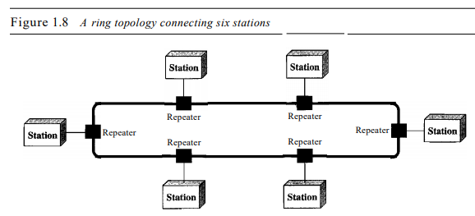
Number of cables = n+1 where n is number of devices and 1 for back bone.
If number of stations are 6 then 6+1 numbers of cables are required.
Number of ports= n where n is number of stations

Slide 34
Hybrid Topology
A network can be hybrid.
For example, we can have a main star topology with each branch connecting several stations in a bus topology

Slide 35
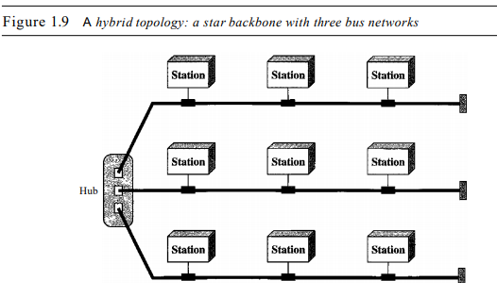

Slide 36
Network Models
The two best-known standards are the
OSI model and the Internet model
Categories of Networks:
we are generally referring to two primary categories: local-area networks and wide-area networks.
The category into which a network falls is determined by its size.
A LAN normally covers an area less than a WAN which can be worldwide

Slide 37
Local Area Network
A local area network (LAN) is usually privately owned and links the devices in a single office, building, or campus
Depending on the needs of an organization and the type of technology used, a LAN can be as simple as two PCs and a printer in someone's home office; or it can extend throughout a company
Currently, LAN size is limited to a few kilometers

Slide 38
LANs are designed to allow resources to be shared between personal computers or workstations.
The resources to be shared can include hardware (e.g., a printer), software (e.g., an application program), or data
The most common LAN topologies are bus, ring, and star

Slide 39
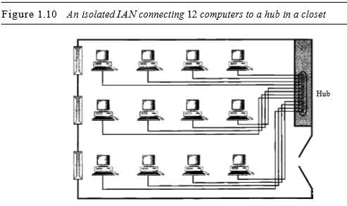

Slide 40
2. Wide Area Network
A wide area network (WAN) provides long-distance transmission of data, image, audio, and video information over large geographic areas that may comprise a country, a continent, or even the whole world.
The switched WAN connects the end systems, which usually comprise a router (internetworking connecting device) that connects to another LAN or WAN.

Slide 41
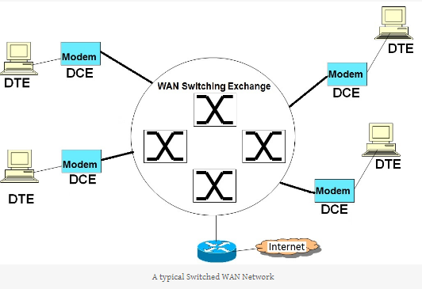

Slide 42
As the name indicates, a switched WAN network is used to connect multiple end nodes through a common WAN network.
The end nodes connect to a switched WAN network to either reach other nodes connected to the switched network or to connect to the public Internet.

Slide 43
3. Metropolitan Area Networks
A metropolitan area network (MAN) is a network with a size between a LAN and a WAN.
It normally covers the area inside a town or a city.
It is designed for customers who need a high-speed connectivity, normally to the Internet, and have endpoints spread over a city or part of city.
Example is the cable TV network that originally was designed for cable TV, but today can also be used for high-speed data connection to the Internet

Slide 44
PROTOCOLS AND STANDARDS
In computer networks, communication occurs between entities in different systems.
An entity is anything capable of sending or receiving information.
However, two entities cannot simply send bit streams to each other and expect to be understood.
For communication to occur, the entities must agree on a protocol.

Slide 45
A protocol is a set of rules that govern data communications.
A protocol defines what is communicated, how it is communicated, and when it is communicated.
The key elements of a protocol are syntax, semantics, and timing.

Slide 46
Syntax : The term syntax refers to the structure or format of the data, meaning the order in which they are presented.
For example, a simple protocol might expect the first 8 bits of data to be the address of the sender, the second 8 bits to be the address of the receiver, and the rest of the stream to be the message itself.
Semantics. The word semantics refers to the meaning of each section of bits.
How is a particular pattern to be interpreted, and what action is to be taken based on that interpretation?

Slide 47
For example, does an address identify the route to be taken or the final destination of the message?
Timing : The term timing refers to two characteristics: when data should be sent and how fast they can be sent.
For example, if a sender produces data at 100 Mbps but the receiver can process data at only 1Mbps, the transmission will overload the receiver and some data will be lost

Slide 48
THE OSI MODEL
It was first introduced in the late 1970s.
An open system is a set of protocols that allows any two different systems to communicate regardless of their underlying architecture.
The purpose of the OSI model is to show how to facilitate communication between different systems without requiring changes to the logic of the underlying hardware and software.
The OSI model is not a protocol; it is a model for understanding and designing a network architecture

Slide 49
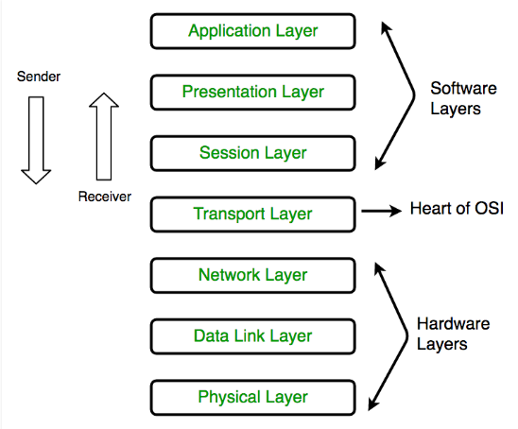

Slide 50
Application Layer
The application layer enables the user, whether human or software, to access the network.
It provides user interfaces and support for services such as electronic mail, remote file access and transfer, shared database management, and other types of distributed information services

Slide 51
Protocols used in application layer

Slide 52
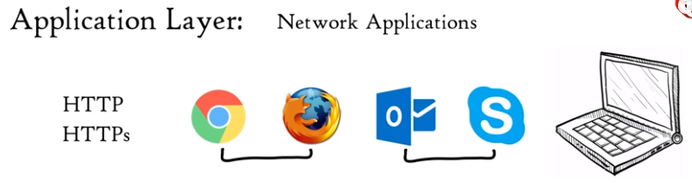
Example
Network application means computer application that use internet like Google crome, skype and many more.
Google crome uses application layer protocols HTTP/HTTPS to do we surfing.

Slide 53
File transfer, access, and management:
This application allows a user to access files in a remote host (to make changes or read data), to retrieve files from a remote computer for use in the local computer, and to manage or control files in a remote computer locally.
2. Mail services : This application provides the basis for e-mail forwarding and storage.
3. Directory services : This application provides distributed database sources and access for global information about various objects and services.

Slide 54
2. Presentation Layer
The presentation layer is concerned with the syntax and semantics of the information exchanged between two systems.
Syntax: structure or format of data and how to read the bit
Semantic: defines meaning of bits

Slide 55
Specific responsibilities of the presentation layer include the following:
Translation :
The processes (running programs) in two systems are usually exchanging information in the form of character strings, numbers, and so on.
The information must be changed to bit streams before being transmitted. Because different computers use different encoding systems, the presentation layer is responsible for interoperability between these different encoding methods.

Slide 56
The presentation layer at the sender changes the information from its sender-dependent format into a common format.
The presentation layer at the receiving machine changes the common format into its receiver-dependent format.

Slide 57
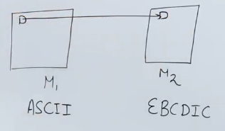
EXAMPLE
Application running on M1 is using ASCII code and application running on M2 uses EBCDIC code.
If M1 sends data to M2 in ASCII format than M2 can’t understand the message because M2 uses EBCDIC code so it is responsibility of presentation layer to convert the message into correct format.

Slide 58
2. Encryption:
To carry sensitive information, a system must be able to ensure privacy.
Encryption means that the sender transforms the original information to another form and sends the resulting message out over the network.
3. Decryption:
Reverses the original process to transform the message back to its original form

Slide 59
4. Compression :
Data compression reduces the number of bits contained in the information.
Data compression is important in the transmission of multimedia such as text, audio, and video.

Slide 60
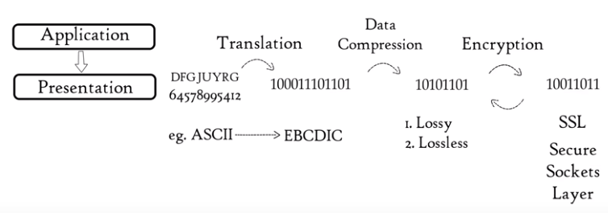

Slide 61
3. Session Layer
The session layer is the network dialog controller.
It establishes, maintains, and synchronizes the interaction among communicating systems.

Slide 62
Specific responsibilities of the session layer include the following
Dialog control: The session layer allows two systems to enter into a dialog.
It allows the communication between two processes to take place in either half duplex (one way at a time) or full-duplex (two ways at a time) mode.
Example : if a user login in HDFC net banking and does not do any activity than after a time period session is expire this service is provided by session layer.

Slide 63
Synchronization : The session layer allows a process to add checkpoints, or synchronization points, to a stream of data. For example, if a system is sending a file of2000 pages, it is advisable to insert checkpoints after every 100 pages to ensure that each 100-page unit is received and acknowledged independently.
In this case, if a crash happens during the transmission of page 523, the only pages that need to be resent after system recovery are pages 501 to 523. Pages previous to 501 need not be resent

Slide 64
4. Transport Layer
The transport layer is responsible for process-to-process delivery of the entire message.
A process is an application program running on a host.
Whereas the network layer oversees source-to-destination delivery of individual packets, it does not recognize any relationship between those packets.
It treats each one independently, as though each piece belonged to a separate message, whether or not it does.
The transport layer, on the other hand, ensures that the whole message arrives intact and in order, overseeing both error control using and flow control at the source-to-destination level.

Slide 65
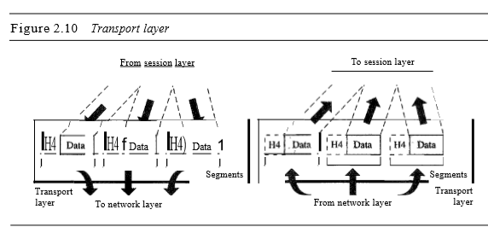
Source and destination port address

Slide 66
Other responsibilities of the transport layer include the following:
Service-point addressing : Computers often run several programs at the same time. For this reason, source-to-destination delivery means delivery not only from one computer to the next but also from a specific process (running program) on one computer to a specific process (running program) on the other.

Slide 67
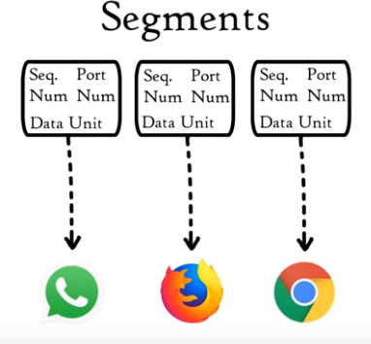
Segmentation and reassembly : A message is divided into transmittable segments, with each segment containing a sequence number. These numbers enable the transport layer to reassemble the message correctly upon arriving at the destination and to identify and replace packets that were lost in transmission.
1
2
3

Slide 68
Flow control: Like the data link layer, the transport layer is responsible for flow control. However, flow control at this layer is performed end to end rather than across a single link

Slide 69
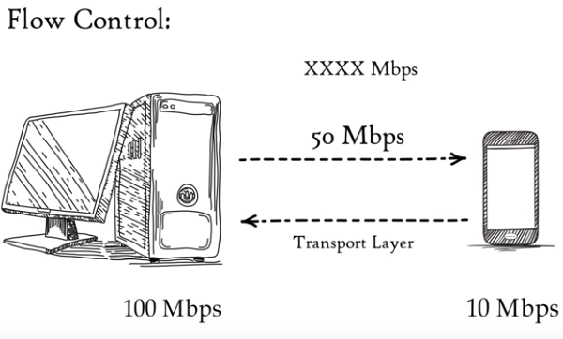
Suppose Server can transmit data at 100 Mpbs and our mobile can process data at 10 Mbps
If we download a file from server and server start sending data at 50 Mpbs which is greater than the rate our mobile can process
So mobile phone with the help of transport layer can tell to slow down data transmission rate up to 10 Mpbs so that no data get lost

Slide 70
Error control : Like the data link layer, the transport layer is responsible for error control. However, error control at this layer is performed process-to process rather than across a single link.
The sending transport layer makes sure that the entire message arrives at the receiving transport layer without error (damage, loss, or duplication).
Error correction is usually achieved through retransmission.

Slide 71
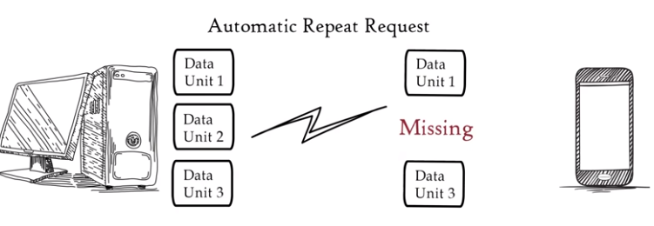
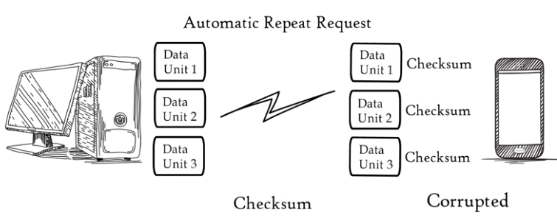
If a segment is missing then a group of bits called checksum is added to find out corrupted segment.

Slide 72
3. Network Layer
The network layer is responsible for the source-to-destination delivery of a packet, possibly across multiple networks (links).
Whereas the data link layer oversees the delivery of the packet between two systems on the same network (links), the network layer ensures that each packet gets from its point of origin to its final destination.

Slide 73
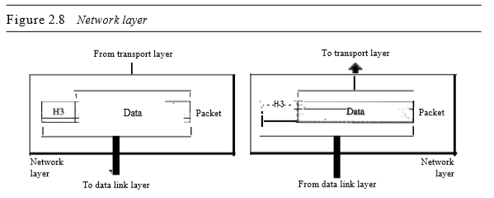
Source IP address and destination IP address

Slide 74
Other responsibilities of the network layer include the following
Logical addressing: The physical addressing implemented by the data link layer handles the addressing problem locally.
If a packet passes the network boundary, we need another addressing system to help distinguish the source and destination systems.
The network layer adds a header to the packet coming from the upper layer that, among other things, includes the logical addresses of the sender and receiver.

Slide 75
Routing : When independent networks or links are connected to create internetworks (network of networks) or a large network, the connecting devices (called routers or switches) route or switch the packets to their final destination.
One of the functions of the network layer is to provide this mechanism

Slide 76
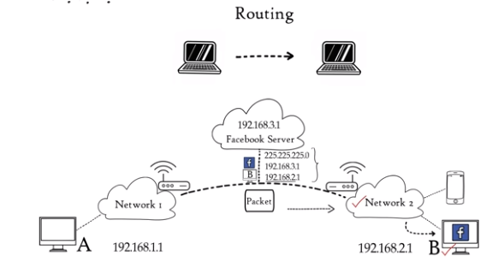
Based on IP address and Mask routing decision are taken
If host A and host B has a unique IP address and host A want to open facebook than it will send a packet to facebook server and facebook server masks the IP address of host A to know where to send packet the network ID which is Network 2

Slide 77
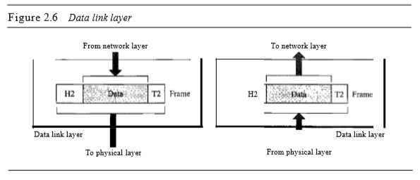
2. Data Link Layer
The data link layer transforms the physical layer, a raw transmission facility, to a reliable link.
It makes the physical layer appear error-free to the upper layer (network layer).

Slide 78
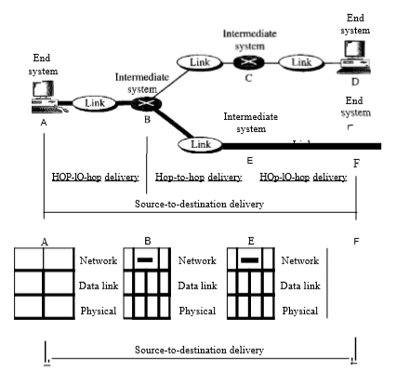
Figure 2.9 illustrates end-to-end delivery by the network layer

Slide 79
As the figure shows, now we need a source-to-destination delivery. The network layer at A sends the packet to the network layer at B. When the packet arrives at router B, the router makes a decision based on the final destination (F) of the packet.
Router B uses its routing table to find that the next hop is router E. The network layer at B, therefore, sends the packet to the network layer at E. The network layer at E sends the packet to the network layer at F.

Slide 80
Other responsibilities of the data link layer include the following
Framing: The data link layer divides the stream of bits received from the network layer into manageable data units called frames.
Physical addressing: If frames are to be distributed to different systems on the network, the data link layer adds a header to the frame to define the sender and/or receiver of the frame.
If the frame is intended for a system outside the sender's network, the receiver address is the address of the device that connects the network to the next one.

Slide 81
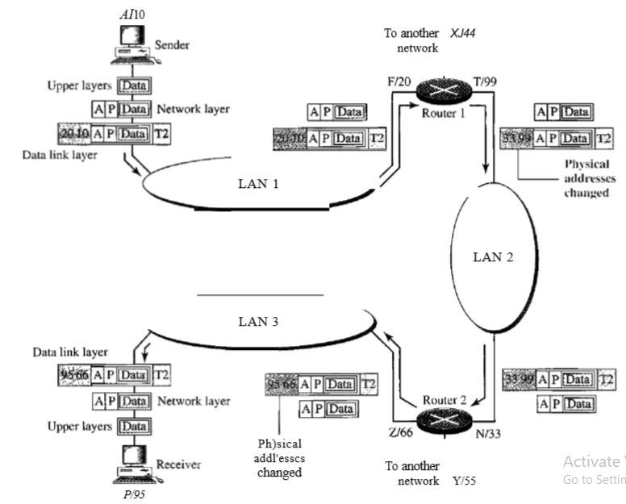

Slide 82
Flow control. If the rate at which the data are absorbed by the receiver is less than the rate at which data are produced in the sender, the data link layer imposes a flow control mechanism to avoid overwhelming the receiver.
Error control. The data link layer adds reliability to the physical layer by adding mechanisms to detect and retransmit damaged or lost frames. It also uses a mechanism to recognize duplicate frames. Error control is normally achieved through a trailer added to the end of the frame.

Slide 83
7. Physical Layer
At the physical layer, communication is direct: device A sends a stream of bits to device B (through intermediate nodes).
At the higher layers, however, communication must move down through the layers on device A, over to device B, and then back up through the layers

Slide 84
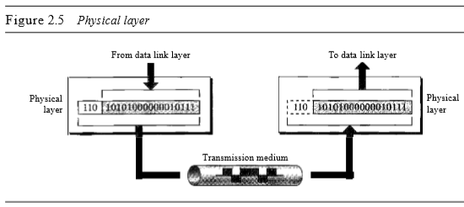

Slide 85
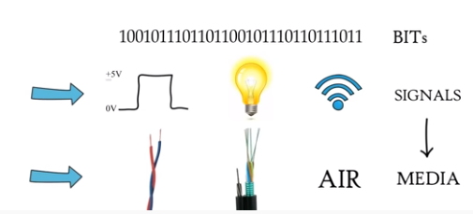
Types of Transmission Media

Slide 86
The physical layer is also concerned with the following
Transmission mode: The physical layer also defines the direction of transmission between two devices: simplex, half-duplex, or full-duplex. In simplex mode, only one device can send; the other can only receive.
The simplex mode is a one-way communication. In the half-duplex mode, two devices can send and receive, but not at the same time.
In a full-duplex (or simply duplex) mode, two devices can send and receive at the same time

Slide 87
2. Data rate: The transmission rate-the number of bits sent each second-is also defined by the physical layer.
In other words, the physical layer defines the duration of a bit, which is how long it lasts.
3. Line configuration: The physical layer is concerned with the connection of devices to the media.
In a point-to-point configuration, two devices are connected through a dedicated link. In a multipoint configuration, a link is shared among several devices.

Slide 88
4. Physical topology:
The physical topology defines how devices are connected to make a network.
Devices can be connected by using a mesh topology (every device is connected to every other device), a star topology (devices are connected through a central device), a ring topology (each device is connected to the next, forming a ring), a bus topology (every device is on a common link), or a hybrid topology (this is a combination of two or more topologies).

Slide 89
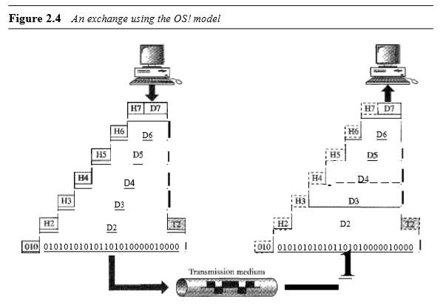

Slide 90
Previous slide gives overall view of the OSI layers
D7 means the data unit at layer 7, D6 means the data unit at layer 6, and so on.
The process starts at layer 7 (the application layer), then moves from layer to layer in descending, sequential order.
At each layer, a header, or possibly a trailer, can be added to the data unit. Commonly, the trailer is added only at layer 2.
When the formatted data unit passes through the physical layer (layer 1), it is changed into an electromagnetic signal and transported along a physical link.

Slide 91
Upon reaching its destination, the signal passes into layer 1 and is transformed back into digital form.
The data units then move back up through the OSI layers.
As each block of data reaches the next higher layer, the headers and trailers attached to it at the corresponding sending layer are removed, and actions appropriate to that layer are taken.
By the time it reaches layer 7, the message is again in a form appropriate to the application and is made available to the recipient.

Slide 92
Encapsulation:
A packet (header and data) at level 7 is encapsulated in a packet at level 6.
The whole packet at level 6 is encapsulated in a packet at level 5, and so on.
For level N - 1, the whole packet coming from level N is treated as one integral unit.

Slide 93
The OSI Model we just looked at is just a reference/logical model.
But when we talk about the TCP/IP model, it was designed and developed by Department of Defense (DoD) in 1960s and is based on standard protocols.
It stands for Transmission Control Protocol/Internet Protocol.
The TCP/IP model is a concise(summary) version of the OSI model.
It contains four layers, unlike seven layers in the OSI model. The layers are:

Slide 94
TCP/IP Protocol
When TCP/IP is compared to OSI, we can say that
The host-to-network layer is equivalent to the combination of the physical and data link layers.
The internet layer is equivalent to the network layer, and
The application layer is roughly doing the job of the session, presentation, and application layers with the transport layer in TCPIIP taking care of part of the duties of the session layer

Slide 95
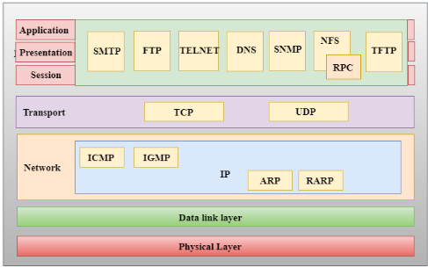
Protocols used in different layer of TCP/IP

Slide 96
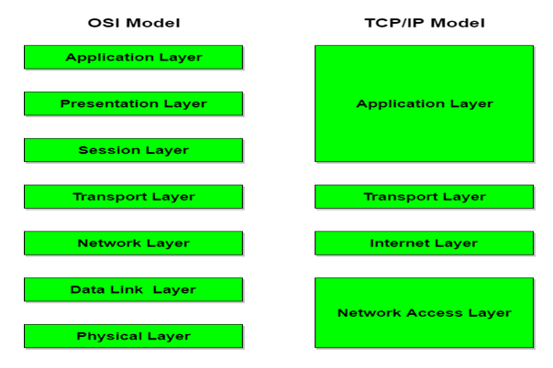

Slide 97
Network Access Layer
A network layer is the lowest layer of the TCP/IP model.
A network layer is the combination of the Physical layer and Data Link layer defined in the OSI reference model.
It defines how the data should be sent physically through the network.
This layer is mainly responsible for the transmission of the data between two devices on the same network.

Slide 98
2. Internet Layer
An internet layer is the second layer of the TCP/IP model.
An internet layer is also known as the network layer.
The main responsibility of the internet layer is to send the packets from any network, and they arrive at the destination irrespective of the route they take.

Slide 99
Following are the protocols used in this layer are:
IP Protocol:
It is unreliable and connection less protocol
No error detection, error correction and error tracking.
Error tracking means that IP does not keep track of packet route.
IP transport data packet known as data gram
Each datagram is transported sepratly.
IP does not give sequence number to them and they travel different path and hence can arrive out of order and even duplicate.

Slide 100
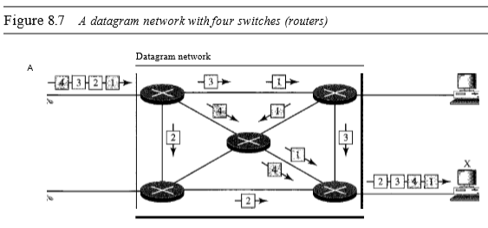

Slide 101
IP Supporting Protocol
ARP(Address Resolution Protocol)
RARP(Reverse Address Resolution Protocol)
ICMP
IGMP

Slide 102
ICMP stands for Internet Control Message Protocol.
It is a mechanism used by the hosts or routers to send notifications regarding datagram problems back to the sender.
An ICMP protocol mainly uses two terms: ICMP Test: ICMP Test is used to test whether the destination is reachable or not.
ICMP Reply: ICMP Reply is used to check whether the destination device is responding or not.

Slide 103
A datagram travels from router-to-router until it reaches its destination.
If a router is unable to route the data because of some unusual conditions such as disabled links, a device is on fire or network congestion, then the ICMP protocol is used to inform the sender that the datagram is undeliverable.

Slide 104
2. ARP(Address Resolution Protocol)
Any time a host or router needs to find Physical address of another host or router in its network it send ARP query packet.
Packet include IP address and Physical Address of sender and IP address of receiver.
Since physical address is not known so packet is broadcasted on the network.
Every router and host receives packet and only receiver recognize it because of IP address and it send its physical address in the packet known as ARP reply packet.

Slide 105
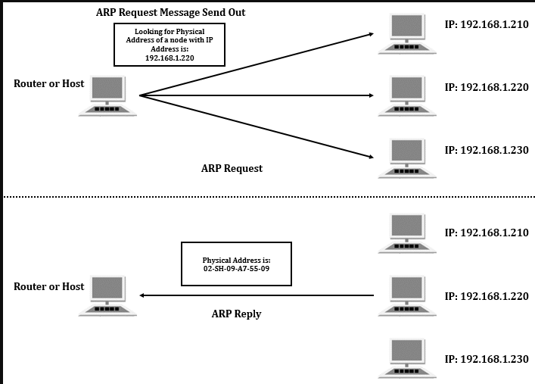

Slide 107
Explanation
Physical address of frame changes from one node to other.
(Node can be router or device)
So to find the physical address of the next router ARP protocol is used.

Slide 108
3 RARP
To create an IP datagram, a host or a router needs to know its own IP address or addresses
RARP is based on client and server architecture because now system want to know its own IP address.
Machine running RARP server program has a list of IP address and Physical address and after searching from the table it responds to the query.

Slide 109
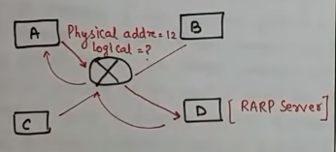
If station A want to known its IP address the it will send a RARP request to the server D.
Server D contains list of IP address and physical address.
Server D respond to station A by sending its IP address in the RARP reply.

Slide 110
4. IGMP
The IP protocol can be involved in two types of communication: unicasting and multicasting.
Unicasting is the communication between one sender and one receiver. It is a one-to-one communication.
However, some processes sometimes need to send the same message to a large number of receivers simultaneously.
This is called multicasting, which is a one-to-many communication

Slide 111
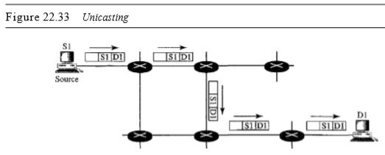

Slide 112
Example
Multiple stockbrokers can simultaneously be informed of changes in a stock price, or travel agents can be informed of a plane cancellation.

Slide 113
3. Transport Layer
TCP and UDP are the two protocols
IP is a host-to-host protocol, meaning that it can deliver a packet from one physical device to another.
UDP and TCP are transport level protocols responsible for delivery of a message from a process (running program) to another process.
A new transport layer protocol, SCTP, has been devised to meet the needs of some newer applications.

Slide 114
User Datagram Protocol
It is Connection less and unreliable protocol
Connection less means without establishing connection data is transferred
Unreliable means it has limited error control because error control is optional
Packet are called user datagram and each user datagram contain entire message.
UDP can transfer only that amount of data which can fit in its packet and hence it is called message oriented protocol.

Slide 115
UDP preserves message boundaries.
If you send "FOO" and then "BAR" over UDP, the other end will receive two datagrams, one containing "FOO" and the other containing "BAR".
If you send "FOO" and then "BAR" over TCP, no message boundary is preserved.
The other end might get "FOO" and then "BAR". Or it might get "FOOBAR". Or it might get "F" and then "OOB" and then "AR".
TCP does not make any attempt to preserve application message boundaries -- it's just a stream of bytes in each direction.

Slide 116
2. Transmission Control Protocol
The Transmission Control Protocol (TCP) provides full transport-layer services to applications.
TCP is a reliable stream transport protocol. The term stream, in this context, means connection-oriented.
Connection-Oriented : A connection must be established between both ends of a transmission before either can transmit data.

Slide 117
At the sending end of each transmission, TCP divides a stream of data into smaller units called segments.
Each segment includes a sequence number for reordering after receipt, together with an acknowledgment number for the segments received.
Segments are carried across the internet inside of IP datagram.
At the receiving end, TCP collects each datagram as it comes in and reorders the transmission based on sequence numbers

Slide 119
REAL TIME APPLICATION FOR TCP:
Email:
Reason: suppose if some packet(words/statement) is missing we cannot understand the content.It should be reliable.
REAL TIME APPLICATION FOR UDP:
video streaming:
* **Reason: ***suppose if some packet(frame/sequence) is missing we can understand the content. Because video is collection of frames. For 1 second video there should be 25 frames(image).Even though we can understand some frames are missing due to our imagination skills. Thats why UDP is used for video streaming.

Slide 120
4. Application Layer
The application layer in TCP/IP is equivalent to the combined session, presentation, and application layers in the OSI model Many protocols are defined at this layer.

Slide 121
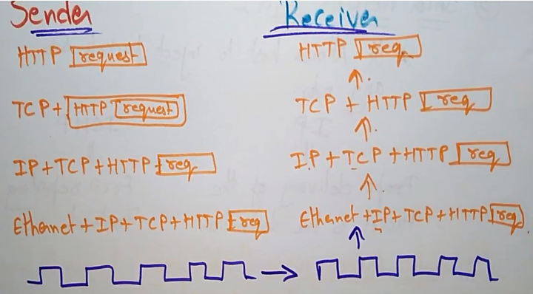
Summary chart

Slide 122
ADDRESSING
Four levels of addresses are used in an internet employing the TCP/IP protocols: physical (link) addresses, logical (IP) addresses, port addresses, and specific addresses

Slide 123
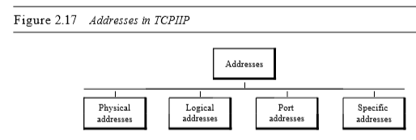

Slide 124
PHYSICAL ADDRESS
In a bus topology, the frame is propagated in both directions (left and right).
The frame propagated to the left dies when it reaches the end of the cable if the cable end is terminated appropriately.
The frame propagated to the right is sent to every station on the network.
Each station with a physical addresses other than 87 drops the frame because the destination address in the frame does not match its own physical address.

Slide 125
The intended destination computer, however, finds a match between the destination address in the frame and its own physical address.
The frame is checked, the header and trailer are dropped, and the data packet is decapsulated and delivered to the upper layer

Slide 126
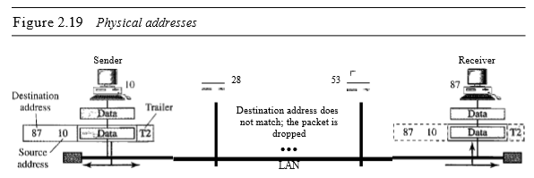

Slide 127
Logical Addresses
Logical addresses are necessary for universal communications that are independent of underlying physical networks.
Physical addresses are not adequate in an internetwork environment where different networks can have different address formats.
A universal addressing system is needed in which each host can be identified uniquely, regardless of the underlying physical network.

Slide 129
The router consults its routing table and ARP to find the physical destination address of the next hop (router 2), creates a new frame, encapsulates the packet, and sends it to router 2. Note the physical addresses in the frame.
The source physical address changes from 10 to 99. The destination physical address changes from 20 (router 1 physical address) to 33 (router 2 physical address).
The logical source and destination addresses must remain the same; otherwise the packet will be lost.

Slide 130
Port Addresses
arrival at the destination host is not the final objective of data communications on the Internet.
A system that sends nothing but data from one computer to another is not complete. Today, computers are devices that can run multiple processes at the same time.
The end objective of Internet communication is a process communicating with another process

Slide 131
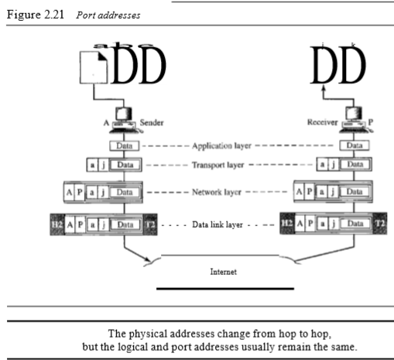

Slide 132
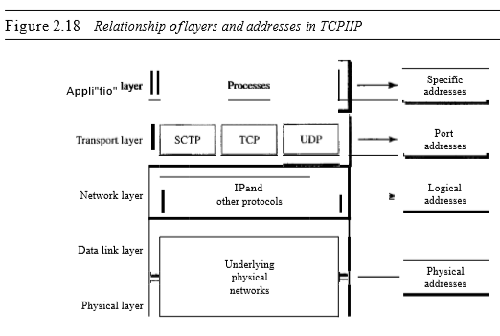

Slide 133
Throughput
The throughput is a measure of how fast we can actually send data through a network.
Although, at first glance, bandwidth in bits per second and throughput seem the same, they are different.
A link may have a bandwidth of B bps, but we can only send T bps through this link with T always less than B. In other words, the bandwidth is a potential measurement of a link; the throughput is an actual measurement of how fast we can send data.

Slide 134
For example, we may have a link with a bandwidth of 1 Mbps, but the devices connected to the end of the link may handle only 200 kbps.
This means that we cannot send more than 200 kbps through this link

Slide 135
EXAMPLE
Imagine a highway designed to transmit 1000 cars per minute from one point to another.
However, if there is congestion on the road, this figure may be reduced to 100 cars per minute.
The bandwidth is 1000 cars per minute; the throughput is 100 cars per minute.

Slide 136
Latency (Delay)
The latency or delay defines how long it takes for an entire message to completely arrive at the destination from the time the first bit is sent out from the source.
We can say that latency is made of four components: propagation time, transmission time, queuing time and processing delay

Slide 137

Latency=propagation time + transmission time +queuing time + processing delay
Propagation Time
Propagation time measures the time required for a bit to travel from the source to the destination.
The propagation time is calculated by dividing the distance by the propagation speed.

Slide 138
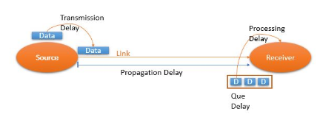
2. Transmission time
Transmission delay is how long it takes to get all the bits into the wire in the first place (it's packet_length/data_rate).
TT=Message Size/Bandwidth

Slide 139
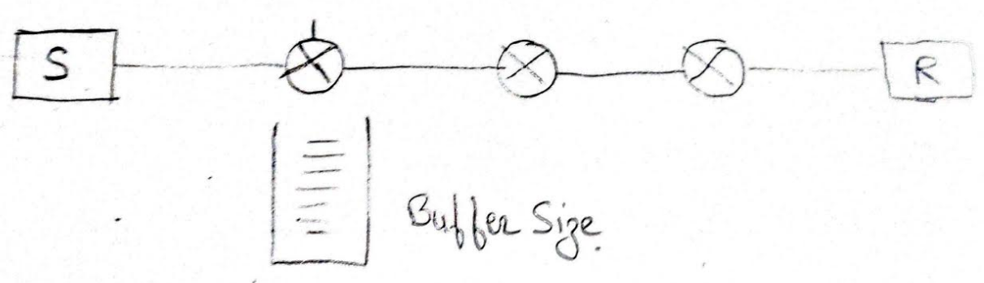
3. Queuing Time
The third component in latency is the queuing time, the time needed for each intermediate or end device to hold the message before it can be processed.
It depends on load of the network.

Slide 140
4. Processing Time
It is the time needed by intermediate device to process the packet.
Total Delay = Tp + Tt + QT + PT

Slide 141
Bandwidth-Delay Product
The bandwidth delay product defines the number of bits that can fill the link.
Bandwidth and delay are two performance metrics of a link

Slide 142
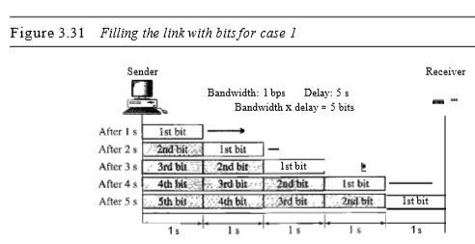

Slide 143
EXPLANATION
Let US assume that we have a link with a bandwidth of 1 bps (unrealistic, but good for demonstration purposes).
We also assume that the delay of the link is 5 s (also unrealistic).
We want to see what the bandwidth-delay product means in this case.
Looking at figure, we can say that this product 1 x 5 is the maximum number of bits that can fill the link.
There can be no more than 5 bits at any time on the link.

Slide 144
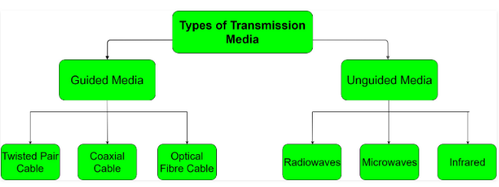
TRANSMISSION MEDIA

Slide 145
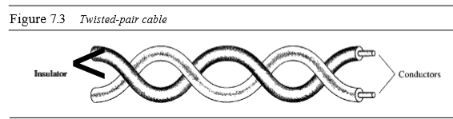
1. Twisted pair
One of the wire is used to carry signal and other act of ground reference so the receiver uses the difference b/w the two.
Twisting of wire reduces cross talk.

Slide 146
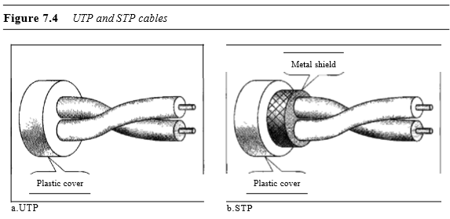
Types of twisted pair cable

Slide 147
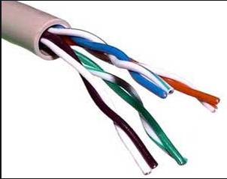
Unshielded Twisted Pair (UTP)
UTP cables are mostly used for LAN networks. They can be used for voice, low-speed data, high-speed data, audio and paging systems, and building automation and control systems..
Advantages:
Least expensive
Easy to install
High speed capacity

Slide 148
Shielded Twisted Pair (STP)
This type of cable consists of a special jacket to block external interference.
It is used in fast-data-rate Ethernet and in voice and data channels of telephone lines.
Advantages:
Better performance at a higher data rate in comparison to UTP
Eliminates crosstalk
Comparitively faster

Slide 149
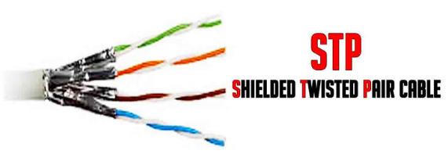

Slide 150
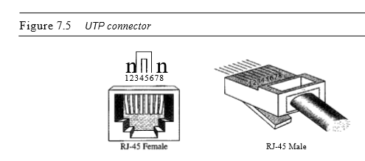
Connector
RJ-45 is used to connect twisted pair which is a key connector.

Slide 151
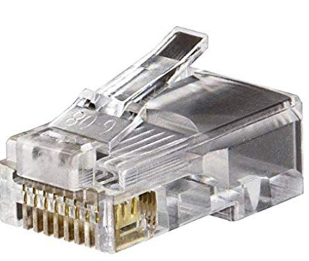
RJ-45 CONNECTOR

Slide 152
Applications
Twisted-pair cables are used in telephone lines to provide voice and data channels.
Unshielded twisted pair (UTP) is a type of copper cabling used in telephone wiring and local area networks (LANs).
The local loop-the line that connects subscribers to the central telephone office---commonly consists of unshielded twisted-pair cables.

Slide 153
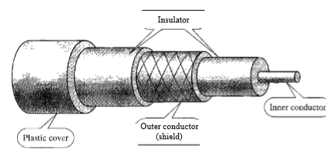
2 Coaxial Cable
Coaxial cable is very commonly used transmission media, for example, TV wire is usually a coaxial cable.
The name of the cable is coaxial as it contains two conductors parallel to each other.
Insulator protects from heating of wire

Slide 154
Coaxial cable (or coax) carries signals of higher frequency ranges than those in twisted pair cable, in part because the two media are constructed quite differently.
Instead of having two wires, coax has a central core conductor of solid or stranded wire (usually copper) enclosed in an insulating sheath, which is, in turn, encased in an outer conductor of metal foil, braid, or a combination of the two.
The outer metallic wrapping serves as a shield against noise.
This outer conductor is also enclosed in an insulating sheath, and the whole cable is protected by a plastic cover

Slide 155
Advantages Of Coaxial cable:
The data can be transmitted at high speed.
It has better shielding as compared to twisted pair cable.
It provides higher bandwidth.

Slide 156
Coaxial Cable Standards
Coaxial cables are categorized by their radio government (RG) ratings.
Each RG number denotes a unique set of physical specifications, including the thickness and type of the inner insulator, the construction of the shield, and the size and type of the outer casing.
Each cable defined by an RG rating is adapted for a specialized function, as shown in Table 7.2.

Slide 157


Slide 158

Connector
To connect coaxial cable to devices, we need coaxial connectors.
The most common type of connector used today is the Bayone-Neill-Concelman (BNe) connector.
The BNC connector is used to connect the end of the cable to a device, such as a TV set.

Slide 159
Applications
Coaxial cable was widely used in analog telephone networks where a single coaxial network could carry 10,000 voice signals.
Later it was used in digital telephone networks where a single coaxial cable could carry digital data up to 600 Mbps.
However, coaxial cable in telephone networks has largely been replaced today with fiber-optic cable.
Another common application of coaxial cable is in traditional Ethernet LANs.

Slide 160
FIBER OPTIC CABLE
Fiber optic cable is a cable that uses electrical signals for communication.
Fiber optic is a cable that holds the optical fibers coated in plastic that are used to send the data by pulses of light.
The plastic coating protects the optical fibers from heat, cold, electromagnetic interference from other types of wiring.
Fiber optics provide faster data transmission than copper wires.

Slide 161



Slide 162
Basic elements of Fiber optic cable:
Core: The optical fiber consists of a narrow strand of glass or plastic known as a core. A core is a light transmission area of the fiber. The more the area of the core, the more light will be transmitted into the fiber.
Cladding: The concentric layer of glass is known as cladding. The main functionality of the cladding is to provide the lower refractive index at the core interface as to cause the reflection within the core so that the light waves are transmitted through the fiber.
Jacket: The protective coating consisting of plastic is known as a jacket. The main purpose of a jacket is to preserve the fiber strength, absorb shock and extra fiber protection.

Slide 163
The two primary types of optical fiber cables are single mode and multi-mode.
Single Mode fiber optic cable has a small diameter core that allows only one mode of light to propagate.
Because of this, the number of light reflections created as the light passes through the core decreases, lowering attenuation and creating the ability for the signal to travel further.
This application is typically used in long distance, higher bandwidth runs by Telecommunication company, cable television companies, and Colleges and Universities.

Slide 164


Slide 165
Multimode fiber optic cable has a large diameter core that allows multiple modes of light to propagate.
Because of this, the number of light reflections created as the light passes through the core increases, creating the ability for more data to pass through at a given time.
Because of the high dispersion and attenuation rate with this type of fiber, the quality of the signal is reduced over long distances.
This application is typically used for short distance, data and audio/video applications in LANs.

Slide 166
Connectors
SC(Subscriber Channel): it is used to connect two optical fiber
ST(Straight Tip): it is used to connect optical fiber with network devices
MTRJ(Mechanical Transfer register jacket):it is used to connect optical fiber with end devices like normal PC

Slide 167


Slide 168
Applications
1. Fiber-optic cable is often found in backbone networks because its wide bandwidth is cost-effective.
Today, with wavelength-division multiplexing (WDM), we can transfer data at a rate of 1600 Gbps.
The SONET network provides such a backbone
2. Some cable TV companies use a combination of optical fiber and coaxial cable, thus creating a hybrid network.
Optical fiber provides the backbone structure while coaxial cable provides the connection to the user premises.

Slide 169
2. UNGUIDED MEDIA: WIRELESS
This type of communication is often referred to as wireless communication.
Signals are normally broadcast through free space and thus are available to anyone who has a device capable of receiving them.
Multicast communication like radio and television.
They can penetrate through walls.

Slide 170

Frequency

Slide 171


Slide 172
Radio Waves
electromagnetic waves ranging in frequencies between 3 kHz and 1 GHz are normally called radio waves;
Radio waves, for the most part, are omni-directional.
When an antenna transmits radio waves, they are propagated in all directions.
This means that the sending and receiving antennas do not have to be aligned.
A sending antenna sends waves that can be received by any receiving antenna.

Slide 173
The Omni-directional property has a disadvantage, too.
The radio waves transmitted by one antenna are susceptible to interference by another antenna that may send signals using the same frequency or band
Radio waves, particularly those of low and medium frequencies.
Radio waves – are used to transmit television and radio programs.

Slide 174

Radio waves, particularly those waves that propagate in the sky mode, can travel long distances

Slide 175
2. Microwaves
In this parabolic antenna are mounted on the tower to send a beam to another antennas km away.
Electromagnetic waves having frequencies between I and 300 GHz are called microwaves.
Microwaves are unidirectional.
The sending and receiving antennas need to be aligned.
Higher the tower greater is the range.
Bandwidth is 1 to 10 mbps
Attenuation due to environment condition
Microwaves are commonly used in radar systems where radar uses microwave radiation to detect the range

Slide 176

Unidirectional Antenna
Microwaves need unidirectional antennas that send out signals in one direction.

Slide 177
3. Infrared
Infrared waves, with frequencies from 300 GHz to 400 THz (wavelengths from 1 mm to 770 nm), can be used for short-range communication.
Infrared waves, having high frequencies, cannot penetrate walls but it can propagate.
This advantageous characteristic prevents interference between one system and another; a short-range communication system in one room cannot be affected by another system in the next room.

Slide 178
Example:
TV remote
Automatic doors
Wireless speakers
Consider to be secure

Slide 179

DTE DCE interface
DTE(Data terminal equipment)
DCE(Data circuit terminating equipment)

Slide 180
DTE(DATA TERMINAL EQUIPMENT)
DTE are the devices or equipment which can produce or consume digital data.
DTE are the sender and receiver devices
Two DTE can’t communicate directly rather DCE is needed for their communication.
DTE is the device where communication lines ends.
Example : printer, microcomputer, fax machine,computer.

Slide 181
2. DCE(DATA CIRCUIT TERMINATING EQUPMENT)
DEC are the devices which are used to convert digital data to analogy signal and vice versa.
Example: Modem
Two DTE can’t communicate directly rather DCE is needed for their communication.
DCE provides path for communication.

Slide 182

DTE-DCE Interface

Slide 183
TRANSMISSION IMPAIRMENT
Signal at the beginning of the medium is not the same as the signal at the end of the medium. What is sent is not what is received. Three causes of impairment are:
Attenuation
Distortion
noise

Slide 184
Attenuation
Attenuation means a loss of energy. When a signal, simple or composite, travels through a medium, it loses some of its energy in overcoming the resistance of the medium. That is why a wire carrying electric signals gets warm, if not hot, after a while.
Some of the electrical energy in the signal is converted to heat.
To compensate for this loss, amplifiers are used to amplify the signal.

Slide 185

Loss of energy

Slide 186



Slide 187
Decibel: To show that a signal has lost or gained strength, engineers use the unit of the decibel.
The decibel (dB) measures the relative strengths of two signals or one signal at two different points.

Slide 188
Distortion
Distortion means that the signal changes its form or shape.
Distortion can occur in a composite signal made of different frequencies.
Each signal component has its own propagation speed (see the next section) through a medium and, therefore, its own delay in arriving at the final destination.
Differences in delay may create a difference in phase if the delay is not exactly the same as the period duration

Slide 189
Distortion
In other words, signal components at the receiver have phases different from what they had at the sender.
The shape of the composite signal is therefore not the same

Slide 190


Slide 191
Noise
Noise is another cause of impairment.
Several types of noise, such as thermal noise, induced noise, crosstalk, and impulse noise, may corrupt the signal.
Induced noise comes from sources such as motors and appliances.
Thermal noise is movement of electrons in wire which creates an extra signal.
Crosstalk noise is when one wire affects the other wire.
Impulse noise is a signal with high energy that comes from lightning or power lines

Slide 192

noise corrupts the signal

Slide 193

Signal-to-Noise Ratio (SNR)
SNR is actually the ratio of what is wanted (signal) to what is not wanted (noise).
A high SNR means the signal is less corrupted by noise; a low SNR means the signal is more corrupted by noise

Slide 194


Slide 195


Slide 196
A very important consideration in data communications is how fast we can send data, in bits per second over a channel.
Data rate depends on three factors:
The bandwidth available
2. The level of the signals we use
3. The quality of the channel (the level of noise)

Slide 197
Two theorems for the evaluation of data rate :
Nyquist for a noiseless channel.
Shannon for a noisy channel.

Slide 198
NYQUIST’S Algorithm
If a bandwidth is B which carry a signal of L number of levels then maximum data rate R is given by
R = 2 x bandwidth x log2 L
R=max data rate of channel.
We can also write C=2xbandwidthxlog2L
C= maximum data rate without any error is called channel capacity

Slide 199


Slide 200
Noisy Channel: Shannon Capacity
In reality, we cannot have a noiseless channel; the channel is always noisy
Capacity =bandwidth X log2 (1 +SNR)
In this formula, bandwidth is the bandwidth of the channel, SNR is the signal-to noise ratio, and capacity is the capacity of the channel in bits per second.
Note that in the Shannon formula there is no indication of the signal level, which means that no matter how many levels we have, we cannot achieve a data rate higher than the capacity of the channel

Slide 201
EXAMPLE
Consider an extremely noisy channel in which the value of the signal-to-noise ratio is almost zero. In other words, the noise is so strong that the signal is faint. For this channel the capacity C is calculated as
This means that the capacity of this channel is zero regardless of the bandwidth.
In other words, we cannot receive any data through this channel.

Slide 202


