Slide 1
Multimedia Genre Classification
Group 11
100010018李哲銓
100071049何天與
100070023楊雅琪
指導教授
賴尚宏 教授

Slide 2
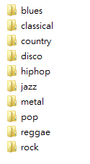
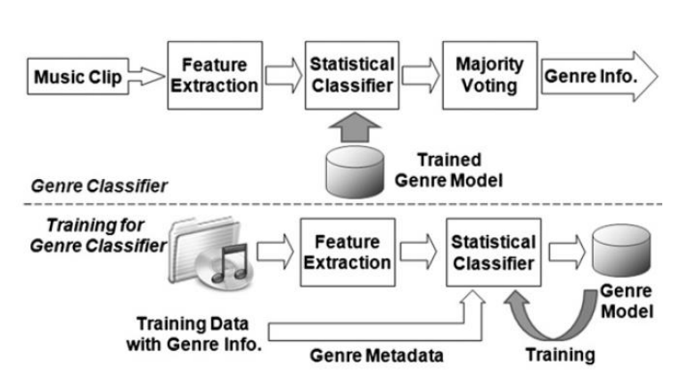
Introduction

Slide 3
FEATURES
Pitch x7
Mean Frequency
Best Pitch Frequency
Slope
PeriodFrequency
PeriodAmplitude
PeriodEntropy
Rhythm x2
Tempo
Pulse clarity
Timbre x4
Brightness
Low energy
Rolloff
Zero cross

Slide 4
METHOD
Toolbox: MIRtoolbox
Training Stage
Feature Extraction
Use 60 songs to train each style
Analysis the data
Delete ten outliers from each style
Derive the range by the rest

Slide 5
method
Classification Stage
Use 400 songs to test
Voting
C(10,2)
Determine the possible style

Slide 6
Reference
George Tzanetakis , “Musical Genre Classification of Audio Signals”, Student Member, IEEE, and Perry Cook, Member, IEEE

Slide 7
Demo time

