Slide 1

Problem Description
Disk Scheduling Algorithm
http://www2.cs.uregina.ca/~hamilton/courses/330/notes/io/node8.html
Minimize the data fetching time based on request data’s location
Notes:
A disk contains many tracks. A track contains many sectors. When we want to fetch data in specific sector, the magnetic head needs to jump to the right track and sector. We assume (1)The magnetic head can spin clockwise or counterclockwise within the track. It takes the magnetic head 360 unit of time to spin around within one track. (2)The magnetic head needs 400 unit of time to jump to the neighboring track. After jumping to the neighboring track, the magnetic remains at the same sector. (3) It takes the magnetic head 10 unit of time to fetch the data one time and after fetching data, the magnetic head remains at the same sector.(4) The magnetic head can only do one thing at a time, jumping to neighboring track, spinning or fetching data.
Now, we need to fetch a group of data. There is one data request at most in a track. Every track has 360 sectors, numbered 0 to 359. The magnetic head begins at track 0, sector 0. After fetching all the data, there are two questions:
1. The magnetic no need to return back to track 0, sector 0
2. The magnetic needs to return back to track 0, sector0.
Our problem is to calculate the minimum time needed to fetch all the data for above two questions
Input:
The first line contains an integer N(0<N<=100000) representing the number of data which need fetching. Then there will be N lines. Each line, there will be two integer T and S(0<=T<10000000<=S<360), representing the track and sector where the data lie in. The track number is in ascending order.

Slide 2
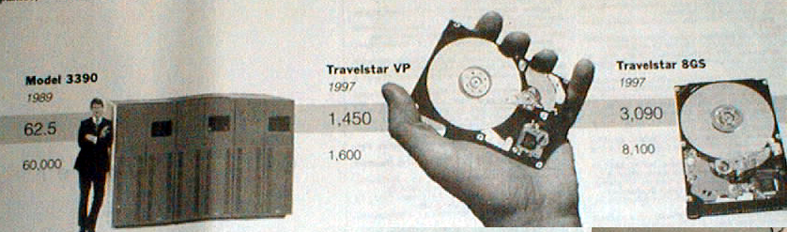
Technical Direction
Tracks location can me get some hints based on time difference of track and sector rotate?
Move to Sector can be either direction clockwise or counterclockwise
Can we do the maths induction to other similar problem?
Greedy Algorithm/Dynamic programming/Graph theory?

Slide 3
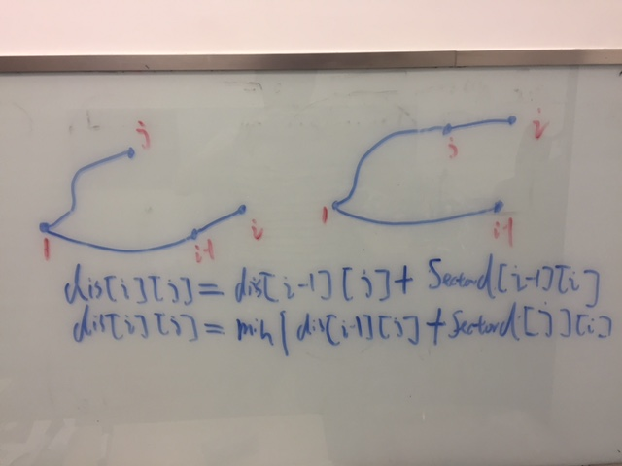
Technical Direction
Induce to Graph theory?
Sectordis[i][j] to indicate distance from one sector to another sector
Dis[i][j] to indicate from I to 1 and from 1 to J(we can assume I > J and don’t link together)

Slide 4
Sample Calculation
Sample Input 1:
1
1 10
Sample Output 1:
420
830
Sample Input 2:
3
1 20
3 30
5 10
Sample Output 2:
2080
4090
Input Data Format:
The first line contains an integer N(0<N<=100000) representing the number of data which need fetching. Then there will be N lines. Each line, there will be two integer T and S(0<=T<10000000<=S<360), representing the track and sector where the data lie in. The track number is in ascending order.
Output Data Format:
Two lines text output
    Line1 - Contain the first question answer.
    Line2 - Contain the second question answer

Slide 5
Executable input/output
Input Para:
  Input data will be organized as a text file
Executable can be run as: programname testfilename :
example: computeProg testfile
  Output result in output console

Slide 6

Judgment criteria
Passed case number, total 10 cases, every case 10 points(40%)
Performance – run 3 times get the average execution time, static buffer size (40%)
Submit time (10%)
Code style – readable, sustainable (10%)

Slide 7

Introduce the env requirement

