Slide 1

THE LISTING PORTAL FOR YACHT BROKERS
Every listing,
client-ready in seconds.
portal.yachtpics.com

Slide 2
THE OPPORTUNITY
Buyers decide in the first few photos.
Your listings deserve better than a Dropbox link and a dozen attachments. The faster you get clean, professional media in front of a buyer, the better that boat looks - and the more you sell.

Slide 3
WHAT IT IS
One place to manage, share, and send every listing.
Manage
Share
Send
Photos, video, and documents organized by listing - categories, visibility controls, and status all in one dashboard.
Every listing becomes a clean, branded slideshow link you can forward to a buyer the moment it's ready.
Email a listing straight to a client from the portal, slideshow attached - from your desktop or your phone.

Slide 4
WHAT YOU CAN DO
Built for how brokers actually work.
Share a listing in seconds
Use your own photos
Every listing gets a branded slideshow link - forward it the moment photos are ready.
Drag in shots from any source: phone, drone, or a past shoot. No YachtPics shoot required.
Photos, video & documents
Send straight to clients
Add walkthrough and drone video, attach surveys and spec sheets, all on the listing.
Email a listing from the portal with the slideshow attached - nothing missing.
Know what's been seen
Install it like an app
Slideshow views and download tracking, so you know when a buyer is looking.
Add it to your phone’s home screen and run your listings right from the dock - no laptop required.

Slide 5
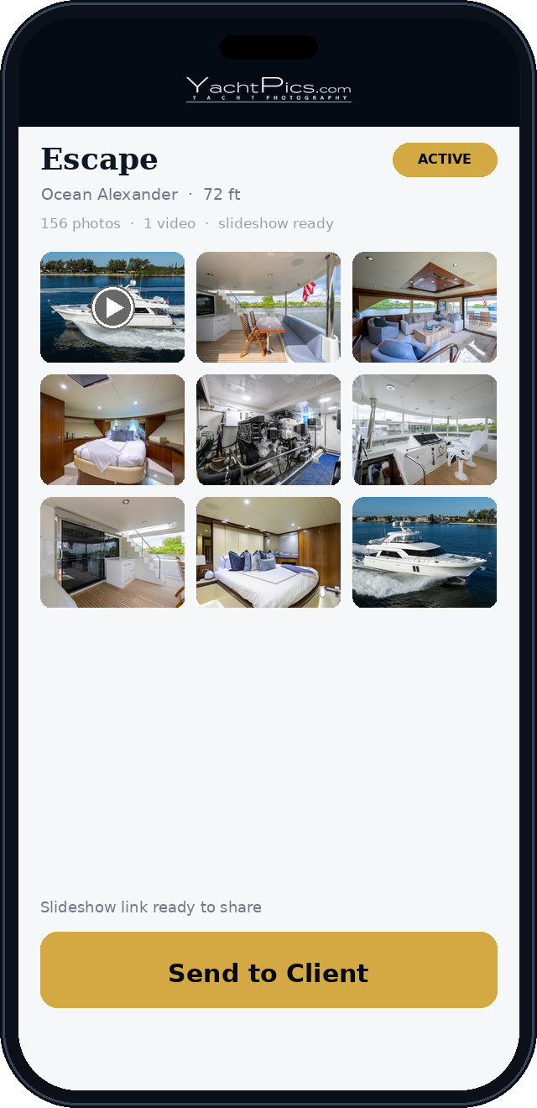
BUILT FOR BROKERS ON THE MOVE
From the dock,
not the desk.
Installs on your phone like an app - full-screen, one tap from your home screen.
Upload photos and video right at the boat - no laptop, no waiting.
Send a buyer a branded slideshow before you leave the dock.

Slide 6
THE DIFFERENCE
No shoot required.
Most listing tools are just galleries. YachtPics Portal is a tool - built by yacht photographers, for yacht brokers. Upload your own media from anywhere and present any listing beautifully, whether or not we shot it.

Slide 7
HOW IT WORKS
Three steps to a buyer-ready listing.
1
2
3
Create a listing
Add your media
Share the link
Add the vessel details.
Upload photos, video & documents.
Send a branded slideshow in two taps.

Slide 8
PRICING
Free to view. A plan to do more.
Viewing and downloading photos is always free. A paid plan unlocks uploading your own photos, video, and the slideshow builder.
Starter
Growth
Pro
Elite
1-5 listings
6-10 listings
11-20 listings
21+ listings
$29 /mo
$49 /mo
$79 /mo
$99 /mo
30-day free trial - no credit card - cancel anytime.

Slide 9
Get your next listing buyer-ready in seconds.
Start free at portal.yachtpics.com
30-day free trial - no credit card - cancel anytime.

