Slide 1


Senior Design Presentation

Slide 2


Team PBJ
Parth Patel – Patel5p3@mail.uc.edu
Brendan Pollak – Pollakbn@mail.uc.edu
Jacob Kennedy – Kenne2jb@mail.uc.edu
Andrew Putnam –
andrewgputnam@gmail.com

Slide 3
Purpose/Goals
Build a website to help travelers plan a trip
Help users plan their trips by offering a wide range of information, including hotel and restaurant reviews, travel guides, and forums where travelers can ask questions and seek advice.
Our platform encourages transparency in the travel industry by enabling travelers to share their honest opinions and experiences. This helps hold businesses accountable for the quality of their services.
Content and recommendations inspire travelers to explore new destinations, try different experiences, and discover hidden gems they may not have known about otherwise. It encourages a spirit of exploration and adventure.

Slide 4
Project Abstract
Our senior design project, which is motivated by our love of travel and built on a solid technical foundation, aims to develop a dynamic, user-centric travel platform similar to Tripadvisor. We're lined up to offer a loaded with features website by utilizing our skills in web development and cybersecurity. User profiles, location-based search, and effective data management are important components. We're dedicated to building a website that is both technically sound and adored by users through a thorough project plan, user testing, and continual improvement. Our goal is to provide accurate information and a seamless experience to tourists. We are inspired by our love of technology and wanderlust to create the ideal fusion of academic knowledge and practical insights.

Slide 5
User Stories
As a user, I want to find the best-rated hotels in a specific city so that I can plan a memorable trip
As a business traveler, I want to quickly locate hotels with convenient access to transportation hubs and essential amenities, so I can efficiently manage my work trips and stay productive.
As a restaurant enthusiast, I want to discover hidden gem eateries and read authentic reviews from fellow foodies, so I can savor unique culinary experiences and support local businesses.
As a user, I want to visit all the famous attractions at my destination so I can make the most of my trip and create lasting memories
As a user, I want to find the cheapest hotels at the destination so I can save money in my trip.

Slide 6
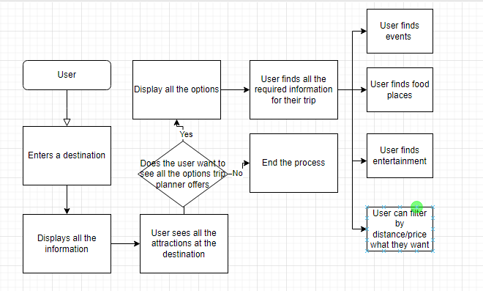
Design Diagram

Slide 7
Project Constraints
Security Constraint: This constraint emphasizes the importance of implementing robust security measures. It includes protecting user-generated content and sensitive data, addressing threats such as viruses and eavesdropping, implementing encryption protocols (e.g., HTTPS), and ensuring compliance with data protection regulations.
Social Constraint: The social constraint highlights the potential societal benefits of the project. It aims to simplify travel planning and decision-making for users. It also emphasizes the potential to support local businesses through user reviews and recommendations, contributing to the economic well-being of local communities. There's also a mention of adopting a non-profit or community-oriented approach.
Ethical Constraint: Ethical considerations play a significant role in the project. The constraint involves maintaining an ethical community by establishing mechanisms to address unethical or fraudulent content, particularly in user-generated reviews. The project acknowledges its moral influence over travel choices and business reputations.

Slide 8
Current State
We have Researched front-end technologies for building a responsive website
Completed the Research for existing travel recommendation platforms to identify gaps and opportunities
Started to pick out the tools needed for the project.

Slide 9
Expected Accomplishments
Get all of the research done and document our findings
Explore UI possibilities
Start looking into the security aspect of the project

Slide 10
Division of Work
Jacob is responsible to Design a backend infrastructure to host all relevant components and Develop relevant infrastructure as code (IaC) scripts
Parth is responsible to Implement user registration and login functionality. Implement the review submission and display functionality for hotels and restaurants.
Brendan is responsible for Designing the user interface for user registration and profile creation along with Designing UI for main features such as search functionality and webpage display

Slide 11
Demo
Our demo will consist of our user interface that will be pulled up on a laptop that the people at the demo can use in real time.

