Slide 1
ORM - JPA - Hibernate
Yacov yitzhak 26/10/2024

Slide 2
ORM - Object Relation Mapping
Objects vs Relations
JPA - Jakarta Persist API
Hibernate - implementation
Mapping - Annotations or XML’s
Advantages - Less Code, Fast Development, OOP, Consistency, Decoupling from vendor
Disadvantages - Learning curve, hard to debug, Performance , specific vendor features
Still it’s a powerful platform for the most time ,when needed consider JDBC Solution.

Slide 3
From Object To Tables and vice versa
Problems
The Granularity problem - how to map embeddable object into table
Mismatch between the number of classes in the object model and the number of tables in the relational model
Inheritance - how to map inherited classes to tables, how if db has no inheritance?
Identity - How to map references (instance identifiers) to rows keys?
Association - how to map object relations to tables relations

Slide 4
The Granularity Problem
public class User {
private Long id;
private String name;
private Address address;
}
create table Users (
id bigint not null,
city varchar(255),
country varchar(255),
name varchar(255),
street varchar(255),
zipCode varchar(255),
primary key (id)
)
public class Address {
private String street;
private String city;
private String country;
private String zipCode;
}

Slide 5
The Granularity Solution
@Entity
public class Users {
@Id
private Long id;
private String name;
@Embedded
private Address address;
}
@Embeddable
public class Address {
private String street;
private String city;
private String country;
private String zipCode;
}

Slide 6
The Inheritance Problem
4 Strategies:
MappedSuperclass – the parent classes, can’t be entities
Single Table – The entities from different classes with a common ancestor are placed in a single table.
Joined Table – Each class has its table, and querying a subclass entity requires joining the tables.
Table per Class – All the properties of a class are in its table, so no join is required.

Slide 7
Entity
What is entity
An entity is a lightweight persistent domain object
Must be top level class (not nested …)
Must have No-args constructor
Entities can’t be
Enum
Interface

Slide 8
Configuration by exception
JPA provider use defaults rules unless specified else
Entity Name => Table Name
Fields names (Attributes) => Column name
Java primitives
String => VARCHAR(255)
Long => BIGINT
…

Slide 9
@Table and @Column
@Entity
@Table(name = "Students", schema = "dbo", catalog = "demo")
public class Student {
@Id
@GeneratedValue(strategy = GenerationType.AUTO/IDENTITY/SEQUENCE/TABLE)
private Long id;
@Column(name = "first_name", nullable = false, length = 50, unique = true)
private String firstName;
private String lastName;
private String nationality;
private LocalDate birthDate;
@Transient
private Integer age;
private Language language;
}

Slide 10
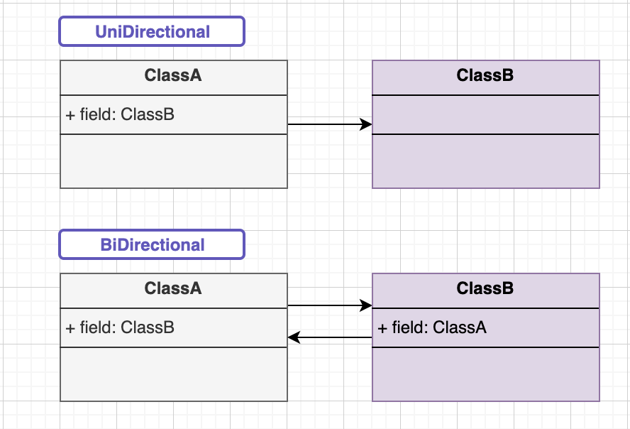
Entity Relationships
Unidirectional
Bidirectional

Slide 11
Database Relations
Table
PrimaryKey
Join Column
Join Table

Slide 12
JPA To Database
Mapping & Fetching
JPA Annotation | Database
@OneToOne | Join Column Eager
@ManyToOne | Join Column Eager
@OneToMany | Join Table Lazy
@ManyToMany | Join Table Lazy

Slide 13
Eager VS Lazy
 | Memory | Query
Eager | All data in memory | Less queries
Lazy | Some data In Memory | Multiple queries

Slide 14
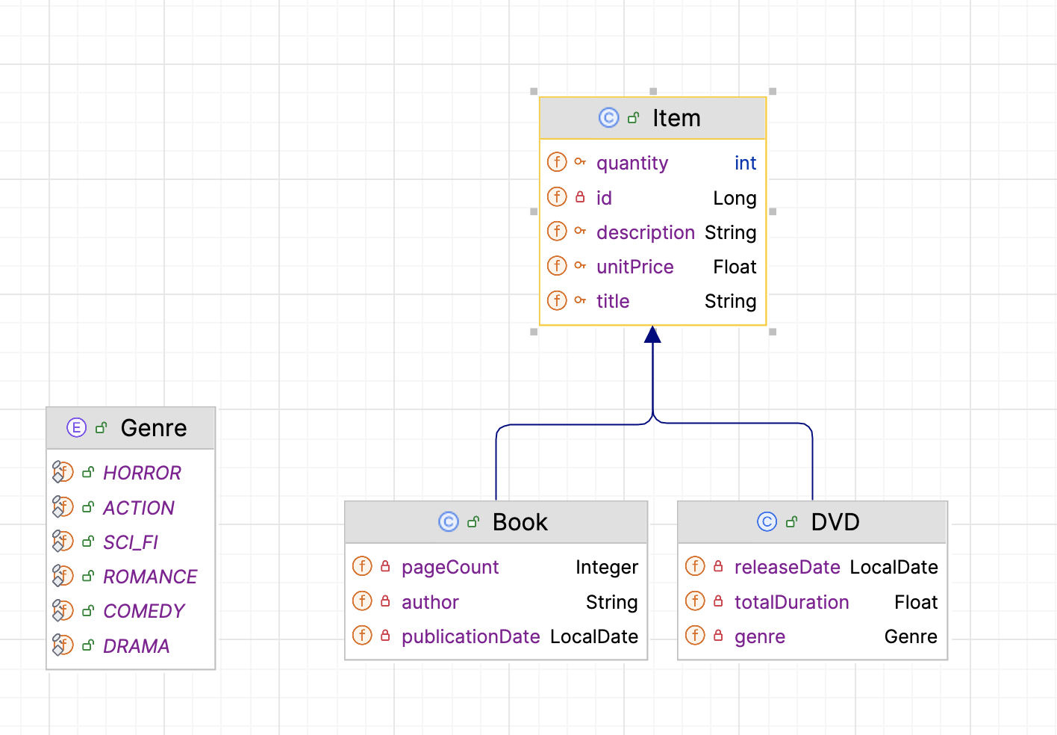
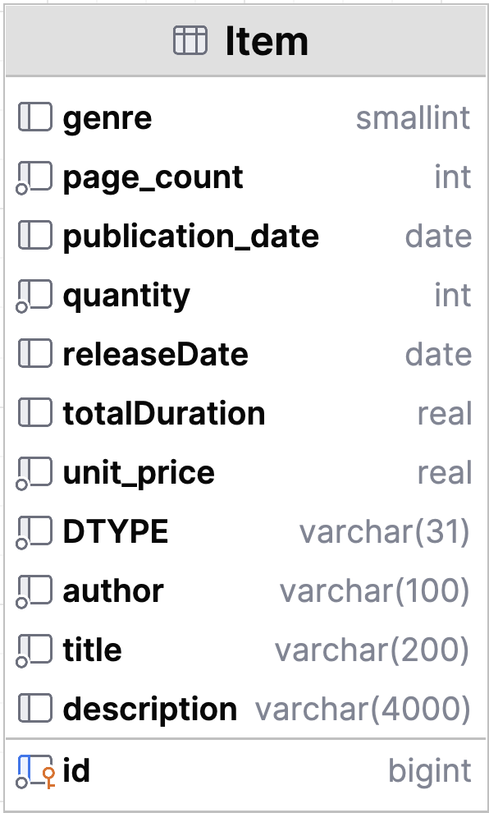
Inheritance
Single Table Strategy

Slide 15
@Inheritance
@Entity
@Inheritance(strategy = InheritanceType.SINGLE_TABLE)
@DiscriminatorColumn(name = "item_type", discriminatorType =)
@DiscriminatorValue("ITEM")
public class Item {
@Id
@GeneratedValue
private Long id;
@Column(length = 200, nullable = false)
protected String title;
@Column(length = 4000, nullable = true)
protected String description;
@Column(nullable = false)
protected int quantity;
@Column(name = "unit_price", nullable = false)
protected Float unitPrice;
}

Slide 16
Extends classes
@Entity
@DiscriminatorValue("BOOK")
public class Book extends Item {
@Column(name = "page_count")
private Integer pageCount;
@Column(name = "author", length = 100)
private String author;
@Column(name = "publication_date")
private LocalDate publicationDate;
}
@Entity
public class DVD extends Item {
@Column(name = “total_duration")
private Float totalDuration;
private Genre genre;
@Column(name = "release_date")
private LocalDate releaseDate;
}

Slide 17
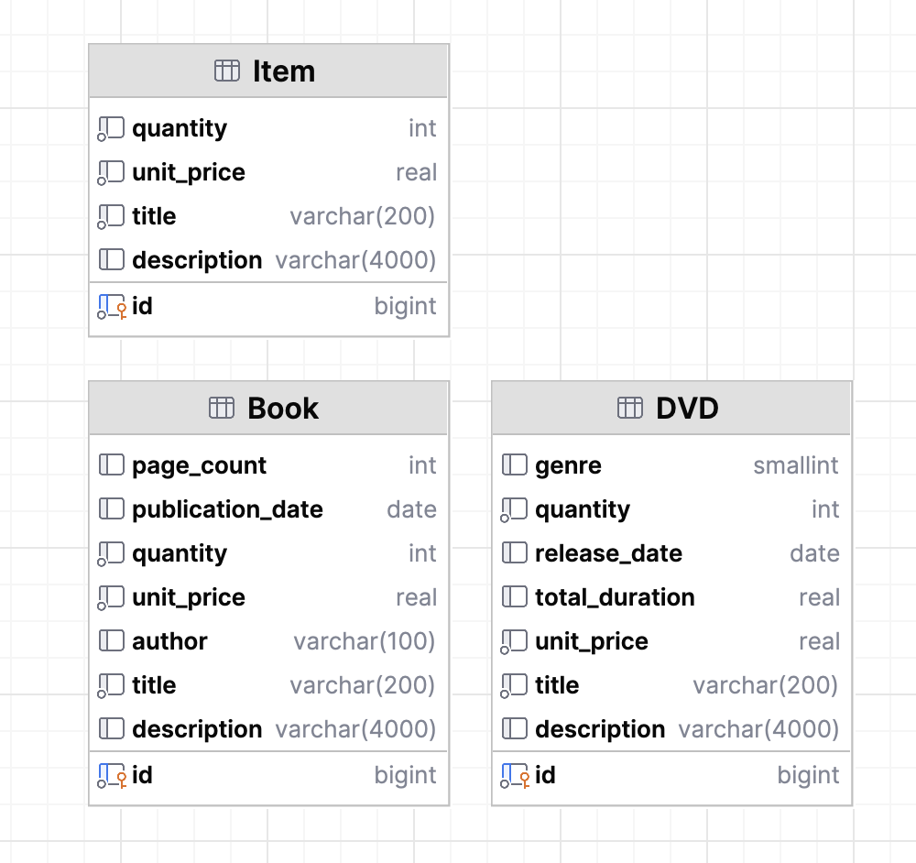
Inheritance
Table Per Class Strategy

Slide 18
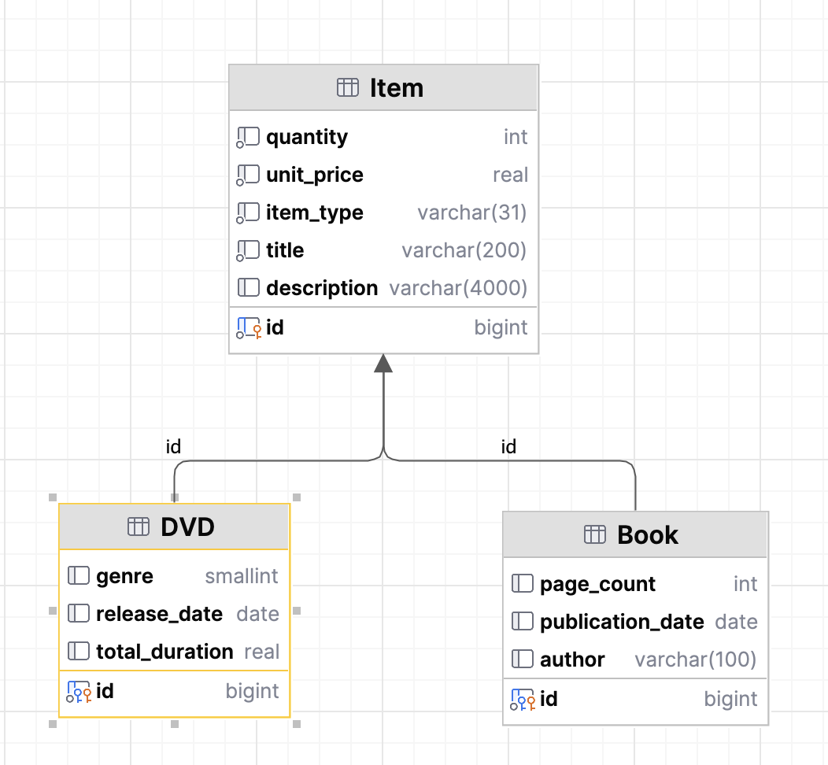
Inheritance
Joined Table

Slide 19
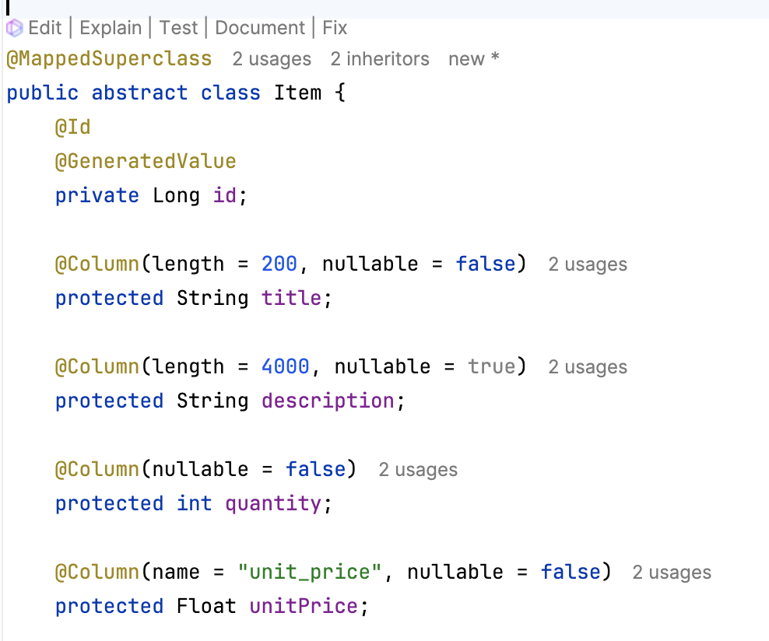
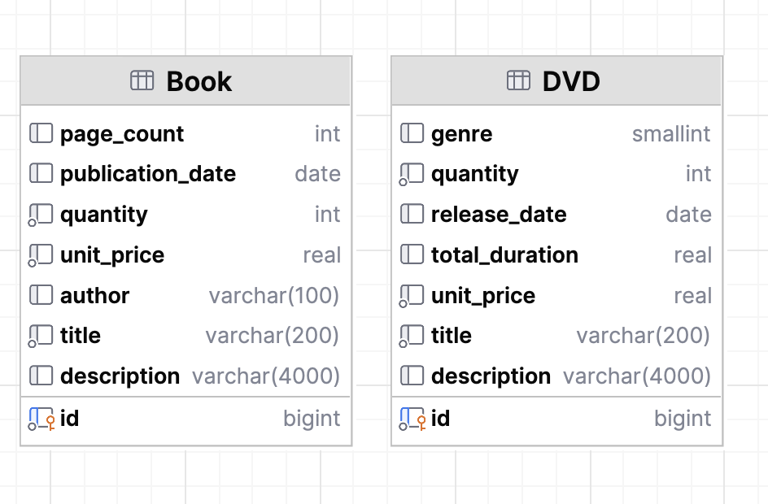
Inheritance from Transient class
Transient - Not an entity class

Slide 20
Composite (Primary) Key
Class Type Annotation
@IdClacc
@EmbeddedId
Must do
The composite primary key class must be public.
It must have a no-arg constructor.
It must define the equals() and hashCode() methods.
It must be Serializable.

Slide 21
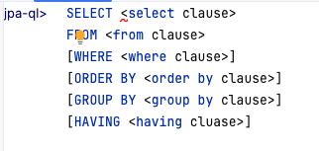
JPQL Syntax
Java Persist Query Language

Slide 22
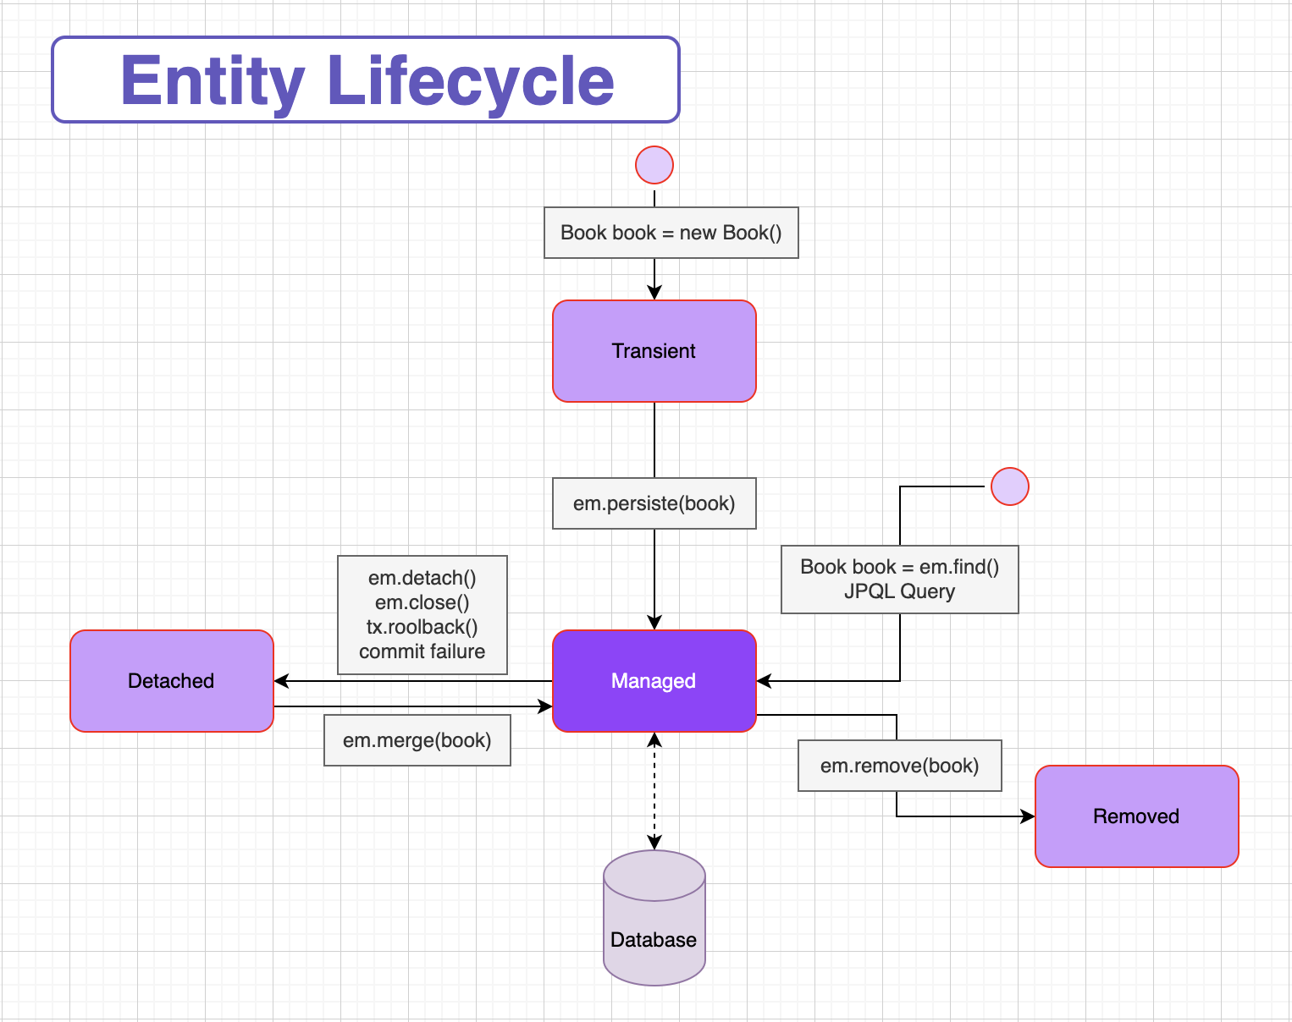
Entity Lifecycle

