Slide 1
JMM
|
V
CPU MM

Slide 2
LOAD and STORE Operations
a.k.a
READ and WRITE Memory Operations

Slide 3
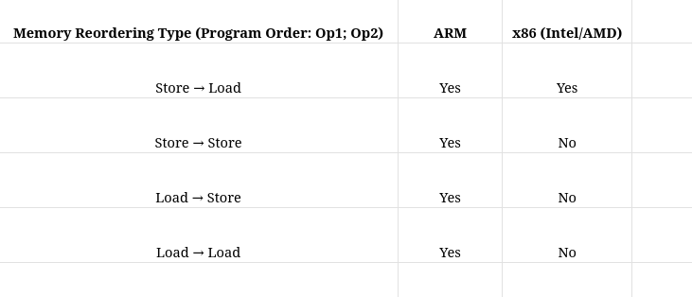

Slide 5
Memory Reordering Type | ARM | x86
Store → Load | DMB ISH | MFENCE or LOCK
Store → Store | DMB ISHST
Load → Store | DMB ISH
Load → Load | DMB ISHLD

Slide 6
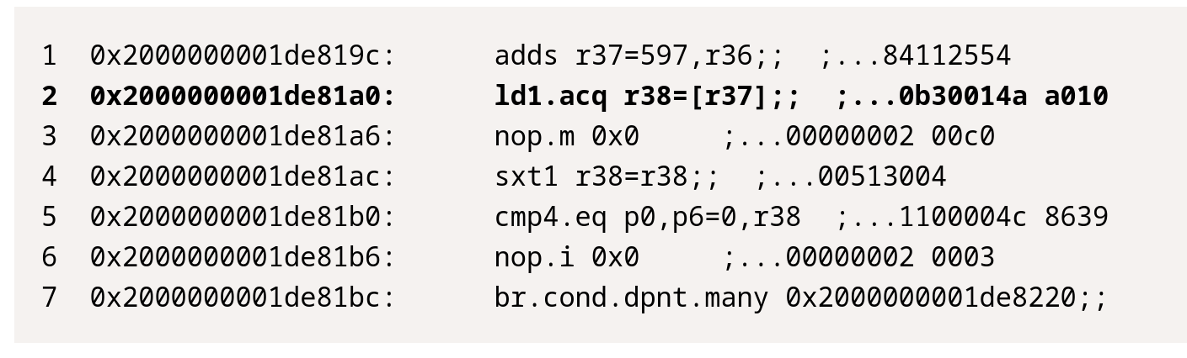
Volatile LOAD Operation – JVM Instructions

Slide 7
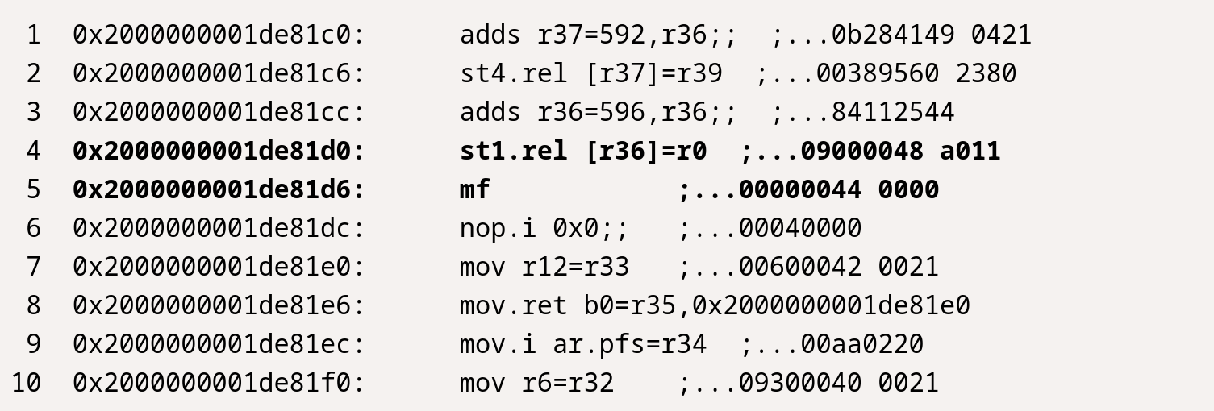
Volatile Store Operation – JVM Instructions

Slide 8
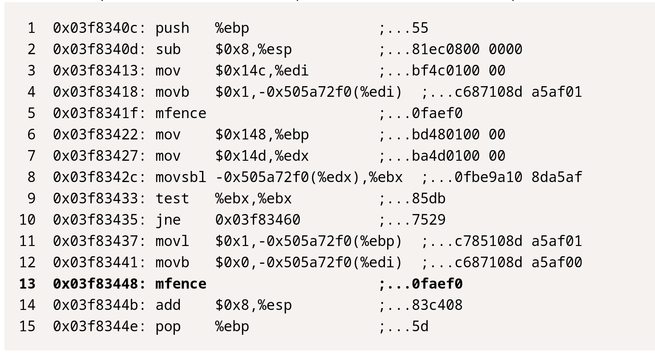
Volatile Store Operation – x86 Instructions

Slide 9
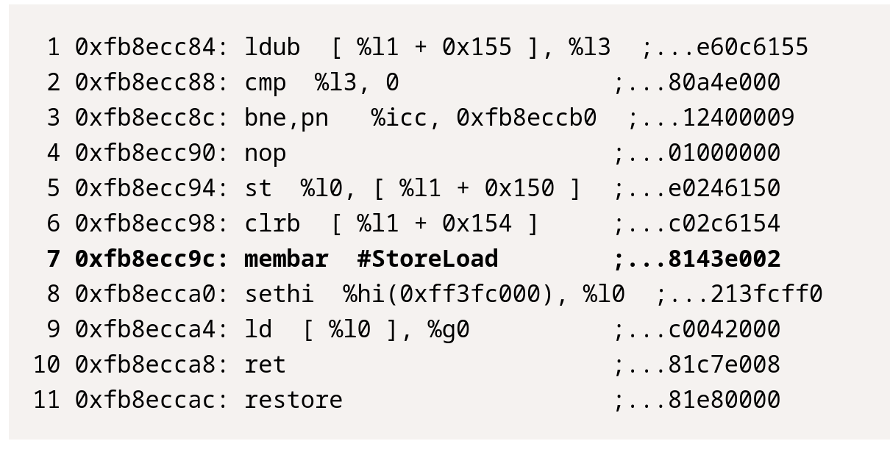
Volatile Store Operation – SPARC Instructions

