Slide 1




ATM
Technology :core java
Domain name : ATM

Slide 2
ABSTRACT
The ATM System is the project which is used with bank account.
Cash withdrawn, they can enter their pin number once their withdrawn as successful.
Also customer must be able to make a balances inquiry.

Slide 3

FUNCTION OF ATM
24 –hours access to cash.
Transfer funds between account.
Pay your utility bills
Deposit cash

Slide 4
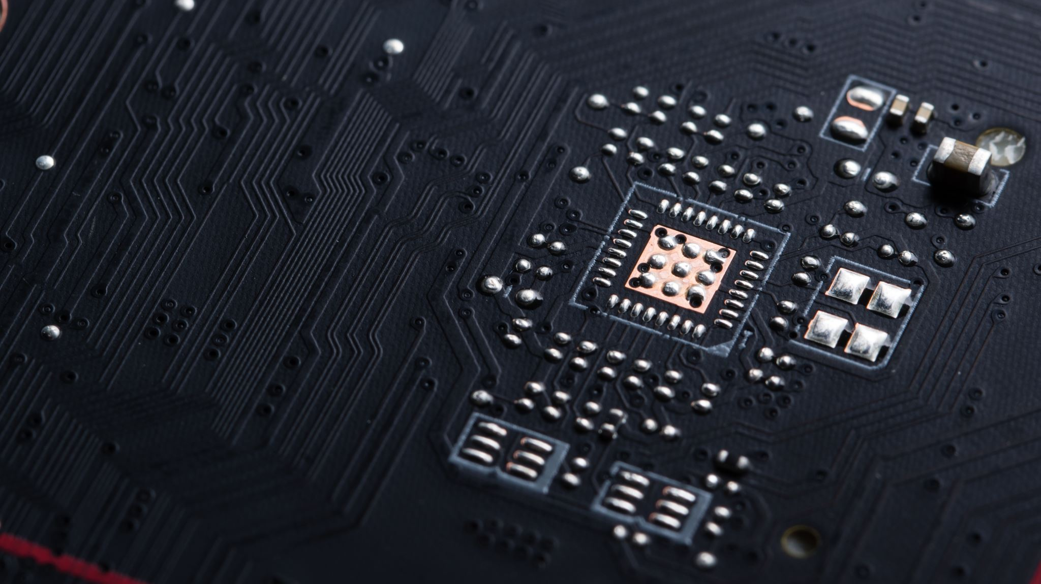
STRUCTURE OF ATM
Card reader
Keypad
Speaker
Display
Cash dispenser

Slide 5

SECURITY
Don’t write down your PIN.
Make your series of letter or number that you can easily remember, but that cannot easily be associated with you personality.
Avoid using birth dates initials, house number or your phone number.

Slide 6
CONCLUSION
As the banking sector computerize day to day ,and ATM have became a part of modern banking system .The growth of ATM rapidly high at the world wide level also in India.

Slide 7


