Slide 1

Project: Online Shopping Cart
Group members:
2510030316-Avusula Rajeshwari
2510040091-Guthi Vaishnavi
2510030397-RangaReddy Jashwitha
Guided By : Dr. Mahesh Babu sir

Slide 2
Introduction
The Online Shopping System is a real-time application
used to manage products, customers, orders
and deliveries status.
This project demonstrates how data structures and
algorithms help in building scalable systems.

Slide 3
Features
• Manage product details efficiently.
• Add and remove items from cart
• Process customer orders
• Handle delivery status
• Provide fast product search
• Sort products based on price.

Slide 4
Working of System
1. User selects products from the system
2. Products are added to the shopping cart
3. User can modify or remove items
4. Delivery status handled

Slide 5
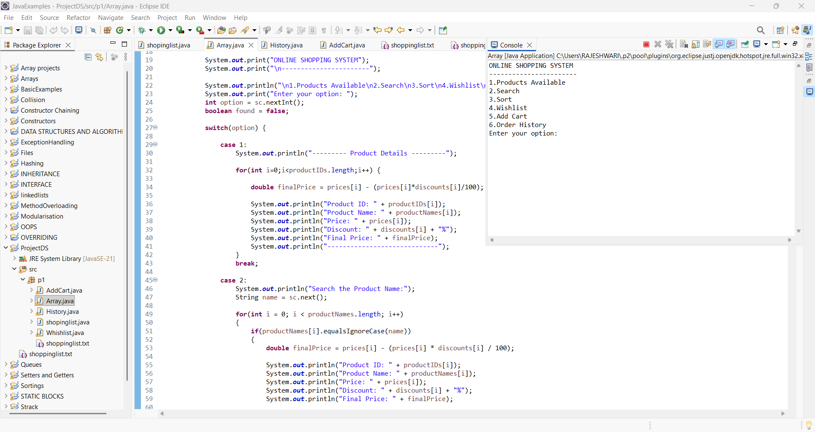
Arrays
Arrays are used to display the items in the cart.
And also created search and sorting operations.

Slide 6
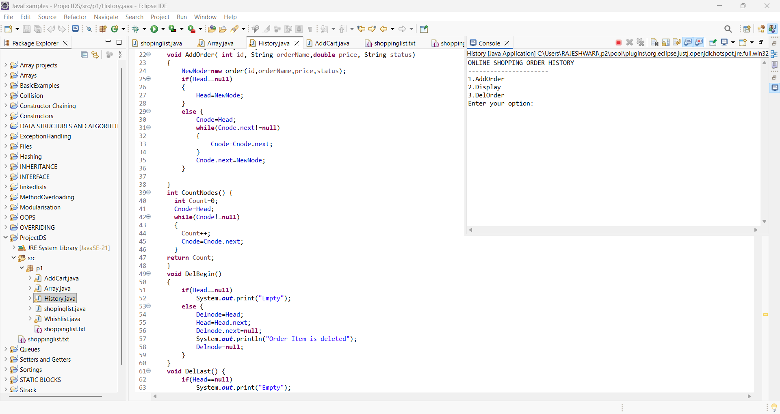
Linked list
Linked list is used to create the order history.

Slide 7
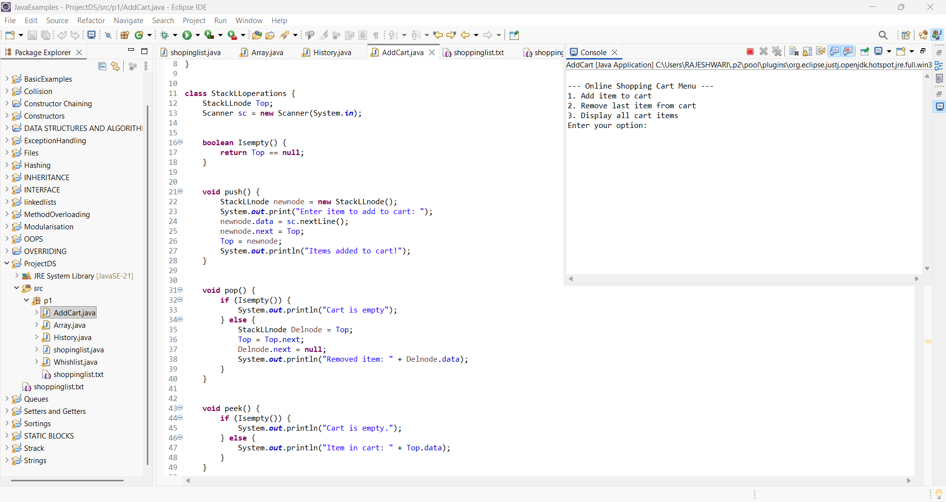
Stacks
Stacks are used to create the Add Cart.

Slide 8
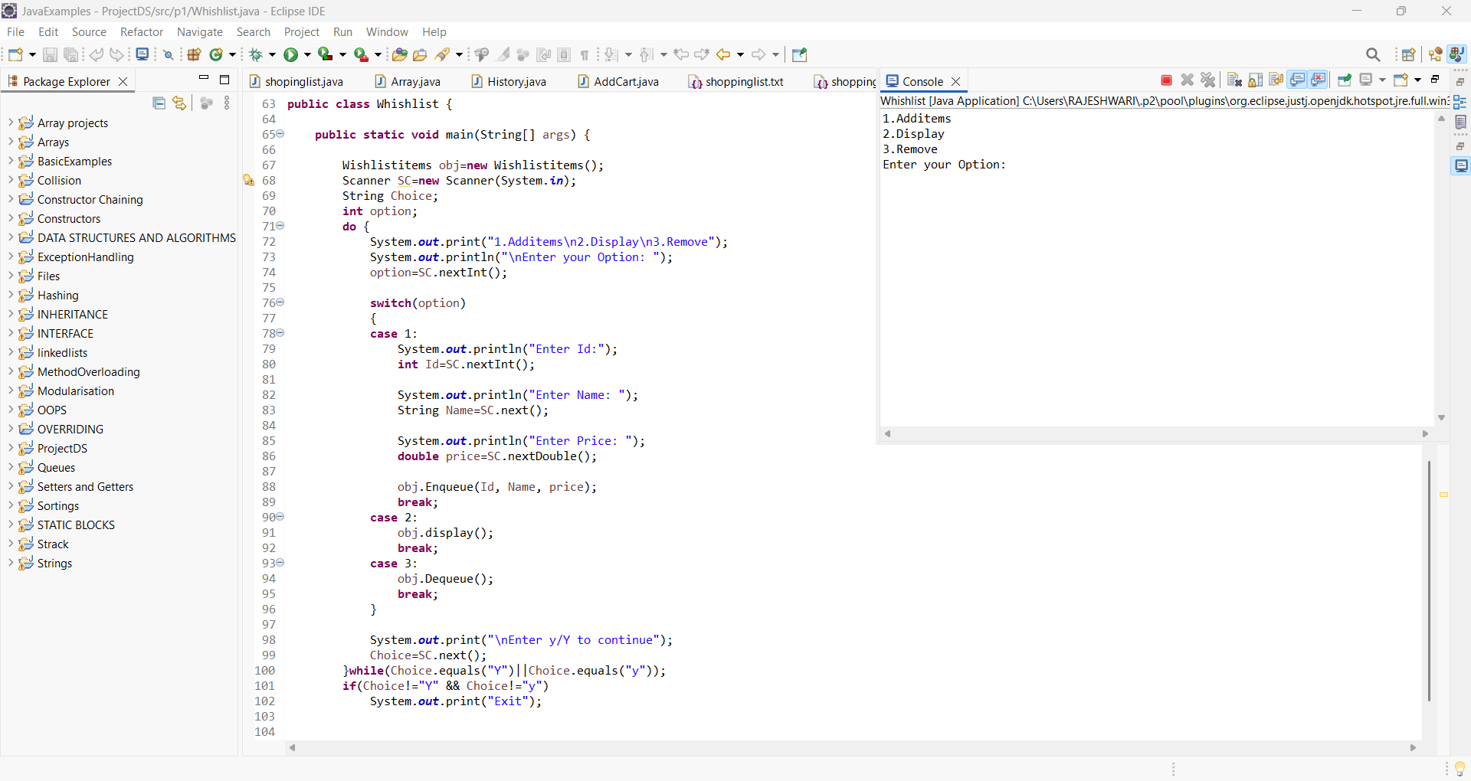
Queues
Queues are used to create the Wishlist.

Slide 9
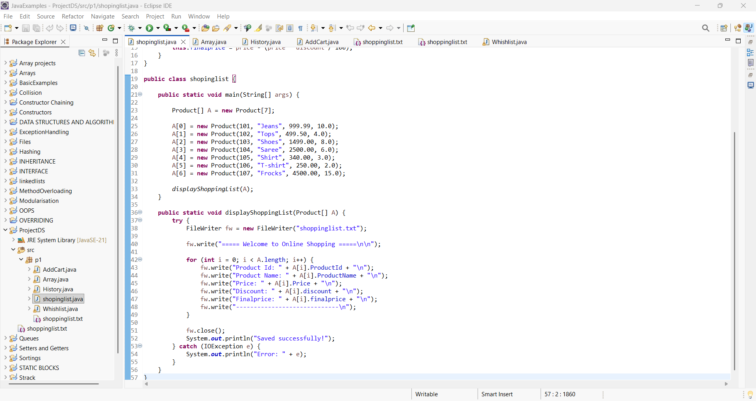
File Writer

Slide 10
Conclusion
This project demonstrates the use of data structures like arrays, linked lists, stacks, and queues along with searching and sorting algorithms to build an efficient online shopping system. It improves performance, data management, and user experience, reflecting real-world e-commerce applications.

