Slide 1



HereWeGoAgain
Data Analytics in Agent-BasedModeling for Crop Health Risk
6610195 - Banyar Htet Naung
6610300 - Win Thiri
6610311 - Yadanar Aung
6610321 - Soe Soe San
6610399 - Hsu Lae Than Tun
ICT358 - Data Science

Slide 2
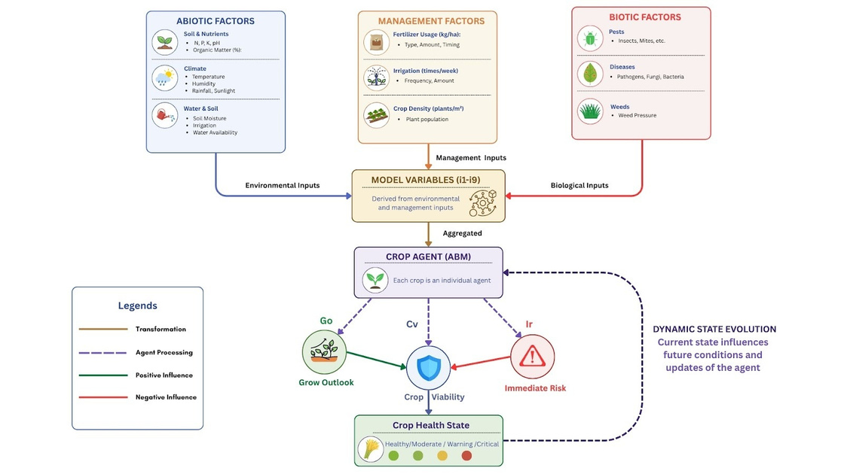
Introduction
Crop health depends on environmental factors
soil, water, weather
Traditional methods are static
This project uses Agent-Based Modeling (ABM)
Focus on dynamic crop-environment interaction

Slide 3
Objective
Theory
Each crop = an agent
Angent interacts with environment
soil, weather, water
Outputs: Growth Outlook (Go), Immediate Risk (Ir), Crop Viability (Cv)
Dynamic system over time
Analyze crop–environment interaction
Identify crop health patterns
Predict crop health
Support decision-making

Slide 4

Key Formula
Cv = Growth Outlook Go × (1 − Ir)
High Go + Low Ir → Healthy
Low Go + High Ir → Critical
Go (Growth Outlook) → positive condition
Ir (Immediate Risk) → stress
Cv (Crop Viability) → overall health

Slide 5
Dataset
Dataset: Smart Farming Dataset 2024
Variables: soil, weather, water, pests
Process:
Preprocessing & normalization
Feature engineering (THI, VPD, GDD)

Slide 6
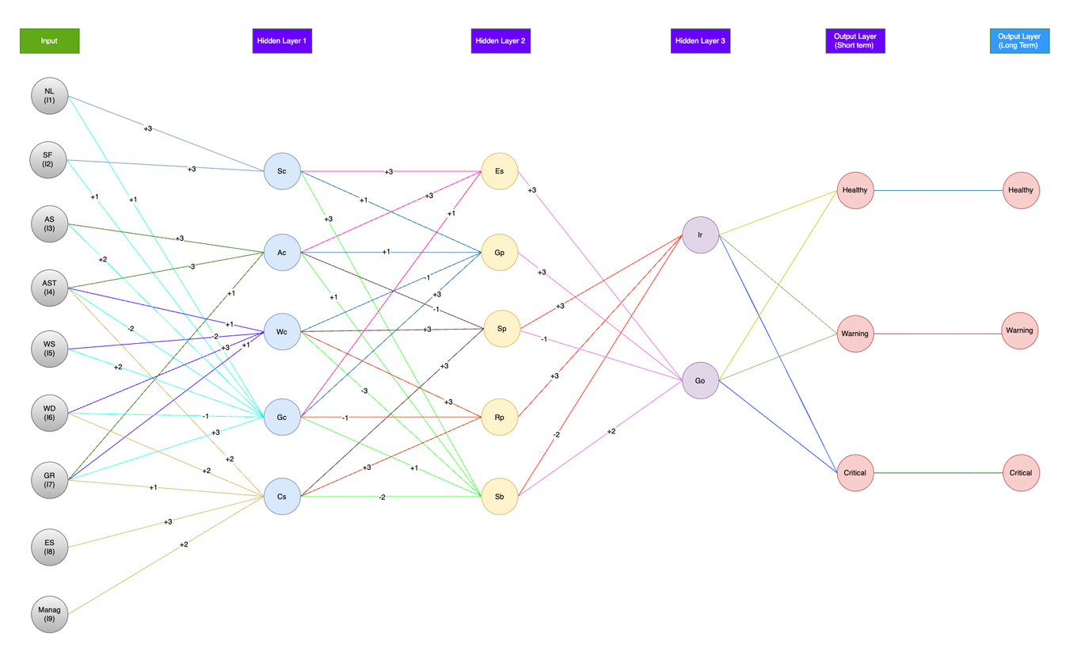
Model Structure
Environmental inputs are transformed into variables(i1 - i9) eg.
i1 → nutrient level
i2 → soil fertility
i3 → atmospheric support
i6 → water deficit
i8 → environmental stress
Model Flow:
Input → Condition → Behavior → Decision → Output

Slide 7
Model Structure
Hidden Layer 1 (Condition)
Sc, Ac, Wc, Gc, Cs
Hidden Layer 2 (Behavior)
Es, Gp, Sp, Rp, Sb
Hidden Layer 3 (Decision)
Go (growth), Ir (risk)
Output:
👉 Cv = Go × (1 − Ir)

Slide 8
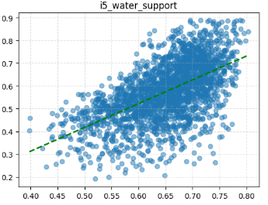
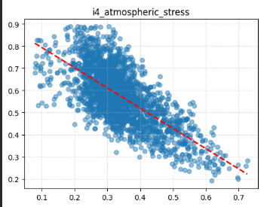
Results(Key Findings)
Positive factors:
water support, nutrients
Negative factors:
atmospheric stress, water deficit

Slide 9
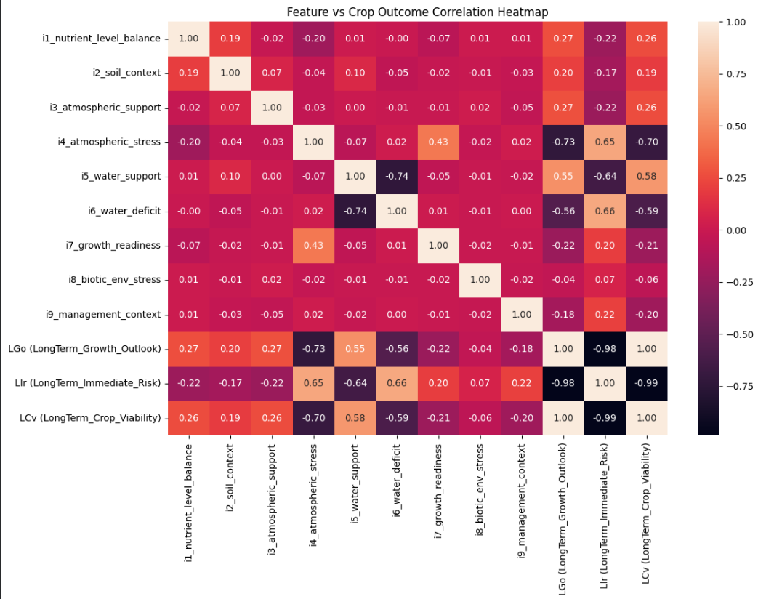
Correlation Heatmap
Shows relationship between variables
Water support → positive effect
Stress & water deficit → negative effect
Go ↑ → Cv ↑
Ir ↑ → Cv ↓

Slide 10
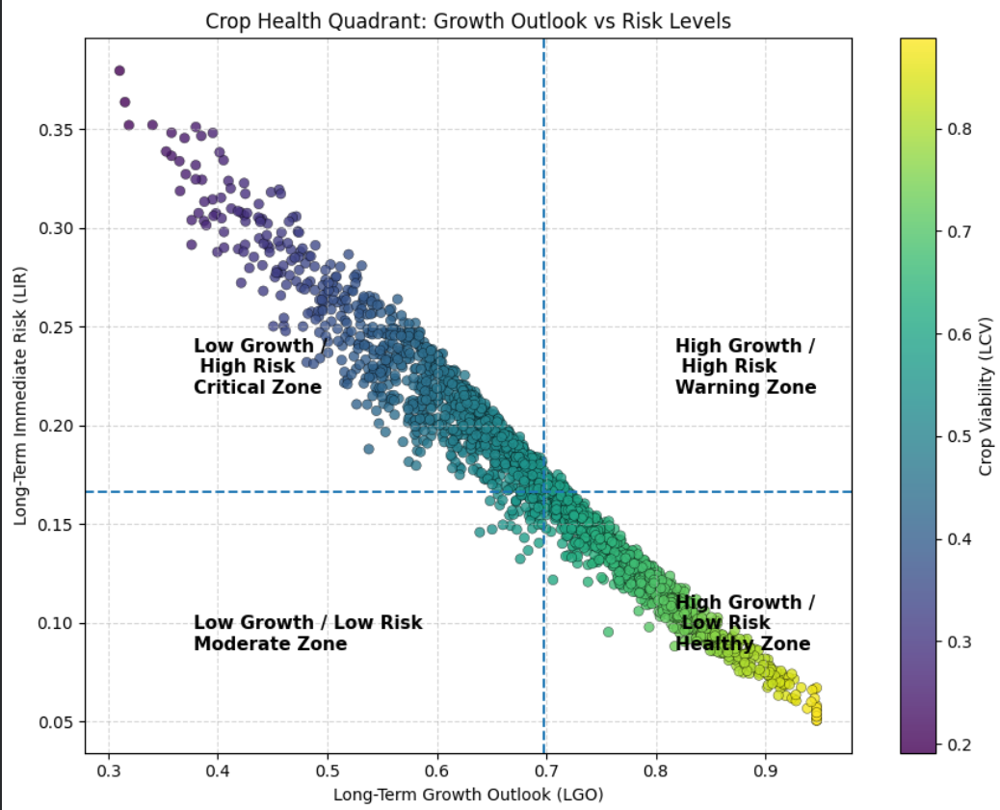
Decision Zones
High Growth + Low Risk → Healthy
High Growth + High Risk → Warning
Low Growth + Low Risk → Moderate
Low Growth + High Risk → Critical

Slide 11
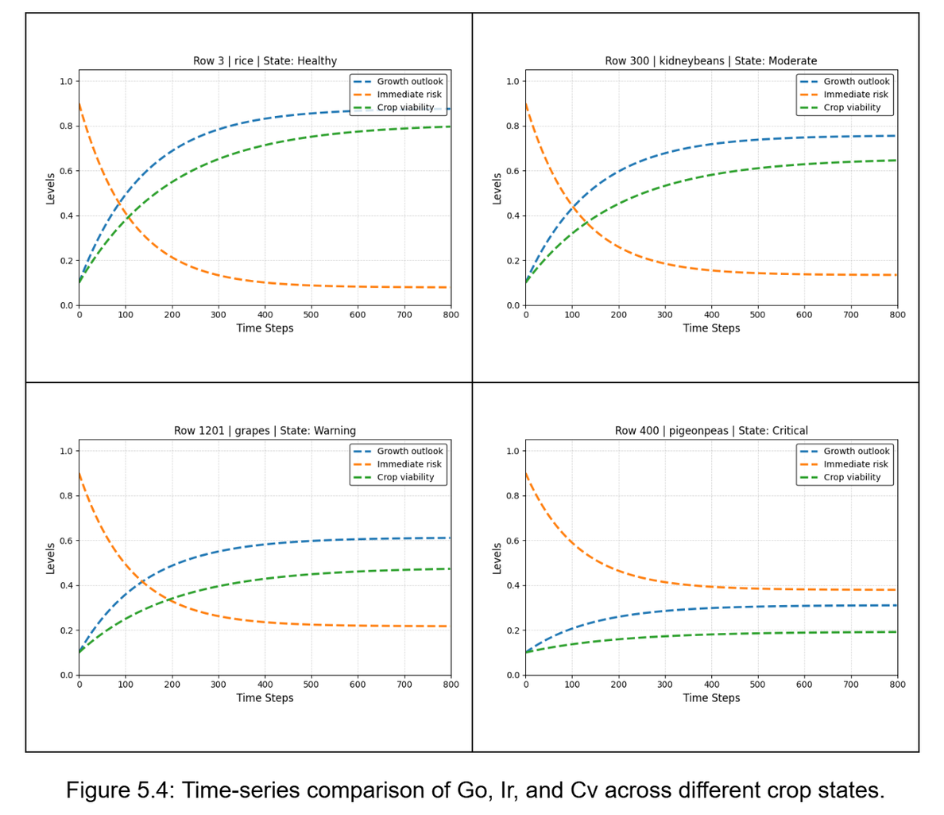
Decision Zones
Shows change over time
Healthy → growth increases, risk decreases
Critical → low growth, high risk
System becomes stable

Slide 12
Conclusion
ABM models complex agricultural systems
Provides predictive insights
Supports smart farming decisions

