Slide 1
.
echarts layer
zrender layer
Canvas (in browser)
Canvas (in nodejs)
VML
SVG

Slide 2
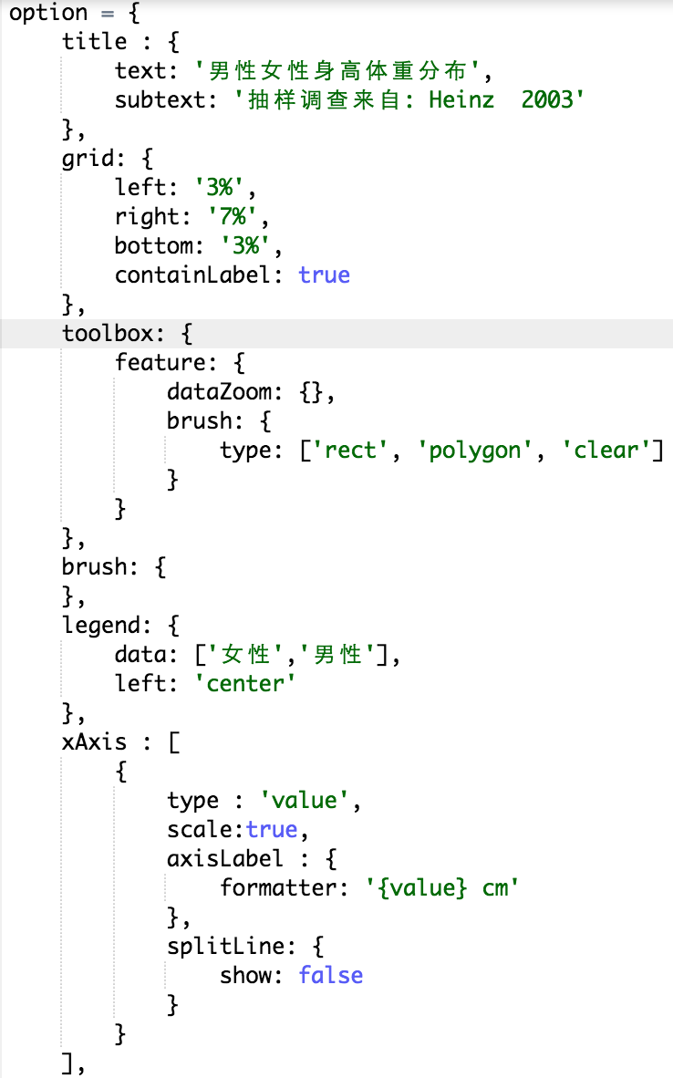
.
option
echarts
Process
&
Render
Input
Dispatch event and then
user updates option
Handle user interaction
and update view

Slide 3
.
- option management
(init/merge/restore/…)
- Message Center
- API
- render charts
- render components
- view state maintenance
line
echarts main
bar
option
scatter
pie
map
…
grid (cartesian)
axis
legend
call render
dataZoom
…
dispatch event

Slide 4
.
option = {
color: [ ... ],
xAxis: {},
yAxis: {},
series: {
itemStyle: {
...
},
data: [
{
value: 15.29,
itemStyle: {
...
}
},
{
value: 34.44
},
...
]
}
}
ecModel
find config from parent
seriesModel
find config from parent
dataItemModel
find config from model
var color = data
.getItemModel(dataIndex)
.get('itemStyle.normal.color')

Slide 5
processing order
.
xAxis
yAxis
radiuAxis
angleAxis
…
grid
(cartesian)
polar
…
line
Bar
scatter
pie
…
legend
dataZoom
visualMap
…
axes
coord sys
series
others
depend on
depend on
depend on

Slide 6
.
update
legend selected
record
tooltip
message
center
legend
series
line
Bar
scatter
…
update
legend selected
record
dispatch event: 'legendselected'
…
listen to (and know) legend component

Slide 7
.
legend
data
…
series
line
bar
scatter
pie
…
dataZoom
visualMap
process
tooltip
…
retrieve info

Slide 8
.
filter
map
update coord sys
visual encoding
layout
render
…
data / …

Slide 9
.
echarts
zrender
create models
process data
visual
render
input
output
layout
option
model
processor
shape
view
create shapes update shapes
set style
raw data
animation
data
visual encoding
color opacity
glyph size …
user interaction
create
update
 | dim0 | dim1 | dim2 | …
0
1
2
3
dispatch action
action handler
update models
coordinate
system
scale

Slide 10
.
scatter model
scatter
option
read visual config
create symbol
and
set style
output
visualMap component
scatter
view
shape
set visual for
each data item
(color / glyph / …)
get item visual
data

