Slide 1
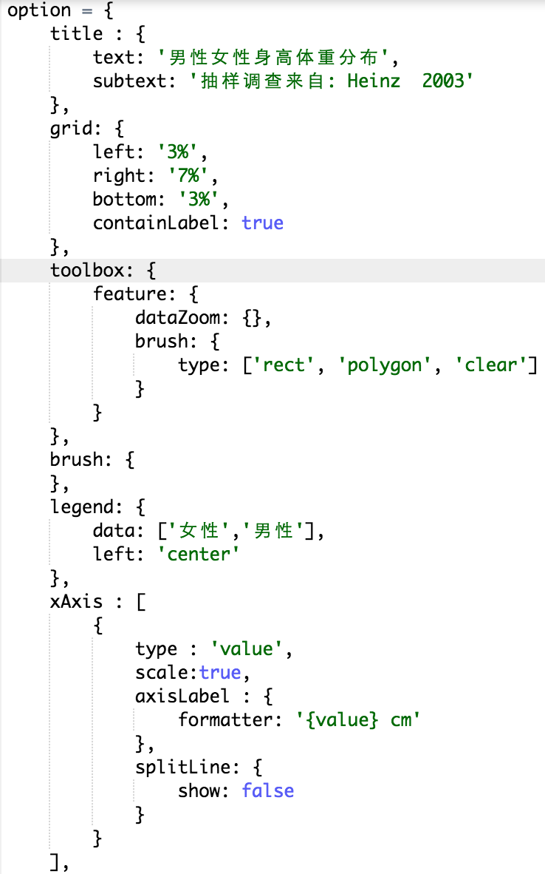
.
option
echarts
Process
&
Render
Input
Dispatch event and then
user updates option
Handle user interaction
and update view

Slide 2
.
renderItem
(custom series)
legend
dataZoom
visualMap
echarts
zrender
create models
process data
visual
render
input
output
layout
option
model
processor
shape
view
create shapes update shapes
set style
raw data
animation
data
visual encoding
color opacity
glyph size …
user interaction
create
update
 | dim0 | dim1 | dim2 | …
0
1
2
3
dispatch action
action handler
update models
coordinate
system
scale

