Slide 1
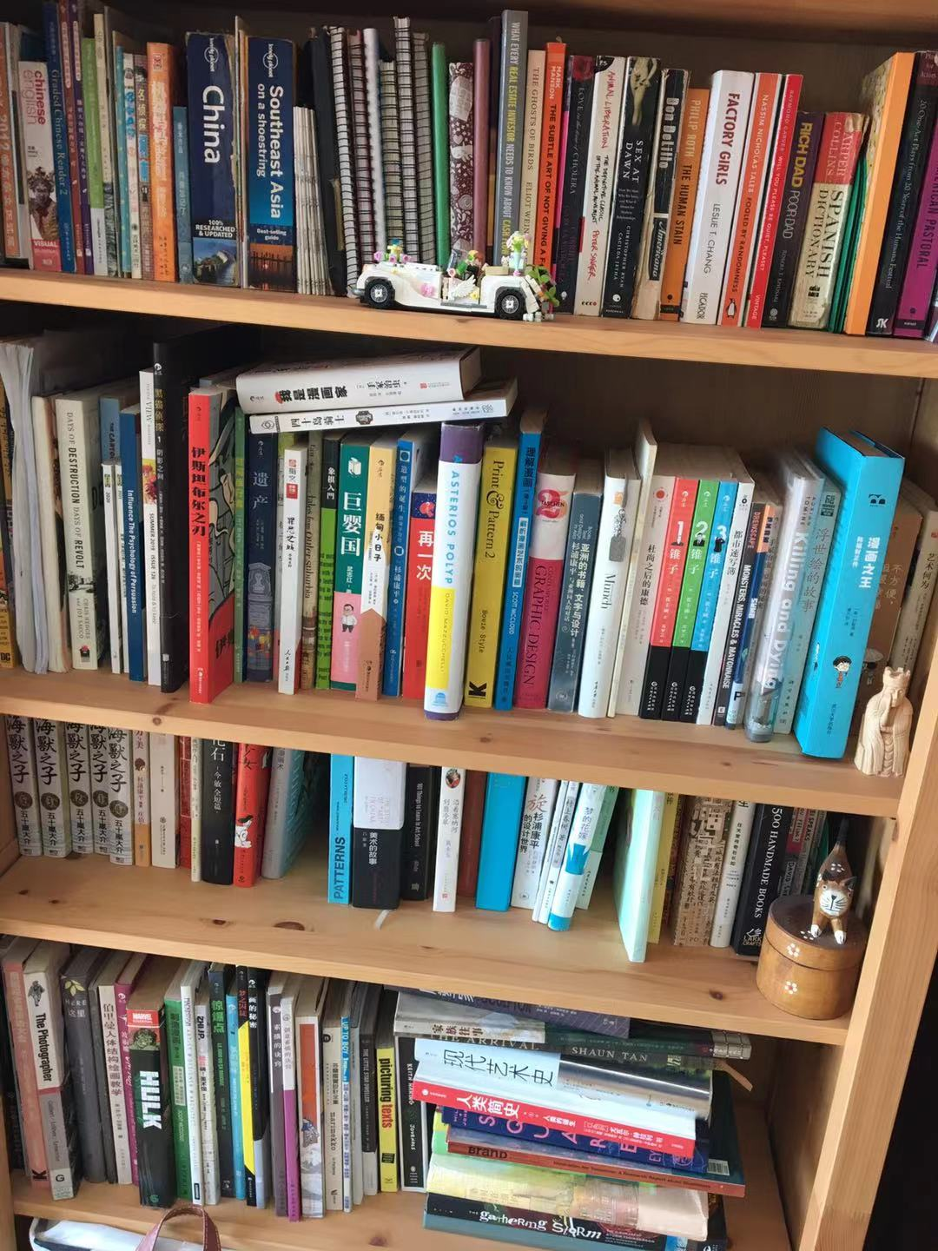
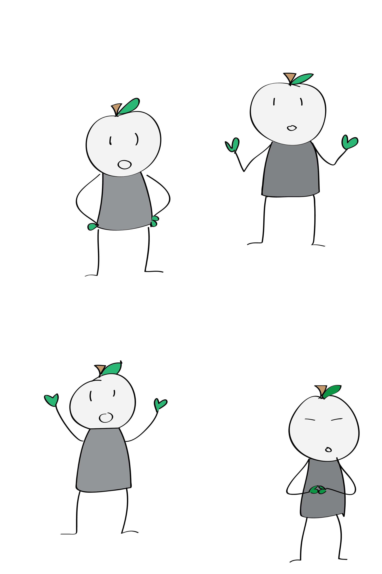
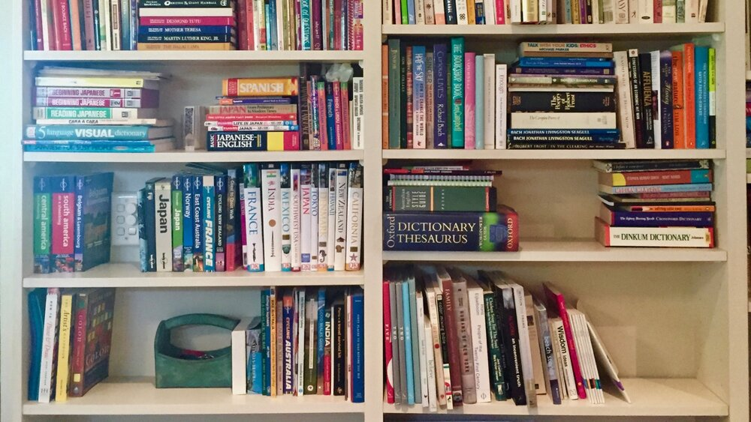
Books are not achieving their full potential!

Slide 2

Books should be in circulation!

Slide 3
Shu(书)Share* Every bookshelf is your library.
Users can borrow and lend.
User selects which books to lend out and chooses options
Borrower searches database for book and makes request
Lender receives request and user info
Lender can send the book by SF, drop off the book, or meet in person
*Name sucks on purpose - let’s think of something far better.

Slide 4
Why do this?
Achievable
Needed
Scalable

