Slide 1
Programming Notes

Slide 2
Ruby installation
https://rubyinstaller.org/
Installed 5/19/2021
Version: Ruby+Devkit 2.7.X (x64)
downloaded Sublime Text (IDE)
downloaded node
downloaded yarkpkg
downloaded gitbash (for Windows only) https://git-scm.com/downloads
*I selected “Use Git from command line and 3rd party software (recommended)
Codecademy.com username
array9767928053

Slide 3
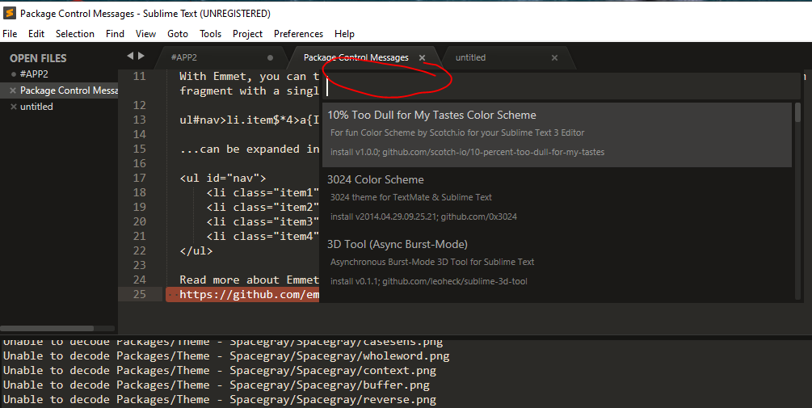
Sublime Text 3
Turn on syntax highlights
View -> Syntax -> Choose language (Ruby)
Install “Package Control”
Preferences -> Package Control
CTRL + SHIFT + P (Preferences)
Install Package: Emmet
Install Package: Sublime Linter
search here

