Slide 1











Table of Contents
Life
Quest

Slide 2
















Table of Contents
Notes:
https://www.freepik.com/free-ai-image/photorealistic-timber-house-interior-with-wooden-decor-furnishings_152371631.htm

Slide 3
Problem
Statement
Here are the problems that users have
16x
40%
17.5%
Unemployed individuals are more likely to commit suicide
increase in the likelihood of reporting loneliness when unemployed.
higher risk of unemployment is linked to experiencing loneliness earlier in life.

Slide 4
Problem
Statement
Here are the problems that users have
16x
40%
17.5%
Unemployed individuals are more likely to commit suicide
increase in the likelihood of reporting loneliness when unemployed.
higher risk of unemployment is linked to experiencing loneliness earlier in life.
Sources: National Library of Medicine, BMC Public Health, Researchhub

Slide 5



Our Mission
Connecting | Motivating | Empowering
the unemployed to find jobs through gamified real-world quest

Slide 6
Our Mission
Connecting | Motivating | Empowering
the unemployed to find jobs through gamified real-world quest

Slide 7
User Personna

Slide 8


User Persona
Alex Thompson
Recently Laid Off
Background/ Demographics
Age: 34 years
Location: Cincinnati, OH
Occupation: Ex- Project manager
Income: --
Interests
Challenges & Struggles:
Turning career recovery into a structured
personal growth and networking
Exploring how community and mentorship
Using skill-building and self-improvement as a path to career success.
Lost primary social circle after layoff.
Anxious about finances (mortgage & loans).
Feels like a failure despite company-related layoff.
Struggles to explain employment gap in interviews.
Motivation
Goals
Rebuild professional identity after unexpected job loss.
Connect with supportive professionals.
Stay skilled and relevant during job search.
Establish a routine to avoid aimlessness.
Land a marketing job within three months.
Expand professional network beyond one company.
Gain new digital marketing skills for employability.
Reclaim purpose and accomplishment from past role.
Solutions / Messages
Transform - Unlock leadership potential.
Empower - Drive personal growth.
Inspire - Motivate team success.
Achieve - Reach measurable goals.

Slide 9

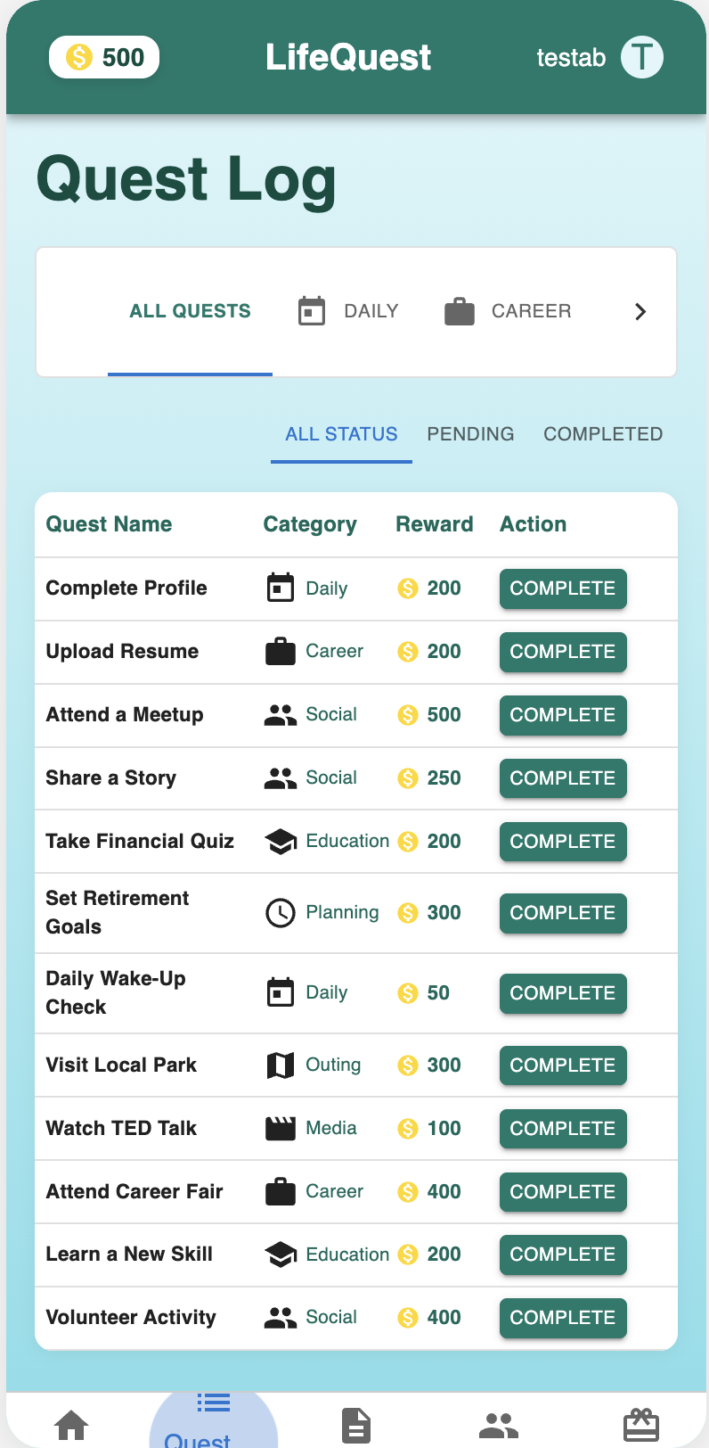
Solution
Life
Quest
Social Connection
Connects users to in-person and virtual events, helping them network beyond their previous job and reduce isolation.
Job Support
LifeQuest" is a mobile game that gamifies healthy behaviors to combat isolation and foster social connections.
Offers in-built resume support and proven healthy behaviors to combat loneliness while preparing users for job re-entry.
Rewards & Engagement
Click Here
Awards points for completing tasks, which can be redeemed for real-life rewards, keeping users motivated.

Slide 10
Solution
Life
Quest
Social Connection
Connects users to in-person and virtual events, helping them network beyond their previous job and reduce isolation.
Job Support
LifeQuest" is a mobile game that gamifies healthy behaviors to combat isolation and foster social connections.
Offers in-built resume support and proven healthy behaviors to combat loneliness while preparing users for job re-entry.
Rewards & Engagement
Click Here
Awards points for completing tasks, which can be redeemed for real-life rewards, keeping users motivated.

Slide 11
Detailed
Explanation
Here are the problems that users have
Loss of Community
Lack of Career-Oriented Progress
Loss of Structure and Direction
Unemployment severs workplace networks, increasing loneliness by 40% and doubling social isolation.
Job loss halts career development, with 43% of unemployed reporting poor mental health due to stalled progress.
Without work routines, unemployed individuals lose purpose, exacerbating isolation
LifeQuest" shows users in-person and virtual social events (e.g., "Player Meetup" for 500 Quest Coins) and networking opportunities via geolocation, rewarding attendance with points redeemable for rewards (e.g., Spotify subscriptions for 1500 Coins), rebuilding community ties
LifeQuest" rewards users with points (e.g., 200 Quest Coins for "Resume Boost," 400 for "Career Fair Visit") for completing self-improvement tasks like resume enhancements and job applications, driving employability with tangible incentives
LifeQuest" provides daily quests (e.g., "Daily Wake-Up" for 50 Coins) and goal-oriented tasks (e.g., career fairs), offering a structured path and direction to regain focus and combat aimlessness.

Slide 12
Detailed
Explanation
Here are the problems that users have
Loss of Community
Lack of Career-Oriented Progress
Loss of Structure and Direction
Unemployment severs workplace networks, increasing loneliness by 40% and doubling social isolation.
Job loss halts career development, with 43% of unemployed reporting poor mental health due to stalled progress.
Without work routines, unemployed individuals lose purpose, exacerbating isolation
LifeQuest" shows users in-person and virtual social events (e.g., "Player Meetup" for 500 Quest Coins) and networking opportunities via geolocation, rewarding attendance with points redeemable for rewards (e.g., Spotify subscriptions for 1500 Coins), rebuilding community ties
LifeQuest" rewards users with points (e.g., 200 Quest Coins for "Resume Boost," 400 for "Career Fair Visit") for completing self-improvement tasks like resume enhancements and job applications, driving employability with tangible incentives
LifeQuest" provides daily quests (e.g., "Daily Wake-Up" for 50 Coins) and goal-oriented tasks (e.g., career fairs), offering a structured path and direction to regain focus and combat aimlessness.

Slide 13
Business
Model
Key milestones
LAUNCH
TESTING
DEVELOPMENT
CONCEPT
ANALYSIS
JAN
FEB
MAR
APR
MAY
JUN
JUL
AUG
SEP
OCT
NOV
DEC

Slide 14
Business
Model
Overview of our
business model
1
2
3
4
5
Value Creation: Turning Unemployment into Opportunity
Revenue Streams: Free for Users, Paid by Partners
Onboarding and Engagement: Strategic Promotion
Competitive Edge: Unique Gamified Approach
Sustainability and Flexibility: Long-Term Impact

Slide 15
Competition
We're well positioned to win in this market.
Top
LOGO
LOGO
Left
Right
LOGO
LOGO
Bottom

Slide 16



Competition
We're well positioned to win in this market.
Social Engagement
Job Focus
Job Focus
Social Engagement

Slide 17



Financials
Key metrics
$97M+
x10
78%
Provide more information about this key performance indicator.
Provide more information about this key performance indicator.
Provide more information about this key performance indicator.
99%
770K+
$1.7M
Provide more information about this key performance indicator.
Provide more information about this key performance indicator.
Provide more information about this key performance indicator.

Slide 18
Financials
Key metrics
$6.5M+
85%
$800K
from impact-focused VCs like Acumen scales 'LifeQuest' to 600K+ users by 2030 with Series A and B rounds.
85% retention (above the 30% industry average for social apps) due to quests (e.g., "Player Meetup)
U.S. Department of Labor and Innovate UK supports 'LifeQuest’s' job re-entry mission through 2027.
$250K
$400K+
95%
Kickstarter in 2025 validates 'LifeQuest’s' demand while funding initial marketing to reach 25K users.
from Ford and Gates Foundations by 2028 drives 'LifeQuest’s' loneliness reduction studies and scalability.
completion of quests (e.g., "Resume Boost," 200 Quest Coins) due to gamification, and flexibility

Slide 19
Thank You
With your support, LifeQuest will transform unemployment into opportunity, connecting 600K+ lives by 2030—let's make loneliness a thing of the past!
Questions?

Slide 20
Thank You
With your support, LifeQuest will transform unemployment into opportunity, connecting 600K+ lives by 2030—let's make loneliness a thing of the past!
Questions?

