Slide 1
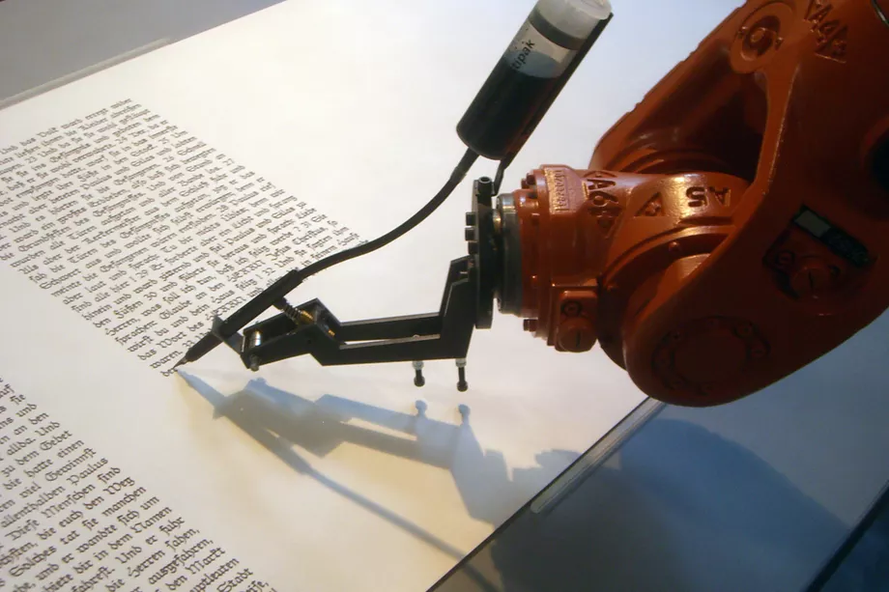
Decoding GPT:
Unleashing Text Generation Potential
By - Dushyant Mahajan

Slide 2

Introduction
GPT (Generative Pre-trained Transformer) is a state-of-the-art transformer-based model developed by OpenAI
It can also be described by different names such as,
Large Language Model
Generative AI
Artificial Intelligence
Chatbot
Transformer
For our use case, we will consider Large Language model

Slide 3
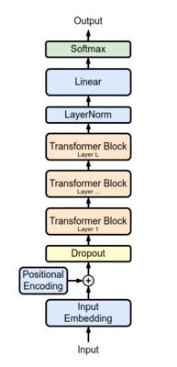
What is a Language Model?
Language model is model of language, it produces a probability distribution over some vocabulary
GPT (Generative Pre-trained Transformer) is a state-of-the-art transformer-based model developed by OpenAI
It uses their pre-trained knowledge to predict and generate the next words
It knows how to mix and match patterns from its training data to come up with new and interesting ideas, while still making sense
GPT's text generation capabilities are transforming the way we communicate and create content
GPT Architecture

Slide 4
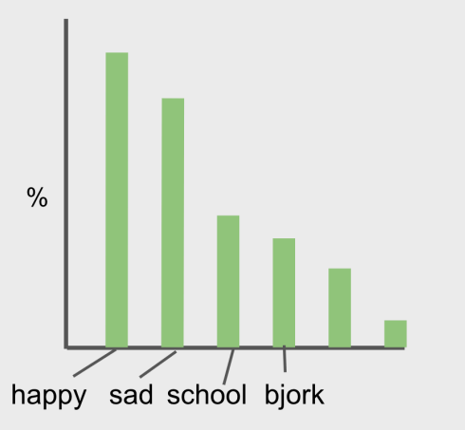
Language Model
Produce a probability distribution over some vocabulary
• What follows “I am…”?
• Vocabulary = all words
• Can sample predicted word repeatedly to generate text

Slide 5
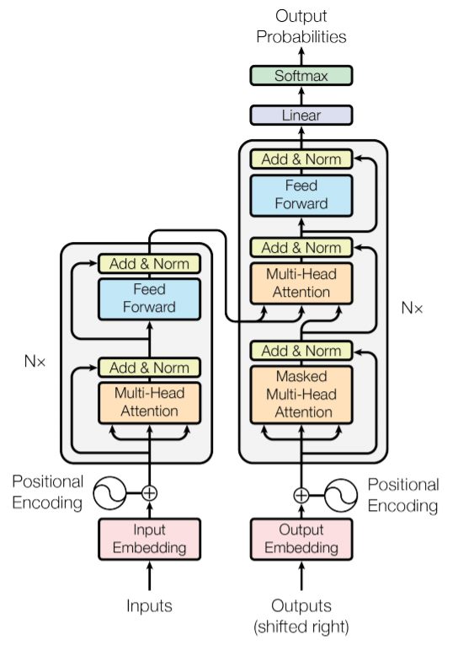
Contextual Understanding
With an innate ability to grasp context, GPT models generate text that seamlessly fits the given context, ensuring coherence and relevance
GPT employs causal self-attention, a mechanism that allows tokens to only attend to preceding tokens during training, unlike BERT which uses bidirectional context
Additionally, positional encodings differentiate words with similar meanings in different positions, enhancing the model's grasp of context
The art of context empowers GPT models to infuse the right style, tone, and meaning into their creations, catering to diverse communication needs
The Transformer Architecture

Slide 6
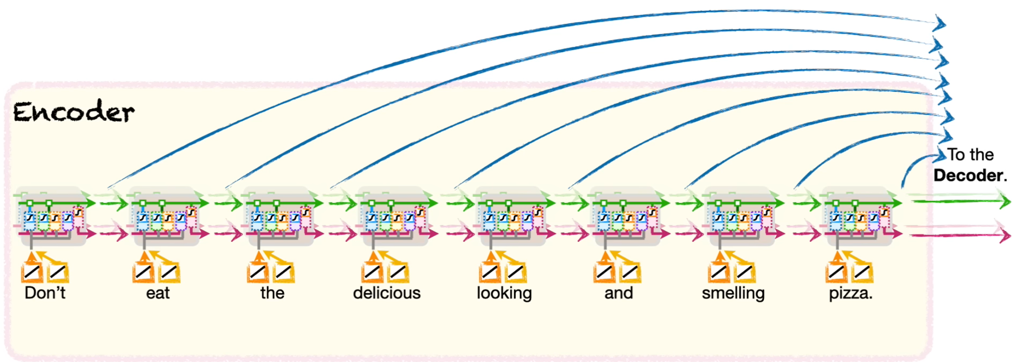
Attention Mechanism
The attention mechanism allows the model to weigh the importance of different elements in the input data, giving more emphasis to relevant information and less to irrelevant information
It adds a bunch of paths from the Encoder to Decoder, so that the Decoder can directly access the input values
In the context of attention, each word (or token) in the input sequence is associated with three vectors: a Query vector, a Key vector, and a Value vector

Slide 7
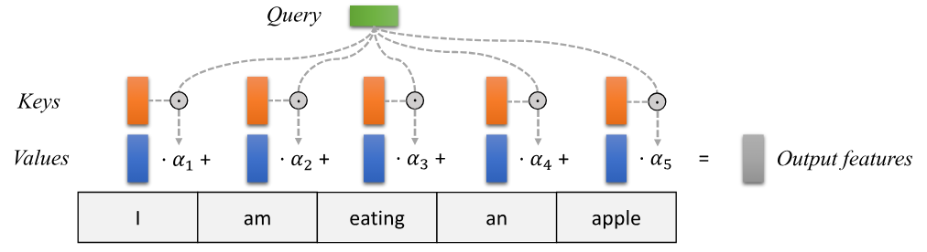
Attention Heads
Instead of focusing on the entire sentence at once, attention heads help to focus selectively on specific words or phrases which seem crucial
Each attention head focuses on learning specific relationships and dependencies between tokens in the input sequence
For a specific token's Query vector, the attention head computes a similarity score with the Key vectors of all tokens in the input sequence
The similarity scores can be calculated using the dot product or cosine similarity between the Query and Key vectors
These scores indicate how much focus or importance the token should assign to other tokens in the sequence

Slide 8
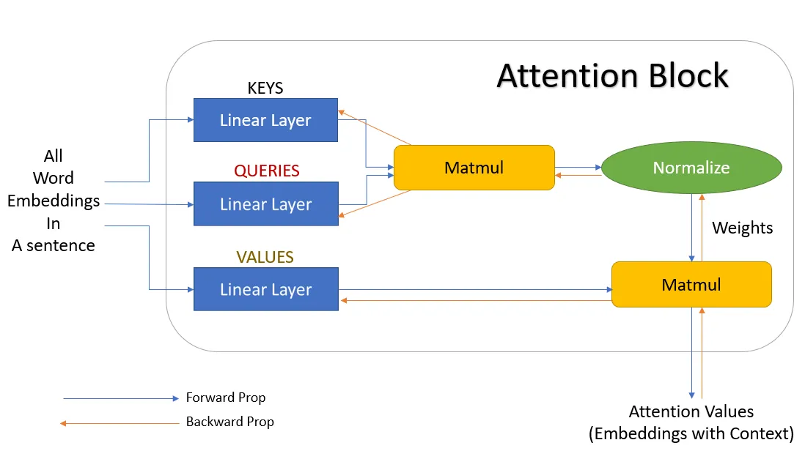
Multi-Head Attention

Slide 9
GPT’s Training Process
Pre-Training phase -
In pre-training, a GPT model learns to predict the next word by training on extensive text data without labeled tasks. It involves:
Tokenization: Dividing input into smaller tokens.
Positional Embeddings: Adding positions to tokens.
Self-Attention Mechanism: Weighing token importance.
Transformer Layers: Multiple context refinement layers.
Masked Language Model (MLM): Predicting masked tokens using context.

Slide 10
GPT’s Training Process
2. Fine-tuning Phase:
This involves training the model on a smaller dataset that is labeled for a specific task, such as language translation, text completion, or question answering
Task-specific Data: Labeled dataset for the target task
Fine-tuning Architecture: Pre-trained GPT model serves as the base
Loss Function: Task-dependent loss, e.g., cross-entropy for classification
Optimization: Model parameters updated via gradient descent

Slide 11
Demo
https://colab.research.google.com/drive/1zhm3zs_-6QpcbOFT26yMWQo9nJd-nVD1#scrollTo=VVBzW-DyFb_A

Slide 12
References
https://arxiv.org/abs/1706.03762
https://openai.com/blog/chatgpt
https://uvadlc-notebooks.readthedocs.io/en/latest/tutorial_notebooks/tutorial6/Transformers_and_MHAttention.html
https://towardsdatascience.com/all-you-need-to-know-about-attention-and-transformers-in-depth-understanding-part-1-552f0b41d021
https://hackernoon.com/why-is-gpt-better-than-bert-a-detailed-review-of-transformer-architectures
https://www.youtube.com/watch?v=kCc8FmEb1nY&t=4055s

