Slide 1
Week 11
Leveraging Large Language Models for Data Verification
Benefits and Challenges of Cross-referencing Information
INFO -7390 Advances in Data Science and Architecture

Slide 2

Contents
Introduction to Large Language Models
How Large Language Models are trained
How do Large Language Models work?
Why LLMs are Suitable for Data Verification
Challenges in Leveraging LLMs for Data Verification
How to Overcome These Challenges
Best Practices for Using LLMs in Data Verification
Benefits of Cross-referencing Information
Challenges of Cross-referencing Information
Practical Example: Fake News Detection

Slide 3
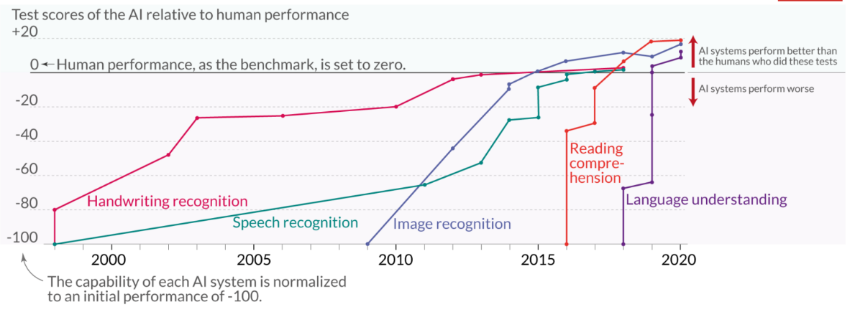
Language and Image Recognition capabilities of AI has improved Rapidly

Slide 4

Introduction to Large Language Models (LLMs)
What are LLMs?
Large language models, such as GPT-3 (Generative Pre-trained Transformer 3), are advanced artificial intelligence systems designed to understand and generate human-like text. These models are built using deep learning techniques and have been trained on vast amounts of text data from the internet.
Deep Learning Techniques
Text
These models use self-attention mechanisms to analyze the relationships between different words or tokens in a text, enabling them to capture contextual information and generate coherent responses.

Slide 5
How Large Language Models are trained ?
Large language models typically undergo pre-training on a broad, all-encompassing dataset that shares statistical similarities with the dataset specific to the target task.
Text Pre- processing
Random Parameter Initialization
Inputting Numerical Data
Loss Function Calculation
Parameter Optimization
Iterative Training

Slide 6
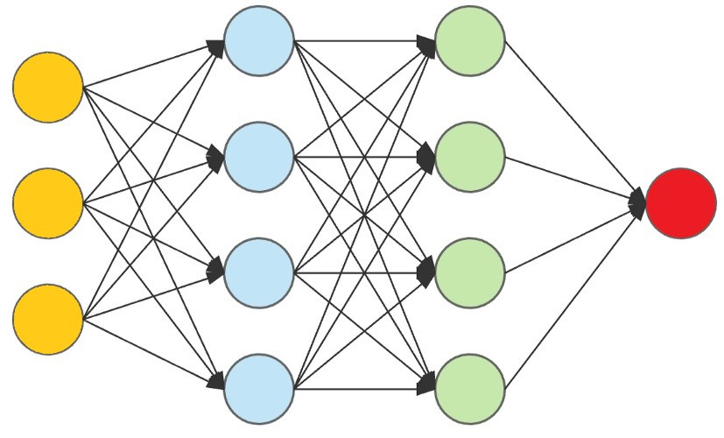
How do Large Language Models work?
Large language models leverage deep neural networks to generate outputs based on patterns learned from the training data.
They use statistical algorithms to analyze text data. These algorithms use patterns to determine the most probable next word or phrase. Once trained, LLMs can generate responses based on the analyzed text data.

Slide 7



Why LLMs are Suitable for Data Verification ?
Fast and efficient
Improved accuracy
Identify patterns and anomalies
LLMs can quickly process large amounts of text data. This speed and efficiency make them ideal for tasks like data verification.
Compared to manual verification, LLMs can improve accuracy by identifying patterns in data that humans may overlook.
LLMs can help identify patterns and anomalies in the data that may be indicative of an error or fraudulent activity.

Slide 8
Use Cases
Fact Checkers and Fake News Detection: LLMs can identify and flag false information in news articles and online content. Anti-Plagiarism Checkers: LLMs can analyze written work to identify instances of plagiarism by searching for matching patterns in other texts. Email Security: LLMs can detect phishing and malicious emails by identifying suspicious keywords and phrases.
Notes:
Fact Checkers and Fake News Detection: LLMs can identify and flag false information in news articles and online content. Anti-Plagiarism Checkers: LLMs can analyze written work to identify instances of plagiarism by searching for matching patterns in other texts. Email Security: LLMs can detect phishing and malicious emails by identifying suspicious keywords and phrases.

Slide 9
Challenges in Leveraging LLMs for Data Verification
1
2
3
Data Bias
Algorithmic Transparency
Complex Queries
Certain tasks like medical diagnosis require complex queries and inputs that LLMs may not be able to handle.
LLMs can perpetuate data bias if the training data is not diverse or representative.
Understanding how LLMs make decisions is challenging due to their complexity.

Slide 10
How to Overcome These Challenges ?
Training Data –Ensure that the LLMs are trained on diverse and representative data to avoid perpetuating data bias.
Algorithmic Transparency- Develop algorithms that enable LLMs to provide insights into how they arrived at their decisions.
Specialized LLMs - Develop specialized LLMs, trained on specific kinds of data that can more accurately handle complex queries, such as medical diagnosis.

Slide 11
Best Practices for Using LLMs in Data Verification
Data Scrubbing
Validation
Constant Updating
Ensure that the training data is free from bias and errors.
Replace sensitive information with generic labels.
Validate LLM outputs with manual verification.
Periodically re-validate LLM algorithms and models.
Update LLMs with current data and continue with training to improve accuracy.
Update LLMs with current data and continue with training to improve accuracy.

Slide 12

Cross Referencing
Cross-referencing refers to the practice of comparing and relating information from different sources or datasets to enhance the quality, reliability, and accuracy of the data or model.
Cross-referencing allows for the validation of data by comparing it against a trusted external source

Slide 13
Benefits of Cross-referencing Information -
Enhanced Reliability
Error Detection
Deeper Understanding
Mitigating Bias

Slide 14
Challenges of Cross-referencing Information
Source Reliability: Not all sources are equally reliable. Cross-referencing can be challenging if the sources used are themselves inaccurate or biased.
Time-Consuming: Cross-referencing requires time and effort, especially when dealing with a large amount of information or complex topics.
Discrepancies: Inconsistencies between sources may arise due to different interpretations, updates, or changes in information over time.
Subjectivity: Determining the trustworthiness of a source can be subjective. What's considered reliable by one person may not be seen the same way by another.
Contextual Differences: Sources might present information in different contexts, leading to varying interpretations of the same data.
Incomplete Information: Some sources might not cover all aspects of a topic, leading to gaps in the cross-referenced information

Slide 15
Practical Example: Fake News Detection
The popularity of social media has increased the impact of fake news on our culture. People frequently believe that anything they read or hear is true, and this has a significant political and economical impact on the entire world. Therefore, using Python and the BERT Model, we will create an application today that can recognize fake news automatically.
True
80% Train
Train Model
LLM
(BERT)
Accuracy Score
News
Fake
Test Model
20% Test

Slide 16
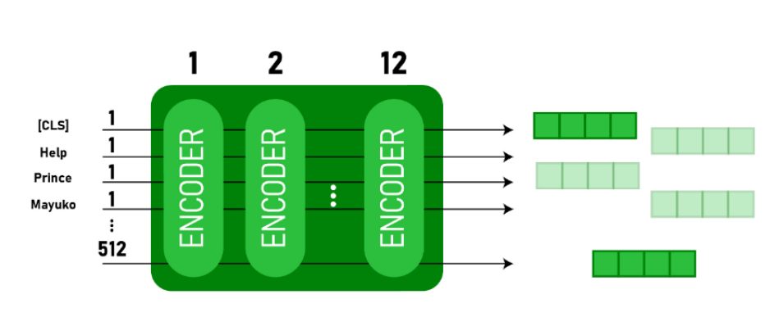
BERT Model
BERT Stands for Bi-Directional Encoder Representations from Transformers. Bert uses the Transformers to understand the contextual relation between words present in a sentence or text.
BERT Transformer has two mechanisms: An encoder that reads the text input and a decoder that predicts for a given task.

Slide 17
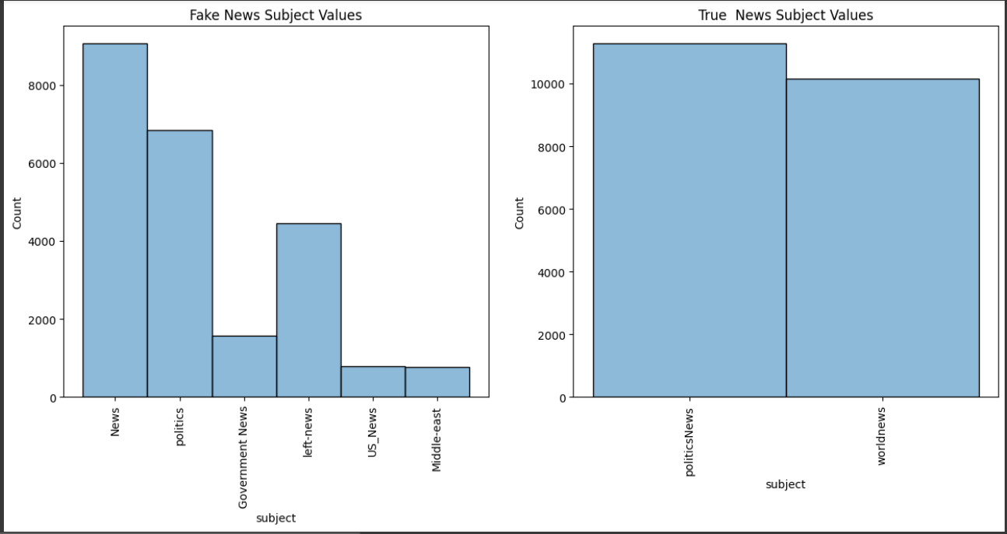
Code Output
Histograms showcasing different subjects for Fake and True News

Slide 18
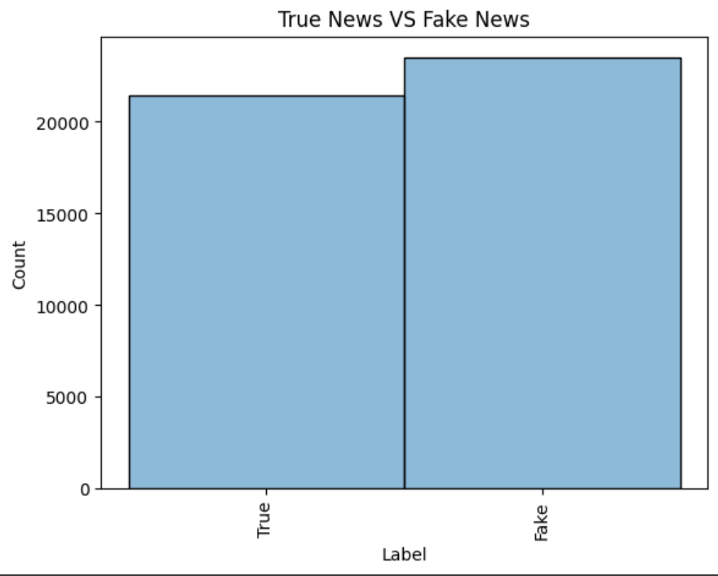
Code Output
Plot showcasing True News Data vs Fake News Data

Slide 19
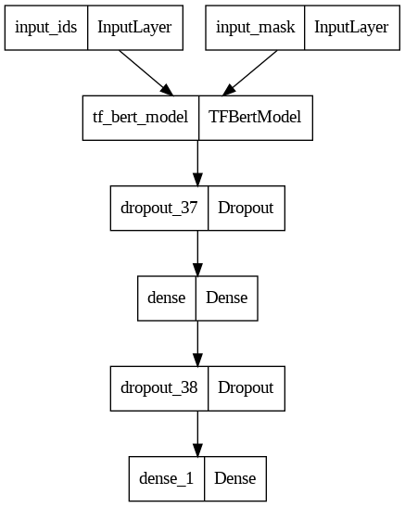
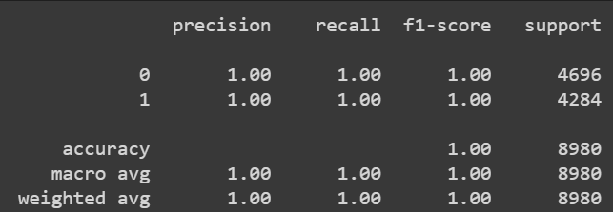
Code Output
Accuracy Score and Precision Graph of the model
Plot showcasing the created model

