Slide 1
Interpretable Cross-Cohort
Transcriptomic Classification
TCGA RNA-seq
Train / test classifier
Breast cancer molecular subtypes using TCGA-BRCA and METABRIC
SHAP + pathway enrichment
Recover known biology
METABRIC validation
External accuracy 0.818
Project demo deck
Notes:
Open with the main story: this is a complete transcriptomics ML project, not just a classifier. It includes preprocessing, ML, explainability, pathway biology, and external validation.

Slide 2
Big picture: tumor subtype is a transcriptomic fingerprint
Breast cancer is molecularly heterogeneous; gene expression captures subtype identity.
Core question
RNA-seq expression
Subtype labels
Can a model trained on TCGA-BRCA RNA-seq learn breast cancer subtype biology and transfer to another cohort?
Classifier
Why this matters
• Subtypes guide biology, prognosis, and treatment context
• ML can test whether subtype signals are separable
• External validation asks: is the signal real or cohort-specific?
Biological interpretation
External validation
TCGA-BRCA × METABRIC transcriptomics ML project
01
Notes:
Use the fingerprint analogy: each subtype has a characteristic gene-expression pattern. The model learns those molecular fingerprints.

Slide 3
Data architecture: one training cohort, one external cohort
TCGA-BRCA builds the model; METABRIC tests transfer across platform and cohort.
TCGA-BRCA
METABRIC
RNA-seq • Training / validation / testing
Illumina microarray • External validation
821
20,530
1,608
4,311
final modeling samples
original gene features
4-class validation samples
shared genes used
5,000
86.22%
selected ML genes
TCGA-METABRIC gene overlap
Matched classes: LumA, LumB, Basal, Her2
TCGA-BRCA × METABRIC transcriptomics ML project
02
Notes:
Make clear that the two cohorts are not identical. That is why external validation is meaningful and challenging.

Slide 4
Reproducible pipeline: from expression matrix to validation
Leakage control was built into feature selection and scaling.
Download
expression + metadata
Filter primary
tumors
Merge PAM50
labels
Train / val / test
split
Top 5,000 genes
train-only
Scale
train-only
Train models
LR/RF/MLP
Interpret
SHAP + pathways
METABRIC
external validation
Leakage prevention
Feature selection and scaling were fit on training data only, then applied to validation, test, and external data.
Reproducibility
The full pipeline is script-based and rerunnable from the repository with conda + bash run_all.sh.
Core principle: do not let test/external information influence preprocessing.
TCGA-BRCA × METABRIC transcriptomics ML project
03
Notes:
This slide demonstrates methodological maturity. Emphasize leakage control and reproducibility.

Slide 5
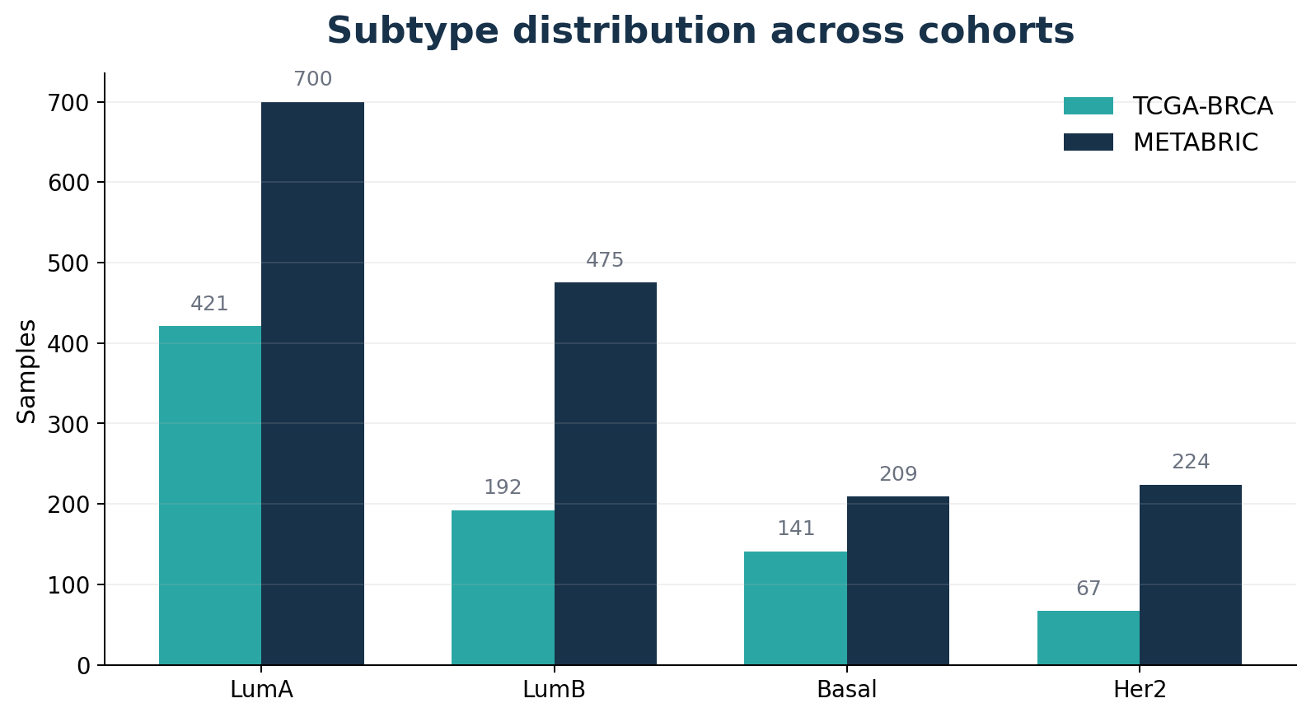
Cohort composition: subtype imbalance is real
LumA dominates both cohorts, so balanced accuracy and macro F1 matter.
Why macro F1?
Accuracy can look high when the model mostly predicts the largest class.
Macro F1 gives each subtype equal importance, so it penalizes poor minority-class performance.
This is important for Her2 and Basal samples.
Evaluation: accuracy + balanced accuracy + macro F1
TCGA-BRCA × METABRIC transcriptomics ML project
04
Notes:
Show that you understand class imbalance. This justifies using balanced accuracy and macro F1, not just accuracy.

Slide 6
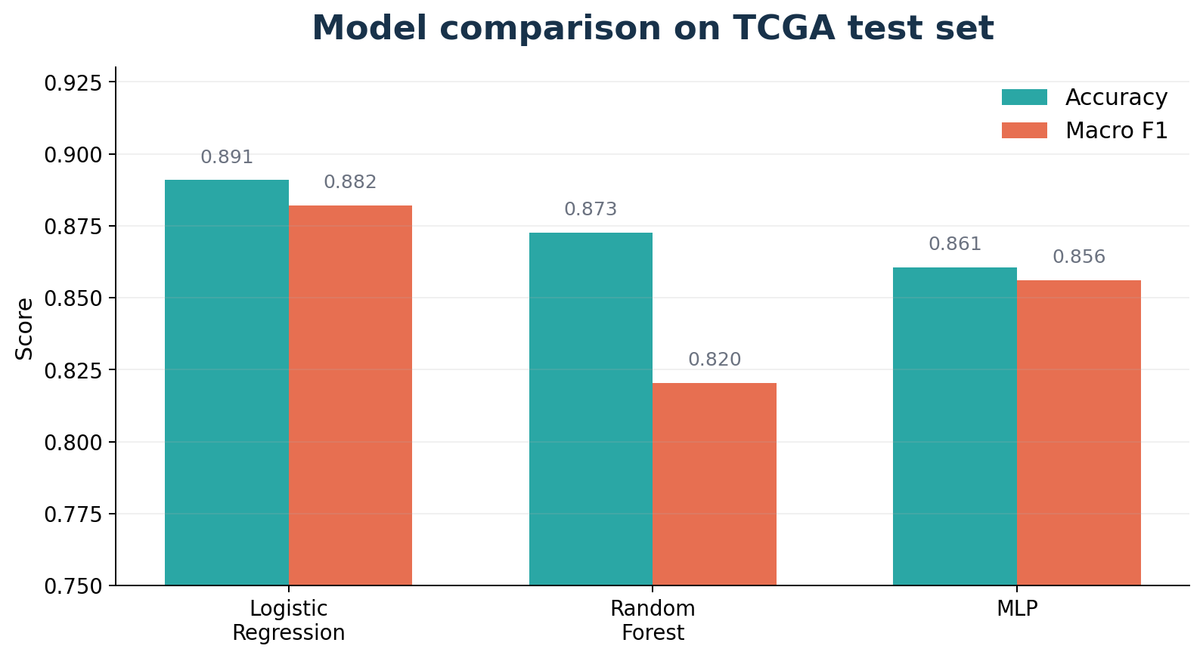
Model comparison: simple linear model wins
Logistic Regression outperformed Random Forest and the MLP benchmark.
Best current model
Logistic Regression
Test performance
0.8909
0.8821
accuracy
macro F1
Interpretation: the subtype signal was strong and mostly linearly separable in transcriptomic space.
TCGA-BRCA × METABRIC transcriptomics ML project
05
Notes:
Key interview answer: deep learning did not beat logistic regression because the sample size is modest and the signal is already linearly separable.

Slide 7
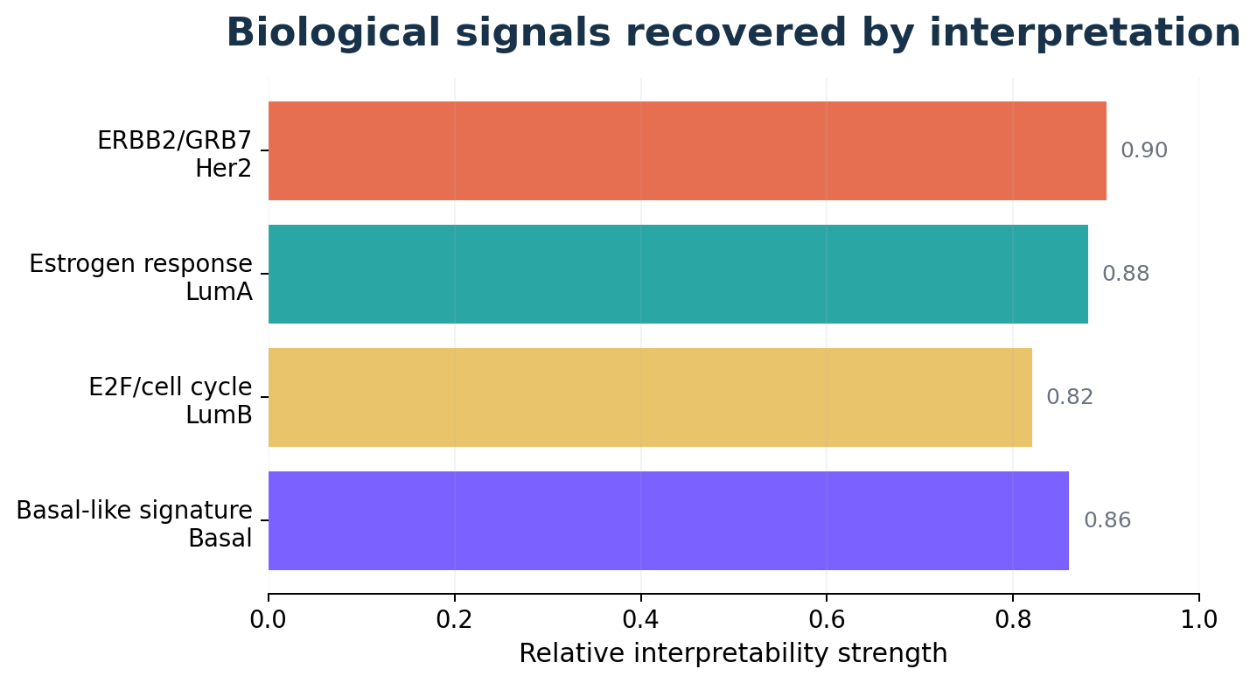
Interpretability: the model recovered known subtype biology
Coefficients, SHAP, and pathway enrichment aligned with breast cancer biology.
Subtype
Recovered signal
Meaning
Her2
ERBB2 / GRB7
HER2 signaling
LumA
ESR1 / estrogen
Hormone-response
LumB
E2F / cell cycle
Proliferation
Basal
Basal-like profile
Non-luminal signal
Main point
The model was not only accurate; it learned biologically meaningful gene programs.
TCGA-BRCA × METABRIC transcriptomics ML project
06
Notes:
This slide proves biological credibility. Mention ERBB2/GRB7, estrogen response, E2F/cell-cycle, and basal-like signal.

Slide 8
External validation challenge: platform shift
Raw METABRIC microarray values were not directly comparable to TCGA RNA-seq scaling.
TCGA-BRCA
METABRIC
RNA-seq expression
Illumina microarray expression
Model learns
TCGA-scaled boundaries
Raw values shift
into wrong feature space
Raw transfer failed: model predicted almost everything as LumA
TCGA-BRCA × METABRIC transcriptomics ML project
07
Notes:
Explain platform shift: a model trained on RNA-seq-scaled features cannot directly interpret raw microarray values.

Slide 9
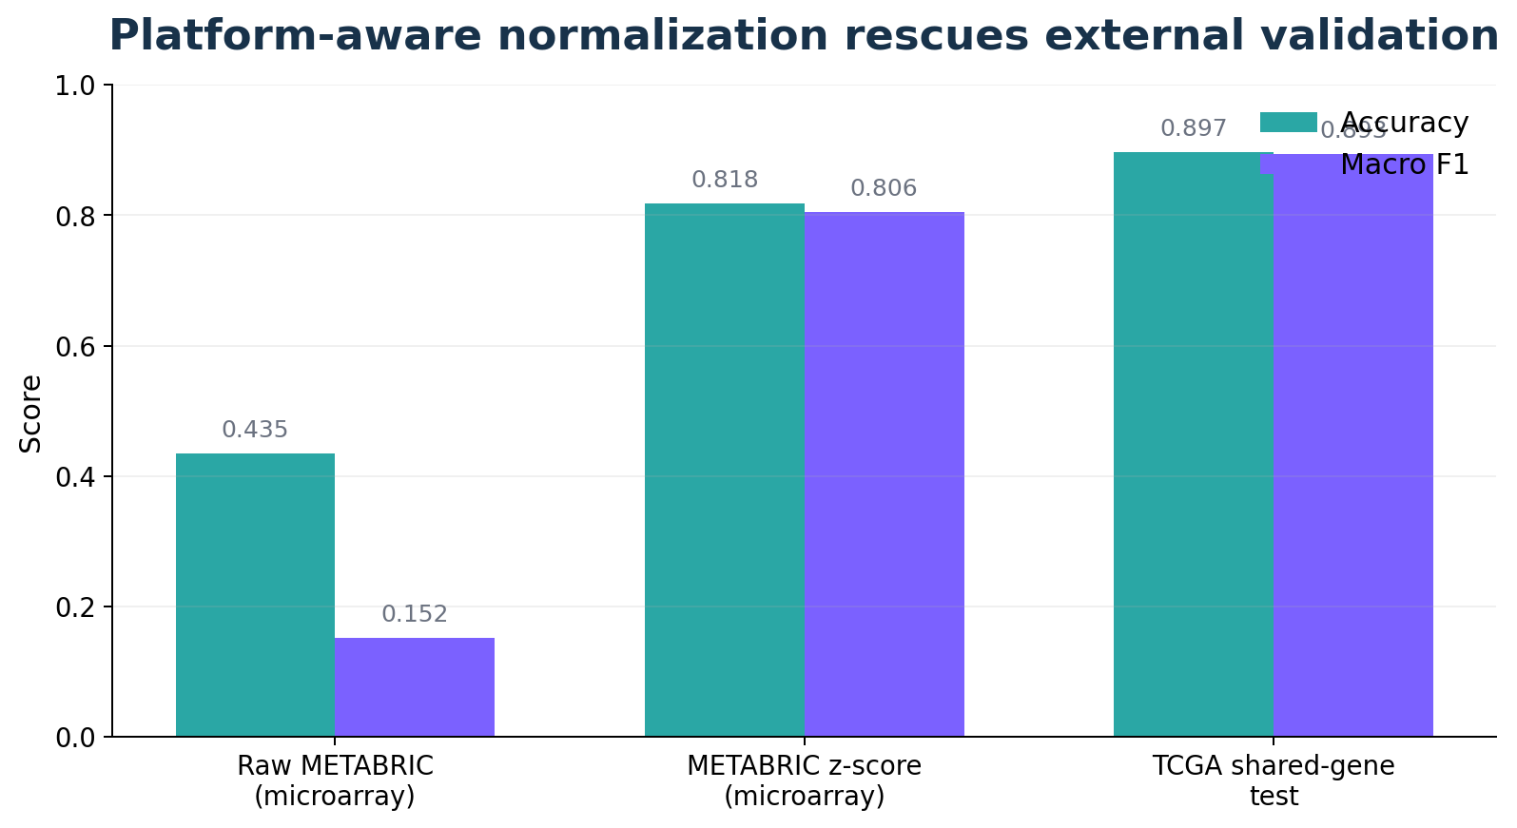
Z-score normalization rescued external validation
METABRIC z-score expression improved cross-platform transfer.
METABRIC z-score result
0.8178
0.8057
external accuracy
external macro F1
Interpretation
Z-score expression reduced platform-specific scale differences and recovered transferable subtype biology.
Research lesson
External validation is not just running the model on a new dataset; normalization determines whether biology is comparable.
TCGA-BRCA × METABRIC transcriptomics ML project
08
Notes:
This is the strongest result. State the failure and rescue clearly: raw failed, z-score worked.

Slide 10
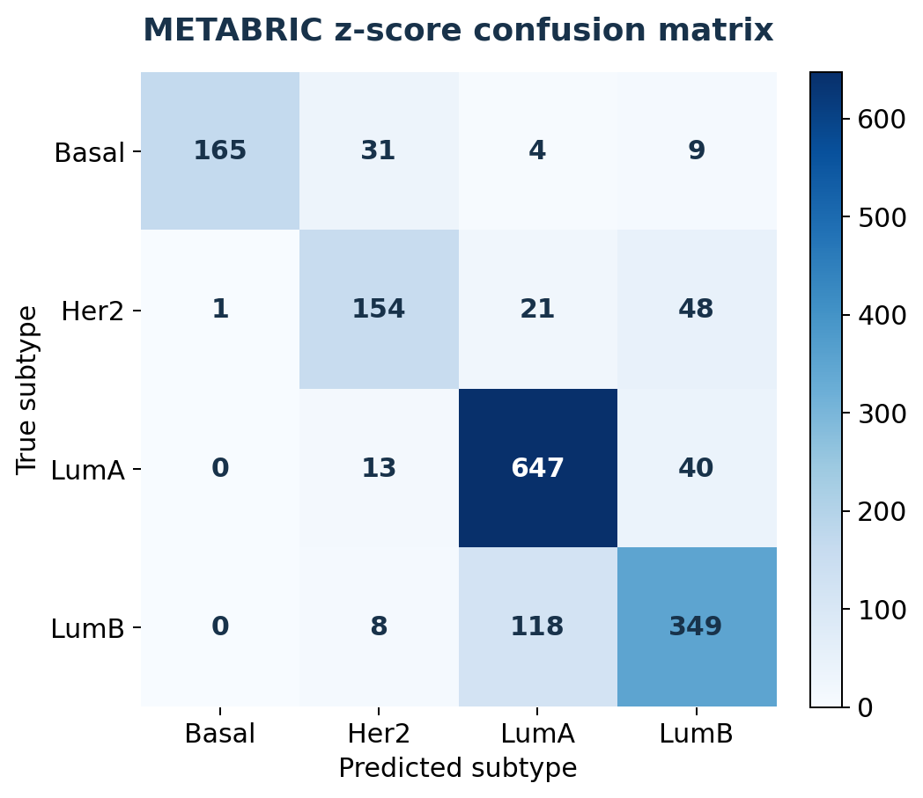
External validation error pattern is biologically sensible
LumA and Basal were strongest; LumA/LumB confusion reflects shared luminal biology.
What the errors mean
• Basal: strong distinct signal
• LumA: very strong luminal signal
• Her2 → LumB: partial overlap with proliferative biology
• LumB → LumA: expected because both are luminal
Most important confusion
LumB → LumA
Shared hormone-response programs; LumB separation depends heavily on proliferation/cell-cycle signal.
TCGA-BRCA × METABRIC transcriptomics ML project
09
Notes:
Discuss the confusion matrix. It is not random failure: errors are aligned with known subtype relationships.

Slide 11
What makes the project strong — and what still needs work
The project balances prediction, interpretation, and external validation.
Strengths
Limitations
• End-to-end reproducible pipeline
• Leakage-aware preprocessing
• Multiple model comparison
• SHAP + coefficient interpretation
• Pathway enrichment
• Independent METABRIC validation
• TCGA and METABRIC use different platforms
• Only one external cohort tested
• More batch correction methods needed
• Survival analysis not yet included
• MLP not extensively tuned
Best defense line
“A useful biomedical ML model should not only predict well — it should avoid leakage, recover known biology, and generalize to independent data.”
TCGA-BRCA × METABRIC transcriptomics ML project
10
Notes:
This slide is for defense. It shows you know what is strong and what is not finished.

Slide 12
Next extension: survival analysis using subtype probabilities
Option B turns the classifier into an outcome-linked translational analysis.
Predicted
probabilities
Clinical survival
metadata
Kaplan–Meier
curves
Cox models
HR + p-value
Risk-linked
subtype biology
Survival question
Do model predictions or subtype-confidence scores relate to patient outcomes?
Planned outputs
• Kaplan–Meier plots
• Cox proportional hazards table
• Survival comparison by predicted subtype
• Optional: high-vs-low probability groups
This is the next natural research upgrade after external validation.
TCGA-BRCA × METABRIC transcriptomics ML project
11
Notes:
End by saying the next extension is survival analysis: it connects molecular subtype predictions with clinical outcome.

