Slide 1


PRESENTATION ON Optimization Scheme for Power Transmission in Wireless Sensor Network
Group Members:
Anshul Kumar Yadav
Akshita Sharma
Anurag Yadav
Ankita
PRESENTATION AT:
PIECON-2023
Aligarh Muslim University
Project Supervisor:
​
Dr. Ankit Vijayvargiya

Slide 2
Content
Problem statement
Objective of research
Factors responsible for energy loss.
WSN model
Connectivity of network
Result analysis
Magnitude analysis
Box plot analysis
Convergence analysis
References

Slide 3
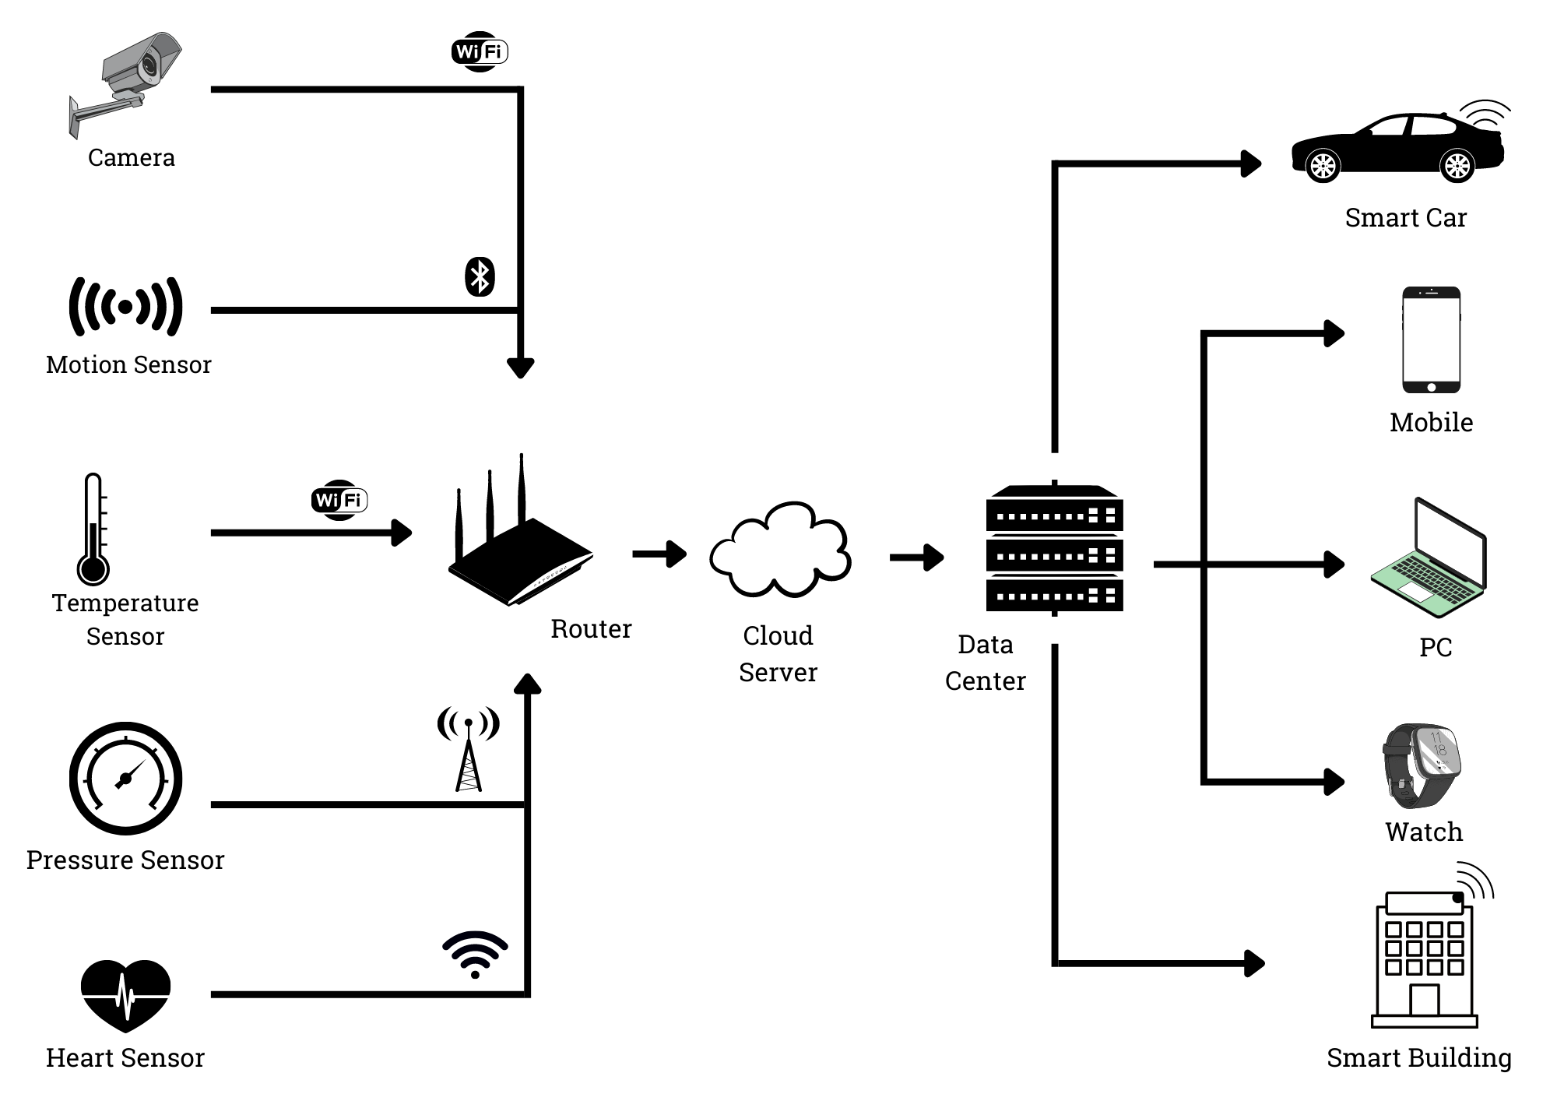
Problem statement
Fig: IoT

Slide 4
Objectives of the research
To model a cluster of wireless sensor network.
To achieve optimal transmission wave energy for each node of the network, without creating disconnected areas in a sensors cluster using different optimization algorithm

Slide 5
Factors responsible for energy loss
Packet overhead
Idle listening
Overhearing
Over emmiting
Collisions
State transitions

Slide 6
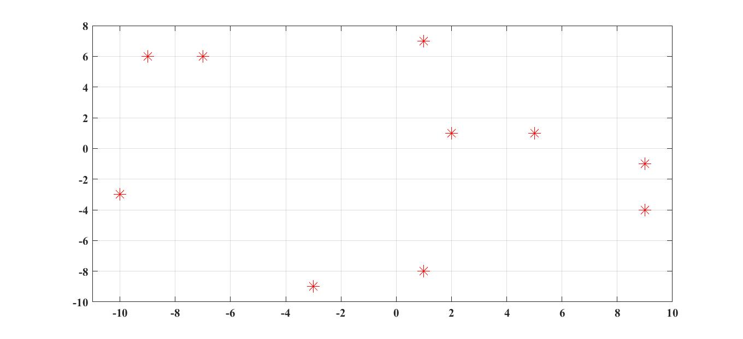

System models
Single cluster with N wireless sensors.
Send their measurement packets to a sink node through the mesh network
The sensors and sink positions will be bounded to an L-sided square.
$${Γ_{ }}_{\left(y\right)}=\left\{\begin{matrix}0 & ifρ_{j}<ρ_{th} \\ 1 & ifρ_{j}>ρ_{th}\end{matrix}\right.$$
ρ_{j} is the received power at node j
Y is transmitted power
ρ_{th} is the receiver sensitivity.
Fig: Node placement

Slide 7
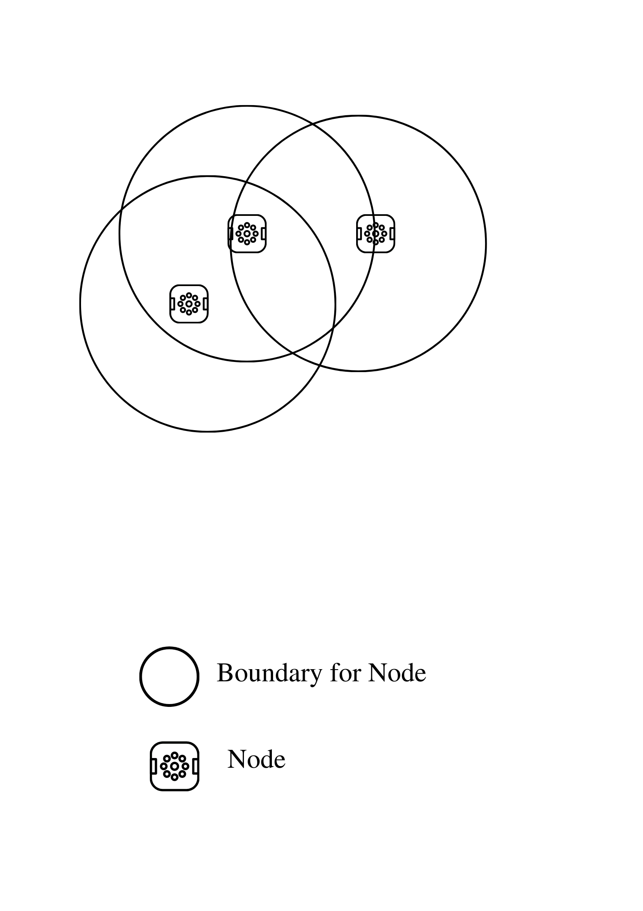
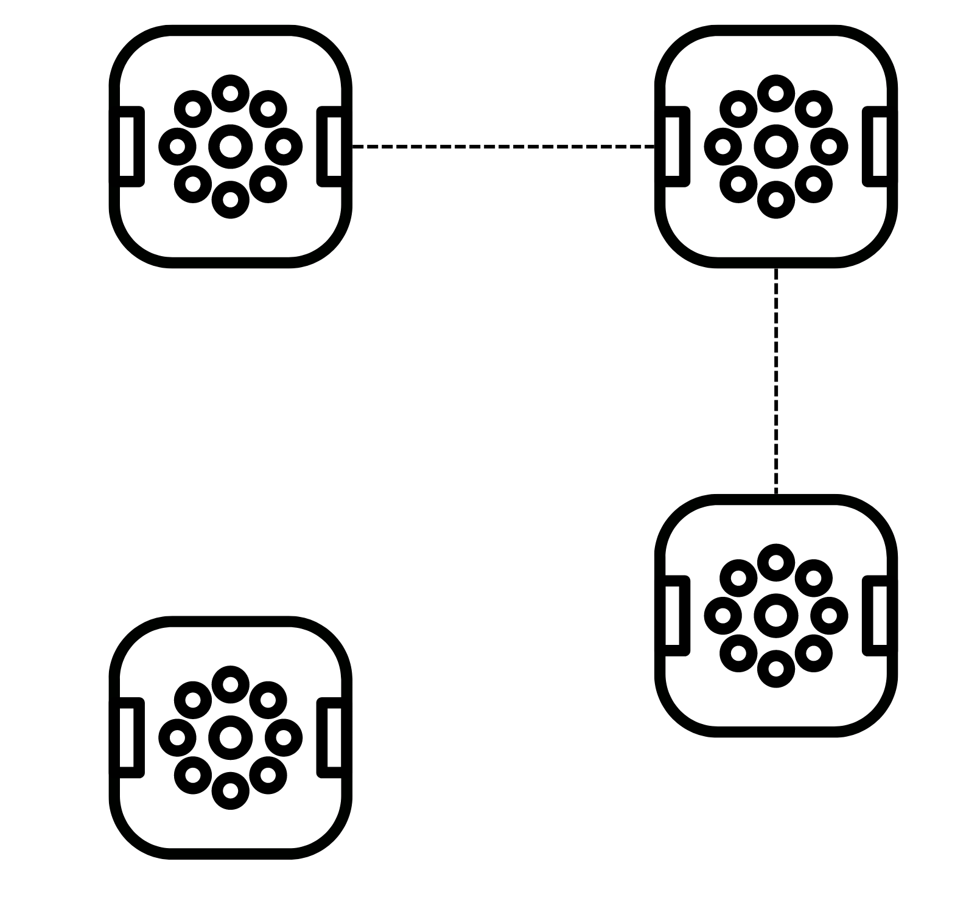
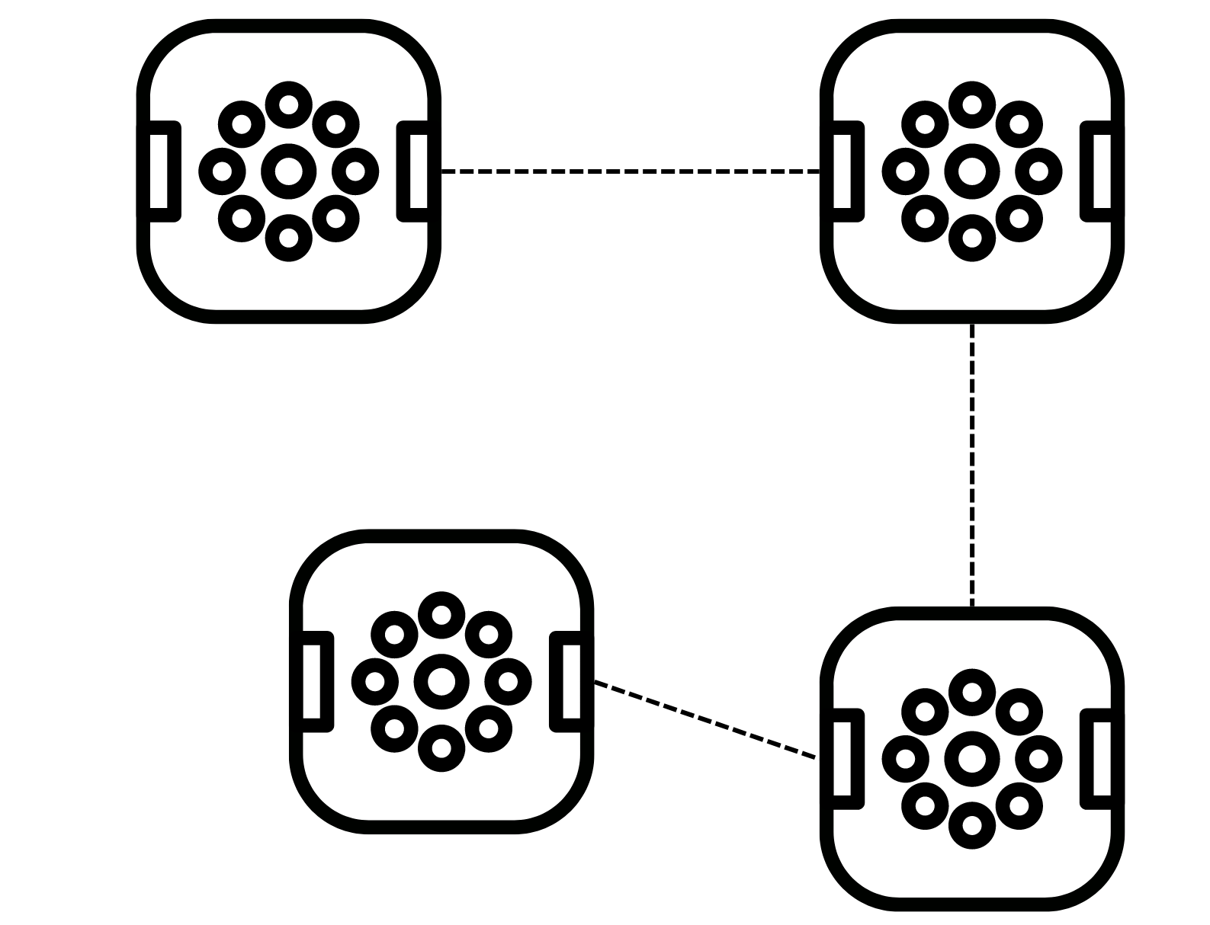
Fig: (a) Network fully connected. (b) Disconnected network.
Fig: System Model

Slide 8
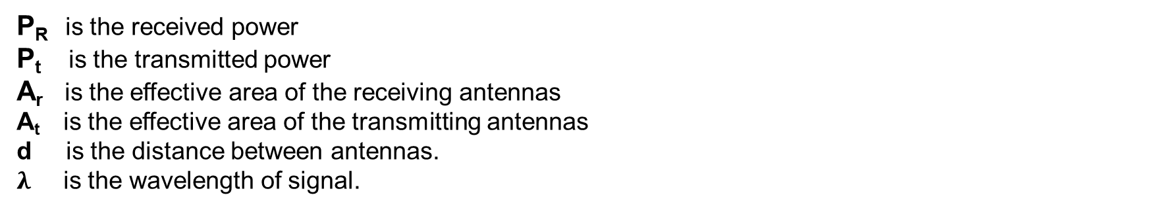

System models
Two nodes are connected when the first transmits with enough power such that the received signal has more power than the receiver sensitivity.
The received power is a function of the physical distance between the nodes and the transmitted power, related by the Friis formula :
$$\frac{P_{r}}{P_{t}}=\frac{A_{r}A_{t}}{d^{2}λ^{2}}$$
P_{R} is the received power
P_{t} is the transmitted power
A_{r} is the effective area of the receiving antennas
A_{t} is the effective area of the transmitting antennas
d is the distance between antennas.
$λ$ is the wavelength of signal.

Slide 9


System models
The simplest antenna model is be chosen to model the effective antenna areas, as the prior work does not focus on a specific hardware platform for the sensor nodes.
Area of Antenna,
considering a single transmission and reception isotropic antenna at each sensor node
$$A_{isotropic}=\frac{λ^{2}}{4×Π}$$
Now the power ratio simplifies to,
$$\frac{P_{r}}{P_{t}}={\left(\frac{λ}{4×Π×d}\right)}^{2}$$

Slide 10
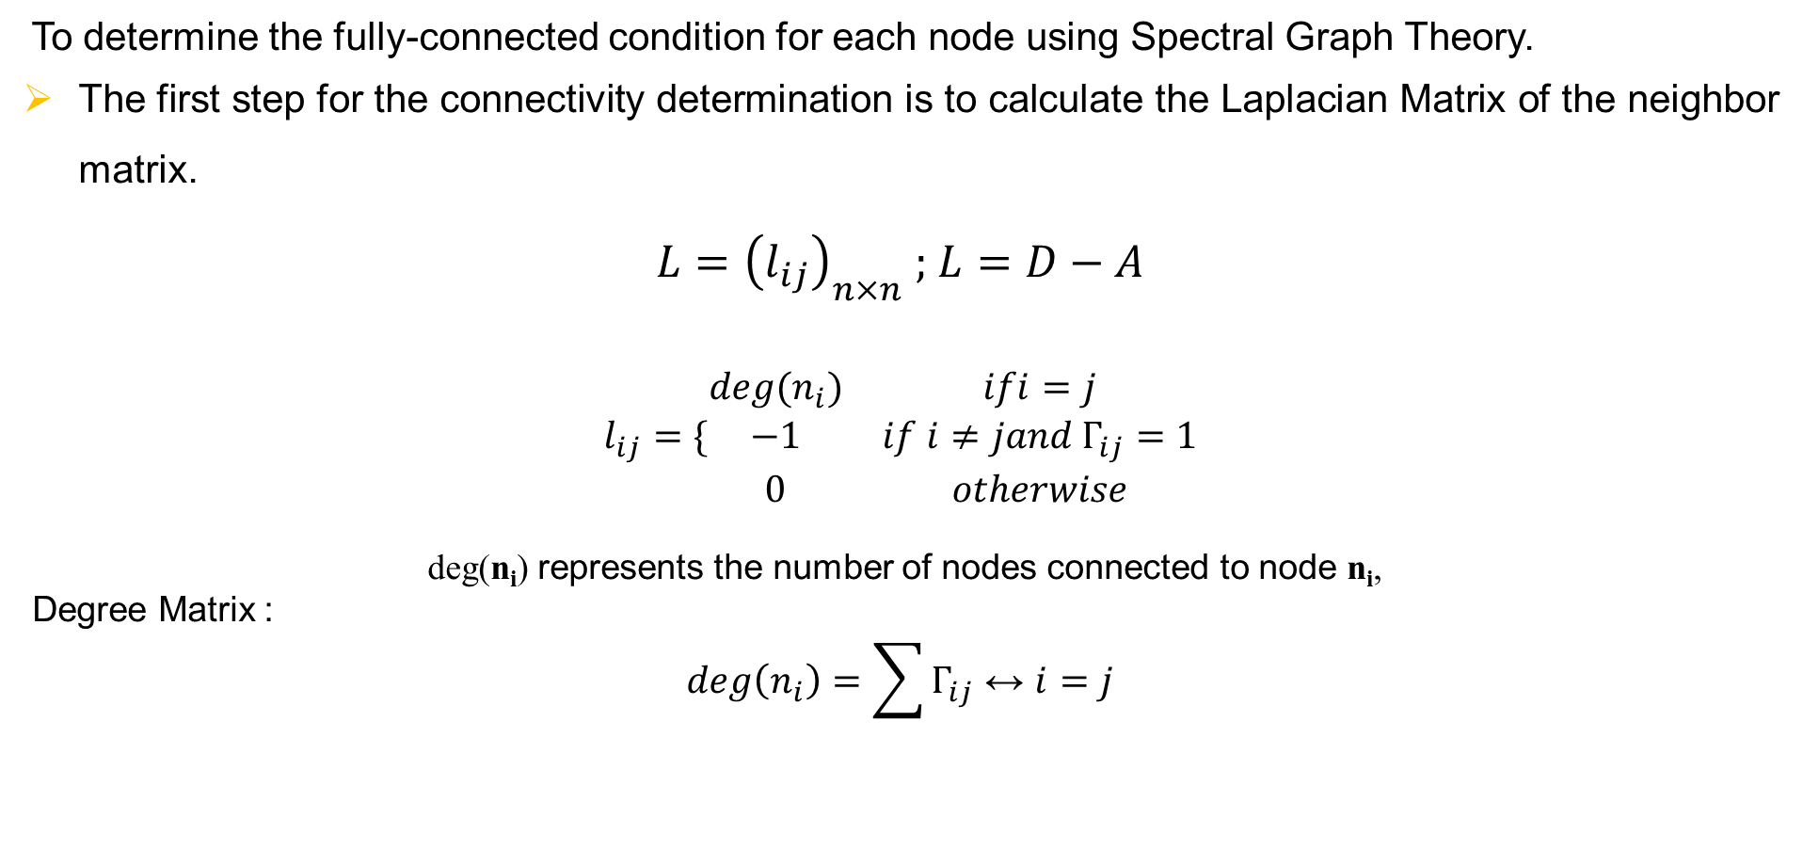
Connectivity of network
To determine the fully-connected condition for each node using Spectral Graph Theory.
The first step for the connectivity determination is to calculate the Laplacian Matrix of the neighbor matrix.
$L={\left(l_{ij}\right)}_{n×n} ;$ $L=D−A$
$$l_{ij}=\{\begin{matrix}deg(n_{i}) & ifi=j \\ −1 & if i≠jand Γ_{ij}=1 \\ 0 & otherwise\end{matrix}$$
deg(n_{i}) represents the number of nodes connected to node n_{i},
Degree Matrix :
$$deg\left(n_{i}\right)=\sum{Γ_{ij}}↔i=j$$

Slide 11
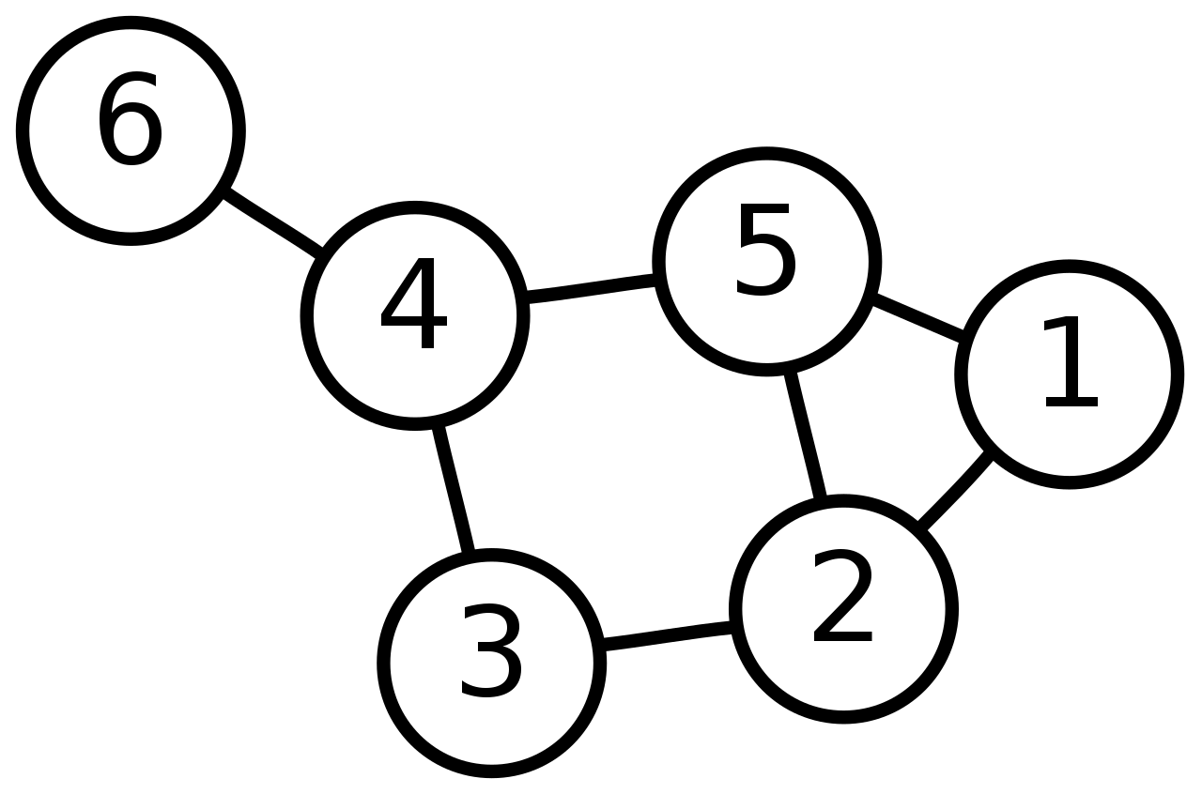
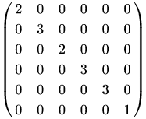
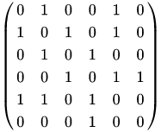
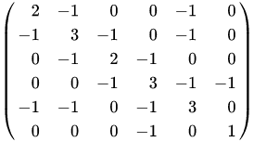
Connectivity of network
Example :
Nodes
Degree Matrix
Adjacent Matrix
Laplacian Matrix

Slide 12
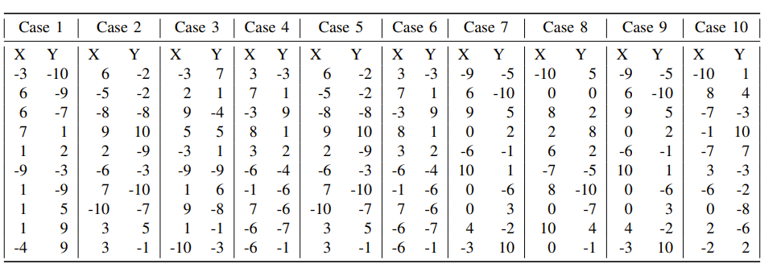
Fig: Node coordinated

Slide 13
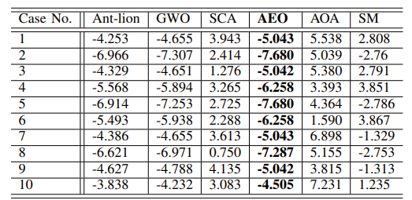
Result Analysis
The model performed 25 optimization runs with 500 iteration per run.
We are reporting the best results obtain in 25 optimization runs by each optimizer.
To justify the 500 iterations, the search space was increased to - 30dBm
Fig: Optimal cluster transmission power by the SM and
5 optimizers

Slide 14
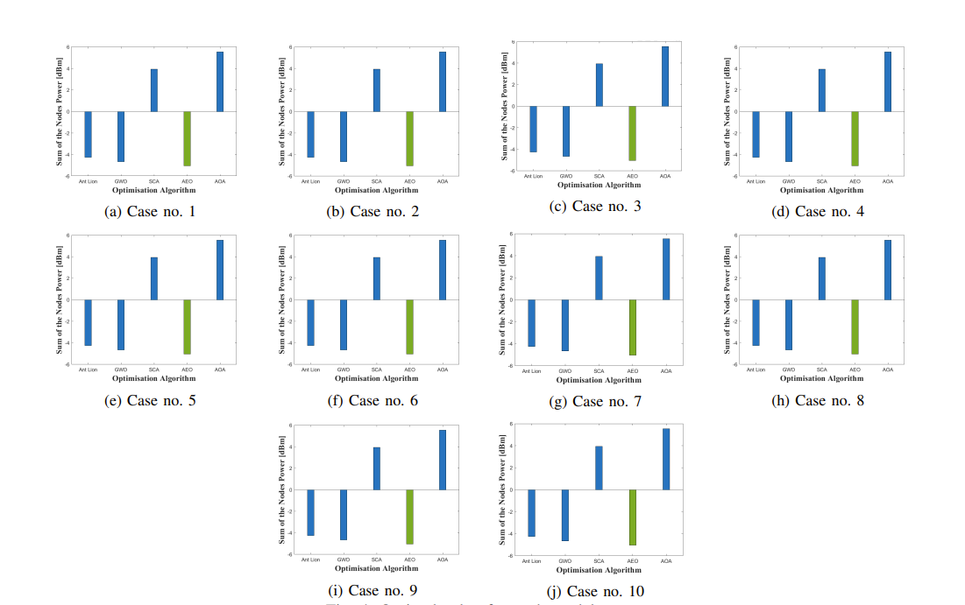
Magnitude Analysis

Slide 15
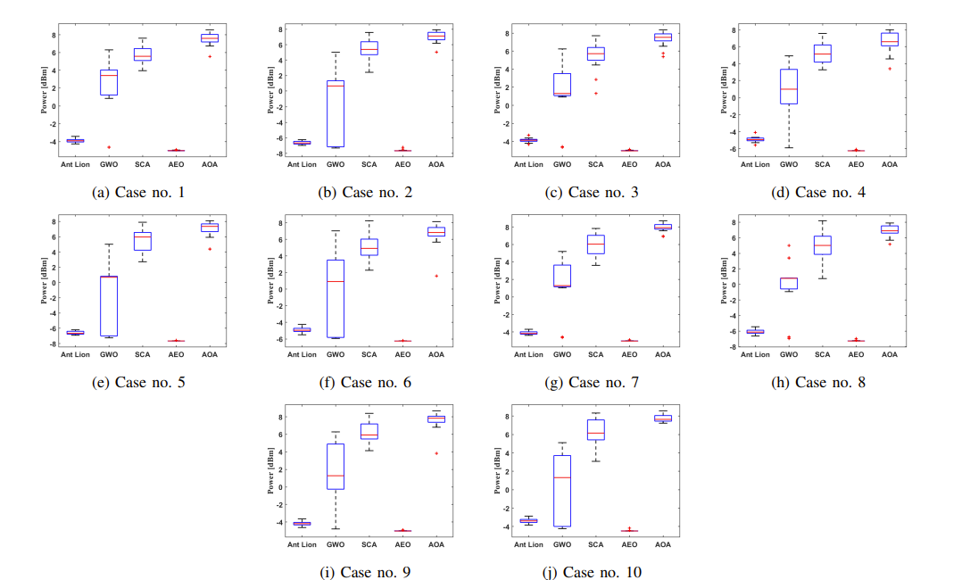
Box plot analysis

Slide 16
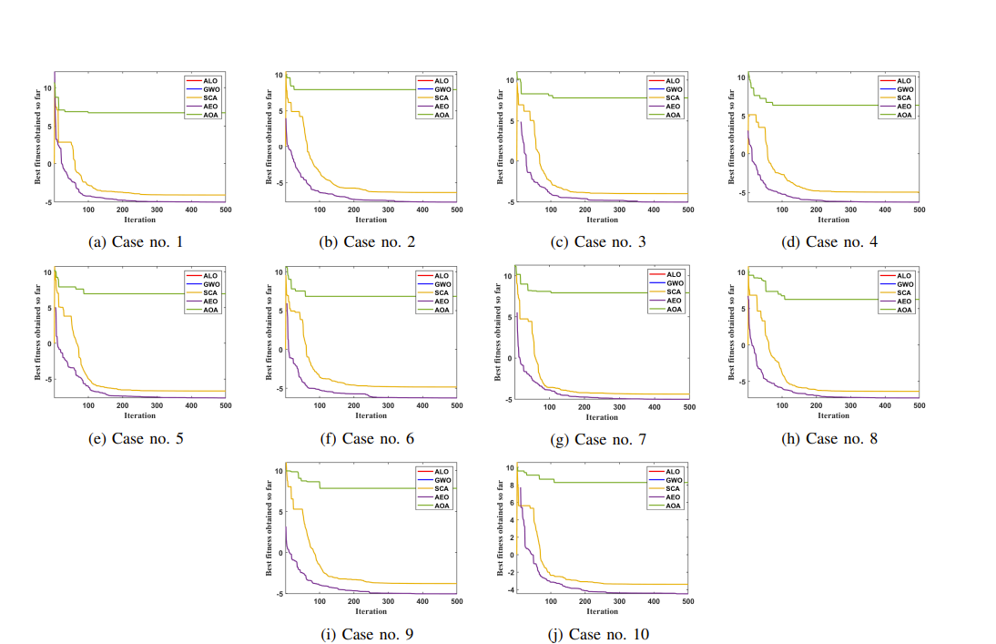
Convergence Analysis

Slide 17
Conclusion
The AEO algorithm gave the best result out of AOA, GWO, SCA, and ALO.
Compared to simplistic method, average energy saved by AEO is 6.4 dBm.
The AEO capability of optimization is superior to all others due to the fact that the production step guides the population fragments from one region to the best obtain region with greater speed as iterations increase.

Slide 18
References
F. Lavratti, A. Ceratti, D. Prestes, A. Pinto, L. Bolzani, F. Vargas, C. Montez, F. Hernandez, E. Gatti, and C. Silva, “A transmission power self-optimization technique for wireless sensor networks,” International Scholarly Research Notices, vol. 2012, 2012.
M. A. Matin and M. Islam, “Overview of wireless sensor network,” Wireless sensor networks-technology and protocols, vol. 1, no. 3, 2012.
K. Haseeb, I. Ud Din, A. Almogren, and N. Islam, “An energy efficient and secure iot-based wsn framework: An application to smart agriculture,” Sensors, vol. 20, no. 7, p. 2081, 2020.
G. L. da Silva Fre, J. de Carvalho Silva, F. A. Reis, and L. D. P. Mendes, ´ “Particle swarm optimization implementation for minimal transmission power providing a fully-connected cluster for the internet of things,” in 2015 International Workshop on Telecommunications (IWT), pp. 1–7, IEEE, 2015.
D. C. Hoang, P. Yadav, R. Kumar, and S. K. Panda, “Real-time implementation of a harmony search algorithm-based clustering protocol for energy-efficient wireless sensor networks,” IEEE Transactions on Industrial Informatics, vol. 10, no. 1, pp. 774–783, 2014.
D. Hoang, R. Kumar, and S. Panda, “Fuzzy c-means clustering protocol for wireless sensor networks,” in 2010 IEEE International Symposium on Industrial Electronics, pp. 3477–3482, 2010.
D. C. Hoang, R. Kumar, and S. K. Panda, “Realisation of a cluster-based protocol using fuzzy c-means algorithm for wireless sensor networks,” IET Wireless Sensor Systems, vol. 3, no. 3, pp. 163–171, 2013.
S. Rana, S. Jasola, and R. Kumar, “A hybrid sequential approach for data clustering using k-means and particle swarm optimization algorithm,” International Journal of Engineering, Science and Technology, vol. 2, no. 6, 2010.

Slide 19
References
H. T. Friis, “A note on a simple transmission formula,” Proceedings of the IRE, vol. 34, no. 5, pp. 254–256, 1946.
J. L. Gross and J. Yellen, Handbook of graph theory. CRC press, 2003.
X. Lu, P. Wang, D. Niyato, D. I. Kim, and Z. Han, “Wireless networks with rf energy harvesting: A contemporary survey,” IEEE Communications Surveys & Tutorials, vol. 17, no. 2, pp. 757–789, 2014.
S. Mirjalili, “The ant lion optimizer,” Advances in engineering software, vol. 83, pp. 80–98, 2015.
S. Mirjalili, S. M. Mirjalili, and A. Lewis, “Grey wolf optimizer,” Advances in engineering software, vol. 69, pp. 46–61, 2014.
S. Mirjalili, “Sca: a sine cosine algorithm for solving optimization problems,” Knowledge-based systems, vol. 96, pp. 120–133, 2016.
W. Zhao, L. Wang, and Z. Zhang, “Artificial ecosystem-based optimization: a novel nature-inspired meta-heuristic algorithm,” Neural Computing and Applications, vol. 32, no. 13, pp. 9383–9425, 2020.
L. Abualigah, A. Diabat, S. Mirjalili, M. Abd Elaziz, and A. H. Gandomi, “The arithmetic optimization algorithm,” Computer methods in applied mechanics and engineering, vol. 376, p. 113609, 2021.
D. F. Williamson, R. A. Parker, and J. S. Kendrick, “The box plot: a simple visual method to interpret data,”

Slide 20
THANK YOU & ANY QUERIES…?

