Slide 1
Problem Statement
The objective is to create a custom chatbot using Generative AI (GenAI) with a focus on fine-tuning Large Language Models (LLM) on Intel's 4th Generation Xeon Scalable processors. This project will demonstrate the integration of advanced AI tools to develop a domain-specific chatbot, leveraging the Alpaca dataset from Stanford University.

Slide 2
Unique Idea Brief (Solution)
Solution Overview
We aim to simplify the process of creating a high-performance, domain-specific chatbot by utilizing Intel’s AI software tools and hardware. The solution involves:
Performing simple LLM inference on CPU
Fine-tuning LLM models for specific domains
Optimizing the chatbot’s performance using Intel's AI extensions

Slide 3
Features Offered
Key Features
Domain-Specific Knowledge: The chatbot will be fine-tuned on a dataset relevant to a specific domain, ensuring accurate and contextually appropriate responses.
User-Friendly Interaction: The chatbot will provide intuitive and coherent interactions, enhancing user experience.
Efficient Processing: Utilizing Intel’s AI tools will ensure that the chatbot operates efficiently even on standard CPU hardware.
Additional Features
Scalability: The solution can be easily adapted for various domains by fine-tuning with different datasets.
Robust Performance: Enhanced by Intel's AI optimizations, the chatbot will deliver reliable and quick responses.

Slide 4
Process flow
Development Workflow
Data Preparation: Gather and preprocess the domain-specific dataset (Alpaca dataset).
Model Inference: Perform initial inference using a pre-trained LLM on Intel CPU.
Fine-Tuning: Utilize Intel AI Extensions to fine-tune the model with the domain-specific dataset.
Optimization: Apply optimizations for performance improvements.
Testing: Validate the chatbot’s responses to ensure accuracy and relevance.
Deployment: Deploy the chatbot for user interaction.

Slide 5
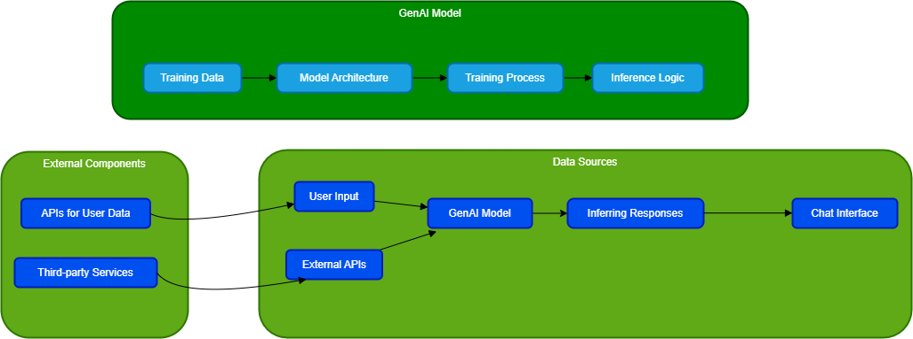
Architecture Diagram

Slide 6
Technologies used
Software and Tools
Python: Programming language for model development.
Hugging Face Transformers: Library for accessing pre-trained LLMs.
Intel AI Extensions: Tools for optimizing AI models on Intel hardware.
Scikit-learn: For data preprocessing and initial analysis.
Hardware
Intel 4th Generation Xeon Scalable Processors: For efficient model inference and fine-tuning.

Slide 7
Team Members
Project Completed by
YADAV A

Slide 8
Conclusion
The proposed solution showcases the potential of GenAI and LLMs in creating specialized chatbots. By leveraging Intel’s AI tools and hardware, we can develop efficient and domain-specific chatbots that offer robust performance and user-friendly interactions. This project not only serves as a practical demonstration of AI capabilities but also provides a scalable solution for various applications.

