Slide 1
Agents in Artificial Intelligence

Slide 2
What is an Agent?
An agent can be anything that perceive its environment through sensors and act upon that environment through actuators. An Agent runs in the cycle of perceiving, thinking, and acting. An agent can be:
Human-Agent: A human agent has eyes, ears, and other organs which work for sensors and hand, legs, vocal tract work for actuators.
Robotic Agent: A robotic agent can have cameras, infrared range finder, NLP for sensors and various motors for actuators.
Software Agent: Software agent can have keystrokes, file contents as sensory input and act on those inputs and display output on the screen.

Slide 3
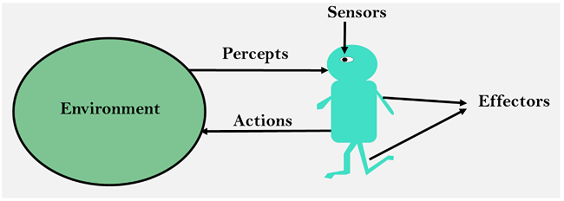
Sensor: Sensor is a device which detects the change in the environment and sends the information to other electronic devices.
Actuators: Actuators are the component of machines that converts energy into motion. The actuators are only responsible for moving and controlling a system.
Effectors: Effectors are the devices which affect the environment.

Slide 4
Intelligent Agents:
An intelligent agent is an autonomous entity which act upon an environment using sensors and actuators for achieving goals.
Rules for an AI agent:
Rule 1: An AI agent must have the ability to perceive the environment.
Rule 2: The observation must be used to make decisions.
Rule 3: Decision should result in an action.
Rule 4: The action taken by an AI agent must be a rational action.

Slide 5
Rational Agent:
A rational agent is said to perform the right things. AI is about creating rational agents to use for game theory and decision theory for various real-world scenarios.
Rational agents in AI are very similar to intelligent agents.

Slide 6
Structure of an AI Agent
The structure of an intelligent agent is a combination of architecture and agent program. It can be viewed as:
Agent = Architecture + Agent program
Following are the main three terms involved in the structure of an AI agent:
Architecture: Architecture is machinery that an AI agent executes on.
Agent program: Agent program is an implementation of agent function.
Agent Function: Agent function is used to map a percept to an action.
f:P* → A

Slide 7
PEAS Representation
PEAS is a type of model on which an AI agent
works upon.
P: Performance measure
E: Environment
A: Actuators
S: Sensors

Slide 8
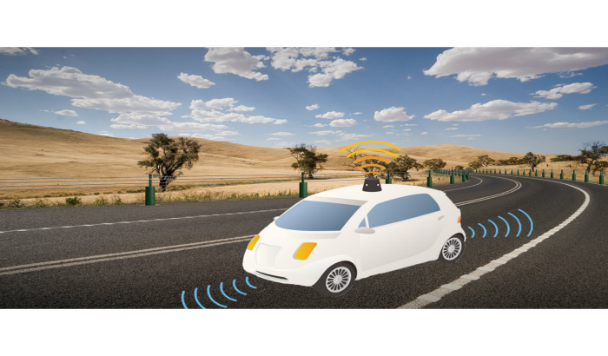
Example :
PEAS for self-driving cars:
Let's suppose a self-driving car then PEAS representation will be:
Performance: Safety, time, legal drive, comfort
Environment: Roads, other vehicles, road signs
Actuators: Steering, accelerator, brake, signal, horn
Sensors: Camera, GPS, speedometer, odometer, accelerometer, sonar.

Slide 9
Types of AI Agents
An intelligent agent is a program that can make decisions or perform a service based on its environment, user input and experiences.
Agents can be grouped into five classes based on their degree of perceived intelligence and capability.
Simple Reflex Agent
Model-based reflex agent
Goal-based agents
Utility-based agent
Learning agent

Slide 10
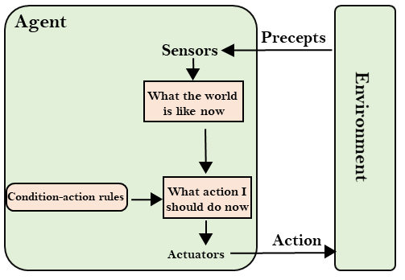
Simple Reflex Agents
They choose actions only based on the current percept.
They are rational only if a correct decision is made only on the basis of current precept.
Their environment is completely observable.
Condition-Action Rule − It is a rule that maps a state (condition) to an action.

Slide 11
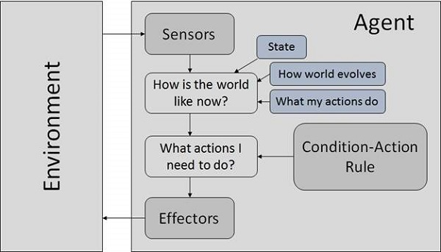
Model Based Reflex Agents
They use a model of the world to choose their actions. They maintain an internal state.
These agents have the model, "which is knowledge of the world" and based on the model they perform actions.
Updating the state requires the information about −
How the world evolves.
How the agent’s actions
affect the world.

Slide 12
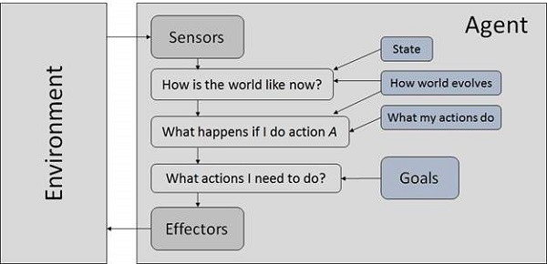
Goal Based Agents
It has a goal and has a strategy to reach that goal. All actions are taken to reach this goal. More precisely, from a set of possible actions, it selects the one that improves the progress towards the goal (not necessarily the best one).

Slide 13
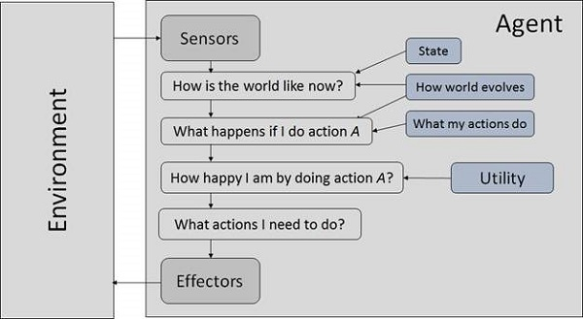
Utility Based Agents
These agents are similar to the goal-based agent but provide an extra component of utility measurement which makes them different by providing a measure of success at a given state.
Utility-based agent act based not only goals but also the best way to achieve the goal.
The Utility-based agent is useful when there are multiple possible alternatives, and an agent has to choose in order to perform the best action.

Slide 14
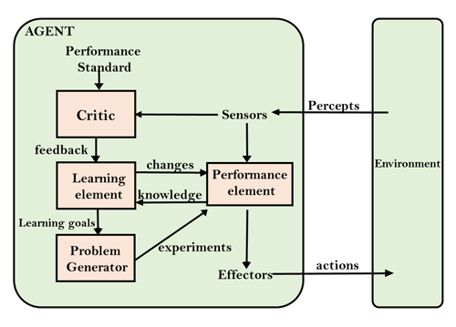
Learning Agents
A learning agent is an agent capable of learning from experience. It has the capability of automatic information acquisition and integration into the system. Any agent designed and expected to be successful in an uncertain environment is considered to be learning agent.

Slide 15
Agent Environment in AI
It is not a part of an agent itself. An environment can be described as a situation in which an agent is present.
The environment is where agent lives, operate and provide the agent with something to sense and act upon it.
Features of Environment
Fully observable vs Partially Observable
Static vs Dynamic
Discrete vs Continuous
Deterministic vs Stochastic
Single-agent vs Multi-agent
Episodic vs sequential
Accessible vs Inaccessible

Slide 16
Fully Observable / Partially Observable − If it is possible to determine the complete state of the environment at each time point from the percepts it is observable; otherwise it is only partially observable.
Examples:
Chess – the board is fully observable, and so are the opponent’s moves.
Driving – the environment is partially observable because what’s around the corner is not known.
Static / Dynamic − If the environment does not change while an agent is acting, then it is static; otherwise it is dynamic.
Discrete / Continuous − If there are a limited number of distinct, clearly defined, states of the environment the environment is discrete (For example, chess); otherwise it is continuous (For example, driving).
Examples:
The game of chess is discrete as it has only a finite number of moves.
Self-driving cars are an example of continuous environments as their actions are driving, parking, etc. which cannot be numbered.
.

Slide 17
4. Deterministic / Non-deterministic - When a uniqueness in the agent’s current state completely determines the next state of the agent, the environment is said to be deterministic otherwise it is non-deterministic.
Examples:
Chess – there would be only a few possible moves for a coin at the current state and these moves can be determined.
Self-Driving Cars- the actions of a self-driving car are not unique, it varies time to time.
Single agent / Multiple agents − An environment consisting of only one agent is said to be a single-agent environment. An environment involving more than one agent is a multi-agent environment.
Episodic / Non-episodic − In an episodic environment, there is a series of one-shot actions, and only the current percept is required for the action.
However, in Sequential environment, an agent requires memory of past actions to determine the next best actions.
Accessible / Inaccessible − If an agent can obtain complete and accurate information about the state's environment, then such an environment is called an Accessible environment else it is called inaccessible.

