Slide 1
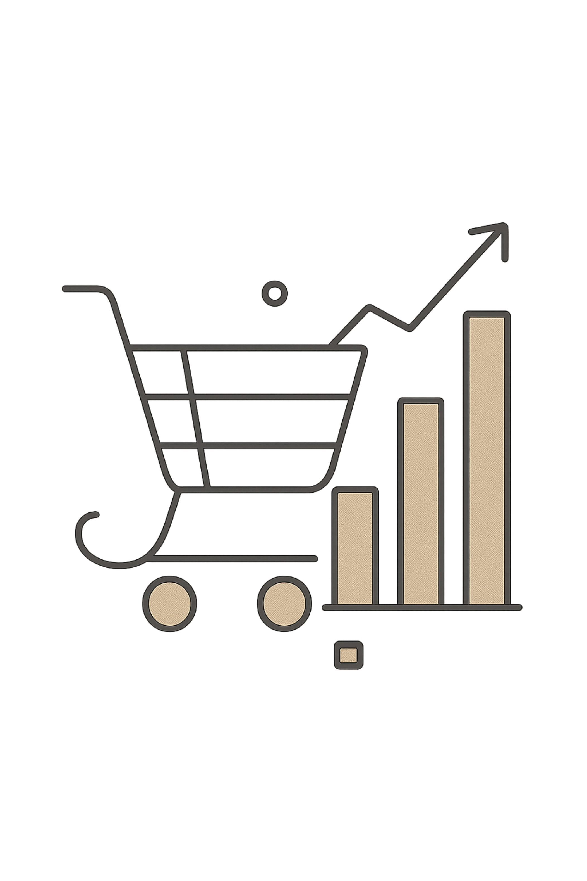
DATA ANALYTICS PROJECT
Customer Shopping Behaviour Analysis
Study of 3,900 transactions to identify customer segments, product performance, promotion behaviour and loyalty patterns.
PYTHON • SQL • POWER BI
From raw transactions → business actions

Slide 2
01
Executive Summary
3,900
18
37
98.87K
Transactions
Columns
Missing ratings
Repeat purchases
Imputed with mean
Power BI
01 Female customer gap
02 Revenue concentration
03 Retention opportunity
Female subscription is 0%; the subscription base is entirely male.
Clothing + Accessories account for ≈76% of product revenue.
A limited set of age-gender groups drives the top 70% of revenue.
BUSINESS TAKEAWAY
Focus resources where revenue is concentrated, while testing targeted offers to close female subscription and promotion gaps.
CUSTOMER SHOPPING BEHAVIOUR ANALYSIS
01

Slide 3

02
Dataset & Analytical Scope
3,900
18
37
Rows
Columns
Missing review ratings
WHAT THE DATA COVERS
Demographics • item & category • purchase amount • season • discounts • promo usage • purchase frequency • ratings • shipping
Data quality action: 37 review_rating values were imputed with the mean.
CUSTOMER SHOPPING BEHAVIOUR ANALYSIS
02

Slide 4
03
EDA & Data Preparation
01
02
03
Clean
Transformation
Feature Engineering
Imported with pandas; checked cardinality, .describe(), .info(), outputs and duplicates.
Renamed columns to snake_case; imputed 37 ratings; dropped redundant discount_applied.
Created purchase_frequency_days and age_group bins; renamed repeat_purchase_count.
READY FOR SQL
CLEAN EXPORT
ANALYSIS-READY
CUSTOMER SHOPPING BEHAVIOUR ANALYSIS
03

Slide 5
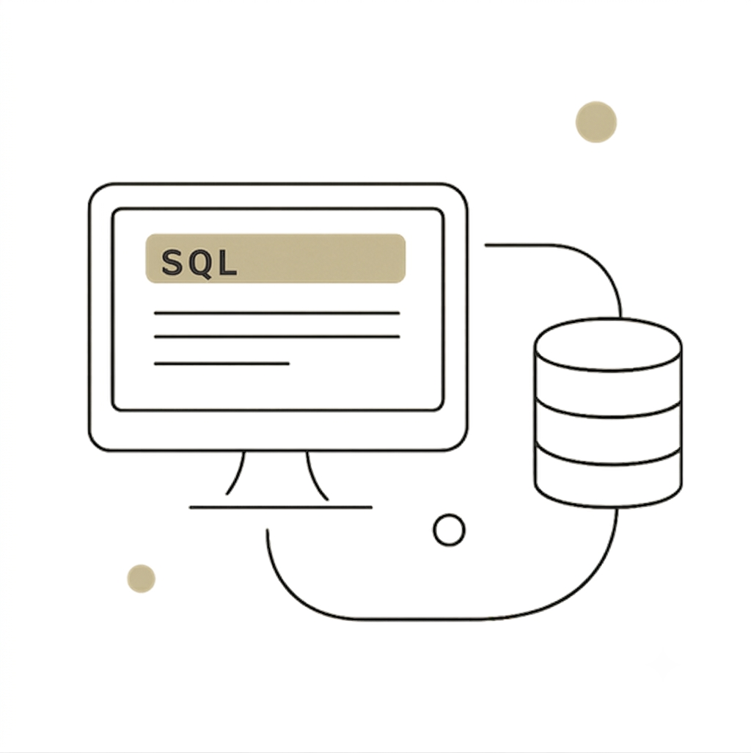
04
SQL Analysis Framework
ONE CLEAN DATASET UPLOADED • FOUR-PART ANALYSIS FRAMEWORK
01
Customer Overview
Who are the valuable customer segments?
02
Product Analysis
Which categories and products lead revenue?
03
Marketing & Promotion
How do promo and payment behaviours differ?
04
Customer Loyalty and Repeat Behaviour
Which segments drive repeat purchase and the top 70% of revenue?
All visuals and tables were generated from SQL queries against the cleaned export.
CUSTOMER SHOPPING BEHAVIOUR ANALYSIS
04

Slide 6

05
Customer Overview — Key Insights
0%
0.16
70%
Female subscribers
Frequency gap
Revenue lens
Subscription base is entirely male
Subscribers vs non-subscribers
Pareto concentration
Top-value segments
A small set of age-gender segments generate the majority of revenue based on average revenue per customer.
Subscription finding
Average purchase frequency differs only minimally between subscribers and non-subscribers.
CUSTOMER SHOPPING BEHAVIOUR ANALYSIS
05

Slide 7
06
Product Analysis — Revenue Concentration
PRODUCT REVENUE SHARE
JEANS
Clothing
44.7%
Sales are notably lower.
Accessories
31.7%
Recommended action
Review product, pricing and logistics factors behind lower sales.
Combined Clothing + Accessories ≈ 76% of product revenue.
CUSTOMER SHOPPING BEHAVIOUR ANALYSIS
06

Slide 8
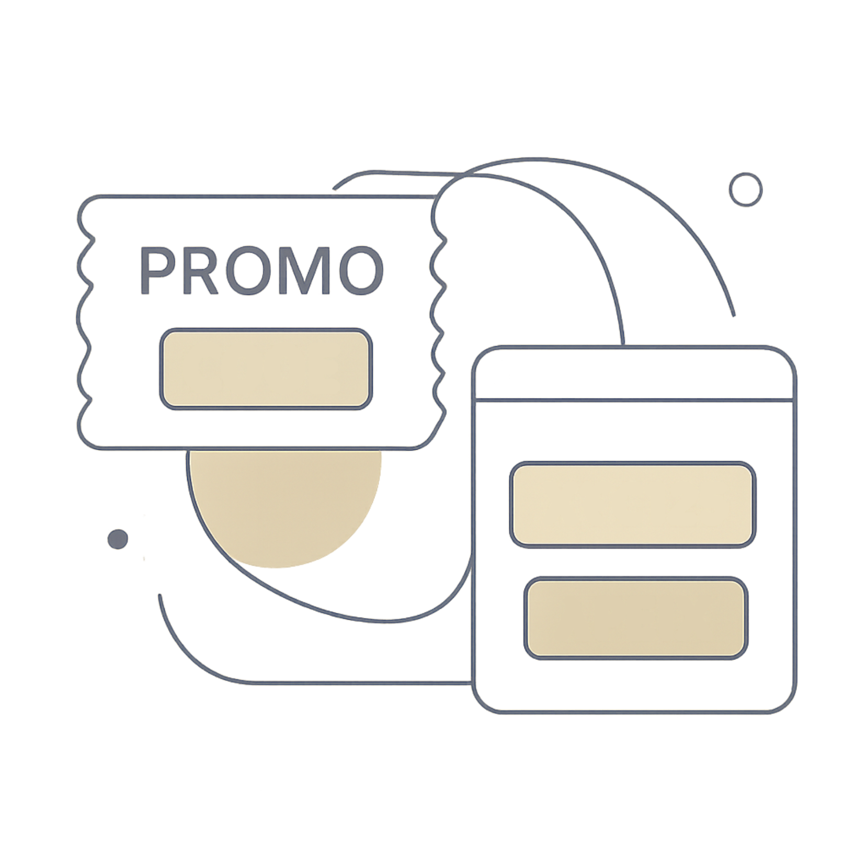
07
Marketing & Promotion Analysis
839
0.02
High-spend customers
Rating difference
Use promo codes
Promo vs non-promo
Promo use by payment
Promo-code share varies by payment method; online-payment incentives are worth testing.
Ratings are stable
Promo usage has a negligible effect on review ratings (difference = 0.02).
CUSTOMER SHOPPING BEHAVIOUR ANALYSIS
07

Slide 9
08
Customer Loyalty & Pareto Insights
1
2
3
Identify
→
Compare
→
Prioritise
Age-gender groups driving 70% of revenue
Assess repeat purchases across age groups
Focus retention actions on Pareto-ranked groups
KEY INSIGHT
Top 70% of revenue is concentrated in a limited set of age-gender groups; some age groups also show above-average repeat purchases.
Total repeat purchases reported in Power BI: 98.87K
CUSTOMER SHOPPING BEHAVIOUR ANALYSIS
08

Slide 10
09
Business Recommendations
1
Target female customers
2
Prioritise Clothing & Accessories
Target female customers—launch a dedicated discount campaign and subscription drive (currently 0% female usage in both)
Protect availability and investment in categories contributing ≈76% of product revenue.
3
Optimise shipping
4
Review Jeans & logistics
Test free-shipping offers for Outerwear; ~20% of Outerwear revenue comes from free-shipping orders.
Investigate product, pricing and shipping factors behind lower Jeans sales.
5
Encourage online payments
6
Rework subscription value
Test incentives for online payments to reduce COD reliance and improve cash flow.
Subscription status has minimal impact on purchase frequency (difference = 0.16).
PRIORITY: 1) Female growth 2) Category concentration 3) Retention 4) Payment & shipping optimisation

