Slide 1

Customer Behavior & Sales Performance Analysis
Using Power BI – Insights for Data-Driven Marketing & Growth Optimization
Presented By | Mahalakshmi Yadav

Slide 2
Introduction
Understanding customer behavior and sales performance is essential for improving retention, strengthening marketing strategies, and driving sustainable revenue growth.
However, businesses often face challenges such as:
Identifying what factors influence customer purchases
Determining which customer segments contribute most to sales
Understanding the causes of churn or low engagement
Measuring the impact of seasons, promotions, and product categories on revenue
To address these challenges, this project develops an interactive Power BI dashboard that analyzes Sales Performance and Customer Behavior across multiple dimensions, enabling data-driven decision-making.

Slide 3
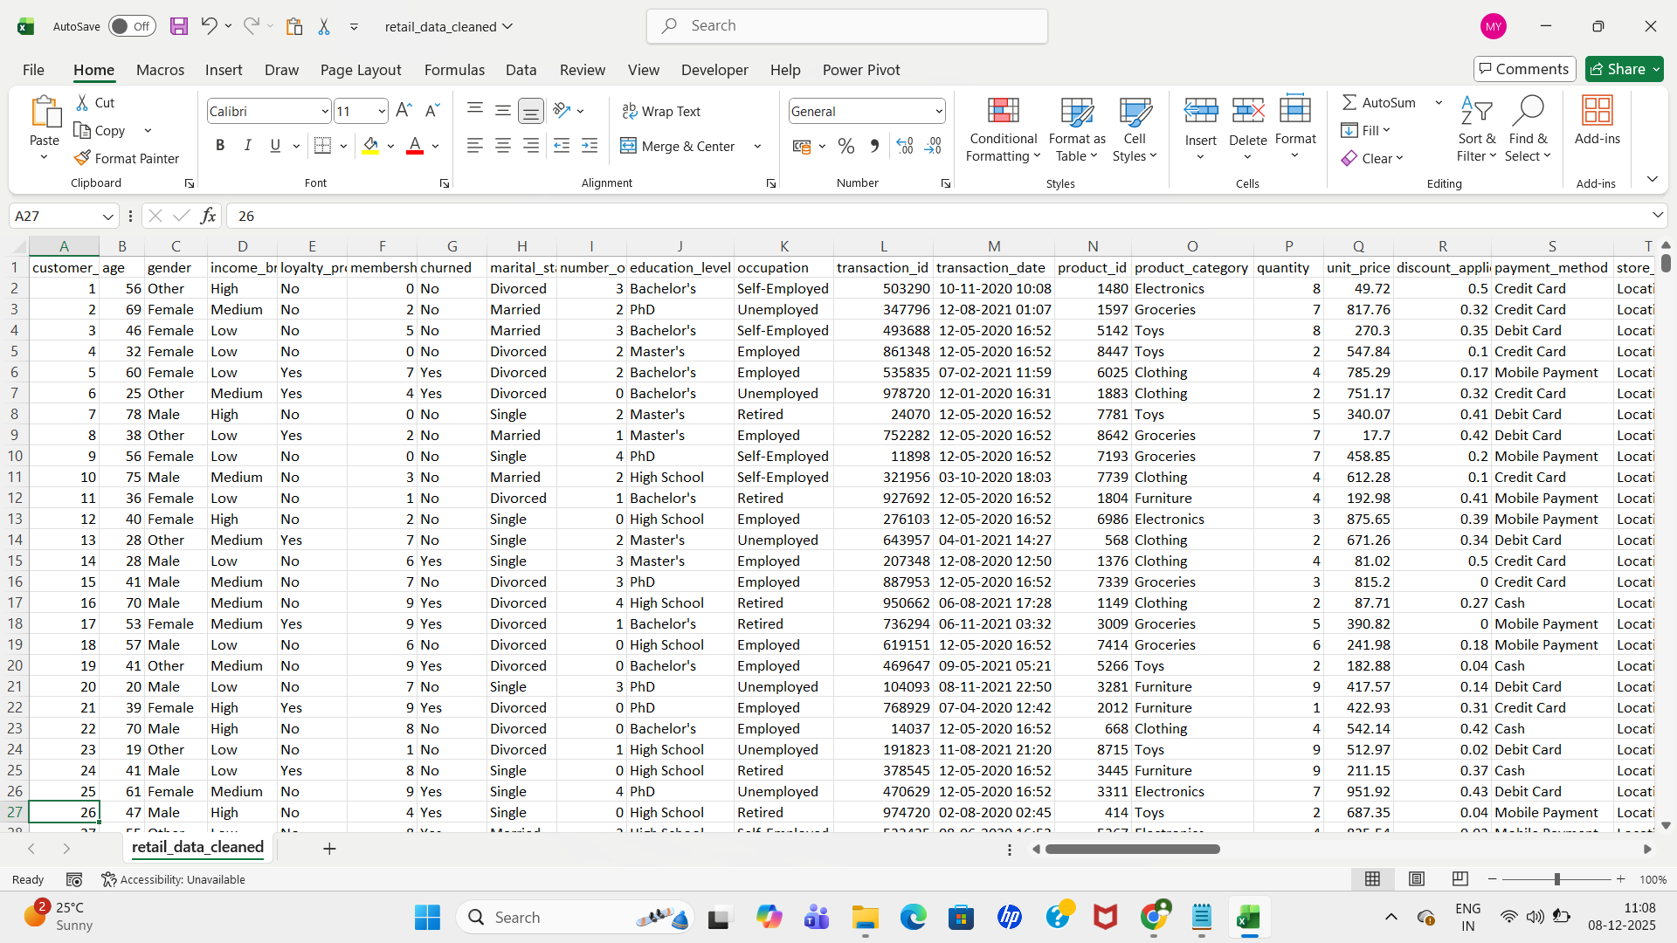
Dataset Overview
The dataset contains a comprehensive mix of transactional, demographic, product, and marketing information.

Slide 4
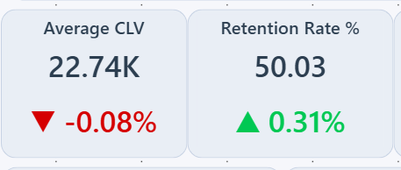
Key KPIs
Customer Lifetime Value (CLV) — 22.74K
Customer Lifetime Value represents the total revenue a customer contributes over their entire relationship with the brand. An average CLV of 22.74K signifies a strong revenue stream driven by high-value segments. Notably, customers with Master’s and PhD education levels have the highest CLV, indicating higher purchasing power and stronger engagement. Focusing on these segments can further maximize long-term growth.
Retention Rate — 50.03%
Retention rate reflects how consistently customers continue buying from the business. A retention rate of 50.03%, with a slight positive improvement (+0.31%), indicates moderate customer loyalty. This is a critical metric because retaining customers is far more cost-effective than acquiring new ones. Improving retention can significantly impact long-term profitability and strengthen brand loyalty.

Slide 5
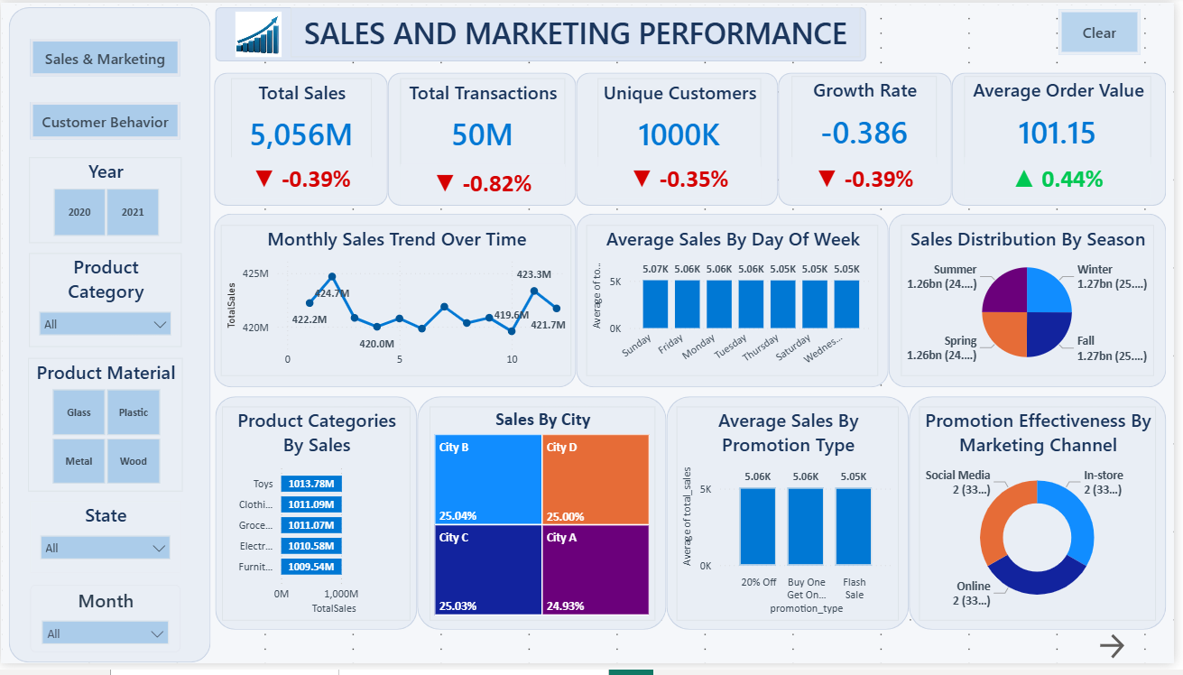
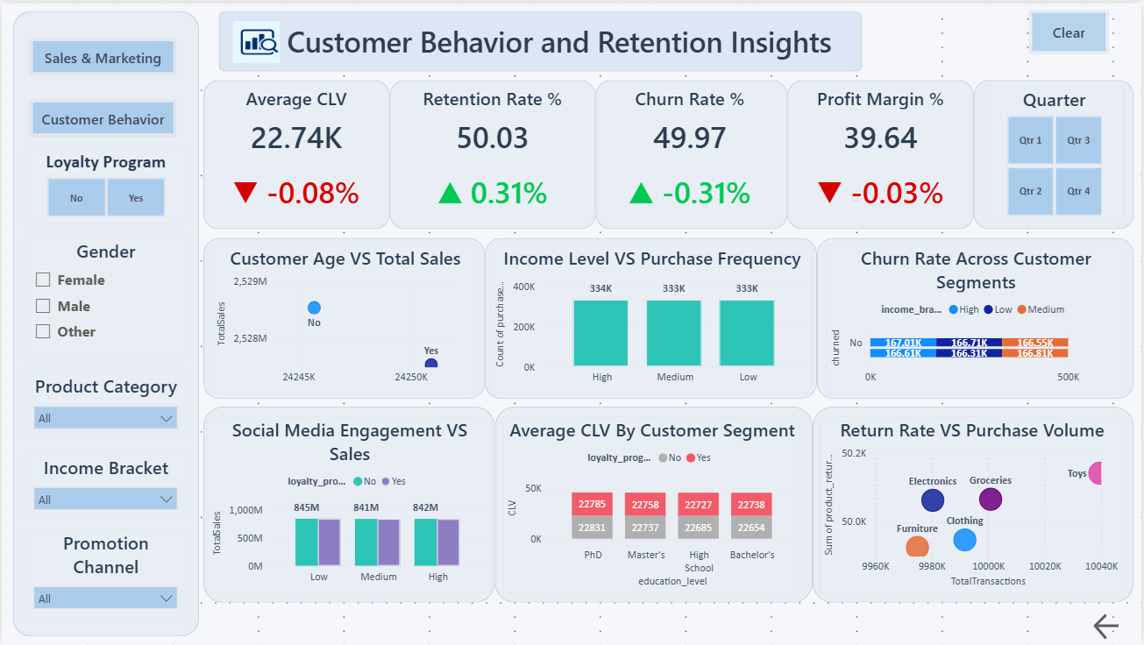
Power BI Dashboard

Slide 6
Business Insights & Findings
Sales Insights
Total Sales: 5,056M with consistent month-to-month stability
Top Categories: Toys, Clothing, and Grocery show the highest contribution
City-wise Sales: All cities exhibit balanced performance (~25% share each)
Seasonal Impact: Winter and Fall seasons generate slightly higher revenue
Promotion Effectiveness: Online and social media promotions drive strong engagement and conversions
Customer Behavior Insights
Retention Rate: ~50%, indicating moderate brand loyalty
Churn Rate: ~49.97%, highlighting a need for retention strategies
Income-Level Patterns: High-income customers purchase more frequently
CLV Segmentation: Customers with PhD and Master’s degrees show the highest CLV
Loyalty Membership: Members contribute higher sales and improved engagement
Social Media Influence: Increased social media engagement is directly correlated with higher purchases

Slide 7
Challenges & Future Enhancements
Challenges
Data cleaning required due to missing or inconsistent values
Merging multiple datasets with varying formats
Visualizing complex, multi-dimensional metrics effectively
Limited customer history affecting deeper behavioral analysis
Future Enhancements
Implement predictive models for churn prediction and sales forecasting
Add AI-based customer segmentation (e.g., K-Means clustering)
Enable real-time dashboard updates using APIs
Develop personalized recommendations for each customer segment

Slide 8
Conclusion
This project provides a comprehensive analysis of customer behavior and sales performance using advanced Power BI visualizations.
The insights obtained can help businesses:
Improve customer retention
Optimize promotional strategies
Enhance customer experience
Drive sustainable revenue growth
Overall, the dashboard serves as a powerful decision-support tool for marketing, sales, and management teams.
Thank you!!!

