Slide 1

Customer Churn Analysis
Understanding Customer Behavior & Improving Retention
Presented by: Mahalakshmi Yadav
Tools: Python | SQL | Power BI

Slide 2
Problem Statement
Customer churn refers to customers discontinuing a company’s service.
In competitive industries, customer retention is critical, as acquiring new customers is significantly more expensive than retaining existing ones.
Objective of the Project:
Identify customers at risk of churning
Analyze key factors influencing churn
Provide data-driven insights to improve retention strategies

Slide 3
Tools & Technologies Used
Python
Data preprocessing and cleaning
Handling missing and inconsistent values
SQL
Data extraction and transformation
Querying and aggregating customer data
Power BI
Interactive dashboard development
KPI tracking and visual storytelling
Advanced features like tooltips and bookmarks

Slide 4
Dataset Overview
The dataset contains customer information from a telecom domain.
Dataset Highlights:
Total Customers: ~7,000+
Features: 20+ variables
Key Attributes:
Demographics: Gender, Senior Citizen
Services: Internet Service, Phone Service
Account Details: Contract Type, Payment Method
Financials: Monthly Charges, Total Charges
Target Variable: Churn (Yes/No) or (1/0)

Slide 5
Data Cleaning & Preparation
Data preprocessing was performed to ensure accuracy and reliability of analysis:
Converted data types (e.g., Total Charges to numeric format)
Handled missing and null values
Removed inconsistencies and errors
Standardized categorical variables
Validated data for analytical consistency

Slide 6
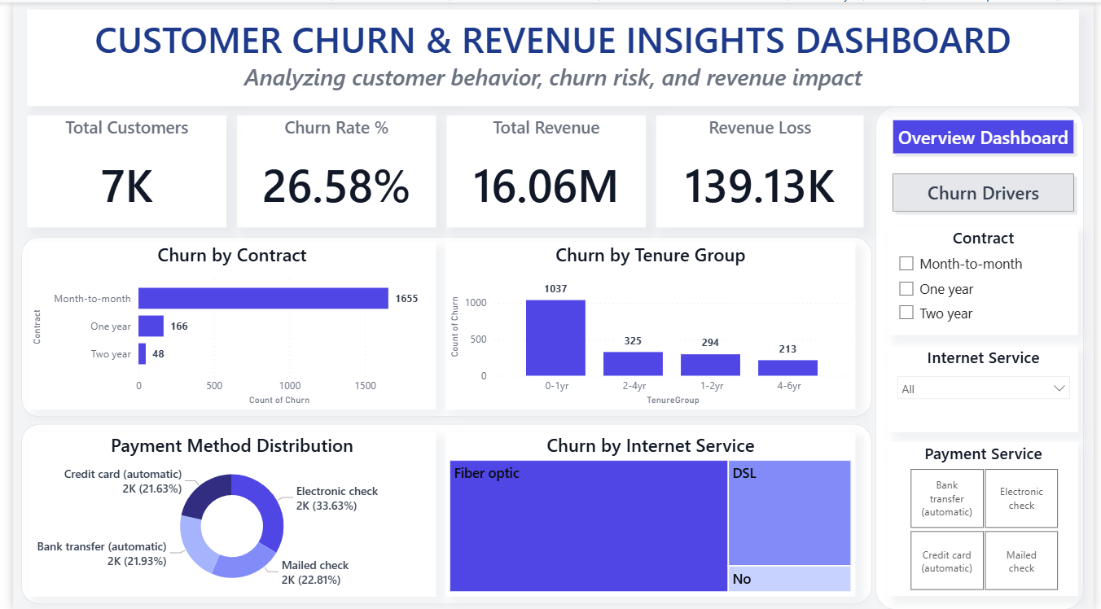
Dashboard Overview

Slide 7
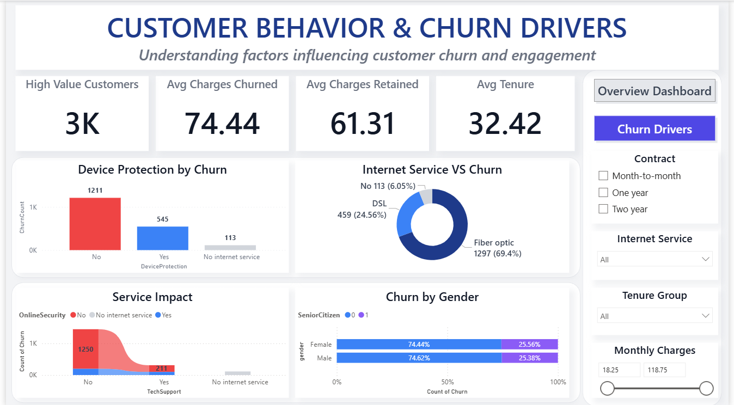
Dashboard Analysis

Slide 8
Key Insights
The analysis reveals several important business insights:
Customers with month-to-month contracts exhibit the highest churn, indicating low long-term commitment
Users with fiber optic internet service show higher churn, possibly due to pricing or service expectations
Customers with higher monthly charges are more likely to discontinue services
Long-term contract customers demonstrate significantly lower churn rates

Slide 9
Conclusion & Business Recommendations
Conclusion: Customer churn is influenced by multiple factors, including contract type, service offerings, and pricing structure.
Additionally, the analysis highlights that customer commitment level and perceived value of services play a crucial role in retention. Customers with flexible plans and higher costs tend to switch providers more frequently, indicating the need for stronger engagement strategies.
Proactively identifying high-risk customers allows businesses to take timely actions and reduce potential revenue loss.
Recommendations:
Promote long-term contracts to improve retention
Enhance service quality, especially for high-risk segments
Offer personalized plans and loyalty incentives
Monitor high-charge customers proactively

Slide 10
Future Scope
This project can be further enhanced by:
Developing Machine Learning models to predict churn
Implementing real-time dashboards for continuous monitoring
Performing advanced customer segmentation
Integrating with business systems for automated decision-making
THANK YOU!!!

