Slide 1

Chapter 2
Attack Scenarios and Involved Threat Actors

Slide 2
Introduction
Organizations and companies face a new worldwide level of sophistication in cyber attacks due to the continuous evolution of technology.
Technological changes, such as the rise of cloud technology, widely available low-priced bandwidth, and cryptocurrency, bring new security threats.
The resulting threat landscape calls for a paradigm shift and for fundamentally new approaches in cyber defense.
Security breaches and cyber attacks of all kinds are becoming more professional, stealthy, automated, and complex.
These advanced forms of cyber attacks and threat actors beat traditional defense methods and techniques.

Slide 3
The Definitions of Cyber security in a Nutshell.
Security in general covers the protection of critical assets from numerous threats posed by various vulnerabilities.
Therefore, the determination of assets deserving protection from threats helps to distinguish among the commonly used terms:
information security,
ICT security, and
cyber security.
The aim of information security (IS) is to preserve business continuity and to minimize business damage by limiting the impact of security incidents.
According to the international standards, such as the ISO 27002, information security deals with the protection of confidentiality, integrity, and availability of information stored electronically or on paper.

Slide 4
The term cyber security is usually understood as an all-inclusive term covering information security, ICT security, and their combination.
The prefix cyber is used to describe terms relating to ICT security and information security, but with a strong “cyber component.”
Thus, cyber security describes the protection of persons, societies, and nations, including their information- and non-information-based assets via tools, security concepts, guidelines, risk management approaches, best practices, and technologies in order to protect the interest of a person, society, or nation.
It aims to protect all information-based and non-information-based assets, including persons and knowledge, that are threatened via exploited ICT.

Slide 5
In general, cyber security is used as an umbrella term whereas information security sets its focus on the preservation of the CIA triad—confidentiality, integrity, and availability—of information, and ICT security focuses on the underlying technical infrastructure.
Cyber security takes a broader view and includes the human dimension in its operating and protection range.

Slide 6
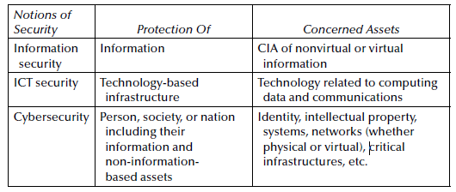
Notions of Security

Slide 7
On Cyber Attacks, Cybercrime, and Cyberwar: Emerging Trends and Threats
Cyber security aims to prevent, detect, and respond to cyber incidents and attacks, and mitigate cyber threats.
Unlike physical threats, they are mainly stealthy, and the threat actors usually manage to remain anonymous. The spectrum of risks is limitless.
A cyber attack refers to an attack that is carried out through ICT and compromises the cyber security of persons, societies, or nation-states, targeting their information- and non information-based assets.
Cyber attacks may include various consequences:
breach of access, data exfiltration, identity theft, fraud, intellectual property theft, denial of service, and malware infection.
Not every single cyber attack has the potential to escalate into serious conflicts.

Slide 8
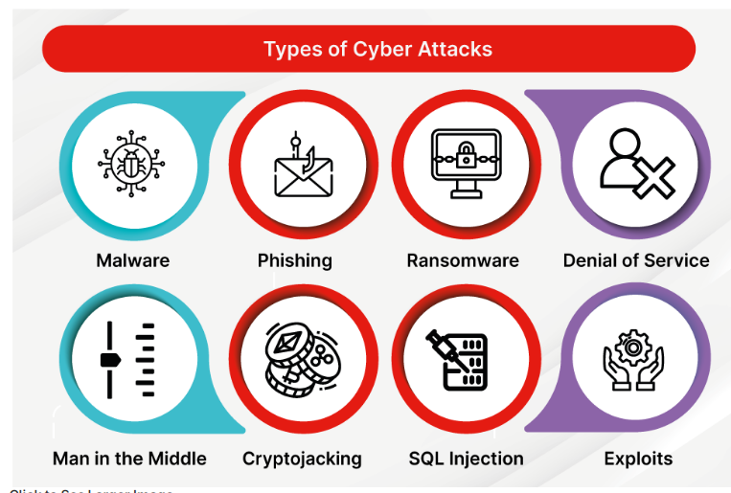

Slide 9
A cyber campaign refers to a series of planned cyber attacks and other supporting operations.
Cyber attacks are becoming more sophisticated, and their tactics, techniques, and procedures (TTPs) are continuously developing.
Due to the variety of exploitable technologies and applied techniques, it has become quite hard to maintain a consistent categorization of cyber attacks.
The documentations of cyber attacks use confusing categories that are partly overlapping with each other, such as cybercrime, data breaches, cyberwarfare, and government and corporate espionage.

Slide 10
One preferable option is the categorization of cyber attacks by their targets, for example, government facilities, corporate facilities, or military facilities.
However, the borderlines between these target categories are also blurred.
From a legal and law enforcement aspect, cyber attacks can be divided into two large categories:
cybercrime
cyberwar.
In this categorization, cyber espionage (the malicious theft of data, information, or intellectual property from and/or through computer systems) and cyber terrorism belong to cybercrime. The main difference is the attacker’s motivation.
In case of cyber terrorism, the threat actors have political, religious, or ideological motivation,
Motivation behind cyberwar is related to the protection of homeland and national assets

Slide 11
Currently, the term cyberwar has no official or generally accepted definition.
After analyzing a great number of definitions of cyberwar, the following definition presents a trade-off among the diverse approaches (Uma and Padmavathi, 2013):
cyberwar is an escalated state of conflict between or among nation-states in which cyber attacks are carried out against ICT systems of critical infrastructures as part of a military campaign (NATO -North Atlantic Treaty Organization CCDCOE, 2016).

Slide 12
Although there is no universal definition of cybercrime, it is becoming increasingly accepted that the term is used to describe crime and other illicit activities (Hunton, 2009) that involve the use of ICT.
Some organizations distinguish between advanced cybercrime and cyber-enabled crime (Interpol, 2016).
Advanced cybercrime covers sophisticated attacks executed within cyberspace,
Cyber enabled crime includes “traditional” crimes enabled by technological (or ICT) achievements, such as financial crimes, online fraud, and even terrorism

Slide 13
Cybercrime is so fast growing that international law enforcement agencies opened an additional category for the most wanted cyber criminals.
The nature of cybercrime has evolved remarkably in its quite short history.
In the past, cybercrime was committed mainly by individuals (Interpol, 2016). Today, it is committed by highly organized and professional groups from all over the world.
The crimes are not necessarily new, but the TTPs are continuously evolving with the opportunities presented by the evolving ICT.
Cybercrime often falls still into a regulatory gray area, and the ability to categorize the true scale and criminal nature of cybercrime remains difficult.

Slide 14
EXAMPLE: CYBERWAR CASES
In 2007, the highly networked Estonian government was the target of cyber attacks. The DoS attacks began on the foreign minister’s website but spread to all government institutions and key businesses, such as banks. The large-scale attack had a significant effect on public life in the small country (Lesk, 2007).
There were also conflicts between Bangladesh and Myanmar (Burma) that escalated in continuous cyber attack, such as defacing governmental websites, by national hacktivists from both sides (Gandhi et al., 2011).

Slide 15
The Russian-Georgian cyberwar in August 2008 represented a long
history of geostrategic conflicts between the two nations; it was based on many complex factors, such as geopolitical, legal, cultural, and economic (Hollis, 2015). Synchronized with the physical attack, Russia started attacking Georgia’s military and government networks and assaulting websites related to communications, finance, and government to block communication with the citizens (Oltsik, 2009).

Slide 16
Emerging Technologies and Threat Trends in Cyberspace
There is still no common definition of cyberspace, but militaries especially usually treat it as an own domain, namely, as the fifth one after land, sea, air, and space.
The fundamental difference between cyberspace and the other domains is that the hierarchy of the other domains is geophysical by nature.
Cyberspace is embedded in all domains and it is transforming continuously.
The NATO definition states that cyberspace is the name given to the global and dynamic domain composed of ICT.
It has blurred borders, involving users in an unprecedented globalization that provides new opportunities but also entails new challenges, risks, and threats (NATO CCDCOE, 2017).

Slide 17
One commonly described property is that cyberspace is in a continuous state of change. Cyberspace is still in expansion, as well as the resulting attack surface.
There are hundreds of technological, societal, economic, and regulatory/legal trends that constantly shape the appearance of cyberspace.
One of the most significant technology trends with impact on security is the Internet of Things (IoT). It multiplies exploitation opportunities.
Internet connected devices are being rapidly adopted by both consumers and businesses, particularly in sectors such as manufacturing, healthcare, and entertainment.

Slide 18
IoT has begun to change the virtual but also the real world. On the one hand, the growing use of smart equipment in private and public life leads to the continuous tracking of its users.
IoT generates a huge amount of data, sometimes referred to as Big Data
Big Data is compiled from an increasing amount of data from sensors, smart systems, entertainment products, and social media applications
The data volume will continue to grow and the analysis techniques must (and certainly will) improve.
Processing Big Data, especially the merging of different large databases, faces already huge challenges— on the one side with privacy regulation and on the other side with security

Slide 19
Example:
first wave of smart vehicles.
Leading manufacturers have to deal with numerous privacy problems because of continuous tracking of the physical car and its geolocation. The first published cyber incidents targeting smart cars took place in summer 2015 (Ring, 2015). Hackers succeeded in intruding into some cars’ systems via mobile telephone networks and were able to take over vital functions such as the brake system and engine (Schellekens, 2016).
wireless technology
such as smart home platforms and fitness trackers. Generally speaking, the use of wireless devices increases the risk of potential cybersecurity threats. The increasing use of wireless office devices, such as the wireless keyboard and mouse, opens new opportunities for gaining access to potential target systems

Slide 20
cryptocurrencies.
Cryptocurrencies such as Bitcoin, Ether, or Solar Coin have the potential to significantly change the finance sector and the cyber domain by reviving the business of cyber attacks, especially ransomware. The news in 2015 and 2016 was full of stories about cyber attacks using ransomware focusing on public and private facilities (Pathak and Nanded, 2016). Main advantages of ransomware business for criminals are the the low-maintenance and operation costs and the short path to anonymous monetization thanks to Bitcoin.

Slide 21
The anonymity provided by cryptocurrency, especially by Bitcoin, led to a rising number of ransomware attacks on soft target organizations. Modern ransomware attacks increasingly target small businesses, local government, and medical institutions due to their historically often poor information security maturity levels. Because of the lack of regular backups and suitable protective measures in these organizations, different ransomware tactics have evolved.
Distributed denial-of-service (DDoS)
DDoS attacks continue to increase in frequency, complexity, and size and focus mainly on cloud services, financial services, and the public sector (Verisign, 2016).

Slide 22
Deep and Dark web.
Deep Web (the part of the Internet that cannot be discovered by using traditional search engines. It contains web pages, databases, networks, and online communities that are hidden from average users). Dark Web is a part of the Deep Web. The Dark Web is based on secured networks where connections are made between trusted peers (Ciancaglini et al., 2016), using TOR, Freenet, or I2P.
Nowadays information located on the Deep Web is estimated to be 400–550 times larger than the information on the Surface Web. Hence, the Deep Web is the largest growing part of the Internet (Bergman, 2001) and massively increases the number of threats

Slide 23
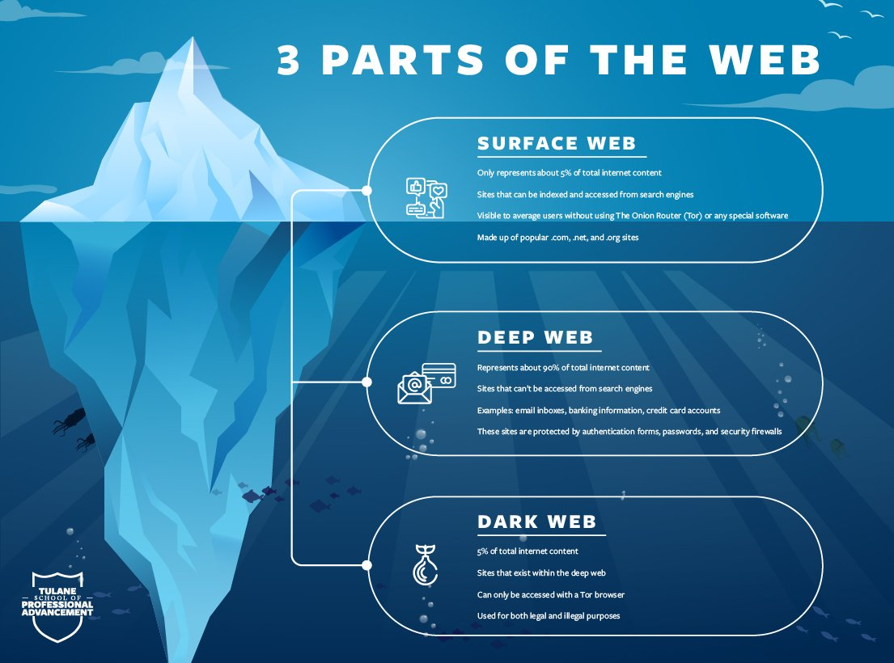

Slide 24
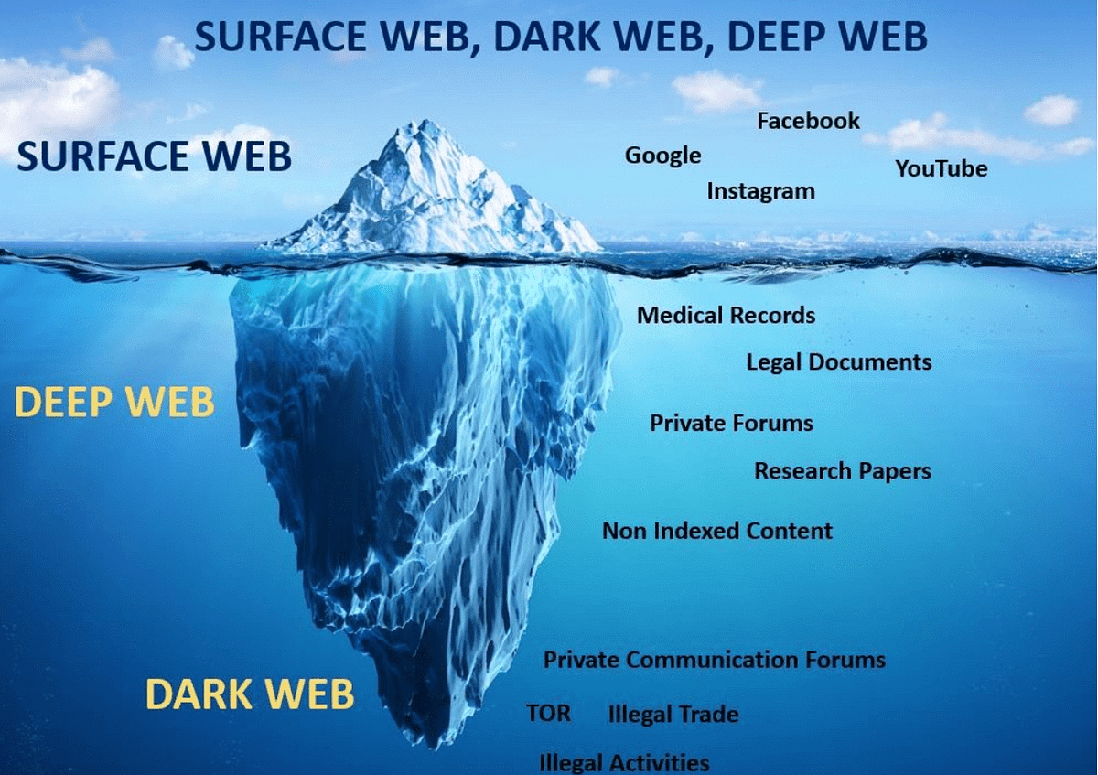

Slide 25
A series of new off-the-shelf tools are commoditizing the art of hacking. This makes it possible for everybody, even with little know-how, to launch attacks by renting services from the Dark Web.
Available services allow, for instance, the renting of botnets for a small fee from botnet owners for the purpose of launching DDoS attacks.
Industrial control systems (ICS).
There is an increasing interest in industrial products as targets. A significant incident was the successful attack on the Ukrainian power grid, which resulted in a large-scale power outage (U.S. DHS ICS-CERT, 2016). Countless organizations have fallen prey to cyber attacks, even large companies with advanced defense methods.

Slide 26
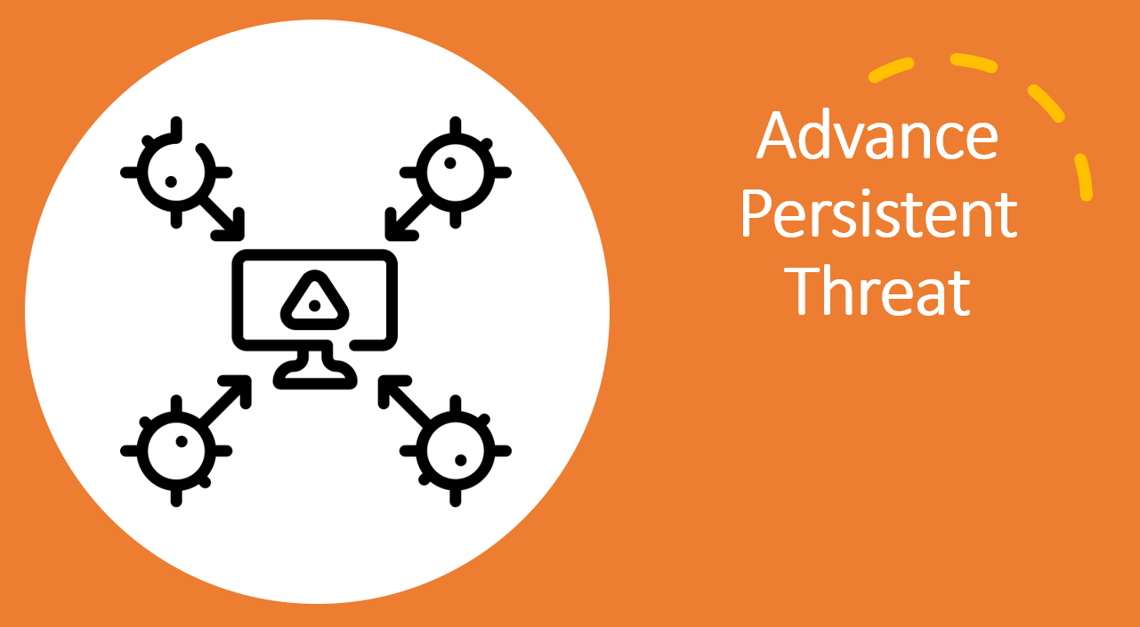

Slide 27
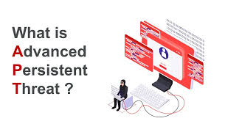
In recent years, a new category of cyber threats hit the mainstream, namely, the advance persistent threats (APTs).
APTs are carried out by sophisticated and well-resourced adversaries targeting specific information in high-profile companies and governments.
Usually in a long-term campaign involving different methods and tools, such as the latest zero-day vulnerabilities, sophisticated toolkits, and social engineering techniques.
An APT is carried out by “an adversary that possesses sophisticated levels of expertise and significant resources which allow it to create opportunities to achieve its objectives by using multiple attack vectors (e.g., cyber, physical, and deception).

Slide 28
The advanced persistent threat:
pursues its objectives repeatedly over an extended period of time;
adapts to defenders’ efforts to resist it; and
(iii) is determined to maintain the level of interaction needed to execute its objectives”
APTs focus on specific high-value targets and their intellectual property or classified information in order to gain strategic benefits.
in APTs an attacker carries out multiple steps over a longer time span.

Slide 29
APTs start repeated attempts to access the target system within long-term campaigns.
As APTs target advanced victims, mainly governmental organizations, finance, high-tech, and consulting companies (FireEye, 2016), they may need more time and advanced tools to penetrate the company’s defense line while remaining undetected.
Therefore, the threat actors of APTs are usually well resourced and organized groups with deep technical know-how.

Slide 30
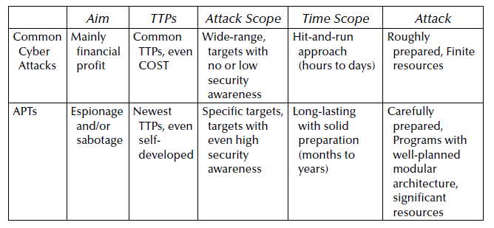
Attack Characteristics

Slide 31
Cyber Kill Chain
A kill chain is a systematic process to target and engage an adversary to create desired effects”
Basically, it is a simplified approach of the cyber kill chain model proposed by Lockheed (2014).
It is part of the Intelligence Driven Defense model for identification and prevention of cyber intrusions activity.
The model identifies what the adversaries must complete in order to achieve their objective.
APTs generally follow the following common phases in the cyber kill chain:
(1) reconnaissance, (2) weaponization, (3) delivery,
(4) exploitation and initial intrusion,
(5) command and control (C2 or C&C) and lateral movements, and
(6) actions of intent.

Slide 32
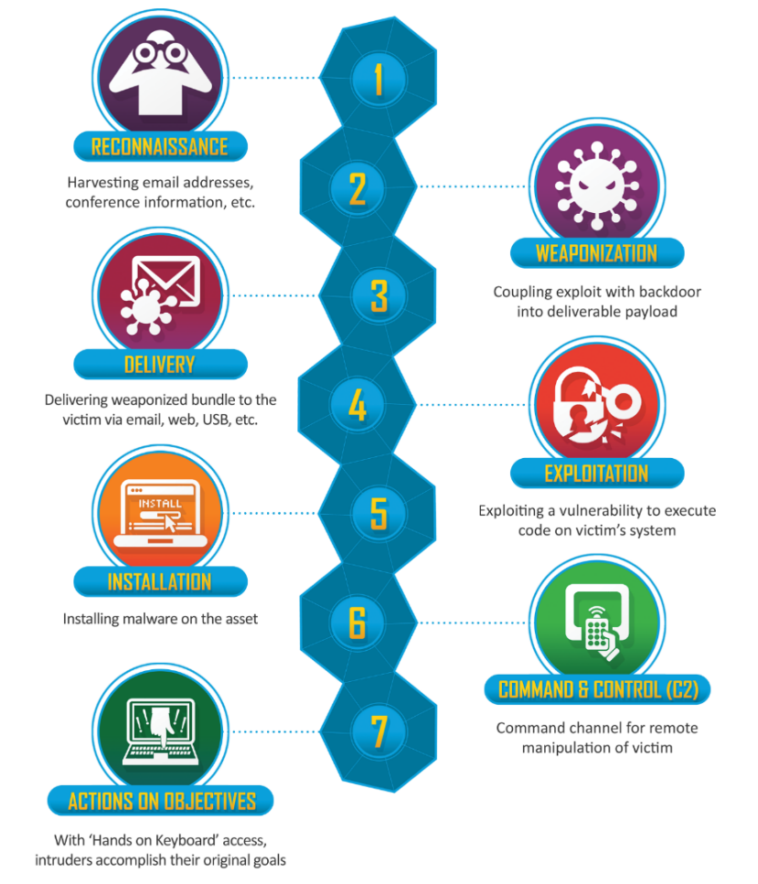

Slide 33
Step 1: Reconnaissance
In this phase, the threat actor tries to collect all relevant information about the target organization in order to discover the target’s technical environment, organizational processes, and key personnel that could be exploited to achieve the threat actors’ objective.
As part of this process, the attacker may harvest login credentials or gather other information, such as email addresses, user IDs, physical locations, software applications and operating system details, all of which may be useful in phishing or spoofing attacks.
The threat actors can gain valuable information from open source intelligence (OSINT) or gain internal information through social engineering.

Slide 34
The following OSINT sources might be relevant for information gathering or for further social engineering fraud: corporate websites, social networks, press releases, public documents, white papers, job offers, and search engines.
Generally speaking, the more information the attacker is able to gather during the Reconnaissance phase, the more sophisticated and convincing the attack will be and, hence, the higher the likelihood of success.

Slide 35
Input: Selected target
Activity: Data gathering on the target
Output: Solid knowledge of the target system, discovered vulnerabilities for
further attacks
Tools and techniques: Traditional or special search engines, social engineering

Slide 36
Step 2: Weaponization
Weaponization covers the preparation of malicious payloads for further attacks. In this phase, the threat actor has solid knowledge of the target’s attack surface, and it has identified potential victim employees.
Weaponization refers to compiling tailored malware for the discovered vulnerabilities in order to gain remote access to the target system

Slide 37
The attacker creates an attack vector, such as remote access malware, ransomware, virus or worm that can exploit a known vulnerability.
During this phase, the attacker may also set up back doors so that they can continue to access to the system if their original point of entry is identified and closed by network administrators.

Slide 38
Input: Solid knowledge of target system, collection of potential entry points
to the system
Activity: Designing the initial compromise
Output: Malicious payload
Tools and techniques: Zero-day vulnerabilities, tailored malware

Slide 39
Step 3: Delivery
Delivery covers the transmission of the malicious payload to a target using different methods, for instance via e-mail attachments, websites, or USB sticks.
The delivery of the exploits could be performed in a direct or indirect way.
The direct delivery mechanisms utilize various social engineering techniques, such as spear phishing.
Phishing e-mails usually contain a clickable link which forwards the user to a fake website.

Slide 40
Another way for delivering the payload is provided by social networks.
Professional business networks or social networks—such as LinkedIn, Data.com Connect, Xing, Beyond, and Facebook—provide a huge amount of useful information for the APT attackers.
APT hackers just need to create a fake profile and send connection request to the members of the target company.
The attacker sends a link, for instance, in the traditional phishing e-mail or a malicious attachment.
The attacker can compromise the victim’s device within the company and move on to infect more hosts or even install a backdoor on the target system.

Slide 41
An example for direct delivery is to attack the companies’ Internet servers, such as e-mail or DNS. After finding vulnerabilities (such as configuration weaknesses) on a publicly reachable server, the attacker can compromise further hosts and install a backdoor.
Indirect delivery happens through a trusted third party of the target company, causing APT attackers to be hard to trace. A trusted third party can be a supplier or a legitimate website that is frequently visited or contacted by the target company

Slide 42
Input: Tailored payload, solid knowledge of target system
Activity: Delivery of the malicious payload
Output: Malicious payload delivered, compromised hosts
Tools and techniques: Phishing, spear-phishing, watering hole, physical access

Slide 43
Step 4: Exploitation and Initial Intrusion
After delivering the payload, vulnerability needs to be exploited in order to be able to execute the malicious code on the victim’s system.
The attackers do not necessarily need technical exploits if they obtain access credentials through social engineering and simply use them to gain access to the victim’s systems.
The execution of the exploit is relevant only when APT attackers take advantage of detected software or hardware vulnerabilities, in sophisticated cases zero-day exploits
Zero-day vulnerabilities are undisclosed computer-software vulnerabilities that hackers can exploit to adversely affect computer programs, data, additional computers, or a network.

Slide 44
Installation refers to installing malware on the infected computer. The installation is relevant only if the APT attacker used malware as a part of the attack or malware is involved.
The exploitation and installation make the initial intrusion to the target system possible. After accessing the target system, APT attackers establish a foothold in the network, typically by installing backdoor malware

Slide 45
Input: Payload is delivered to the target
Activity: Exploit the target’s vulnerabilities, installation of further malware
Output: Initial intrusion to the target system
Tools and techniques: Backdoor malware, zero-day exploits, unpatched vulnerabilities

Slide 46
Step 5: C2 and Lateral Movements
The aim is to establish remote access to the target system for further attacks and investigation.
This stage usually takes longer, hence the activities run slowly in order to evade detection.
Backdoors allow attackers to establish connections to their command and control (C&C or C2) channel. The C2 mechanism takes control of the compromised hosts.
The backdoor installation applies a number of strategies to enable successful intrusion, such as port binding, connect-back, connect availability use, or legitimate platform abuse.
In order to remain undetected, attackers increasingly use more advanced services and tools.

Slide 47
Some APT attackers host their C2 servers in Tor to remain anonymous and avoid being blocked and blacklisted.
In APT attacks, the commonly used RATs (Adachi and Omote, 2016) are Poison Ivy RAT, DakComet, Black Shades, njRAT, ZxShell, and Gh0st RAT
The next step after infecting one endpoint or system within the target organization is spreading the malicious activity in order to establish a foothold.
The APT attacker might have managed to gain the credentials of a privileged user or managed to cause privilege escalation.
The Active Directory service (AD) is a preferred target related to privilege escalation. Once successfully attacked, AD could enable control of the whole network to the threat actors.

Slide 48
lateral movement, such as internal reconnaissance, compromising additional systems, privilege escalation, and identifying valuable assets and information location, such as password hashes in the Security Account Manager
Input: Successful initial intrusion
Activity: Use of the tools to establish remote access, establishing foothold, lateral movements
Output: Control of the target system, establishing (persistent) access to the target
Tools and techniques: C&C server, RATs, backdoors

Slide 49
Step 6: Actions of Intent
After preparing the victim system, the threat actors execute the final attack phase in order to achieve their primary goal. This might include the destruction of essential control systems, DDoS attacks against critical services, or data exfiltration.
Data exfiltration refers to copying or transferring the desired information to the C&C server or to an internal server where it is encrypted and prepared for transmission to the threat actor.
The unauthorized exfiltration is executed in several steps so that the network traffic does not differ too much from the daily traffic.

Slide 50
The attacker can use FTP or HTTP to send the files in order to obfuscate the exfiltration as legitimate communication within the target network.
The sensitive data now can be delivered to the customer or be sold on anonymous marketplaces on the Deep Web.
Input: APT attackers have established foothold and prepared the last attack
Activity: Actions on target, such as data exfiltration, DDoS, paralyzing essential control systems, etc.
Output: Primary goal achieved
Tools and techniques: FTP, HTTP—both for illegitimate transfers.

