Slide 1
Information Sharing
Chapter 4

Slide 2
Introduction
Importance of Cybersecurity:
Critical infrastructures (telecommunications, electricity) face increasing cybersecurity threats.
Operators struggle due to standard ICT products and network interdependencies.
Need for New Approaches:
Exchange of network monitoring data and threat information across organizations is crucial.
Aims to enhance situational awareness for better incident preparedness and response.
Collaboration Benefits:
Sharing threat information aids in coordinated countermeasures.
Helps protect against various cyber threats (cybercrime, cyberwar, hacktivism, terrorism).

Slide 3
Challenges with Current Solutions:
Standard antivirus and firewall systems often inadequate against advanced threats (APTs).
Growing network complexity and emerging vulnerabilities contribute to frequent novel attacks.
Information Platforms:
Existing platforms provide generic security information, lacking industry-specific details.
Sector-specific insights and experience reports needed for effectiveness.
Role of National Cybersecurity Centers:
Proposed by standardization bodies (NIST, ITU-T, ISO) for coordinated cybersecurity efforts.
Establishment challenges include technical, legal, and multidisciplinary research needs.
Peer-to-Peer (P2P) Sharing:
Limited experience in P2P information sharing among companies due to risks (low quality info, reputational issues).
Awareness and solutions for these challenges are critical.

Slide 4
The Dimensions of Information Sharing
1.Efficient Cooperation and Coordination:
Importance of coordinated cyber defense due to complex systems and sophisticated attacks.
Information sharing is essential for stakeholders, covering:
Indicators of Compromise (IoCs)
Technical vulnerabilities
Zero-day exploits
Social engineering attacks
Critical service outages
2. Legal and Regulatory Landscape:
Information sharing requires a strong legal foundation.
Recent EU and US directives and regulations aim to facilitate broader adoption.

Slide 5
3. Standardization Efforts:
Standards must comply with legal requirements to enable effective information sharing.
Organizations like NIST, ENISA, ETSI, and ISO are developing guidelines.
4. Regional and International Implementations:
Need for integration of standards, organizational measures, and sharing structures.
Contributions from CERTs and national cybersecurity centers are crucial.
5. Technology Integration in Organizations:
Selection and implementation of sharing protocols and management tools are necessary.
Technical solutions must align with organizational processes and be user-friendly.

Slide 6
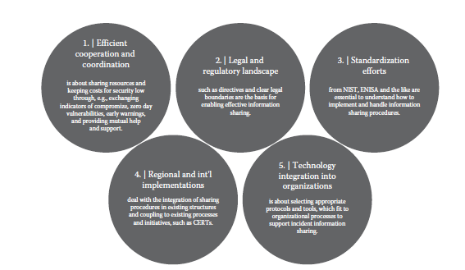

Slide 7
Dimension I: Efficient Cooperation and Coordination
Increased IT Presence:
Modern critical infrastructures are heavily reliant on information technology.
Emerging Threats:
New types of global threats are proliferating, shifting in focus and intensity.
Exploitation of Technology:
Threats exploit opportunities created by advancements in technology.
Mitigation Measures:
Existing strategies can address these threats, but they require support.
Collaboration Needed:
Effective responses necessitate cross-organizational and cross-border collaboration.

Slide 8
Cyber Defense as a Joint Endeavor
Importance of International Collaboration in Cybersecurity
Digital Boundaries:
Cyber threats cross national borders; clear definitions are lacking.
Collective Responsibility:
Cybersecurity is a social responsibility impacting all sectors
Established Response Mechanisms:
Policies have been in place since early ICT development.

Slide 9
Targeted Threats:
Cyber attacks threaten critical infrastructures like online payments and e-government services.
Public Confidence:
Increased use of ICT in vandalism, terrorism, and fraud undermines trust and raises risks.
Coherent Security Framework:
ICT security must be consistent across borders and sustained over time.
Key Organizations
ENISA: (European Network and Information Security Agency )
Promotes cooperation among EU Member States, encourages information exchange, and coordinates security efforts.
NIST: (National Institute of Standards and Technology.)
Supports CSIRTs in incident response by providing standards and guidelines for cooperation and information sharing.

Slide 10
The Threat Landscape
Evolving Cyber Threat Landscape
Rapid Changes:
Cyber threats are continuously evolving, with new malicious methods emerging.
Targets:
Cyber criminals and nation-states seek valuable data such as financial info, product designs, and user credentials.
Advanced Attack Techniques:
Attackers utilize zero-day vulnerabilities, high-quality toolkits, and social engineering for targeted attacks, often employing multistage methods to infiltrate networks.
Diverse Attack Vectors:
Modern threats leverage web, email, and application-based attacks, combining mass-market malware with sophisticated, targeted options.

Slide 11
Motivations:
Attacks are increasingly driven by social and political motives, with groups like Anonymous targeting various entities.
Complexity of Threats:
Comprehensive analysis of cyber incidents is essential to understand the multifaceted nature of threats, including agents, methods, and trends.
Emerging Trends:
Shift from botnets to malicious URLs for malware distribution; increased attacks on popular CMSs (Content management System); rise of P2P botnets and use in cryptocurrency mining.
Cyber Espionage(Spying):
Significant growth in cyber espionage and mass surveillance by nation-states .
Identity Theft Tactics:
Exploitation of financial Trojans on mobile platforms targeting two-factor authentication.

Slide 12
Importance of Information Sharing:
Essential for strengthening defenses; collaboration is needed among organizations facing similar vulnerabilities.
ENISA's Key Message:
Promote knowledge transfer within the cybersecurity community to enhance collective defense efforts.

Slide 13
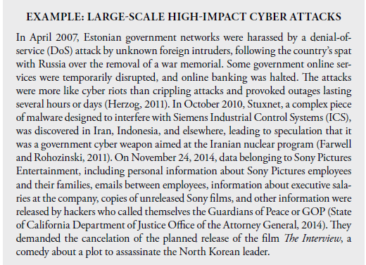

Slide 14
Incident Taxonomies
Purpose:
Taxonomies help uniquely identify and compare events, incidents, and attacks.
Types of Taxonomies:
Developed by individual CERTs or universally recognized.
Common Language Taxonomy
Key Terms:
Event: Information about a target and action taken.
Attack: Detailed description including tools, vulnerabilities, and outcomes.
Incident: Requires knowledge of the attack, source, and objective.
Pros:
Extensive and detailed classification.
Cons:
Time-consuming and may lack complete information; primarily for research and theoretical use.
I

Slide 15
IDEA Taxonomy (Intrusion Detection Extensible Alert)
Origin:
Developed within the European CSIRT(Computer Security Incident Response Team) Network, based on Swedish CERT taxonomy (TS-CERT).
Structure:
Main Categories: Eight incident classes.
Subcategories: 25 incident types, part of the description rather than strict classification.
Advantages:
User-friendly and applicable across various European CERTs(Computer emergency Response team).

Slide 16
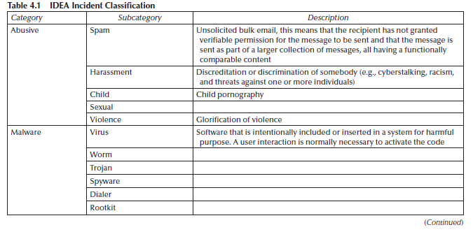

Slide 17
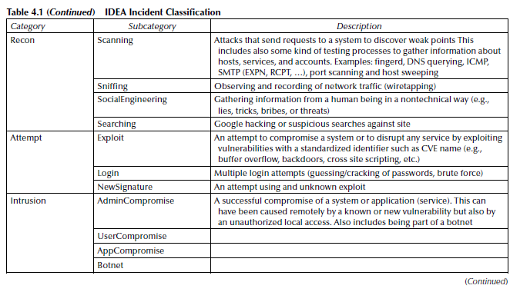

Slide 18
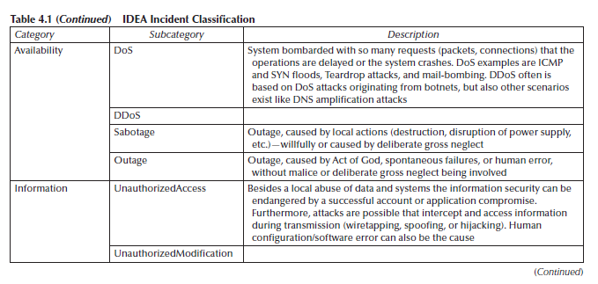

Slide 19
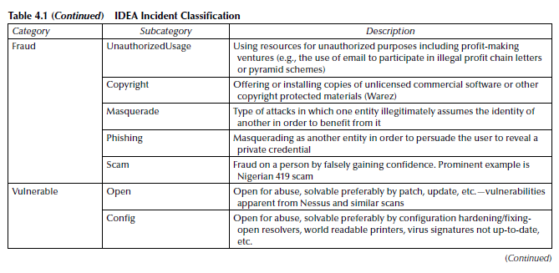

Slide 20
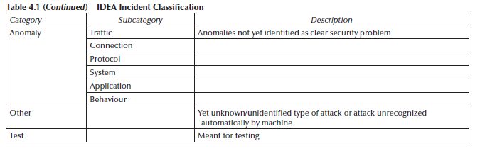

Slide 21
Sharing Scenarios
Given the current threat landscape, sharing resources can significantly reduce security costs for partners in an alliance.
National initiatives are also establishing cybersecurity centers to support critical infrastructure providers.
We identified four scenarios illustrating the need for sharing and its economic potential.
This approach is applicable not only to non-ICT critical infrastructure organizations but also to ICT network service providers, cybersecurity providers, and other infrastructure sectors.

Slide 22
1. Sharing Information about Recent or Ongoing Incidents
Scenario Overview: Enables sharing sensitive information on current incidents, including:
Service status
Organizational impacts
Attack vectors or reasons for malfunctions
Estimated recovery time

Slide 23
Importance:
Critical for mutual aid, prewarnings, and learning from incidents.
Sensitive information could harm organizational reputations.
Use Cases:
Victim Reporting: Organizations report cyber incidents to a national cyber center.
National Center Alerts: National cyber center informs critical-service organizations about relevant incidents.
Confederation Communication:
Organizations share information on major service degradations with each other, particularly business customers.
Outcome:
Enhances overall cyber situational awareness

Slide 24
2. Sharing Information about Service Dependencies
Scenario Overview:
Focuses on sharing static service dependencies to predict impacts of service degradation or outages.
Relevance:
Critical for risk assessment, especially when services from different companies are interdependent (e.g., cloud provider outages affecting other organizations).
Reporting Cases:
1. Consumer Reporting:
Organizations report their service dependencies to a national cyber center.
2.National Center Communication:
The national cyber center informs federated organizations about service dependencies of others.
3.Peer Communication:
Federated organizations share their own service dependencies with each other.
Goal: Improve risk assessment and impact prediction through enhanced visibility of service dependencies.

Slide 25
3. Sharing Information about the Technical Service Status
Scenario Overview: Involves sharing dynamic information on the technical status of services, including:
Availability
Confidentiality
Integrity
Predictions for restore time during outages
Purpose: Used for modeling and informing dependent organizations about service status.

Slide 26
Reporting Cases:
Provider Reporting:
Organizations report their service status to the national cyber center.
National Center Communication:
The national cyber center informs organizations about the status of others' services.
Peer Communication:
Organizations share their service status with one another.
Goal: Enhance awareness of service status to improve coordination and response during outages.

Slide 27
4. Request Assistance of Organizations
Internal Handling: Organization may struggle to manage a cyber incident independently.
Request for Help:
Organizations can seek assistance from external experts at the national cyber center.
Cyber center can reach out to external organizations or individuals for specific expertise.
Broker Role: Cyber center connects appropriate experts to address incidents effectively.
Two Scenarios:
Direct Assistance: Organization requests help from others with similar past issues.
Federated Support: Cyber center seeks aid from federated organizations for specific challenges.

Slide 28
Dimension II: Legal and Regulatory Landscape
Cybersecurity Importance: CI cybersecurity has gained global attention, with the EU and US focusing on secure digital environments for member states.
EU Initiatives:
The European Commission released a cybersecurity strategy and a directive to ensure a high level of network and information security (NIS) in 2016.
US Initiatives:
In 2013, President Obama signed Executive Order 13636 and Presidential Policy Directive 21 to enhance critical infrastructure cybersecurity.
The Cybersecurity Information Sharing Act (CISA) of 2015 facilitates information sharing between private companies and the government regarding cyber threats.

Slide 29
Key Differences:
Executive Order (EO): Focuses on the security of critical infrastructures and emphasizes threat information sharing.
CISA (Cybersecurity and Infrastructure Security Agency): Primarily concerns security information sharing across all sectors, not limited to critical infrastructure.
Global Context:
Smaller countries, particularly in Latin America (e.g., Argentina, Colombia), are developing cybersecurity strategies based on best practices from developed nations.
Asia-Pacific countries have been slow in creating comprehensive cybersecurity frameworks, but are now prioritizing cooperation among public and private sectors to enhance critical infrastructure protection.

Slide 30
EU Cybersecurity Strategy: “An Open, Safe and Secure Cyberspace”
EU Cybersecurity Strategy Goals:
Protect fundamental rights, freedom of expression, personal data, and privacy.
Ensure the integrity and security of the Internet for safe access.
Promote a multistakeholder governance approach.
Raise awareness of shared responsibilities among public authorities, the private sector, and citizens.
Key Initiatives:
NIS Directive (2016):
Requires Member States to establish effective CERTs.
Mandates the creation of national and international NIS cooperation plans.
Emphasizes information sharing and mutual assistance among national authorities.
Requires reporting of significant incidents affecting core services.

Slide 31
Cybercrime Focus:
Support the European Cybercrime Centre (EC3) for analysis, intelligence, and investigation.
Facilitate cooperation and information sharing among authorities and stakeholders.
Cyber Defense Policy:
Develop a framework aligned with the Common Security and Defence Policy (CSDP).
Emphasize dynamic risk management, threat analysis, and information sharing.
Roles and Responsibilities:
Define the roles of NIS authorities, CERTs, law enforcement, and industry.
National governments lead prevention and response efforts, establishing connections with the private sector.
EU-level involvement is essential for effective national responses to cyber incidents.

Slide 32
EU Network Information Security Directive
Objective:
Ensure a secure and trustworthy digital environment across the EU for Member States, key Internet enablers, and critical infrastructure operators (e.g., e-commerce, energy, transport, banking, healthcare).
Role of ENISA(European Network and Information Security Agency):
Assist Member States and the Commission with expertise and advice.
Facilitate effective information sharing through a cooperation network.
Information Sharing Infrastructure:
Establish a secure infrastructure for exchanging sensitive information.
Only Member States meeting high security requirements can access this infrastructure.

Slide 33
Incident Notification:
Early warnings are required for severe incidents affecting multiple Member States.
Preserve informal and trusted information-sharing channels between private and public sectors.
Union NIS Cooperation Plan:
Define formats and procedures for collecting and sharing information on risks and incidents.
Establish assessment procedures and criteria for incidents.
Personal Data Protection:
Incidents involving personal data breaches must comply with data protection laws.
Cooperation between competent authorities and data protection authorities is essential for public interest objectives.

Slide 34
U.S. White House Executive Order (EO 13636): Improving CI Cybersecurity
Objective:
Strengthen cybersecurity for critical infrastructure (CI).
Key Components:
Information Sharing:
New programs for sharing classified and unclassified threat information with U.S. companies.
Cybersecurity Framework:
Directed NIST to develop a framework to reduce cyber risks for critical infrastructure.
Federal Agency Reporting:
Require timely unclassified reports on cyber threats for private sector entities.
Generate classified reports for authorized critical infrastructure entities.
Establish tracking for production and dissemination of classified reports.

Slide 35
Enhanced Cybersecurity Services:
Expand program for near real-time sharing of threat information to assist critical infrastructure companies.
Privacy and Civil Liberties:
Framework includes provisions for incorporating privacy and civil liberties into cybersecurity practices.

Slide 36
U.S. Presidential Policy Directive (PPD-21): Critical Infrastructure Security and Resilience
Objective: Update national approach to strengthen security and resilience of critical infrastructures.
Three Strategic Imperatives:
1. Refine Functional Relationships:
Enhance collaboration and information exchange among federal government, infrastructure owners, and operators.
Establish two national critical infrastructure centers by the Department of Homeland Security:
One for physical infrastructures.
One for cyber infrastructures.
Serve as focal points for situational awareness and actionable information.

Slide 37
2.Enable Effective Information Exchange:
Identify baseline data and system requirements for the federal government.
Ensure timely exchange of threat and vulnerability information.
Establish requirements for data formats, system interoperability, and redundancy.
3.Implement Integration and Analysis Function:
Conduct operational and strategic analysis on incidents, threats, and emerging risks.
Collate and assess vulnerability and threat information to prioritize assets and manage risks.
Anticipate interdependencies and cascading impacts.
Recommend security and resilience measures before, during, and after incidents.
Support incident management and restoration efforts for critical infrastructure.

Slide 38
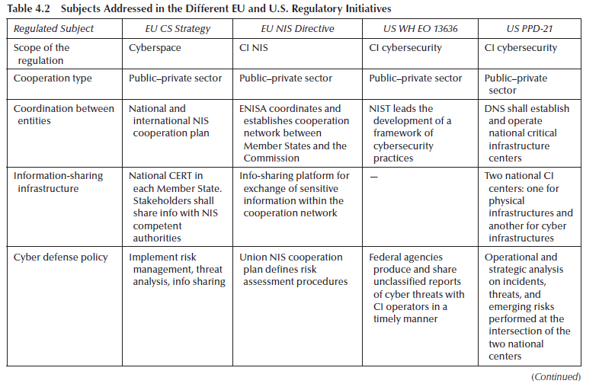

Slide 39
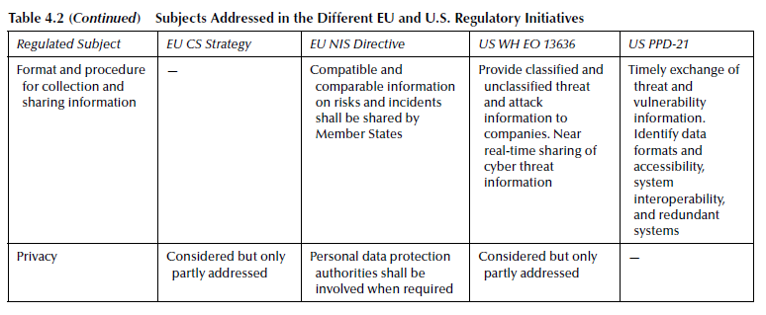

Slide 40
Dimension III: Standardization Efforts
ENISA: Proactive Detection of Network Security Incidents
Key Findings:
CERTs underutilize external data sources.
Limited data sharing among CERTs.
Technical and legal/organizational shortcomings in incident detection.

Slide 41
Recommendations for Stakeholders:
1. Data Providers:
Enhance outreach to CERTs.
Adopt suitable data formats and distribution methods.
Improve data quality and enrichment.
Screen data recipients for eligibility.
Establish contacts with security institutions.
Use standard protocols (HTTPS, SCP, SFTP).
Include correlation data (timestamps, ASN, IPs, etc.).
Deliver timely information and include detailed methods.
Enrich incident data with additional metadata.
Maintain historical data for research, with aging mechanisms.

Slide 42
2. Data Consumers:
Guide on accessing datasets and integrating external feeds.
Select appropriate data sources and develop monitoring capabilities.
Establish relationships with security communities (FIRST, TF-CSIRT, APCERT).
Be aware of legal issues in data sharing.
Implement automation systems for incident data processing.
Develop criteria for assessing data source quality.
Use feedback mechanisms to improve provider services.
Deploy monitoring mechanisms (sensors, honeypots, etc.).

Slide 43
3. EU/National Level:
Balance privacy protection and security needs.
Encourage common formats and underused technologies.
Integrate statistical incident data on a larger scale.
Research data-leakage reporting.

Slide 44
ISO/IEC27010: Information Technology—Security Techniques—Information-Security Management for Inter-Sector and Inter-Organizational Communications
ISO Guidelines on Sharing Confidential IT Security Information (2015)
Purpose:
Provides principles for sharing sensitive information on IT security threats, vulnerabilities, and incidents among organizations.
Aims to build trust and foster international information-sharing communities.
Key Recommendations:
1. Establish Information-Sharing Communities:
Define common interests to determine the scope of shared information.
Clearly outline organizational structures and management functions.

Slide 45
2. Information Classification:
Classify shared information by value, legal requirements, sensitivity, credibility, and criticality.
Ensure consistent protection of shared information.
3. Anonymity:
Remove identifiers if anonymity is requested during information exchange.
4. Secure Information Exchange:
Design and implement processes for timely and secure information flow.
Ensure dissemination to appropriate personnel with assurances against misuse.

Slide 46
5. Risk Knowledge and Management:
Include risk management in communications among community members.
6. Sector-Specific Benefits:
Greater benefits arise from sharing within the same sector or with aligned corporate objectives.
Cross-sector sharing can also be effective, especially within geographical or hierarchical communities.
7. Operational Rules and Conditions:
Define community objectives, membership procedures, obligations, and disciplinary processes.
Set rules for the usage of shared information, along with legal and financial responsibilities.
8. Information-Exchange Agreement:
Specify types of exchangeable information (e.g., alerts, incident handling).
Implement filtering methods to avoid sharing too much or too little information.

Slide 47
NIST: Framework for Improving CI Cybersecurity
Purpose: Develop a voluntary, risk-based cybersecurity framework.
Collaboration: Created through government and private sector collaboration.
Publication Date: February 12, 2014.
Focus: Aligns cybersecurity activities with business needs and risk management.
Key Components
1. Framework Core
Set of cybersecurity activities, outcomes, and informative references.
Five functions:
Identify
Protect
Detect
Respond
Recover
Guides organizations in managing cybersecurity risks through categories and subcategories.

Slide 48
2. Framework Profiles
Align cybersecurity activities with business requirements, risk tolerances, and resources.
Represents outcomes based on selected framework categories/subcategories.
Helps identify improvement opportunities by comparing "current" and "target" profiles.
Supports self-assessments and internal/external communication.
3. Framework Implementation Tiers
Describe the organization’s approach to managing cybersecurity risk.
Tiers range from Partial (Tier 1) to Adaptive (Tier 4).
Reflects progression from informal responses to agile, risk-informed practices.
Considerations: current practices, threat environment, legal/regulatory requirements, and business objectives.

Slide 49
Additional Considerations
Privacy and Civil Liberties: Incorporates principles to protect individual privacy in cybersecurity activities.
Standardization: Provides structure to various cybersecurity approaches by consolidating effective industry standards and practices.

Slide 50
Recommendation ITU-T X.1500 Cybersecurity Information-Exchange Techniques
Overview of ITU-T X.1500 Recommendation (2012)
Approval Date: April 2011
Purpose: Enhance cybersecurity through effective global information exchange.
Focus: Coherent, comprehensive, timely, and assured cybersecurity information sharing.

Slide 51
Cybersecurity Information Exchange (CYBEX) Model
Basic Functions:
1.Structuring Information: Organize cybersecurity data for effective exchange.
2. Identifying Information: Discover relevant cybersecurity information and entities.
3. Establishing Trust: Create trust and policy agreements for information exchange.
4. Requesting/Responding: Facilitate requests and responses for cybersecurity information.
5. Assuring Integrity: Ensure the integrity of the information exchanged.

Slide 52
Key Characteristics of Cybersecurity Information
State of Equipment/Software: Details on vulnerabilities and system status.
Forensics: Information related to cybersecurity incidents.
Heuristics/Signatures: Knowledge from past cybersecurity events.
Specifications: Modules, schemas, and terms for information exchange.
Identities and Assurance: Attributes of cybersecurity information and entities.
Implementation Guidelines: Best practices for effective exchanges.
Structured Information Capabilities
Organized into six clusters for distinct cybersecurity information exchange groups.

Slide 53
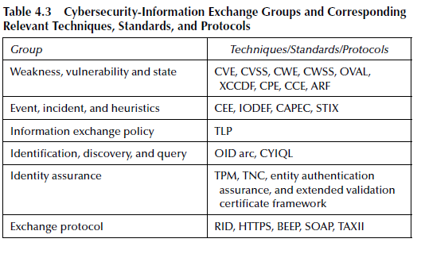

Slide 54
Overview on Information-Sharing Standardization Efforts
ENISA Report:
Provides generic recommendations for cyber security information sharing.
Covers a wide range of matters related to information exchange.
NIST Framework:
Targets American and non-American organizations.
Focuses on risk management and privacy preservation.

Slide 55
ISO/IEC 27010:
Oriented toward protecting data during information sharing.
Emphasizes collection, analysis, and correlation of cyber incidents for effective mitigation.
ITU-T X.1500:
Analyzes techniques, standards, and protocols for:
Systems monitoring
Threat detection
Vulnerability inventory
Incident exchange
Also referenced by ENISA and NIST for comprehensive guidance.

Slide 56
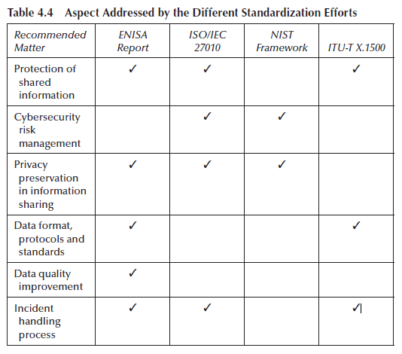

Slide 57
Dimension IV: Regional and International Implementations
- Role of CERTs:
- Vital in regional cybersecurity ecosystems.
- Collect information on new threats.
- Issue early warnings through mailing lists.
- Provide assistance on request.
- Regional Cooperation:
- Most effective due to:
- Short travel times.
- Lower costs for meetings.
- Cultural similarities enhance networking and collaboration.
-

Slide 58
**Global Collaboration**:
- Necessitated by the international nature of cyber threats.
- CERTs maintain strong international connections.
- Emergence of well-connected national cyber centers.

Slide 59
CERTs
Asia: APCERT
Formation: Established in March 2002 during the APSIRC meeting in Japan.
Purpose: Enhance cross-border cooperation and information sharing among CERTs.
Membership: 15 CERT teams from 12 Asia-Pacific economies joined in February 2003.
Goals:
Maintain a trusted network of security experts.
Improve regional awareness and competency in computer security.
Develop measures for large-scale network incidents.
Promote collaborative research and assist regional CERTs.
Address legal issues in information security.

Slide 60
Europe: TERENA's TF-CSIRT
Background: Established due to diverse interests of European networks.
Focus: Cooperation on common interests despite lack of a permanent center.
Objectives:
Share incident data and observe trends.
Develop European accreditation and training programs.
Assist new CERT teams.

Slide 61
Europe: NORDUnet CERT
Scope: Coordinates incident handling among Nordic countries.
Collaboration: Works with national research networks in Denmark, Finland, Iceland, Norway, and Sweden.
Function: Acts as a "Web of Trust" among national CERTs and maintains international connections through FIRST and TF-CSIRT.

Slide 62
South America: CLARA
Initiative: Cooperation among CERTs in South America and the Caribbean.
Focus Areas:
Protect critical infrastructure of REDClara.
Create security working groups (CLARA WG-CSIRT).
Goals:
Establish security frameworks for NRENs.
Promote training and data exchange on security incidents.
Coordinate responses to security incidents.

Slide 63
North America: USCERT
Role: Organized CSIRT meetings with various stakeholders (vendors, academia, government).
Collaboration: Works with ISACs for critical infrastructure protection.
IT-ISAC: A trusted community focused on identifying threats and sharing best practices for IT security.
Objective: Provide a coherent view of the security landscape for IT infrastructure.

Slide 64
International Cooperations
Importance of Cooperation:
Essential for effective incident handling among countries and CERTs.
Aims to tackle the global nature of Internet security threats.
Dependency on Collaboration:
Many CERT services rely on partnerships with global teams.
Role of FIRST:
Facilitates the building of an international community among CERTs.
Examples of Sector Cooperation:
Various initiatives promoting collaboration within specific sectors.
Cross-Regional Cooperation:
Region-to-Region: Collaborative efforts between different geographic regions.
Member States Cooperation: Initiatives among countries from two distinct regions within the same organization.

Slide 65
FIRST
Overview of FIRST:
Established in 1990 to enhance communication and coordination among incident response teams.
Membership:
Comprises 286 teams across 61 countries.
Includes organizations from educational, commercial, vendor, government, and military sectors.
Benefits of Membership:
Access to best practices and tools for effective incident response.
Trusted communication with other member teams.
Activities and Goals:
Develop and share technical information and methodologies.
Promote quality security products, policies, and services.
Encourage the creation and expansion of incident response teams globally.

Slide 66
Sector Cooperation
Sector-Specific CERTs:
Defined by constituency type and responsibilities.
Common interests promote cooperation among teams in the public and private sectors.
European Government CSIRTs Group (EGC):
An informal group of governmental CERTs.
Aims to develop incident response methods through member cooperation.
EGC Activities:
Develop measures for network security incident response.
Facilitate information-sharing and technology exchange on IT security threats.
Identify areas for shared specialist knowledge and collaborative research.
Communicate common views with other initiatives and organizations.
International Cooperation:
EGC members engage with global CERT initiatives like FIRST and TF-CSIRT.

Slide 67
Cross-Regional Cooperation
Cross-Regional Cooperation:
Based on knowledge and experience exchange at physical meetings.
CEENet:
Comprises 23 national academic, research, and educational organizations from Europe and Asia.
Mission: Coordinate international aspects of academic, research, and education networks in Central and Eastern Europe and adjacent countries.
Focus: Share information to improve ICT security across the region.
NATO Cooperative Cyber Defence Centre of Excellence (NATO CCD CoE):
Established on May 14, 2008, in Tallinn, Estonia.
Accredited by NATO as an International Military Organization.
Mission: Enhance capability, cooperation, and information sharing in cyber defense among NATO and partner nations.
Activities: Education, research, development, and creation of cybersecurity recommendations, manuals, and guidelines

Slide 68
IT Crisis Management
Western countries are establishing IT crisis-management centers for cybersecurity.
Purpose: Address cybersecurity issues and generate cyber situational awareness.
These centers serve as key information sources for national cybersecurity regarding critical infrastructures.
They provide 24/7 expertise and advice.
Essential to maintain a reliable picture of the current IT security situation.
Monitoring procedures are implemented for governmental and critical infrastructure networks.
Cooperation with national CERTs ensures close contact with national and international partners.
Germany and the Netherlands were early adopters of national IT crisis-management centers.

Slide 69
Dimension V: Technology Integration into Organizations
- National/Governmental Cybersecurity Centers: Significant progress in establishing these centers worldwide, but varying maturity levels.
- Cross-Border Cooperation: Coordination of global cyberattack responses is a challenge, requiring international collaboration.
- Successful Initiatives:
- TF-CSIRT
- CEENET
- North America CSIRT meeting
- FIRST SIGs
- E-COAT
- Achievements: Development of best practices, codes of conduct, legislation recommendations through international collaboration (ENISA, 2006).
- Challenges: Obstacles to seamless information exchange persist, particularly **technical barriers**.
- Focus: State-of-the-art platforms, tools, technology standards, and open protocols for security information exchange and management.

Slide 70
Open Web-Platforms and Open-Source Tools
Data Sharing Initiatives: Driven by CERTs, NATO, and private companies, aiming to improve data sharing among CERTs.
Initiatives are user-friendly, flexible, and often open-source.
Attract solid user communities.
Challenges in CERT Operations:
Focus is often on responding to single incidents rather than identifying larger, interconnected attacks.
Lack of standard frameworks for fully utilizing available data feeds to identify root causes.
Incident Correlation:
Involves comparing events from multiple data sources to identify attack patterns and relationships.
Improves understanding of attacks, reduces workload, and automates classification.
Useful for analyzing data from multiple tools and external services.

Slide 71
Tools for Incident Correlation:
SIEM (Security Information and Event Management): Commercial solutions available but expensive; open-source solutions are harder to manage.
Emerging solutions (e.g., Megatron, AbuseHelper) enable correlation of external incident data but are still maturing.
Current Gaps:
No standard framework for comprehensive correlation using all available data.
Many CERTs recognize the need for these tools but remain underemployed.

Slide 72
Threat-Intelligence Sharing
Challenge with Traditional Detection: Traditional signature-based methods are ineffective against sophisticated attacks that exploit multiple vulnerabilities and evade known signatures.
Organizations need to share higher-level threat intelligence in machine-readable formats to quickly adapt to new threats.
Key Threat Intelligence Sharing Tools:
1 .OpenIOC:
Open framework for sharing threat intelligence using an XML schema.
Describes technical characteristics of threats, attack methodologies, or artifacts left by intrusions.
Advantages: Simple to use and easily parsable into other formats.
Limitations: Primarily used with Mandiant products; limited support for network-based IoCs; focuses more on file-based IoCs.

Slide 73
2. MISP (Malware Information Sharing Platform):
Developed by Belgian Defense CERT and NATO NCIRC.
Central database for technical and non-technical malware information and attack data.
Automatically creates relationships between malware, events, and attributes.
Supports integration with other systems (IDS, OpenIOC, XML, etc.).
Enables selective information sharing within trust groups and subcommunities.
Includes an automatic notification system using PGP.

Slide 74
Data Correlation Tools
Recommendations from ENISA (2013a):
Data Providers: Use correlation methods to reduce false positives and data duplication.
Data Consumers: Implement solutions to verify datasets and improve data quality before sharing.
Challenges:
Extracting common patterns and relationships between incidents is complex, especially when correlating data from different sources.
Open-Source Data Correlation Tools:
Categorized into Three Groups:
Generic Correlation Tools
SIEM (Security Information and Event Management) Tools
Incident Handling Tools with Information Correlation Features

Slide 75
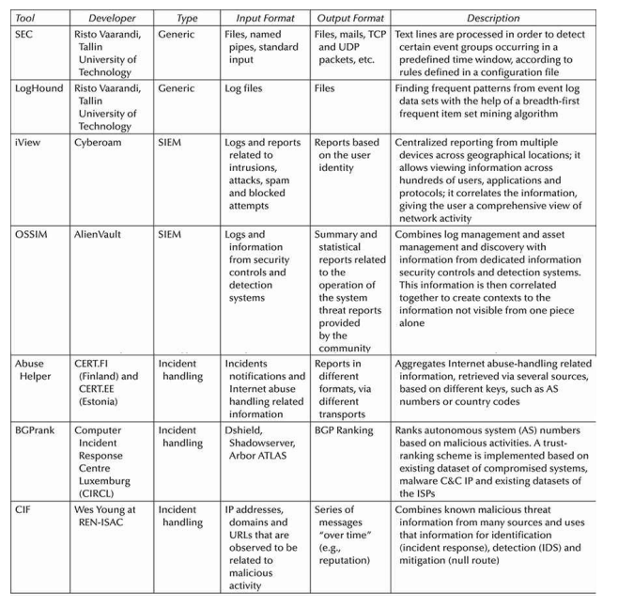

Slide 76
Technical Standards and Protocols
Need for Automation:
Human analysis alone is insufficient due to the complexity of cyber threats and growing data volumes.
Automation is key to improving defensive capabilities and handling large-scale data in threat intelligence and information sharing.
Human and Machine Collaboration:
Machine Role: Automate basic data collection, categorization, and correlation.
Human Role: Analysts generate intelligence by performing complex analyses unsuitable for automation.
Two-Stage Process:
Machine processes raw data (collection, parsing, filtering).
Human experts analyze the data to generate intelligence, reducing false positives and identifying critical information.
Structured Threat Information:
Standardized, structured representations are needed for interoperability across organizations.
Threat information should be expressive, flexible, extensible, automatable, and human-readable.

Slide 77
Threat Information Categories (Figure 4.2 overview):
Standards are grouped into six areas:
Asset definition
Configuration guidance
Vulnerability alerts
Threat alerts
Risk/attack indicators
Incident reports
Some standards cover multiple areas, while others focus on specific domains.
IoC Standardization:
Indicators of Compromise (IoCs): Key for early detection and automated processing of future attacks.
Efforts to standardize IoC formats for more efficient automated handling.
Prominent Initiatives:
OASIS (formerly MITRE) and IETF: Leading efforts to standardize IoC descriptions for better automated processing.

Slide 78
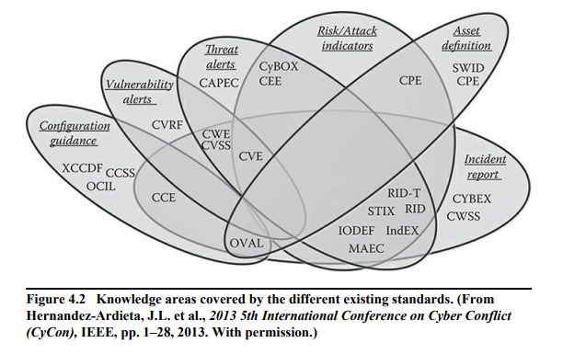

Slide 79
OASIS Standards: STIX, TAXII, and Others
OASIS Cyber Threat Intelligence (CTI):
U.S. standardization committee supporting community-driven security information sharing standards.
Transitioned from MITRE to OASIS in June 2015.
Focuses on non-commercial solutions for threat modeling and transport protocols.
STIX (Structured Threat Information eXpression):
Standardized language for structured cyber threat information representation.
Provides comprehensive cyber threat data for diverse use cases.
Includes classes for indicators, incidents, adversary tactics, techniques, procedures, exploit targets, and more.
Integrates with other structured languages (e.g., CybOX, MAEC, CAPEC) to address specific use cases.
Flexible design for customizable use based on relevance.

Slide 80
TAXII (Trusted Automated eXchange of Indicator Information):
Defines services and message-exchange mechanisms for sharing cyber threat information.
Enhances situational awareness and enables selective information sharing across organizations.
Preferred method for securely exchanging STIX-represented data.
Use cases include public/private alerts, push/pull content dissemination, and data sharing setup.
TAXII Sharing Models:
Source-subscriber: One entity publishes data to multiple consumers.
P2P (Peer-to-Peer): Direct sharing between producers and consumers.
Hub-and-spoke: Central hub distributes data to multiple consumers.
Push/Pull: Push (automatic updates) or Pull (consumer requests data).

Slide 81
IETF Standards: IODEF and RID (Real-Time Internetworked Defence)
MILE(Managed Incident Lightweight Exchange) IETF Working Group:
Defines standards for describing and exchanging cyber incident information.
IODEF (Incident Object Description Exchange Format):
RFC 5070: XML format for sharing incident information across domains.
Includes data on hosts, networks, services, attack methods, forensic evidence, and impact.
Used for documenting incident workflows.
RID (Real-time Inter-network Defense):
RFC 6545: Protocol for transporting IODEF cybersecurity data.
Flexible for exchanging other schemas or data models within or independent of IODEF.
Uses HTTP/TLS for transport.
Preferred for P2P models requiring high security and privacy.

Slide 82
Organizational Aspects of Tools Application
No One-Size-Fits-All Solution:
Powerful solutions often require significant resources, which may be unaffordable for small/medium-sized enterprises (SMEs).
Organizations must carefully evaluate the cost-benefit ratio when selecting tools.
Open-Source Solutions:
Open-source tools with large user communities can be installed quickly and operated at manageable costs, making them viable for SMEs.
Standards Comparison:
IETF Standards: Easier to learn and apply.
OASIS Standards: More complex but more powerful, with a larger community.
Impact of STIX 2.0:
STIX 2.0 (with JSON instead of XML) may accelerate adoption of technical standards and integration into products.

Slide 83
Review of Cyber Incident Information SHARING ASPECT
Importance of Incident Information Sharing:
Crucial for future infrastructures to enhance cybersecurity.
Key Considerations:
Technical: Need for interoperable, standardized formats and automation in data collection, correlation, and sharing.
Non-technical: Cost-benefit analysis, organizational readiness, and the balance between security and resource availability (especially for SMEs).
Recommendations for Future Developments:
Develop more flexible, scalable, and cost-effective solutions for incident sharing.
Prioritize standards that are easier to adopt (like IETF) while leveraging the power of more complex standards (like OASIS) where applicable.
Continue the evolution of tools and standards (e.g., STIX 2.0 with JSON) to improve automation and interoperability.

Slide 84
Public and Private Sector Cooperation
Regulatory Efforts for Cyber Resilience:
Both the U.S. and EU aim to enhance cooperation between public and private sectors to improve cybersecurity for critical infrastructures.
U.S. Initiatives:
Enhanced Cybersecurity Services (ECS): Expands information-sharing programs for near real-time cyber threat data exchange between critical infrastructure and government entities.
CISA (Cybersecurity Information Sharing Act): Facilitates sharing of personal information for cybersecurity threats and enables notifications to affected entities, with privacy protections.
Cyber Threat Indicators: Shared data can be used in prosecuting cybercrimes and related physical crimes.

Slide 85
European Strategy:
International Cooperation: Focus on exchanging best practices, sharing early warnings, and conducting joint incident management exercises.
CIIP Cooperation: Strengthening cooperation networks involving governments, private sector, and academia.
Civilian & Military Synergies: Promotes R&D programs to protect critical cyber assets and enhance public-private collaboration.
Lack of Focus on ICT Supply Chain Vulnerabilities:
No specific focus on sharing information about vulnerabilities in the ICT supply chain.
Legal frameworks are needed to address potential threats like hardware backdoors in IT systems.

Slide 86
International Cooperation
Current Cooperation:
Primarily through sporadic physical meetings, conferences, and mailing lists (ENISA, 2006).
More structured collaboration is needed for tighter, extensive cooperation.
Barriers to Cooperation:
Confidence Issues: International regulations limit sensitive information exchange.
Financial Constraints: Real-life meetings are costly.
Lack of SLAs: Absence of Service Level Agreements slows team-to-team cooperation.
Legal Challenges: Different countries have varying legal environments impacting cooperation.
No Standardized CERT Operations: Lack of global CERT operational standards hinders information exchange.

Slide 87
Benefits of International Cooperation:
Joint incident handling, resource and information sharing.
Improved project collaboration and social networking.
Ecosystem Benefits (Kaufmann et al., 2014):
Facilitates situational awareness of cybersecurity across infrastructures.
Access to critical security information (best practices, vulnerabilities, resolved issues).
Enhances defense against cyber threats through shared knowledge and coordinated response.
Greater effectiveness due to diverse resources and skills within the cooperative ecosystem.

Slide 88
Incident Information-Sharing Architecture
European Directive (2016):
Requires each Member State to create national CERTs.
CERTs must be interconnected via a secure, interoperable information-sharing infrastructure.
U.S. Strategy (White House, 2013):
Proposes two national critical infrastructure centers (DHS-operated):
One for physical infrastructure.
One for cyber infrastructure.
Centers work together to ensure situational awareness and protect both physical and cyber infrastructure.
European Directive (2016):
Requires each Member State to create national CERTs.
CERTs must be interconnected via a secure, interoperable information-sharing infrastructure.
U.S. Strategy (White House, 2013):
Proposes two national critical infrastructure centers (DHS-operated):
One for physical infrastructure.
One for cyber infrastructure.
Centers work together to ensure situational awareness and protect both physical and cyber infrastructure.

Slide 89
Centralized vs. P2P Information Sharing:
Centralized Architecture:
Single point of collection, analysis, and distribution of incident data.
Risk of slow response and single point of failure.
P2P Sharing Models:
More responsive, resilient, and trustworthy.
Allows ad-hoc incident response with tailored, anonymous support from trusted peers.
Reduces dependency on a central entity.
Private Sector Preferences:
Private organizations prefer sharing sensitive information with trusted parties rather than a centralized entity.
Sector-specific cooperation groups and P2P collaboration infrastructures are increasingly common.
Security Considerations:
P2P sharing increases the sensitivity and value of the information.
Requires a more secure and reliable communication infrastructure to ensure safe information exchange.

Slide 90
Data Collection, Information Analysis, and Intelligence Disclosure
Data Collection for Cyber Defense:
Cyber defense centers should collect data from multiple sources (e.g., CERTs, OSINT).
Combining traditional data sources with open-source intelligence (OSINT) improves situational awareness.
Both German and Dutch cybersecurity centers analyze both confidential and open-source data.
Big Data Analytics:
Big data analytics techniques should be used to process large volumes of data for situational awareness (Maltby, 2011).
Automated vs. Manual Information Sharing:
Automated Sharing: High data transfer rate but poses risks like unsupervised transmission and potential regulatory concerns.
Manual Sharing: Necessary when data is too complex or ambiguous for automation (e.g., free-text reports).
Recommended Approach: Combine automated and manual sharing for comprehensive incident analysis (Settanni et al., 2015).

Slide 91
Vulnerability Disclosure:
Selective Warning: Critical to warn organizations about vulnerabilities, bugs, and threats.
Public disclosure of vulnerabilities should be done responsibly—only after vendor solutions (patches, bugfixes) are provided.
Responsible Disclosure: Prioritize vendor contact before public release to avoid exposing organizations (Shepherd, 2003).
Regulatory Frameworks:
EU NIS Directive (2016): Allows public disclosure of vulnerabilities if vendors are contacted and solutions are provided.
U.S. Executive Order (2013): Requires sharing of vetted cyber threat information with qualified commercial service providers (CSPs), not directly with critical infrastructure entities.

Slide 92
Data Format and Exchange Protocols
Quality and Timeliness of Information:
Timely and accurate information exchange is crucial for incident-sharing between expert centers, organizations, agencies, and critical infrastructure owners.
Current Information Sharing:
A mix of standard and proprietary mechanisms is used to exchange indicators across different data types and protocols.
European Directive (2016):
Requires the definition of formats and procedures for collecting and sharing compatible information on risks and incidents by competent authorities.
U.S. Cybersecurity Policy:
The U.S. PPD aims to enable efficient information exchange through standardized data formats, system requirements, and accessibility.

Slide 93
Cybersecurity Information Sharing Act (CISA, 2015):
Defines processes for receiving, handling, and disseminating shared information via DHS Automated Indicator Sharing.
Uses STIX and TAXII specifications for machine-to-machine communication.
U.S. Cybersecurity Framework (NIST, 2014):
Encourages the development of standardized data exchange mechanisms for sector-wide sharing.
Security technologies should be able to detect past attacks, identify compromised systems, and support future attack detection.

Slide 94
Future Research and Development
Need for Investment in R&D:
Highlighted in EU, U.S., and international initiatives as essential for cybersecurity development.
European Union (2013):
R&D will support industrial policy, promote a trustworthy ICT industry, reduce dependence on foreign technologies, and strengthen the internal market.
U.S. Strategy (White House, 2013b):
Directs authorities to develop a comprehensive R&D plan to align federal and federally funded activities focused on critical infrastructure security and resilience.
Tallinn Manual (NATO, 2013):
Launched in 2009 as a leading international cyber law research initiative.
Focuses on:
A comprehensive research agenda.
Practitioner-oriented training opportunities.

