Slide 1
Cyber Threat Intelligence
Chapter 5

Slide 2
Introduction
Evolving Cyber Threats: Cyber attacks have become highly sophisticated, with well-resourced, skilled attackers conducting persistent, targeted attacks.
Shift in Cyber Resilience: Organizations now complement traditional preventive controls with robust monitoring and incident response, recognizing that determined attackers can bypass defenses.
Cyber Threat Intelligence (CTI):
Purpose: Anticipate and prepare for threats instead of just reacting.
Key Elements:
Indicators of Compromise (IoCs): Signs of malicious activity.
Tactics, Techniques, and Procedures (TTPs): Adversaries' methods and tools.
Threat Actor Profiles: Identities, motivations, and historical attacks.
Attacker Campaigns: Series of related attacks with a strategic goal.

Slide 3
Challenges in CTI: With multiple data sources (e.g., FireEye, CERTs), security teams face data overload, lack of context, and delays in critical intelligence.
Threat Intelligence Communities:
Function: Networks where organizations share vetted CTI to improve relevance, timeliness, and shared defense strategies.
Benefit: Collective insights from trusted members strengthen overall cybersecurity.

Slide 4
The Promise of Intelligence Communities
Benefits of CTI Community Exchange:
Reduced Sensitivity Barriers: Trusted relationships foster openness, allowing sharing of sensitive incidents and mitigation experiences.
Meaningful Vetting: Community members validate and verify threat intelligence, enhancing reliability and speeding up response actions.
Expert Collaboration: Experts build on each other’s insights, enriching shared intelligence with observations from individual infrastructures.
Political Support:
US and EU Legislation: The U.S. government and EU NIS Directive encourage private-public CTI sharing to improve cybersecurity.

Slide 5
Traditional Channels and Limitations:
Traditional methods (emails, meetings, IRC) struggle with the pace and volume of emerging threats (e.g., malware, zero-day exploits, DDoS).
Text-based threat info lacks automation capability, hindering analysis and resource efficiency.
Shift to Dedicated CTI Platforms:
To handle rapid threat data flow, communities use technical platforms for efficient CTI exchange.
Platforms support automated processing of Indicators of Compromise (IoCs) and integration with security processes.
Standard protocols (e.g., MITRE’s frameworks) support seamless, automated threat intelligence exchange.

Slide 6
CTI Community Structures
Automated CTI Exchange in Established Communities:
CTI communities are increasingly using standardized, automated channels for information exchange.
Members usually share similar business profiles, creating relevance for shared threat intelligence across the group.
Most communities are partially closed, with membership restricted to trusted organizations to maintain focus and trust.
Community Collaboration Methods:
Automated data exchange is often paired with traditional methods like mailing lists and conference calls for detailed analysis and report sharing.

Slide 7
Vendor-Driven Cloud-Based CTI Communities:
Open to a broader audience, these platforms support large-scale "crowdsourced" threat sharing.
Lacks the high trust level of private communities, as participants are typically vetted only by the vendor.
Allows for ad hoc collaborations focused on specific threats.
Pros and Cons of Cloud-Based Solutions:
Pros: Eliminates the need for dedicated infrastructure and allows CTI exchange within closed groups.
Cons: Reduced control over sensitive data, as it resides in the cloud and is subject to vendor access.
Private Cloud Options: Some vendors offer private clouds for organizations needing higher security and trust.

Slide 8
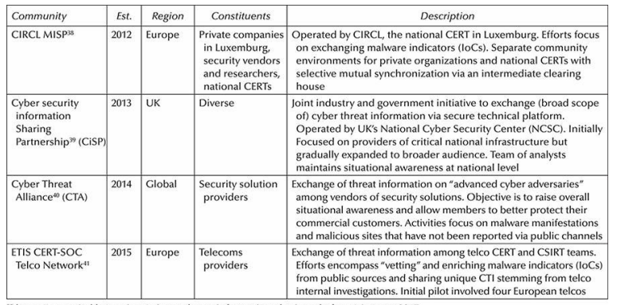
CTI Communities That Employ Automated Channels

Slide 9
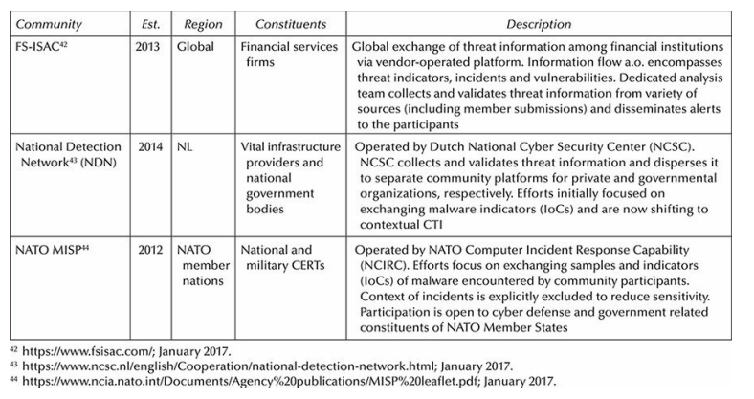

Slide 10
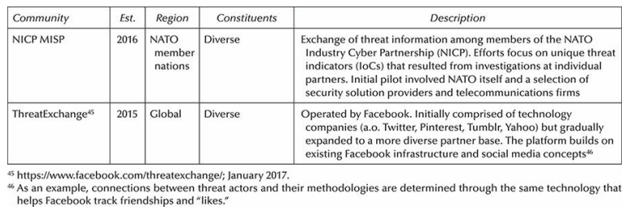

Slide 11
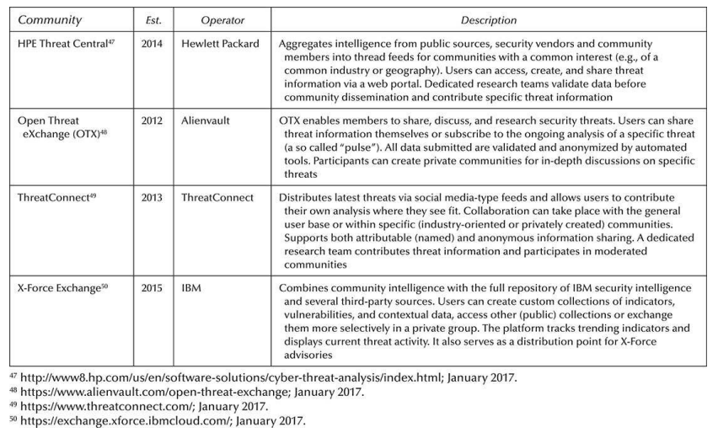
Cloud-Based Services for CTI Sharing

Slide 12
Organizational Context of a CTI Community
Organizational Requirements for CTI Communities:Clear Objectives:
Define mission, scope, and focus areas (e.g., IoCs, TTPs, campaigns).
Decide between focusing on "vetted" information or unique, community-specific data.
Membership Conditions:
Set criteria for industry, region, or CTI capability (e.g., CERT/CSIRT).
May include requirements for regular contributions or periodic reviews of member activity.

Slide 13
Confidentiality Arrangements:
Use protocols like Traffic Light Protocol (TLP) to control data sensitivity.
Information Exchange Policy (IEP) offers further options, like specifying encryption or anonymization for shared data.
Legal Constraints:
Comply with privacy and data protection laws; address concerns about public disclosure, especially with government partners.
Governance and Operations:
Establish a board or committee to manage policies, membership, and performance.
Consider a dedicated team to moderate and improve the quality of shared intelligence.

Slide 14
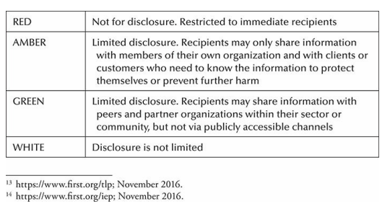
TLP Scheme Definitions

Slide 15
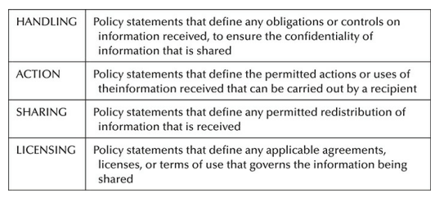
IEP Policy Types

Slide 16
Tooling and Infrastructure
Introduction
Need for Automation:
Growing demand for faster, efficient CTI sharing through automation.
Emergence of CTI Platforms:
New software solutions support automated CTI exchange, analysis, and management.
Malware Information Sharing Platform (MISP): Designed specifically for community CTI exchange.
Cloud-Based CTI Services:
Offer options for automated CTI exchange within specific user communities.
Functions of CTI Platforms:
Facilitate acquisition, sharing, and management of threat intelligence.
Focus on MISP:
MISP highlighted as a key platform used in practical CTI sharing cases.

Slide 17
CTI Sharing Infrastructure
CTI Community Sharing Models
1. Hub-Spoke Model:
Central CTI service (hub) connects to all participants (spokes).
Information shared via the central service, which may also store data.
Participants access via a browser or automated exchange protocol.
Example: Dutch National Detection Network (NDN).
Advantages:
No need for participants to set up their own CTI platforms.
Centralized filtering, anonymization, and additional services.
Example Services: Cloud-based CTI, ISACs, and national CERTs.

Slide 18
2. Peer-to-Peer Model: All participants have their own CTI sharing platforms with local CTI stores.
Automatic exchange of CTI information between members.
Example: ETIS CERT-SOC Telco Network.
Advantages:
More equal trust basis, no reliance on a central authority.
Avoids central entities like government or commercial providers.

Slide 19
Managing Multiple Communities:
Organizations often participate in multiple CTI communities.
Careful management is needed to prevent information spillover across communities.
Platforms should support policies like Traffic Light Protocol (TLP) and Information Exchange Policies (IEP).
Security and Privacy Considerations:
1 Hub-Spoke:
Centralized services can provide customizable filtering and anonymization.
Suitable for larger-scale sharing communities.
2. Peer-to-Peer:
More trust-based and decentralized, reducing reliance on central entities.
Preferred when participants don’t trust commercial providers.

Slide 20
Standards & Interoperability:
TAXII and STIX:
Both models support standardized CTI data exchange formats (STIX) and protocols (TAXII).
STIX profiles and TAXII support interoperability, but many platforms don’t fully support all STIX constructs.
Some platforms only implement TAXII servers (inbox) for receiving CTI, others use TAXII clients for both receiving and sharing.
Emerging Technologies:
Blockchain:
Proposed for secure and trustless CTI sharing, but still in research phase.
Key Takeaways:
Hub-Spoke Model is centralized and easier to manage, while Peer-to-Peer offers more decentralization and equal trust.
STIX/TAXII standards help with interoperability, but not all platforms fully support them yet.

Slide 21
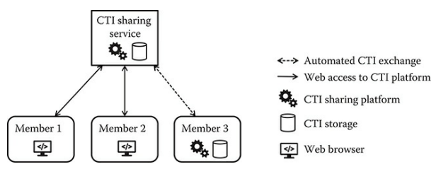
Hub–spoke CTI sharing infrastructure.

Slide 22
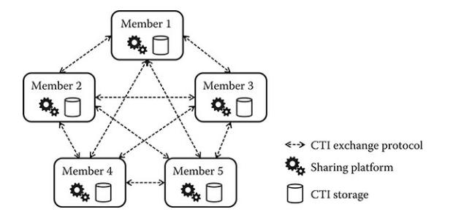
Peer-to-peer CTI sharing infrastructure.

Slide 23
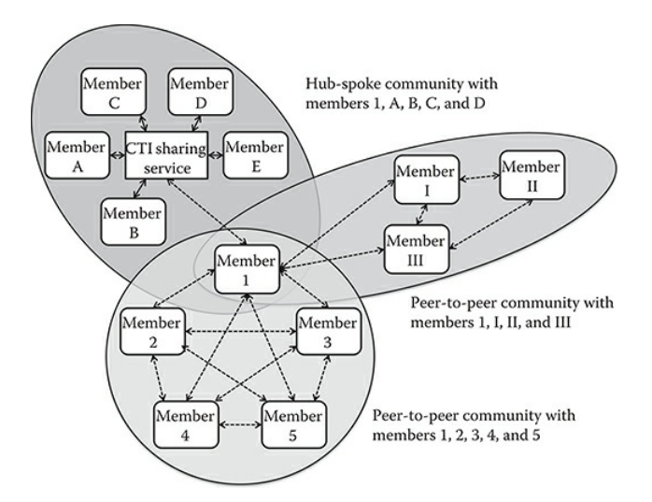
Example of simultaneously participating in multiple CTI sharing communities.

Slide 24
CTI Sharing Platforms
Basic Functions:
View, Create, Edit CTI Records: Users can create, view, and modify CTI records.
Import CTI Data: Allows ingestion of CTI data from external sources (e.g., IDS, SIEM, or other platforms) in formats like OpenIOC, STIX, CSV, PDF, or text files.
CTI Storage and Search: Stores CTI records in a database with search capabilities.
CTI Exchange: Secure sharing of CTI with community members, ensuring confidentiality, integrity, and source authentication.
Community Management: Add/remove members and configure secure sharing.
Notification: Alerts users when new CTI records are shared (e.g., via email).
CTI Export: Export CTI records in various formats like STIX, OpenIOC, CSV, or IDS rule formats (e.g., Snort, Suricata).

Slide 25
Additional Notes:
Separation from General CTI Platform: A dedicated CTI sharing platform may be used separately from the organization's primary CTI platform, allowing easier decision-making regarding sensitive information sharing.
Platform Evolution: As the CTI field develops, the features and functionalities of these platforms will continue to evolve.

Slide 26
Advanced Functions:
Correlation, Fusion, and Analysis: Automatically correlates CTI data, identifies relationships, and provides analysis tools (e.g., statistical, graphical).
Automatic Enrichment: Enrich CTI data (e.g., geolocation, IP addresses) for better analysis.
Contributing, Liking, and Commenting: Allows members to interact with shared CTI, contributing new data or commenting/liking others’ records.
Consuming CTI Feeds: Integrates external CTI feeds for correlation/fusion (more common in general CTI platforms).
Moderation and Anonymous Sharing: In hub-spoke models, moderates content and supports anonymous sharing for privacy.

Slide 27
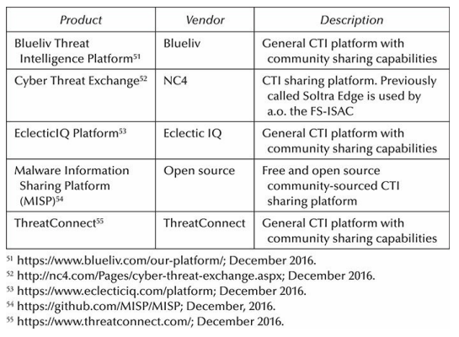
Examples of CTI (Sharing Platforms

Slide 28
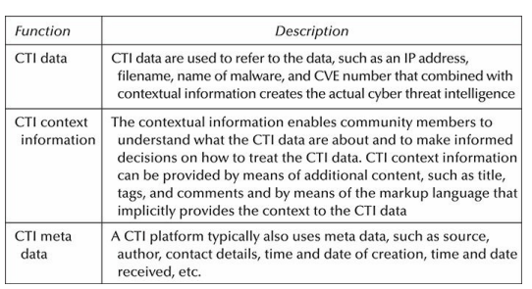
Type of CTI Information Stored on a CTI Sharing Platform

Slide 29
Malware Information Sharing Platform
Purpose:
Open-source platform for sharing malware-related information and indicators.
Developed by Belgian Defense and NATO NCIRC; now community-driven, led by CIRCL (Luxembourg’s CERT).
Data Model:
Event: Core object containing metadata (e.g., date, threat level, source).
Attribute: Specific indicators (e.g., IPs, hashes) linked to an Event.
Tag: Additional categorization for an Event (e.g., TLP level).
Community-Driven:
Relies on user-generated content.
Supports both hub-spoke and peer-to-peer sharing models.

Slide 30
Synchronization:
Pull: Download new/modified events from other MISP instances.
Push: Send events to other MISP instances.
Cherry Picking: Select specific events from other instances to pull.
These mechanisms support peer-to-peer CTI sharing.
Sharing Levels:
Differentiates sharing among organization only, community only, connected communities, and all.
Newer versions allow granular sharing groups.

Slide 31
Export & Integration:
Export Formats: OpenIOC, CSV, STIX (XML/JSON), IDS signatures (Bro, Suricata, Snort).
Allows automatic IDS signature generation based on selected attributes.
Supports the export of indicators for IDS integration.
Future Developments:
MISP continues to evolve to better support incident analysis, mitigation, and response in the IT community.

Slide 32
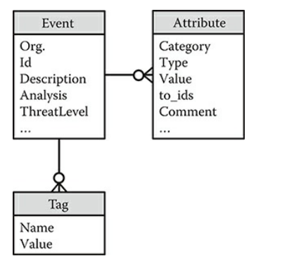
Simplified data model of an event in MISP.

Slide 33
Case Studies
This section discusses the practical experiences and lessons learned from two CTI communities: the ETIS CERT-SOC Telco Network, which includes CERT and CSIRT teams from European telecom providers, and the National Detection Network (NDN) operated by the Dutch NCSC.
Both communities exchange threat information using the Malware Information Sharing Platform (MISP), but they differ in structure and challenges.
The section highlights these differences, their impact on each community, and the key lessons learned from their setups and advancements.

Slide 34
1. ETIS CERT-SOC Telco Network
ETIS Overview:
Membership-based organization for European telecom providers.
Established CERT-SOC Telco Network in 2013 for collaboration on security and incident response.
Pilot Launch (2015):
Small-scale pilot project to explore automated threat information exchange.
Focus on malware indicators and vulnerabilities in telecom-specific equipment.
Participants included four member organizations, with TNO as an independent advisor.

Slide 35
Key Focus Areas for Information Sharing:
Malware Indicators: Unique, vetted indicators relevant to the telco industry.
Vulnerabilities: Focus on vulnerabilities discovered through internal security testing, not widely known.
Other threat information could be shared, but must meet the “vetting” criterion.
MISP Platform:
Open-source platform used for automated threat exchange.
Each telco maintained its own MISP instance (peer-to-peer setup).
Threat data shared in MISP’s XML format and integrated with internal security systems.

Slide 36
Community Governance & Rules:
No formal governance body or dedicated operations team.
Participants followed a concise 10-point manifesto governing community behavior.
Information sharing was voluntary, and not intended for commercial use.
Participants free to act upon shared information as they saw fit.
Outcomes & Lessons Learned:
Emphasis on practical, low-overhead collaboration.
No formal supply quotas, unlike other CTI alliances (e.g., Cyber Threat Alliance).
The pilot refined the approach to CTI sharing and automated threat exchange.

Slide 37
2. National Detection Network
NDN Overview:
Launched by the Dutch NCSC in collaboration with intelligence services in 2012.
Focuses on critical infrastructures (e.g., energy, water, telecommunications) and national government agencies.
Operational since 2014, as part of the second National Cyber Security Strategy.
Initially disseminated high-profile, state-actor threat information; later expanded to include public-source cyber threat data.
Key Features of NDN:
Target Groups: Private companies in critical industries and national government agencies.
Platform: Uses MISP for automated threat information exchange.
Centralized Hub-Spoke Architecture: NDN uses a hub–spoke setup with separate MISP instances for private and government participants.
Vetting: Similar to the telco community, NDN vets threat information to ensure relevance and accuracy.

Slide 38
Technical Setup:
MISP Instances:
Private Sector: API integration with SIEMs for automated signature feeding.
Government Sector: Integration with IDS sensors in government networks for bidirectional data exchange.
Automation: Partners can automatically integrate threat data into their security solutions, with the level of integration left to their discretion.
Incident Reporting: Government sensors send "sightings" of threats back to NCSC, enhancing situational awareness.
Governance and Participation:
Participation is voluntary for both private and government organizations.
Operated by a dedicated team of analysts.
Steering Committee: Comprised of NCSC and selected public/private partners, governing platform development and addressing operational issues.

Slide 39
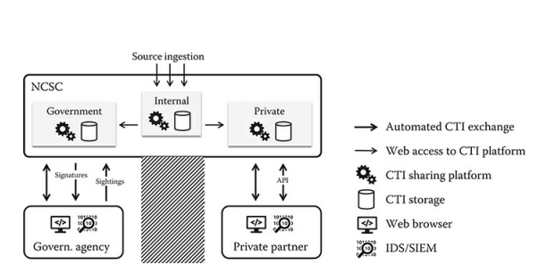
Simple schematic of NDN architecture.

Slide 40
3. Lessons Learned
Automated CTI Exchange is Viable:
Both the European telco group and Dutch NDN demonstrated value from automated CTI sharing.
Threat indicators (IoCs) shared through the community led to significant "sightings" and timely incident response.
Active Participation Requires Maturity:
Many organizations lack the maturity needed for meaningful CTI contribution, especially in early stages.
Organizations with limited CTI capabilities may struggle to provide valuable data, impacting the community’s effectiveness.
Successful CTI communities stimulate maturity in their members, especially when starting with more mature organizations.

Slide 41
Unique Threat Information is Rare:
Truly unique CTI is scarce and often comes in low volumes.
Focusing solely on unique data results in low community activity.
Vetting publicly available information and ensuring relevance leads to more consistent, automated, and routine sharing.
Trust is Crucial but Challenging:
Trust is easier to build in communities with natural peers and fewer participants (e.g., telco community).
Government-supervised communities, like NDN, initially faced trust issues, particularly concerning data disclosure (e.g., FOIA concerns).
Trust requires active management and sometimes special legal or legislative safeguards.

Slide 42
Sustainability Depends on Resourcing and Incentives:
CTI teams prioritize incident handling over information sharing, potentially disrupting community participation.
A balance is needed between contributing and receiving threat intelligence.
Feedback loops (e.g., whether shared information was useful or acted upon) help maintain community engagement and sustainability.

Slide 43
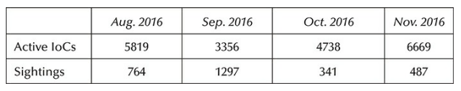
Effects of IoC Sharing in the Dutch NDN Community

Slide 44
Community Enrichment and Enhancements
1. Feedback and Additions
Basic Feedback (e.g., "Like" Button):
Indicates how shared CTI was received, but offers limited value.
Valuable Feedback:
Sightings: Reporting when a shared indicator results in a successful attack detection.
Negative Feedback: Reporting false positives or inaccurate information helps improve the quality of shared CTI.
Platforms like MISP and OTX offer such feedback mechanisms.
Enriching Shared CTI:
Suggesting new indicators based on incident response findings can enhance existing CTI.
These additions should be moderated to ensure relevance and accuracy, avoiding redundant or off-topic information.

Slide 45
Reporting Sightings and Incidents for Creating Situational Awareness
Value of Sightings:
Sharing sightings provides insight into the usefulness of CTI by indicating its value to other members.
Sightings help create situational awareness, especially for large-scale or cascading cyber threats.
Current Initiatives:
NDN is already sharing IoC sightings and “counts” but lacks clarity on the actual impact on services.
Understanding the impact (analogous to weather radar) is necessary to assess the severity of an attack.

Slide 46
2. National CERT Coordination:
National CERTs can coordinate CTI distribution in a hub–spoke model (e.g., NDN).
Community members report back to the national CERT with the following:
Number of Sightings: Shows the active use of attack methods or malware.
Potential Impact: Indicates the threat's severity for the organization, helping assess potential damage.
Incident Information: Details successful use of attack methods, enhancing national CERT’s situational awareness.
Impact and Incident Data: Provides insights into the damage or disruptions caused by the threat.

Slide 47
Challenges in Reporting Impact:
Reporting incidents and impacts is challenging for organizations.
Breach notification laws (e.g., GDPR) mandate reporting certain incidents but do not always facilitate comprehensive sharing.
When organizations see direct benefits from sharing, their hesitance may decrease.

Slide 48
3. Collaborative Analysis
Collaborative Workspaces:
Community members can create shared spaces to discuss and develop CTI.
Members can collaborate to analyze new threats and generate actionable CTI, especially when details are unclear.
Benefits of Collaboration:
Limited resources and expertise can be shared among members to create more accurate and valuable CTI.
Helps move beyond sharing basic indicators to higher-value CTI, such as TTPs (Tactics, Techniques, and Procedures), campaigns, threat actors, and course of actions.

Slide 49
Pyramid of Pain:
Sharing TTPs is more impactful than sharing indicators (e.g., IP addresses, file hashes) because it requires more effort from adversaries to adapt.
Collaborative analysis can provide deeper insights into adversary behavior, improving defense strategies.

Slide 50
4. Private and Secure Sharing of Indicators and Sightings
Challenges:
Sensitive CTI data, such as indicators or ongoing attacks, may expose attackers or harm the reputation of organizations.
Quickly sharing CTI is valuable but could unintentionally reveal too much information.
Attribute-Based Encryption (ABE):
ABE ensures CTI is shared only with specific community members based on defined attributes.
The access policy is encrypted with the CTI and can only be decrypted by members who meet the criteria.

Slide 51
Enhancements for Secure Sharing:
Hashing IoCs (Indicators of Compromise):
Hash IoCs (e.g., IP addresses, ports) to share without revealing actual values.
Community members can hash their own observables and match them against the shared, hashed IoCs.
Use a random salt for added security.
Privacy-Preserving Aggregation:
Community members report the number of sightings of an IoC without revealing details.
Each member encrypts their count and sends it to the source, which can only aggregate the total sightings after decryption.

