Slide 1
Legal Implications of Information Sharing
Chapter 7

Slide 2
Introduction
Sharing information among critical infrastructure operators enhances security and improves threat detection. It allows governments to assess national risks, develop strategies, and allocate resources effectively. Information can be exchanged between operators, national authorities, and international entities, such as the EU Commission and Interpol. Although technological advancements support information sharing, legal and regulatory challenges arise due to varying national approaches to critical infrastructure protection.
This chapter focuses on the EU's cross-sectoral legislation for Network and Information Security (NIS), examining legal requirements and challenges for information sharing. It critiques the barriers and proposes solutions to facilitate data sharing while outlining the EU’s cybersecurity legal framework and discussing breach reporting, best practices, and moving beyond reactive responses.

Slide 3
Mapping the EU Cybersecurity Legal Framework
Network and information systems face threats from natural disasters, human errors, and malicious attacks.
These systems are crucial for society, with disruptions impacting the economy and societal well-being.
Growing reliance across sectors highlights the need for a coordinated EU cybersecurity strategy.
This section:
Outlines recognition of the need for EU-wide cybersecurity coordination.
Prepares for later analysis by scoping the relevant EU legal framework and addressing information sharing requirements, initiatives, and obstacles.

Slide 4
Plotting the Moves toward a More Coordinated EU Cybersecurity Strategy
Importance of Information Sharing: Essential for cyber resilience, policy development, and securing critical infrastructures.
Key Elements for Effective Sharing: Clear communication channels, specified data requirements, and standardized information classifications.
EU's Cybersecurity Agenda:
1999: eEurope initiative emphasizes information infrastructure protection.
2001: EU’s Communication on Network and Information Security proposes a policy approach; Council of Europe adopts the Convention on Cybercrime.
2004: ENISA established to advise on best practices; European Council calls for a strategy to protect critical infrastructures.
2005-2006: EPCIP (European Programme for Critical Infrastructure Protection) and CIWIN (Critical Infrastructure Warning Information Network) introduced.
2013: EU Cybersecurity Strategy highlights importance of information sharing across strategic priorities.

Slide 5
Scoping the Applicable Framework
Actors in Information Sharing:
CI providers share cyber attack data with other CI providers, sector groups, CERTs, national authorities, and law enforcement.
Public (National Authorities, Law Enforcement) and private (many CI providers, CERTs) entities are involved, with varying legal obligations.
Key EU Directives for Cybersecurity:
Cybercrime Directive (2013/40/EU): Defines cybercrimes, promotes cooperation, and mandates national contact points for data collection on cybercrime.
Directive 2008/114/EC: Focuses on energy and transport sectors, establishes the protection of ECIs, and mandates security officers and communication mechanisms.
NIS Directive (2016/1148): Sets common security requirements for network and information systems across the EU, targeting "operators of essential services" and digital service providers.

Slide 6
Principle of Subsidiarity:
EU acts only where Member States cannot achieve objectives independently; cybersecurity remains largely national, with some EU-level harmonization.
Challenges & Critiques:
Fragmented EU approach, with varying national implementations.
Limited scope in earlier directives; NIS Directive aims to address gaps in cross-border cooperation and security incident reporting.
NIS Directive Requirements:
Member States must establish national cybersecurity strategies, competent authorities, and CSIRTs.
Operators of essential services must implement risk management and incident response measures.
Member States identify and report operators to the EU, while maintaining discretion over national security provisions

Slide 7
Information Sharing: Breaches, Threats, and Best Practices
Having scoped the security framework, the analysis now turns to an examination of information sharing requirements. This analysis is divided in two parts: breach notification obligations/damage limitations and proactive information sharing.

Slide 8
Breach Notification Obligations and Damage Limitations
Private Sector Reluctance:
Private companies hesitate to share incident info due to reputational concerns. Obligatory notification laws aim to counteract this reluctance.
Initial Legislation (Telecom Sector):
Directive 2009/140/EC mandates telecoms notify regulatory authorities of significant security breaches.
ENISA compiles reports from national data, which help inform national legislation and operator standards.
National Implementation:
EU Member States include these obligations in national laws (e.g., Germany, Netherlands, Belgium) with guidance from ENISA.
Expanding Notifications:
eIDAS (2014) mandates 24-hour notifications for trust service providers.
PSD II (2015) and NIS Directive (2016) expand similar obligations to payment and essential services sectors, excluding cases covered by telecom-specific rules.

Slide 9
Personal Data Breach Notifications:
GDPR (Art. 33) requires prompt notification (within 72 hours) for data breaches, with specific rules based on the nature and potential impact of the data breach.
Notifications are required for both data controllers and processors, potentially extending obligations across sectors.
Defining Personal Data:
Personal data broadly includes identifiers like IP addresses, per CJEU rulings. Dynamic IP addresses can be personal data if they allow for identification with ISP help.
Sector-Specific Laws:
Some EU countries, like France (LPM) and Germany (IT Security Act), have additional requirements for cybersecurity incident reporting, security measures, and audits for certain operators.

Slide 10
Proactive Information Sharing
Challenges of Breach Notification:
Differences in national laws hinder cross-border information sharing.
Notifications occur only after incidents, with companies cautious due to reputational and liability concerns.
Need for Proactive Information Sharing:
Proactive sharing is essential for resilience but tightly controlled by Member States.
Public access to government data is restricted, with Freedom of Information varying widely by nation.
Public Sector Information (PSI) Directive:
PSI Directive (2003) aims to make public data reusable, but its impact is limited for security-related information and inapplicable to private companies.
CERTs (Computer Emergency Response Teams) have limited access to PSI Directive benefits as most security data remains restricted.

Slide 11
National-Level Laws and Soft Law Initiatives:
Proactive sharing laws exist at the national level; soft law initiatives by ENISA promote information sharing through trusted communities.
NIS Directive’s Information Sharing Framework:
Cooperation Group: Includes Member States, EU Commission, and ENISA to share best practices and incident notification strategies.
CSIRTs Network: Allows Member States' CSIRTs to share non-sensitive, non-confidential info on operations and incidents.
Participation is voluntary, with limitations to protect investigations and avoid sharing commercially sensitive information.

Slide 12
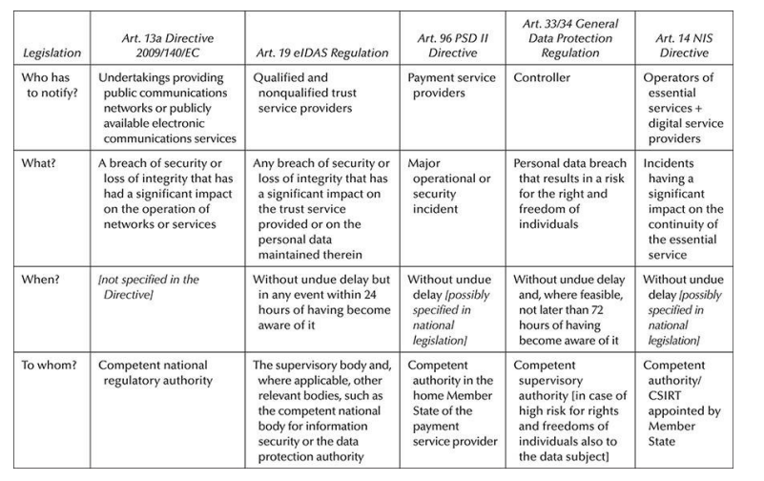

Slide 13
Legal Certainty, Information Sharing, and Potential Legal Barriers to Data Transfer
This section reviews EU legal frameworks that protect specific data categories, potentially hindering information sharing. It’s divided into two parts:
National Security and Economic Interests:
Examines classified information and economic interests, including trade secrets and confidentiality clauses.
Data Protection and Individual Rights:
Focuses on data protection as a fundamental right, highlighting privacy and personal data protections.

Slide 14
Recognizing National Security and Private Economic Interests
Intellectual Property, Trade Secrets, and Confidentiality
Intellectual Property (IP) Law and Information Sharing:
IP rights grant exclusive control over dissemination and duplication of works.
EU and international treaties offer some harmonization, but differences remain across Member States.
IP rights can pose barriers to information sharing, particularly regarding database content and structure.
Key EU Directives:
Copyright Directive (2001/29/EC): Harmonizes copyright and related rights.
Database Directive (96/9/EC): Protects database creators through copyright and sui generis rights, covering the "sweat of the brow" investment.

Slide 15
Copyright and Database Rights:
Holders have exclusive rights to reproduce, distribute, and communicate works.
IP challenges arise if protected content is shared without permission, though licensing can mitigate this.
Trade Secrets and Confidentiality:
Trade Secrets Directive (2016/943): Harmonizes rules against the misuse of trade secrets in the EU.
Trade secrets require confidentiality and reasonable protection steps, and nondisclosure agreements may restrict information sharing.

Slide 16
Classified Information and the Public–Private Overlap
National Security and Critical Infrastructure:
Information related to critical infrastructure can be classified as national security sensitive, leading to blurred public-private lines.
Disparities exist across Member States in classifying such information.
Classification Systems:
Ireland: No framework for data classification; Official Secrets Act 1963 defines official secrets.
Germany: National security secrets are defined in the German Criminal Code and the Safety Assessment Act, with four levels of classification.
Other Countries: Similar classification systems exist in the UK, Italy, Belgium, and France.

Slide 17
EU Framework:
The EU lacks specific legislation on security classification; it is a national responsibility (Art. 4 TEU).
EUCI: EU classified information is distinct from national classified information, with rules set by the Council, Commission, and European Parliament.
Barriers to Information Sharing:
Technical and Organizational Requirements: Handling classified info requires security vetting (Council Directive 2008/114).
NIS Directive: Confidential information can only be exchanged if necessary for its application, and must be kept confidential. National security interests may prevent disclosure.

Slide 18
Individual Rights, Data Protection and Fair Balancing Protections
Data Protection and Information Sharing:
GDPR Impact: The GDPR (2016) harmonizes data protection across Member States, applying to personal data processing.
Exemptions: GDPR does not apply to national security matters (Art. 2(2)(b)) or criminal investigations (Art. 2(2)(d)).
Critical Infrastructure Operators: Often private entities, meaning they must comply with GDPR if processing personal data.
GDPR Principles:
Personal data must be processed fairly, lawfully, and transparently, for specified, legitimate purposes.
Data minimization: Only relevant data should be processed.
Security: Appropriate measures must be taken to protect data.
Data subject rights: Right to access, rectify, erase, and restrict data processing.

Slide 19
Exemptions & Restrictions:
Member States may restrict rights to protect national security, public security, or public interest.
Data controllers must comply with GDPR principles, ensuring processing is lawful, including when sharing data with processors.
Lawful Grounds for Data Processing:
Legitimate Interests: Data processing is allowed for network and information security under legitimate interests (Art. 6(1)(f)).
Public Authorities: Public authorities may not use legitimate interests if processing falls under their task, instead relying on legal obligations (Art. 6(1)(c)) or public interest tasks (Art. 6(1)(e)).
Balancing Test: Processing must be necessary and proportionate to the security purpose, respecting fairness principles.

Slide 20
Breyer Case (CJEU Judgement):
The Breyer Case addressed the legitimate interest as lawful grounds for processing IP addresses, ruling that the German Telemedia Act's restrictions were too limiting.
Legitimate Interests: CJEU confirmed that legitimate interests could be relied upon instead of consent for processing IP addresses, even though the case referenced Directive 95/46/EC, which has been replaced by the GDPR. This interpretation applies to the GDPR as its processing grounds remain unchanged.
Purpose Limitation:Data collected for one purpose (e.g., user tracking) must be compatible with the new purpose (e.g., network and information security) to be processed legally.
This is particularly important for special categories of data (e.g., health, racial origin, biometric data).

Slide 21
Data Transfer:
EU Transfers: If the recipient is within the EU, the GDPR applies, and the data controller or processor must adhere to GDPR requirements.
Non-EU Transfers: Different requirements apply for transferring data to third countries or international organizations.
Processor vs. Controller:
Processor: A recipient who processes data only per the controller's instructions (contractual agreement needed).
Controller: A recipient who determines the purpose and means of processing, which may lead to joint control or separate control arrangements.
Joint Controllers: Occur when different parties share decision-making regarding the processing purpose or means. Separate controllers handle data independently without shared decision-making.

Slide 22
Contractual Arrangements:
The distinction between processor and controller depends on factual circumstances rather than just contractual terms.
Processors: Use the original legal grounds for processing.
Controllers: Must ensure appropriate lawful grounds for processing, as per the GDPR (e.g., legal obligation, public interest).

