Slide 1
Introduction to Mobile Forensics
Mobile forensics involves retrieving digital evidence from mobile devices.
Importance has grown due to mobile usage in crimes.
Supports law enforcement and corporate investigations.

Slide 2
Index
Cellular Network
Evolution of Cellular Network & its History
Cellular Network Architecture and Technologies
Mobile Device Hardware
Evolution of Mobile Devices & its History
Mobile Device Architecture and Technologies
Mobile Operating System
Smart Cards
Subscriber Identification Module (SIM/USIM)
SIM/USIM File Management
SIM/USIM Security

Slide 3
1. Cellular network
Cellular network technology has evolved significantly, transitioning from basic voice communication to high-speed data and advanced applications.
The evolution is marked by generations, each bringing new capabilities and features:
1G provided analog voice, 2G introduced digital and text, 3G enabled mobile internet, 4G offered broadband speeds, and 5G promises gigabit speeds and enhanced connectivity.

Slide 4
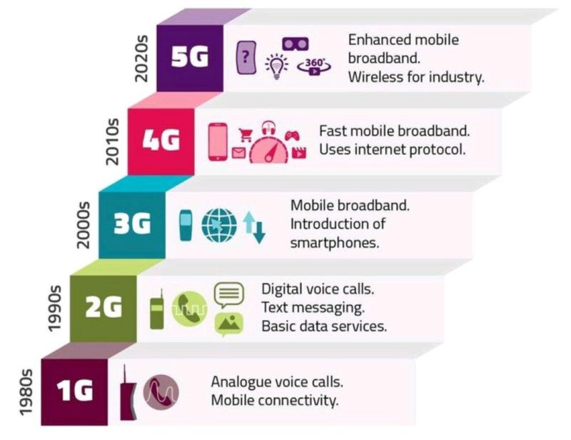
2. Evolution of Cellular Network

Slide 5
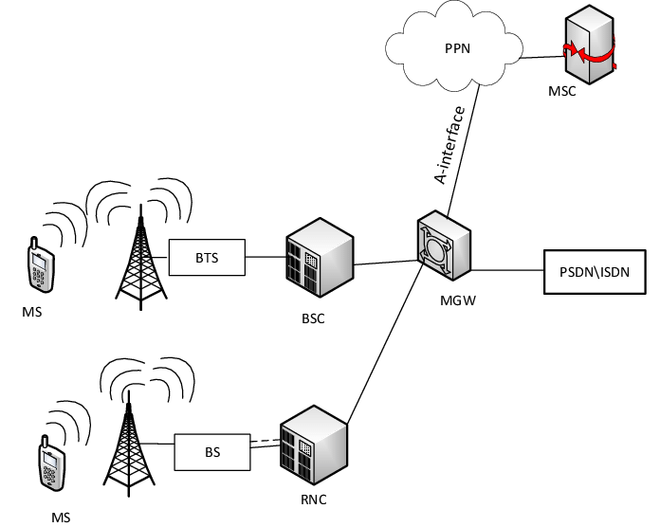
3. Cellular Network Architecture

Slide 6
Cont.
BTS (Base Transceiver Station): Connects phones to network.
MSC (Mobile Switching Center): Routing and call setup.
HLR (Home Location Register): Stores subscriber data.
VLR (Visitor Location Register): Temporary data during roaming.
BSC (Base Station Controller): central management entity for multiple Base Transceiver Stations (BTS) used in 2G (GSM)
RNC (Radio Network Controller): manage radio resources and facilitate communication between mobile devices used in 3G (UMTS)
MGW (Media Gateway): bridge between different types of networks (like voice or video) in call
PSDN (Public Switched Data Network) and ISDN (Integrated Services Digital Network): are technologies that relate to data and voice transmission

Slide 7
4. Mobile Device Hardware Components
System on Chip (SoC): Integrates CPU, GPU, modem.
RAM and Flash Memory: Temporary and permanent storage.
Baseband Processor: Handles radio communication.
Sensors: Accelerometer, GPS, etc.
Power IC: Manages power flow.

Slide 8
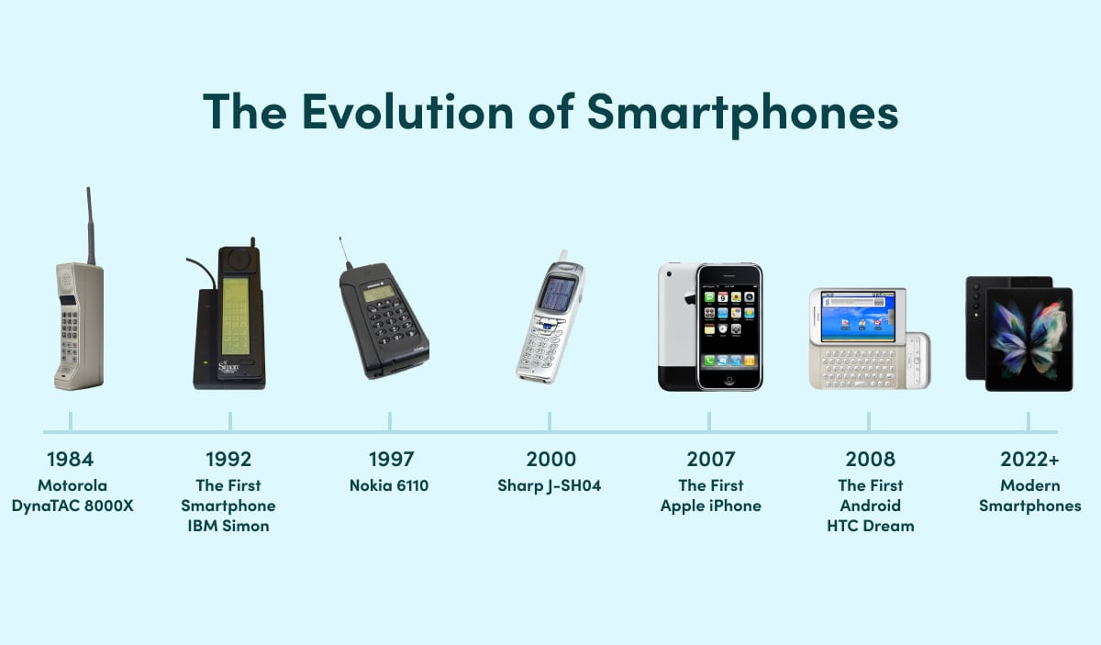
5. Mobile Device Evolution

Slide 9
6. Mobile Device Architecture
Application Layer: Apps and user data.
Operating System Layer: Android/iOS file systems.
Hardware Layer: NAND chip, SoC, etc.
Each layer offers unique data sources for forensics.

Slide 10
7. Mobile Operating Systems
Android: Open-source, Linux-based, file system varies by version.
iOS: Proprietary, secure boot chain, file system – APFS.
Windows Mobile: Outdated but encountered in legacy cases.
BlackBerry OS: Legacy OS with secure messaging.

Slide 11
8. Smart Cards in Mobile Devices
SIM cards are smart cards used in GSM networks.
Store IMSI, authentication keys, and SMS.
Accessing SIM data requires specific tools and permissions.

Slide 12
9. SIM vs USIM
SIM: Used in 2G/3G networks, limited storage.
USIM: Used in 3G/4G/5G, better encryption and storage.
Essential for accessing network credentials and call logs.

Slide 13
10. SIM File Management
Files organized as Master File (MF), Dedicated Files (DF), and Elementary Files (EF).
EFs store SMS, contacts, and other data.
Some files are protected and need authentication to access.

Slide 14
11. SIM/USIM Security
PIN: Personal Identification Number.
PUK: Unlock code for blocked SIM.
Authentication uses challenge-response with A3/A8 algorithms.
Forensic tools must handle locked or encrypted SIMs.

