Slide 1
Chapter 3: Mobile Device Forensics

Slide 2
Introduction
Each mobile OS has a unique architecture, security model, and data storage approach, directly impacting forensic methodologies. Understanding these differences is fundamental.
Android: Open-source OS, supports rooting, app logs, SQLite databases.
iOS: Encrypted file system, requires jailbreaking for deeper access.
BlackBerry: Legacy secure OS, supports PIN messages and encrypted data.
Windows Mobile: Less common today, uses NTFS/FAT file system.

Slide 3
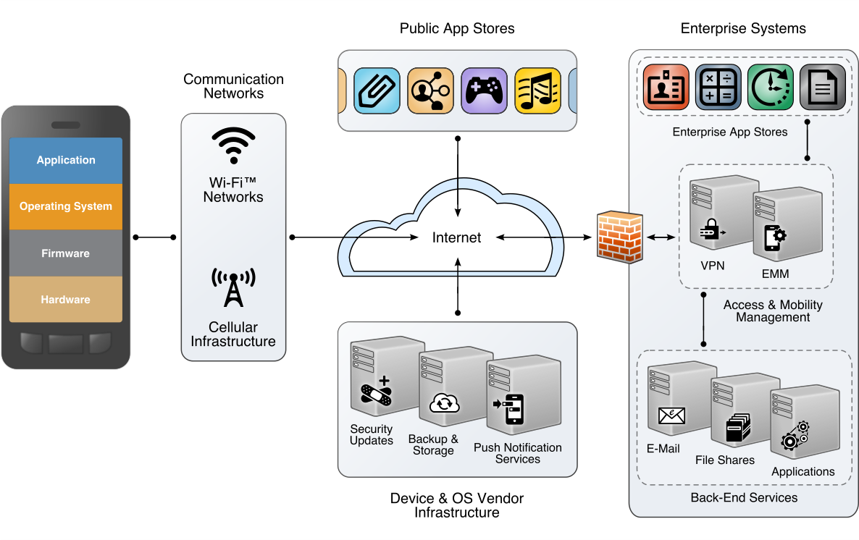

Slide 4
3.1 Mobile OS Forensics
Android Forensics
Architecture & Characteristics:
Linux Kernel-based: Open-source, highly customizable.
Android Runtime (ART): Executes app code.
App Sandboxing: Each app runs in its own isolated process.
File System: Typically ext4 or f2fs. User data often in /data/data/<package_name> (app-specific) and /sdcard (user-accessible).
Device Fragmentation: Wide variety of manufacturers, models, and Android versions
Security Model:
App Permissions: Granular control over resources.
Full-Disk Encryption (FDE) / File-Based Encryption (FBE): Default on modern devices.
Verified Boot, SELinux.
Forensic Implications:
Acquisition Challenges: FBE makes data inaccessible without passcode when locked. Rooting might be needed for full filesystem access (but alters device).
Data Locations: Standardized app data locations (SQLite databases) are common.
Tool Support: Wide range of commercial and open-source tools due to its open nature.

Slide 5
Cont.
iOS Forensics
Architecture & Characteristics:
Unix-like (Darwin Kernel): Closed-source, tightly integrated with Apple hardware.
Secure Enclave: Hardware-based security for cryptographic keys and biometrics.
APFS (Apple File System): Modern file system.
Strict Sandboxing: Apps are heavily restricted.
Security Model:
Hardware Encryption: Always-on encryption tied to user passcode.
Data Protection Classes: Different levels of encryption for files based on access patterns.
Activation Lock: Anti-theft feature.
Code Signing: All apps must be signed by Apple.
Forensic Implications:
High Security: Very challenging when locked due to strong encryption and Secure Enclave.
Limited Access: Reliance on iTunes backups for logical acquisition. Full filesystem often requires jailbreaking (alters device) or specific hardware exploits (e.g., checkm8).
Data Sources: iTunes backups, iCloud backups, specific hardware extractions.
Tool Support: Primarily commercial tools, some open-source for specific vulnerabilities/jailbreaks.

Slide 6
Cont.
BlackBerry Forensics
Legacy Systems (BlackBerry OS 7 and older):
Proprietary OS: Not Android or iOS.
Strong Encryption: Often had robust device encryption.
BlackBerry Desktop Manager: Primary tool for logical backups.
Artifacts: BBM messages, email, calendar, contacts.
Forensic Implications:
Declining Relevance: Less common in modern investigations.
Tool Support: Older commercial tools may support, but limited new development.
Proprietary Formats: Requires specialized parsers.

Slide 7
Cont.
Windows Mobile Forensics
Windows Phone (Windows CE/Mobile, Windows Phone 7/8/10 Mobile):
Microsoft OS: Less prevalent in the market.
Live Tiles Interface.
Integration with Microsoft Services: OneDrive, Outlook.
Forensic Implications:
Limited Market Share: Infrequently encountered in modern cases.
Acquisition: Often relied on logical backups via Zune software (older) or MTP/PTP protocols.
Artifacts: SMS, call logs, contacts, browser history (IE/Edge).
Tool Support: Limited compared to Android/iOS.

Slide 8
3.2 Artefact Extraction
Digital artifacts are pieces of data left behind by user activity or system processes that can be used as evidence.
These artifacts help reconstruct events, establish timelines, identify individuals, and prove intent.

Slide 9
Cont.
Contacts and Phone Call Artefacts
Forensic Value:
Identity: Who the user communicates with.
Associations: Links between individuals.
Communication Patterns: Frequency, duration of calls.
Timelines: Exact timestamps of calls.
Typical Locations:
Android: SQLite databases
/data/data/com.android.providers.contacts/databases/contacts2.db, /data/data/com.android.providers.contacts/databases/calllog.db
iOS: SQLite databases
/private/var/mobile/Library/AddressBook/AddressBook.sqlitedb, /private/var/wireless/Library/CallHistory/call_history.db
Cloud Sync: Google Contacts, iCloud Contacts.
SIM Card: Limited contact storage (EF_ADN) and last dialed numbers.
Extraction Methods: Logical backup, filesystem acquisition, physical acquisition,
SIM card readers.
Tools: Commercial forensic suites (AXIOM, UFED, Oxygen), SQLite browsers, ADB

Slide 10
Cont.
SMS Artefacts
Forensic Value:
Direct Communication: Content of conversations.
Timelines: Exact timestamps of messages sent/received.
Participants: Sender and receiver phone numbers.
Multimedia: Attached images, audio, video in MMS.
Typical Locations:
Android: SQLite database
/data/data/com.android.providers.telephony/databases/mmssms.db
iOS (Messages/iMessage): SQLite database
/private/var/mobile/Library/SMS/sms.db
SIM Card: Limited SMS storage (EF_SMS).
Extraction Methods: Logical backup, filesystem acquisition, physical
acquisition, SIM card readers.
Tools: Commercial forensic suites, SQLite browsers.

Slide 11
Cont.
Network Artefacts
Forensic Value:
Connectivity: When and where the device connected to networks.
Associated Devices: Bluetooth pairings.
Web Activity: Websites visited, search queries.
Communication: Evidence of data transfer, app usage.
Types & Locations:
Wi-Fi Connection History: Network SSIDs, MAC addresses,
connection times (often in system logs or specific databases).
Bluetooth Pairing Records: Paired devices, connection timestamps.
Cellular Network Logs: Cell tower IDs, signal strength, network changes
Web Browser History: URLs, timestamps, downloads
DNS Cache: Recently resolved domain names.
Extraction Methods: Logical/filesystem acquisition, physical acquisition.
Tools: Commercial forensic suites, browser history parsers, network analysis tools.

Slide 12
Cont.
Location Artefacts
Forensic Value:
Movement Patterns: Where the user has been.
Alibi Corroboration/Refutation: Proving or disproving presence at a location.
Association: Linking a device to a crime scene.
Intent: Showing travel to specific locations.
Types & Locations:
GPS Logs: Raw GPS coordinates from the device's GPS receiver (often in system databases or specific app data).
Geotagged Media: Photos and videos often embed GPS coordinates in EXIF metadata.
Wi-Fi Location: Databases of Wi-Fi access points and their known locations.
Cell Tower Location: Records of connected cell towers (less precise, but ubiquitous).
Application-Specific Location Data: Google Maps history, Apple Maps history, ride-sharing apps, fitness trackers, social media check-ins.
Bluetooth Beaconing: Proximity to known Bluetooth devices.
Extraction Methods: Logical/filesystem acquisition, physical acquisition.
Tools: Commercial forensic suites, EXIF data viewers, mapping tools (Google Earth).

Slide 13
Cont.
System Artefacts
Forensic Value:
Device Context: What kind of device, OS version, build.
User Activity: When the device was used, which apps were opened.
Installed Capabilities: What applications were present on the device.
Security Posture: Patch level, security settings.
Types & Locations:
Device Information: IMEI, MEID, Serial Number, Phone Number, OS version,
Installed Applications List: List of all apps, their versions, and installation dates.
Application Usage Records: When apps were last opened
System Logs: Records of system events, errors, crashes, security events
User Accounts: Information about configured email, social media, and cloud
accounts.
Device State: Battery level, network status at specific times.
Extraction Methods Logical/filesystem acquisition, physical acquisition.
Tools: Commercial forensic suites, log viewers, text editors, custom scripts.

Slide 14
Cont.
Multimedia Files Artefacts
Forensic Value:
Direct Visual/Audio Evidence: Content directly related to the investigation.
Context: What was happening, who was present.
EXIF Data (for photos): Timestamps, device model, camera settings,
GPS coordinates (if enabled).
Metadata: Creation/modification dates, file sizes, unique hashes.
Typical Locations:
Android:
/sdcard/DCIM/Camera/, /sdcard/Pictures/, /sdcard/Downloads/,
iOS: /private/var/mobile/Media/DCIM/, /private/var/mobile/Media/PhotoData/.
Cloud Sync: Google Photos, iCloud Photos.
Extraction Methods: Logical acquisition (if accessible), filesystem acquisition,
physical acquisition.
Tools: Commercial forensic suites, image viewers, video players, audio players,
EXIF data viewers/extractors.

Slide 15
3.3 Data and File Carving
Data and File Carving
The process of recovering files or fragments of files from unallocated (free) space on a storage medium. It works by searching for known file headers and footers (signatures) and attempting to reconstruct the data in between.
Why it's needed:
Files that have been "deleted" by the OS are often not immediately overwritten. The OS just removes the pointer to the file in the file system table.
File carving can recover data from damaged file systems or raw disk images where the file system metadata is corrupted or missing.
Process:
Acquire a physical or full filesystem image of the mobile device's storage.
Scan the raw data for specific file signatures
Extract the data blocks between the identified header and footer.
Attempt to reconstruct the file.
Limitations:
Fragmented files are harder to carve completely.
Encryption makes carving impossible without decryption.
Wear leveling and garbage collection on flash memory can make recovery difficult or impossible as data is moved/erased.
Common Tools:
Foremost: Command-line tool for carving various file types.
Scalpel: Improved version of Foremost, faster.
PhotoRec: Recovers various file types, often used for multimedia.

Slide 16
3.4 Deleted File Recovery
Deleted Files Recovery
Concept of "Deletion": When a file is "deleted" by the operating system, its data blocks are not immediately erased. Instead, the file system simply marks the space occupied by the file as "available" or "unallocated." The data remains until it is overwritten by new data.
Why it's challenging on Mobile Devices (Flash Memory):
Wear Leveling: Flash memory (NAND, eMMC, UFS) controllers distribute writes evenly across the memory cells to extend lifespan. This means a "deleted" file's data might be physically moved to a different location without the OS knowing, or its original location might be quickly overwritten.
Garbage Collection (GC): Flash memory controllers periodically consolidate valid data and erase invalid (deleted) data blocks to free up space. This process can permanently erase deleted files.
TRIM Command: Modern operating systems send TRIM commands to SSDs/flash memory when files are deleted. This command tells the controller that the data blocks are no longer needed and can be erased, leading to faster and more permanent deletion.

Slide 17
Cont.
Methods for Recovery:
Physical Acquisition: The most effective method. Creates a bit-for-bit copy of the raw flash memory, allowing carving tools to work on the unallocated space.
Filesystem Acquisition: Can sometimes recover recently deleted files if they haven't been overwritten or garbage collected yet, especially if the file system metadata still points to them.
File Carving: Applied to the unallocated space recovered from physical or full filesystem images.
Factors Affecting Success:
Time Since Deletion: Shorter time, higher chance.
Device Usage: Less activity after deletion means less chance of overwriting.
TRIM Support: If TRIM is active, recovery likelihood decreases significantly.
Flash Memory Type & Controller: Different controllers handle wear leveling/GC differently.
Acquisition Method: Physical acquisition offers the best chance.

Slide 18
3.5 Bypassing Security Controls
Bypassing Security Controls
Purpose: In forensic investigations, bypassing security controls (screen locks, encryption) is often necessary to access evidence.
Legal & Ethical: Crucially, such actions must always be performed with proper legal authorization (e.g., search warrant, consent) and within ethical guidelines. Unauthorized bypass attempts are illegal.
Risks: Improper bypass attempts can lead to data loss, device damage, or alteration of evidence.

