Slide 1
Web Architecture
Chapter 2

Slide 2
2.1 Web browser
What is a Web Browser?
A web browser is application software for exploring the World Wide Web (WWW).
It provides an interface between the server and the client to request web documents and services.
Acts as a compiler to render HTML, the language used to design webpages.
Loads web pages containing text, links, images, style sheets, and JavaScript functions.
Examples: Google Chrome, Microsoft Edge, Mozilla Firefox, and Safari.

Slide 3
History of the Web Browsers
The first web browser, World Wide Web, was invented in 1990 by Tim Berners-Lee and later renamed Nexus.
In 1993, Mosaic was created by Marc Andreessen and his team, the first browser to display text and images simultaneously.
In 1994, Marc Andreessen also developed the browser Netscape.
In 1995, Microsoft launched Internet Explorer, pre-installed in the Windows operating system.
Many other browsers followed with advanced features, including Mozilla Firefox, Google Chrome, Safari, and Opera.

Slide 4
Overview of Browser Functionality
The main responsibilities of a browser are as follows:
Generate and submit requests to web servers by:
Following hyperlinks.
Typing URLs explicitly.
Submitting forms.
Parsing HTML pages for auxiliary resources (e.g., images, applets).
Accept and interpret responses from web servers to create a visual representation by:
Examining response headers (e.g., Content-Type).
Determining the required action and rendering process.
Render results in the browser window or through third-party tools based on the response content type.

Slide 5
Depending on the status code and headers in the response,browsers have to perform other tasks, including:
Caching:
Checks if data is available in the cache to avoid unnecessary server requests.
Queries the server to verify if cached data has been modified.
Authentication and Authorization:
Handles secure server requests by prompting users or using stored credentials.
State Maintenance:
Accepts and stores cookies to maintain state across requests.
Provides user options for cookie acceptance.

Slide 6
Requesting Supporting Data:
Retrieves additional objects (e.g., images, applets, sounds) required for proper page rendering.
Processing HTTP Headers and Status Codes:
Handles redirects, connection persistence, or error notifications based on headers and status codes.
Rendering Complex Objects:
Natively supports content types like HTML, plain text, and common image formats.
Uses plug-ins or external applications for advanced multimedia types.
Error Handling:
Manages connection failures, invalid server responses, and other errors.

Slide 7
Core Functions of a Web Browser:
User Interface:
Provides the interface for user interaction and displays the processed response from the server.
Request Generation:
Builds HTTP requests and resolves relative links into absolute URLs.
Response Processing:
Parses server responses and passes results to the User Interface module.
Networking:
Handles network communications, transmits requests, receives responses, and manages proxies and connections.
Content Interpretation:
Decodes content, processes references (e.g., images, multimedia, JavaScript), and initiates additional requests for auxiliary object

Slide 8
Caching:
Stores retrieved resources locally, checks for updates, and manages memory and disk space for cached items.
State Maintenance:
Maintains browser state using cookies to record information across requests and responses.
Authentication/Authorization:
Handles user credentials for secure resources and stores them for reuse within the same security realm.
Configuration:
Manages fixed and user-defined settings with an interface for modifying options.

Slide 9
browser session
It is the series of interactions between a browser and the HTTP servers it communicates with, commencing with the first such interaction after the browser program starts and ending when the browser program terminates

Slide 10
Browser Sessions vs HTTP Sessions
HTTP sessions are managed by the server; browser sessions are managed by the browser.
The browser stores the HTTP session ID as a non-persistent cookie, linking the two sessions.
HTTP session IDs are unavailable in new browser sessions.
Browser sessions last until the program is closed.
HTTP sessions time out after server-configured inactivity periods.

Slide 11
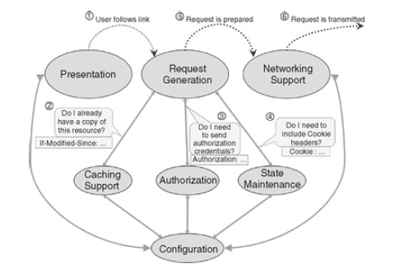
Overview of Processing Flow in a Browser
Transmitting a request
Browser request generation flow.

Slide 12
User Actions:
Click hyperlinks, select links from history/bookmarks, or enter a URL manually.
Events are interpreted by the User Interface module.
User Interface Responsibilities:
Entering URLs: Text entry box or dialog for manual URL entry, with OS support for selecting local files.
History and Bookmarks: Maintains visited links, configurable retention settings, and allows saving links as bookmarks.
Selecting Links: Provides mechanisms for link selection (e.g., mouse clicks, accessibility options). Highlights links and changes cursor shape on hover.

Slide 13
Request Generation Module:
Resolves URLs:
Absolute URLs: Processed directly.
Relative URLs: Resolved relative to the current location or the <BASE> tag if present.
Builds HTTP requests by interacting with:
Caching module: Checks for existing resource copies or newer versions.
Authorization module: Determines if authentication credentials are required.
State Mechanism module: Adds appropriate cookies to the request.
Networking Module:
Transmits the constructed request over the network for processing.

Slide 14
Receiving a response
Response Handling:
Networking module receives and passes responses to the Response Processing module.
Deals with out-of-sequence responses by delaying processing.
Response Processing Actions:
Examines headers to determine required actions:
401 Unauthorized: Prompts user for credentials via the Authorization module and resubmits the request.
Set-Cookie: State Maintenance module stores cookie information.
Content-Encoding/Transfer-Encoding: Decodes content.
Cache-Control/Expires/Pragma: Updates or creates cache entries via the Caching module.

Slide 15
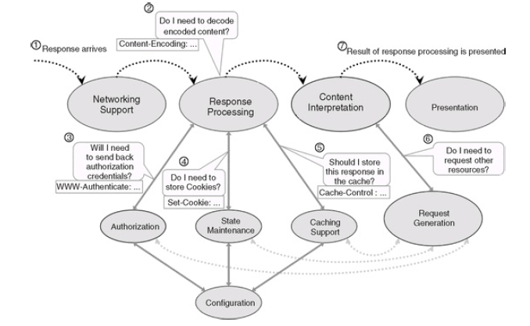
Browser response processing flow

Slide 16
Content Handling:
MIME Type Determination:
Uses Content-Type header or OS-based file extensions.
Native support for HTML, images, audio; non-native handled by plug-ins or helper applications.
Configuration Module: Manages plug-ins and file associations for unsupported content.
Embedded Resources:
Content Interpretation module parses and identifies additional resources (e.g., images, CSS, JavaScript).
Resolves URLs and sends requests via the Request Generation module.
Caching module checks for existing usable copies before sending network requests.
User Interface Updates:
Received resources are passed to the User Interface module for final presentation.
Networking module ensures all requests are satisfied and resubmits as needed.
Dynamic Configuration and State Maintenance:
Adjusts requests based on user settings (e.g., image preferences).
Adds cookie information for previously visited sites.

Slide 17
2.2 Web Server
A web server is a combination of software and hardware that stores, processes, and delivers webpages to users.
Web server is a program which processes the network requests of the users and serves them with files that create web pages.
It uses HTTP and other protocols to respond to requests made over the World Wide Web.

Slide 18
The web server can be any software or hardware but is usually a software running on a computer.
One web server can handle multiple users at any given time which is a necessity otherwise there had to be a web server for each user and considering the current world population, is nearly close to impossible.
A web server is never disconnected from the internet because if it was, then it won’t be able to receive any requests, and therefore cannot process them.

Slide 19
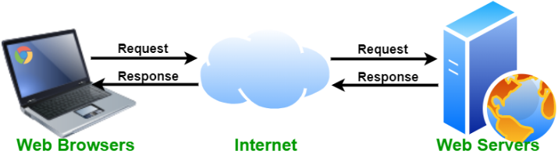

Slide 20
Web Server Request Processing Overview
Networking Module
Receives requests and transmits responses over the network.
Address Resolution Module (Pre-processing):
Virtual Hosting: Identifies target domain and applies corresponding configurations.
Address Mapping: Resolves URL paths to static or dynamic content within the server’s file system.
Authentication: Verifies authorization credentials for protected resources.

Slide 21
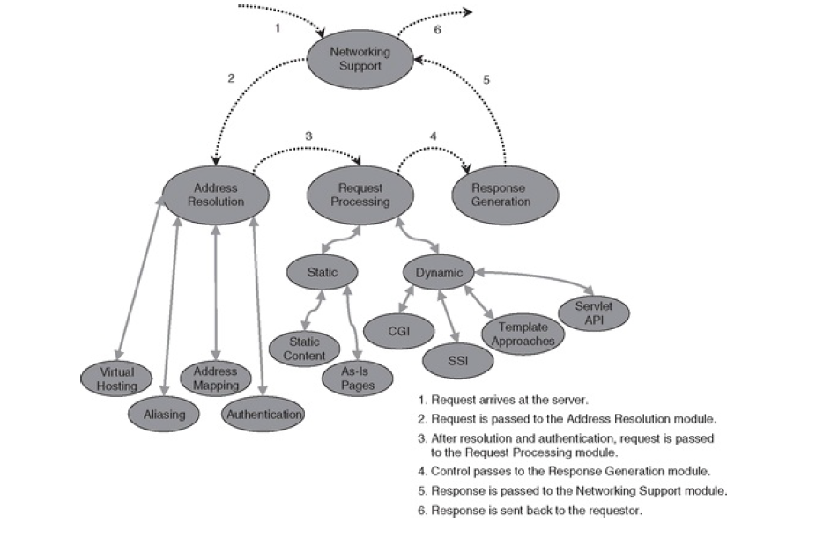
Server operation

Slide 22
Request Processing Module
Invokes sub-modules to handle static or dynamic content.
Response Generation Module
Builds the response and sends it to the Networking module for transmission.
Stateless Nature of HTTP
Server relies on information within the request.
Session state is maintained by server-side applications, referenced via the request.

Slide 23
HTTP request processing
Steps for an HTTP Request to Arrive at the Server
User Request:
User enters the URL http://mysite.org/pages/simple-page.html in the browser.
Browser sends an HTTP request to the server.
Rendering Initial Page:
Server responds with the HTML page containing links to school.html and home.html.
Browser renders the page for the user.

Slide 24
3.Link Resolution:
If links are relative, the browser resolves them to absolute URLs using the current page’s URL.
4 Follow-Up Request:
User clicks on the link to school.html.
Browser sends another HTTP request (via an open connection or a re-established one).
5.Connection Management:
Persistent connections may keep the connection open to improve performance.
If the connection is closed, the browser re-establishes it (directly or via a proxy).

Slide 25
6. Server Request Handling:
Server maintains input and output queues for managing requests and responses.
Requests are processed in FIFO order (First-In-First-Out).
7.Resource Processing:
Server resolves the URL to the physical file location.
Checks for authentication:
If required and fails, sends an error response.
If successful or not required, processes the request.
8.Response Delivery:
Processed response is sent back to the browser (directly or via proxy).

Slide 26
Delivery of static content
Static Content Page:
Files (HTML, XML, images, etc.) that require HTTP responses to be constructed.
Example: /pages/school.html mapped to a server file like wwwdoc/pages/school.html.
As-is Page:
Files containing complete HTTP responses (including headers).
Sent "as is" by the server without modification.
Often used for testing or quick customizations (e.g., redirection targets).
Recognized by extensions like .asis.
Key Details for Static Pages:
MIME(Multipurpose internet mail Extension) Types: Server maps file extensions (e.g., .html to text/html) to determine the Content-Type header for browser rendering.
Content-Length: Optional but useful for progress tracking.
Last-Modified: Indicates the file's modification date, aiding browser caching.

Slide 27
Delivery of dynamic content
Generated Responses:
Requires server-side processing, such as running scripts or programs (e.g., CGI, PHP, JSP, ASP, Java servlets).
May include auxiliary file data or templates.
URL-Based Processing:
Example:
cgi-bin/*.cgi → CGI script.
*.php → PHP script.
servlet/* → Java servlet.
Headers and Content-Length:
Dynamic responses often omit Content-Length as their size is unpredictable until generation is complete.

Slide 28
The original mechanisms for serving up dynamic content are CGI and SSI.
CGI (Common Gateway Interface)
Origins: First consistent, server-independent mechanism for serving dynamic content; defined in early web days.
How it Works:
A new process is "spawned" for each request.
Relies on environment variables populated by server from request info (e.g., SERVER_SOFTWARE, HTTP_USER_AGENT).
Request body provided as standard input; response sent back to server for client delivery.
Key Features:
Platform-independent; works on Unix, Windows, and other systems.
Requires decomposition and decoding of URL-encoded query strings (e.g., ampersand-separated key-value pairs).
Popularly implemented in Perl but can use other languages like C.
Drawbacks:
High overhead due to spawning new processes for each request.
Limited persistence; every request starts fresh.
Slower performance, especially with interpreted languages like Perl.

Slide 29
SSI (Server Side Includes)
Purpose: Simplifies dynamic content insertion into static HTML pages.
How it Works:
HTML comments with SSI macros (e.g., <!--#exec cgi="path/to/script"-->) are parsed by the server.
Supports commands like include, echo, fsize, and exec.
Executes server-side programs or includes content dynamically within pages.
Key Features:
Convenient for mixing dynamic and static content.
Enables partial page updates using templates or auxiliary files.
Provides additional context information (e.g., DOCUMENT_NAME, DATE_LOCAL) to CGI scripts.
Drawbacks:
Adds server load as pages with SSI need parsing.
Security risks with exec command leading to restricted usage.
Limited portability due to server-imposed restrictions.

Slide 30
Comparison
CGI: More flexible but resource-intensive; suitable for full-fledged dynamic applications.
SSI: Lightweight, simpler, but less powerful and constrained by security considerations. Ideal for partial dynamic updates.

Slide 31
2.3 HTTP protocol
HTTP is the foundation protocol of the web.
Web servers and browsers exchange information using the HTTP protocol.
HTTP is an application-level protocol in the TCP/IP protocol suite, using TCP as the underlying Transport Layer protocol for transmitting messages. The
Request - response paradigm
HTTP protocol uses the request –
response paradigm, which basically means that an HTTP client program sends an HTTP request message to an HTTP server, which returns an HTTP response message.
The structure of these request and response messages is similar to that of e-mail messages, in that they consist of a group of lines containing message headers, followed by a blank line, followed by a message body.

Slide 32
Stateless protocol
HTTP is a stateless protocol, which does not rely on a persistent connection for communication logic.
An HTTP transaction consists of a single request from a client to a server, followed by a single response from the server back to the client.

Slide 33
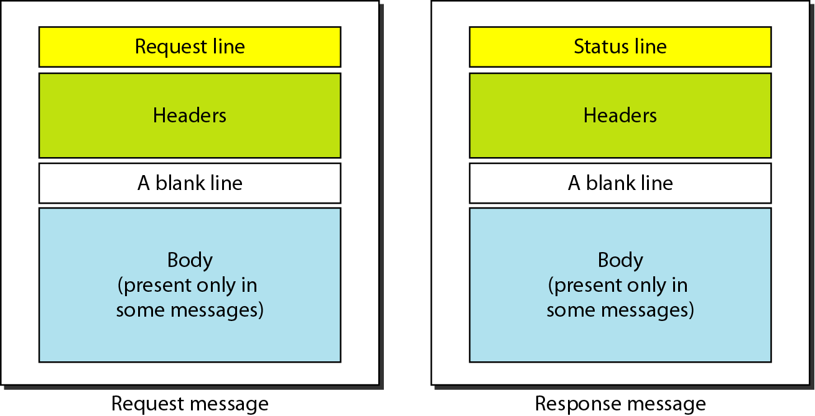
Structure of HTTP messages

Slide 34
HTTP messages resemble email structure: headers, blank line, and body.
Requests:
Start with a request line:
METHOD (e.g., GET, POST)
/path-to-resource (URL path)
version-number (HTTP version)
Followed by headers, a blank line, and an optional body.
GET requests: No body, end with a blank line.

Slide 35
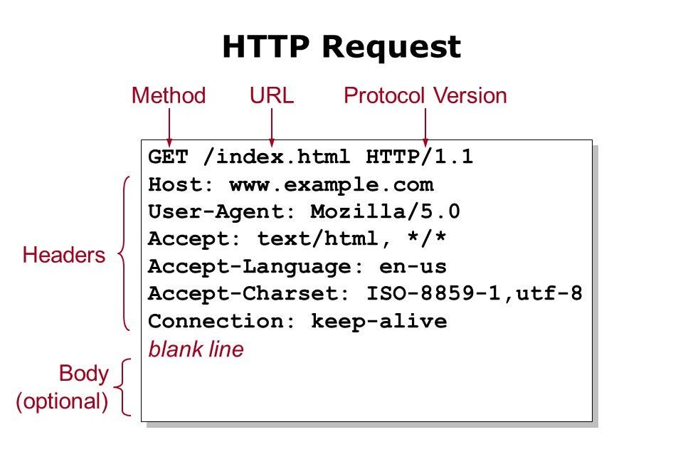

Slide 36
Responses:
Start with a status line:
HTTP version
Status code (e.g., 200 OK)
Followed by headers, a blank line, and response content (e.g., HTML).
Page loading process:
Browser sends GET request → Server responds with HTML
Browser parses HTML → Identifies additional resources (images, scripts, etc.)
Sends additional GET requests for resources → Server responds → Browser renders content.

Slide 37
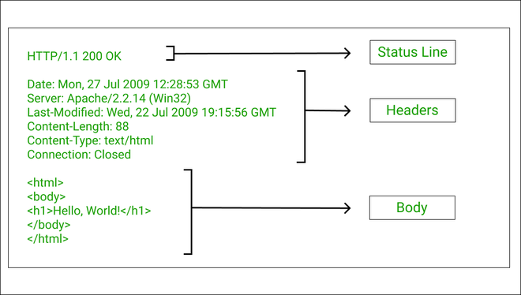

Slide 38
HTTP method types
GET
Get the resource specified in the requested URL. URL may refer to a data-handling process
POST
Send entities (specified in the entity body) to a data-handling process at the requested URL
HEAD
Asks server to leave requested object out of response, but send the rest of the response
PUT
Update a resource at the requested URL with the new entity specified in the entity body
DELETE
Deletes file specified in the URL
... and other methods.

Slide 39
Difference between POST and PUT
POST: the URL of the request identifies the resource that processes the entity body
PUT: the URL of the request identifies the resource that is contained in the entity body

Slide 40
Difference between HEAD and GET
GET: return the requested resource in the entity body of the response along with response headers (we’ll see these shortly)
HEAD: return all the response headers in the GET response, but without the resource in the entity body

Slide 41
Uploading form input: GET and POST
POST method:
Web page often includes form input
Input is uploaded to server in entity body
Posted content not visible in the URL
Free form content (ex: images) can be posted since entity body interpreted as data bytes
GET method:
Entity body is empty
Input is uploaded in URL field of request line
Example:
http://site.com/form?first=jane&last=austen

Slide 42
HTTP response status codes

Slide 44
HTTP authentication
Built-in HTTP Authentication:
Uses a browser’s pop-up dialog for login instead of an in-page form.
Server responds with 401 Unauthorized if access is restricted.
WWW-Authenticate header specifies the security realm.

Slide 45
Authentication Process:
Browser prompts user for username & password.
Credentials are Base64-encoded and sent in the Authorization header.
Server verifies credentials:
If valid → Grants access.
If invalid → Resends 401 or 403 Forbidden after multiple failures.

Slide 46
Limitations of Basic Authentication:
Credentials are only encoded, not encrypted (use secure connections).
Commercial applications often use custom authentication via POST requests over secure connections.
Custom methods avoid 401 but may use 403 Forbidden for unauthorized access.

Slide 47
HTTP connections
Non-persistent HTTP
At most one object is sent over a TCP connection.
HTTP/1.0 uses nonpersistent HTTP
Persistent HTTP
Multiple objects can be sent over single TCP connection between client and server.
HTTP/1.1 uses persistent connections in default mode
TCP is a kind of reliable communication service provided by the transport layer. It requires the connection to be “set up” before data communication.

Slide 48


Non-persistent HTTP
1a. HTTP client initiates TCP connection to HTTP server
1b. HTTP server at host “accepts” connection, notifying client
Suppose user visits a page with text and 10 images.
2. HTTP client sends HTTP request message
3. HTTP server receives request message, replies with response message containing requested object
time

Slide 49
Non-persistent HTTP (contd.)
4. HTTP server closes TCP connection.
5. HTTP client receives response message containing html file, displays html. Parsing html file, finds 10 referenced jpeg objects
time
6. Steps 1-5 repeated for each of 10 jpeg objects

Slide 50
Non-Persistent HTTP’s Response time
Round Trip Time (RTT): time to send a packet from client to server and back.
Sum of propagation, transmission, and queueing delays along both directions.
Response time:
One RTT to initiate TCP connection
One RTT for HTTP request and first few bytes of HTTP response to return
File transmission time
total = 2RTT + file transmission time
initiate TCP
connection
RTT
request
file
RTT
time to
transmit
file
file
received
time
time

Slide 51
Persistent HTTP: jumping to steps 4/5
4. HTTP server sends a response.
Server keeps the TCP connection alive.
5. HTTP client receives response message containing html file, displays html. Parsing html file, finds 10 referenced jpeg objects
time
The 10 objects can be requested over the same TCP connection.
i.e., save an RTT trying to open a new TCP connection per object.

Slide 52
Persistent vs. Non-persistent
Non-persistent HTTP requires at least 2 RTTs per object.
For each object: Open TCP connection; send HTTP request & receive response
Persistent HTTP: since server leaves connection open after sending response, subsequent HTTP messages between same client/server sent over the open connection
Save one RTT per object relative to non-persistent HTTP
In both cases, browsers have a choice of opening multiple parallel connections.

