Slide 1
Animation Generation from Text
Pooja Yadav
Kaivalya Sathe

Slide 2

Problem Definition
To develop a text-to-animation system by representing natural language text, especially instructional text into a machine-understandable form.

Slide 3
Technology
Berkeley neural parser for parsing the input text
Spacy & neuralcoref for Coreference Resolution
Blender tool for creating animations
Python

Slide 4
Methodology
Any instructional text (restricted to a simple sentence) is given as a input to the system.
For eg. Boil rice and add chopped onions to it.
This input text is passed through our Coref Annotator module which performs coreference resolution on it. Coreference resolution is the task of finding all expressions that refer to the same entity in a text.
For eg. Boil rice and add chopped onions to the rice.
The coreference resolved text is then parsed using Berkeley parser to output a parse tree.
The parse tree is input to our Extraction Module which extracts all the noun-verb pairs in the text.
For the above text, the module outputs:
(‘Boil’, ‘rice’)
(‘add’, ‘onions’)

Slide 5
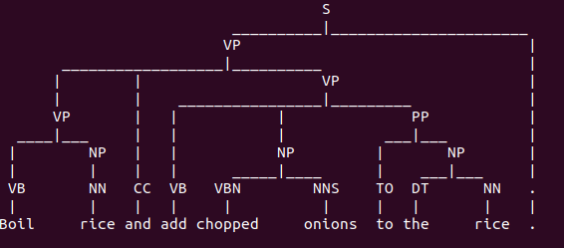
Flow-diagram
Boil rice and add chopped onions to it.
Coref Annotator
Boil rice and add chopped onions to the rice.
Berkeley Parser
Noun-Verb Extractor

Slide 6
Flow-diagram
( ‘Boil’, ‘rice’)
( ‘add’, ‘onions’)
Pre-processing function
( ‘BOIL’, ‘AB_1’)
( ‘ADD’, ‘AB_2’)
Generate function
HEAT(‘AB_1’,+).TAKE(Casserole).ADD(Water).ADD(‘AB_1’).HEAT(‘AB_1’;!)
MOVE( ‘AB_2’; Stove)
Animator

Slide 7
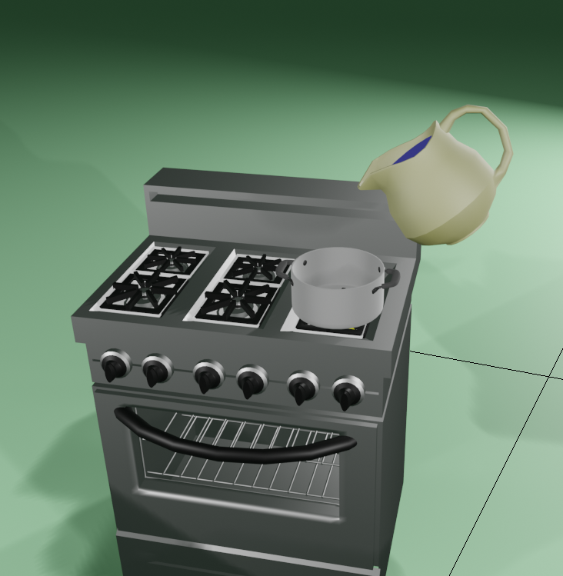
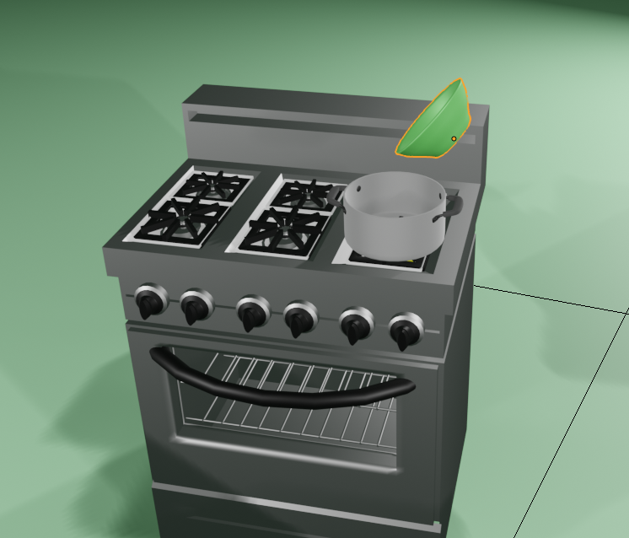
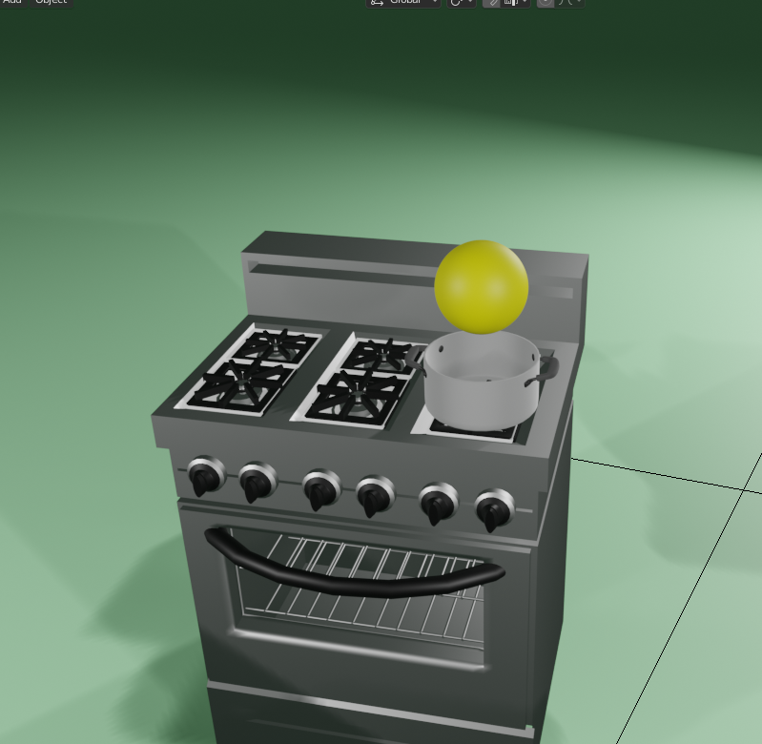
Flow-diagram

Slide 8
Demonstration
.

