Slide 1
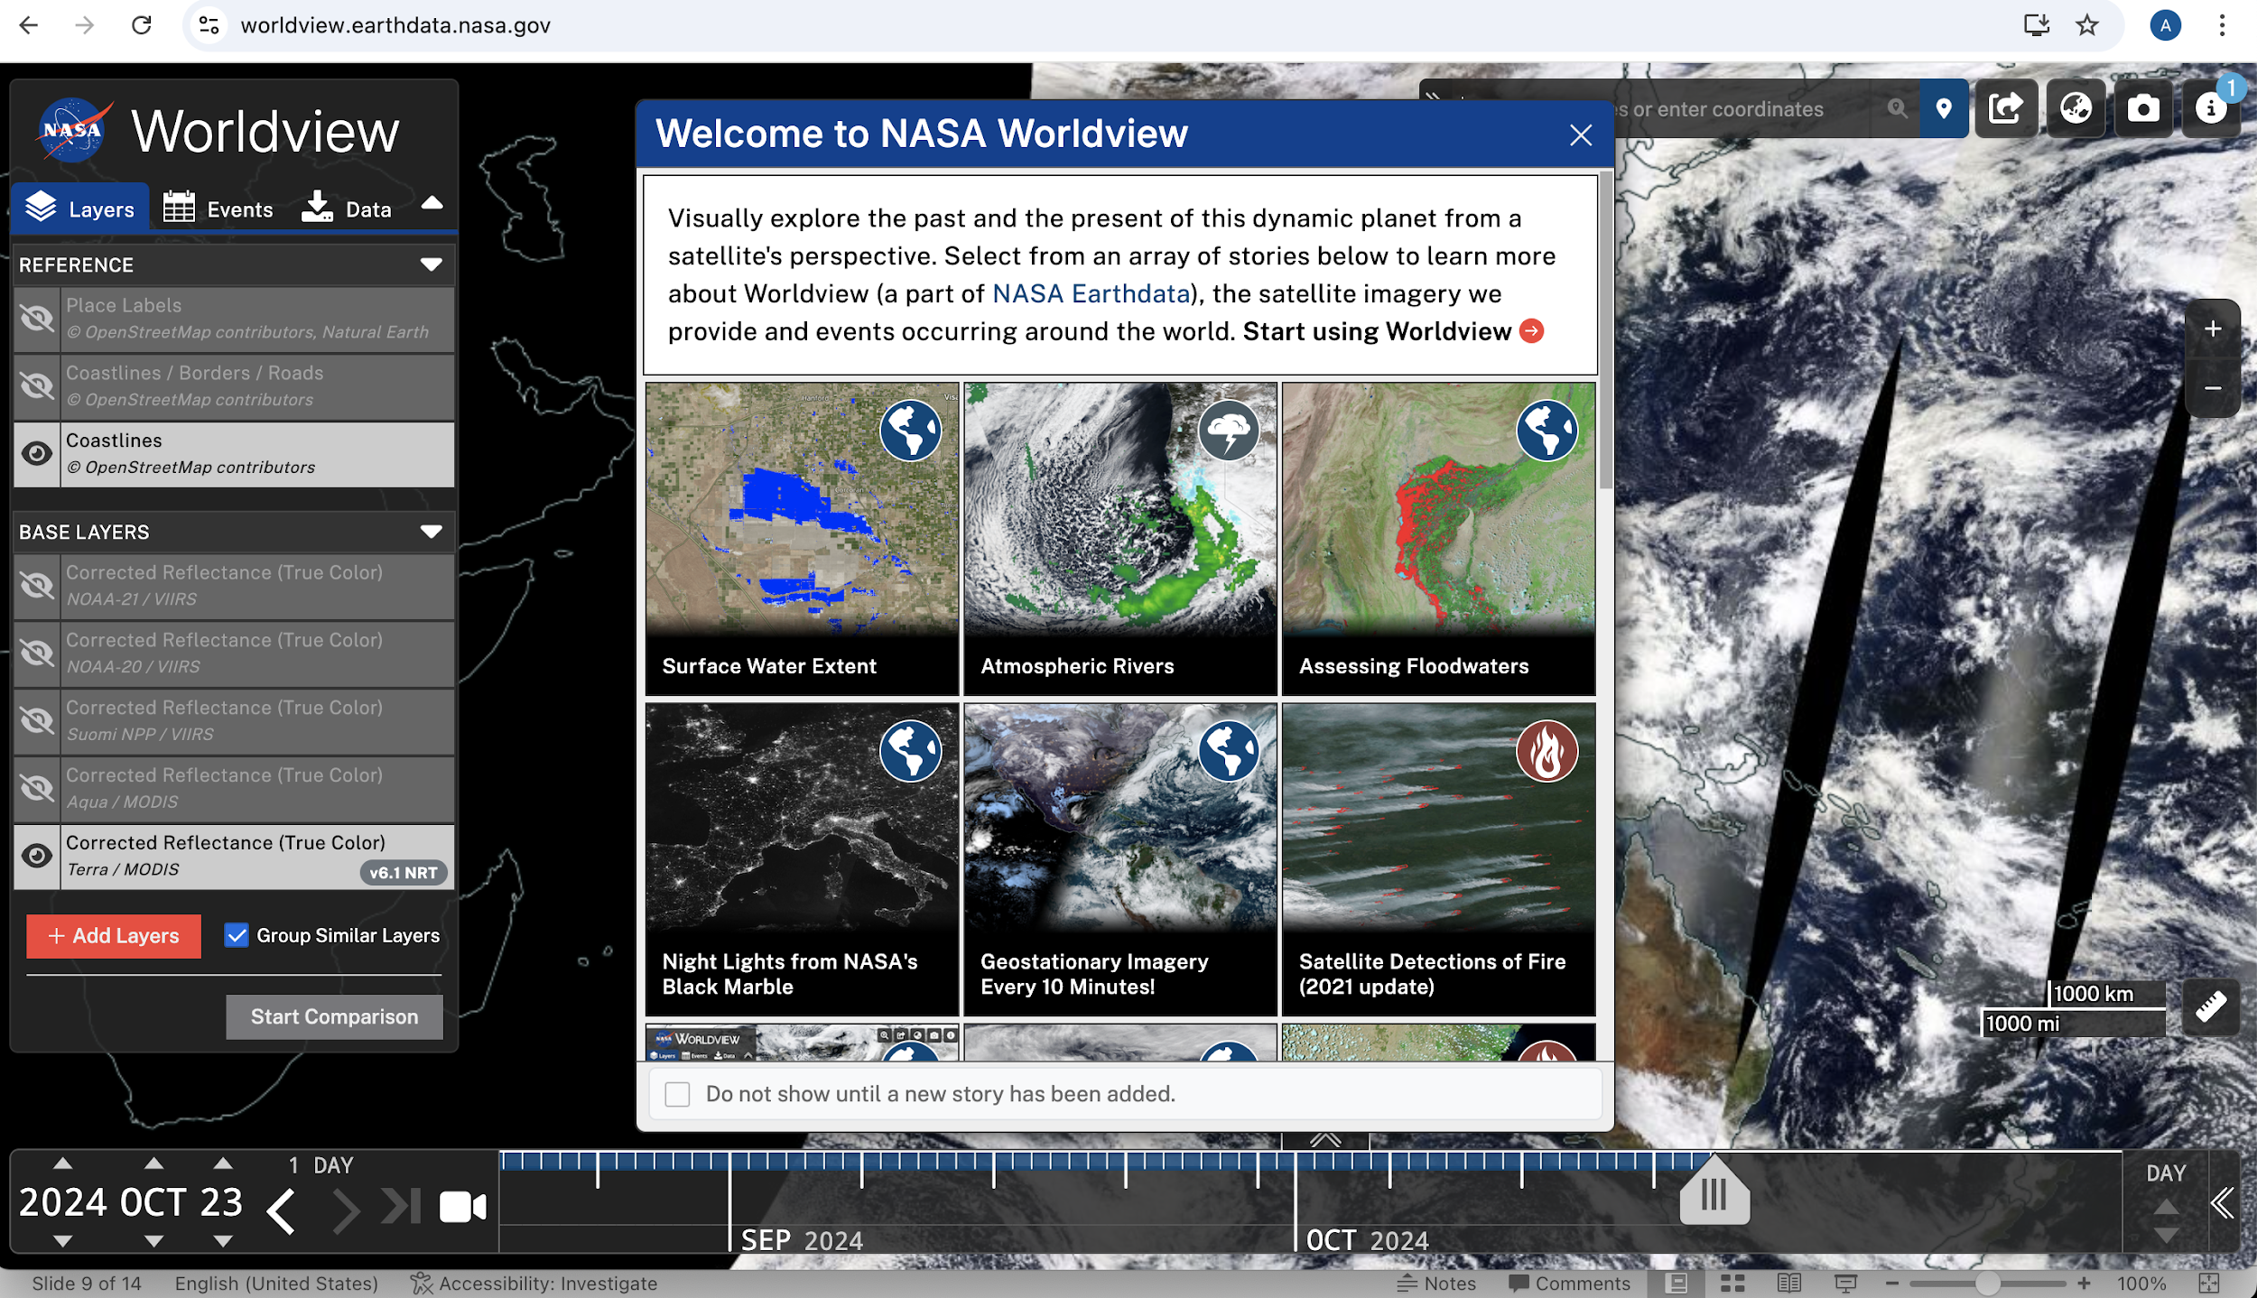
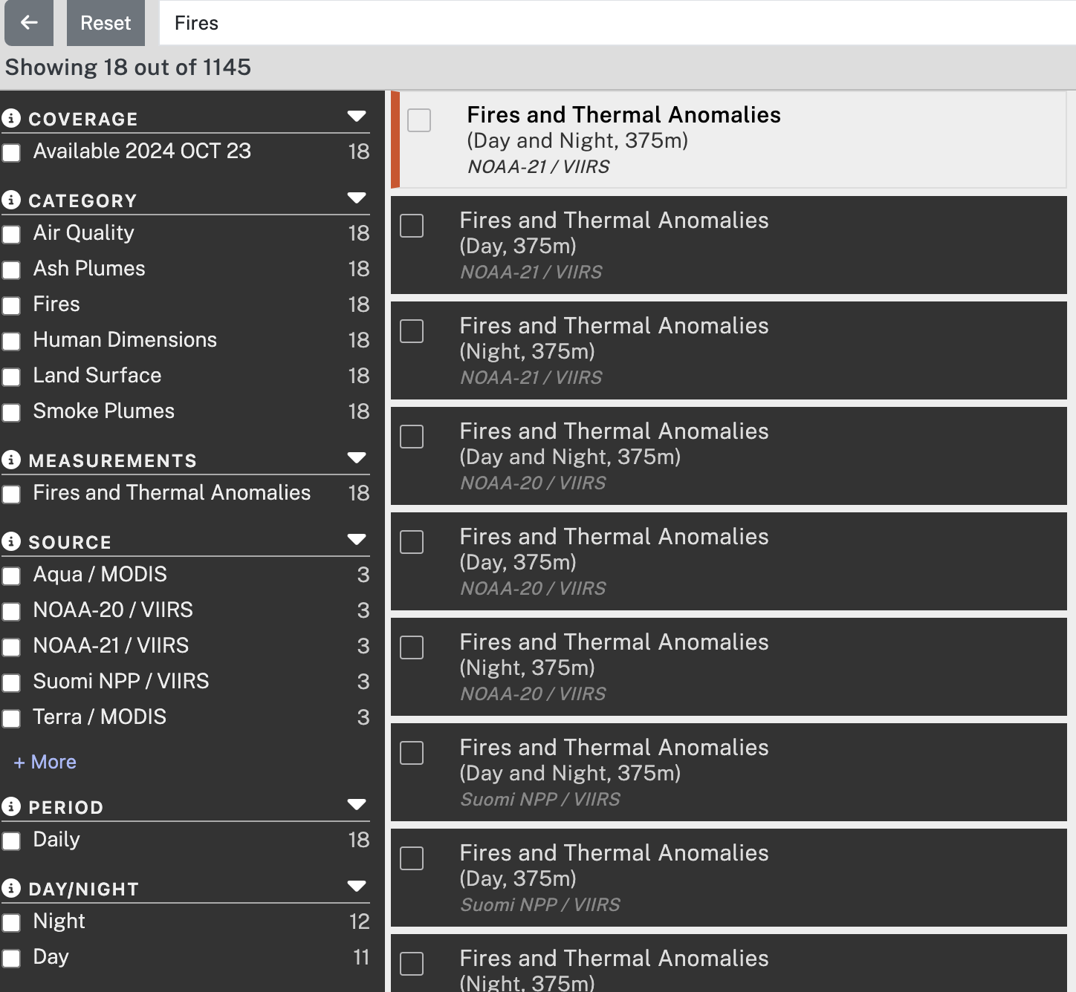
Exercise: Monitor Fires in Uttarakhand
1. Go To NASA Worldview and click on Add Layer.
2. Type Fires in the Search Window.
3. Select the following from the
data product list:
Fires and Thermal Anomalies
(Day and Night 375 m)
NOAA-21 VIIRS
Fires and Thermal Anomalies
(Day and Night 375 m)
NOAA-20 VIIRS
Fires and Thermal Anomalies
(Day and Night 375 m)
Suomi NPP VIIRS
Fires and Thermal Anomalies
(Day and Night)
Terra and Aqua/MODIS
Notes:
Equator Crossing: NOAA-20, NOAA-21, SNPP, Aqua 1:30 am/pm, Terra: 10:30 am/pm Spatial Resolution: 375 m for VIIRS & 1 KM for MODIS

Slide 2
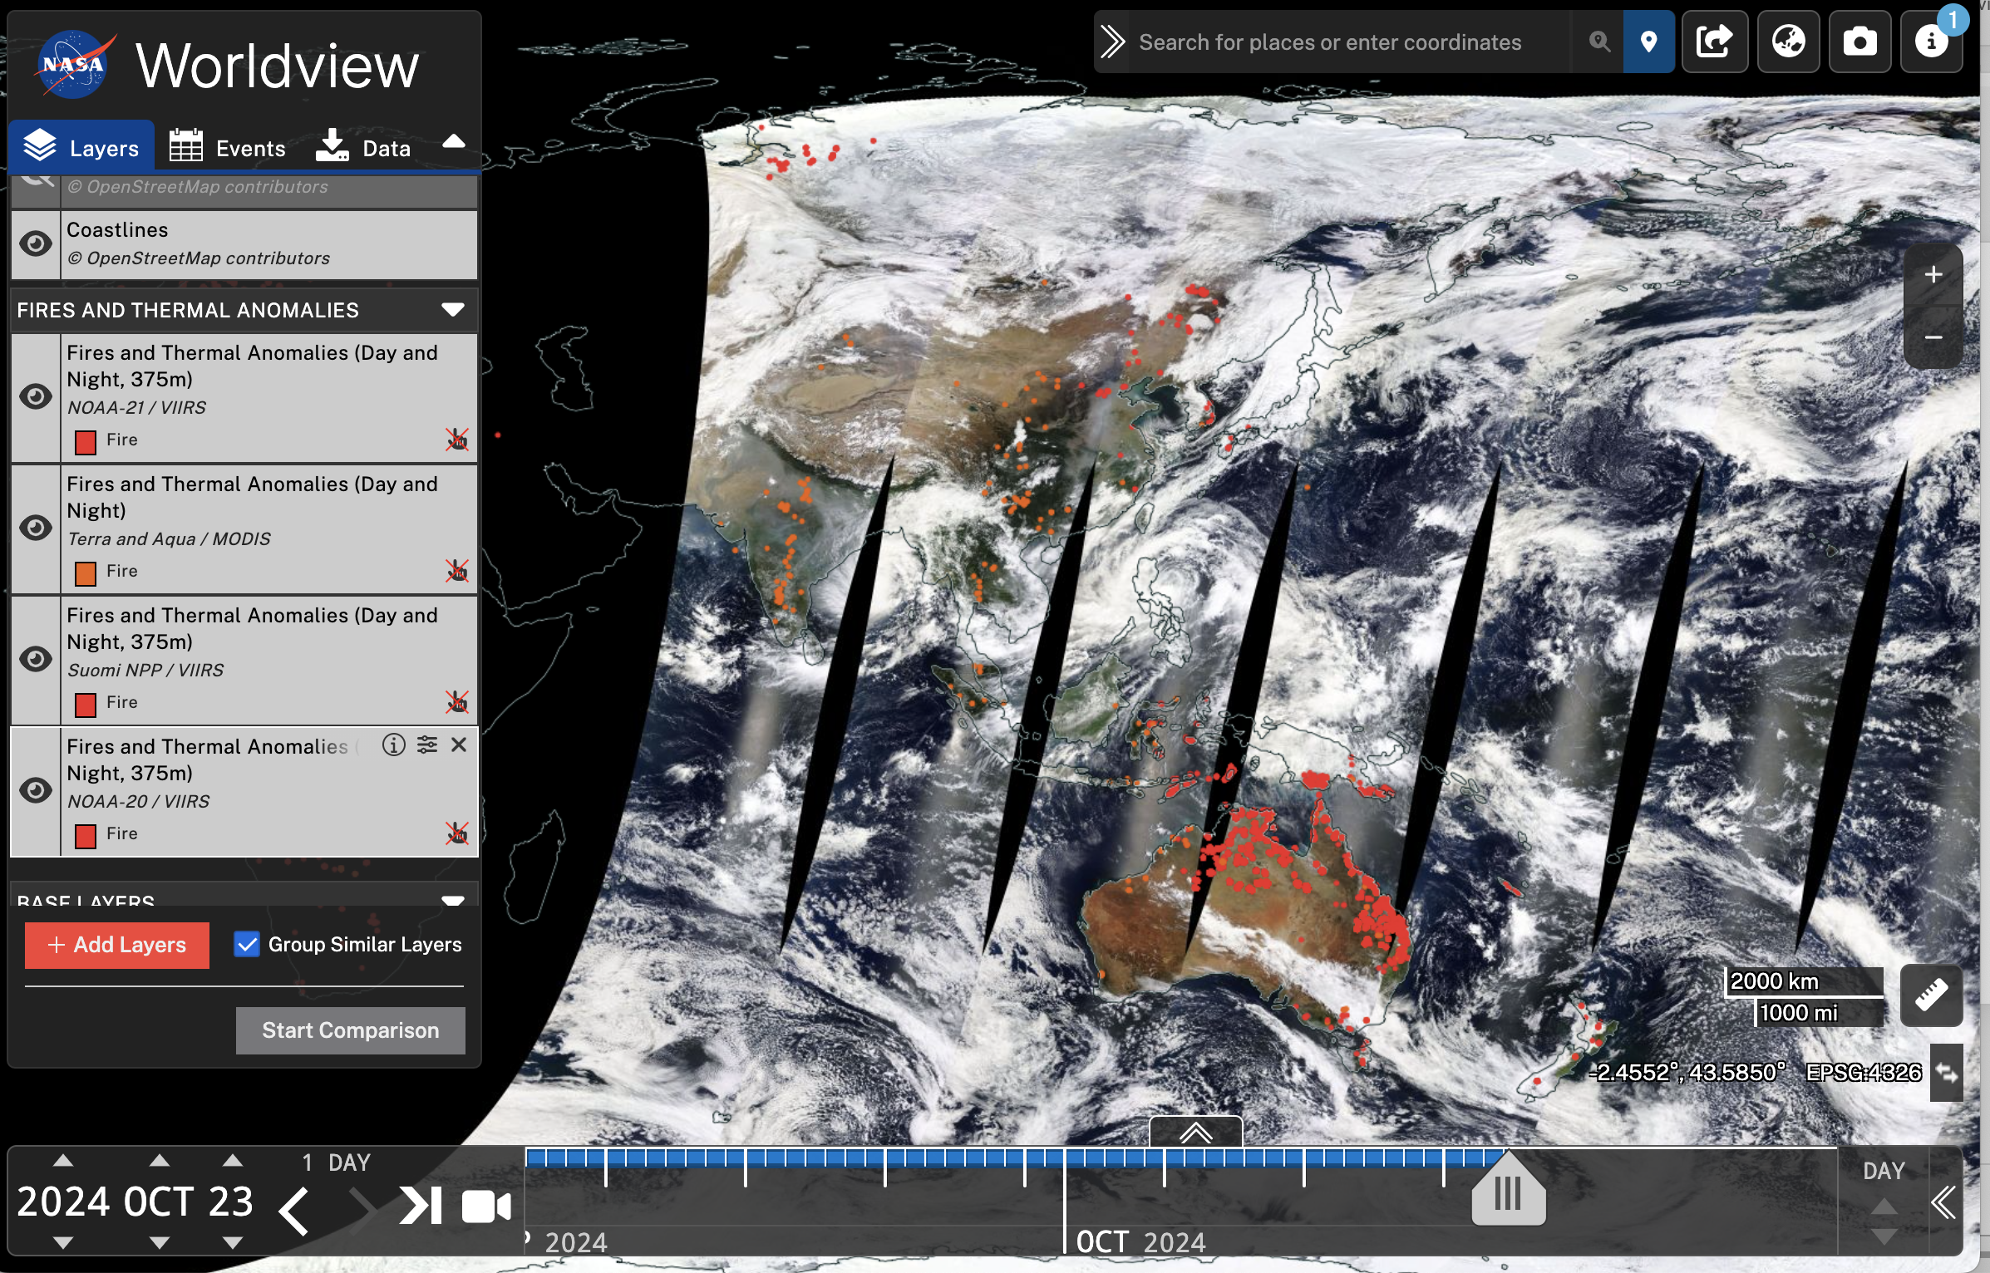
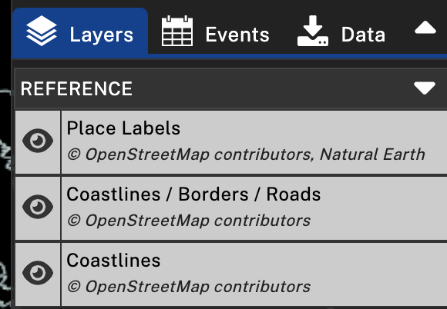
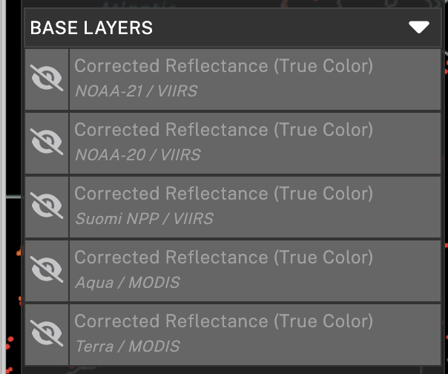
Exercise: Monitor Fires in Panjab/Haryana
4. Close the Layer Selection window
- You will see the layers added to the Layer Panel
- Zoom in and out of the map by using your
computer mouse.
5. Turn all the REFERENCE layers on and BASE LAYERS off.
Notes:
Show MODIS and VIIRS true-color images for swaths.

Slide 3
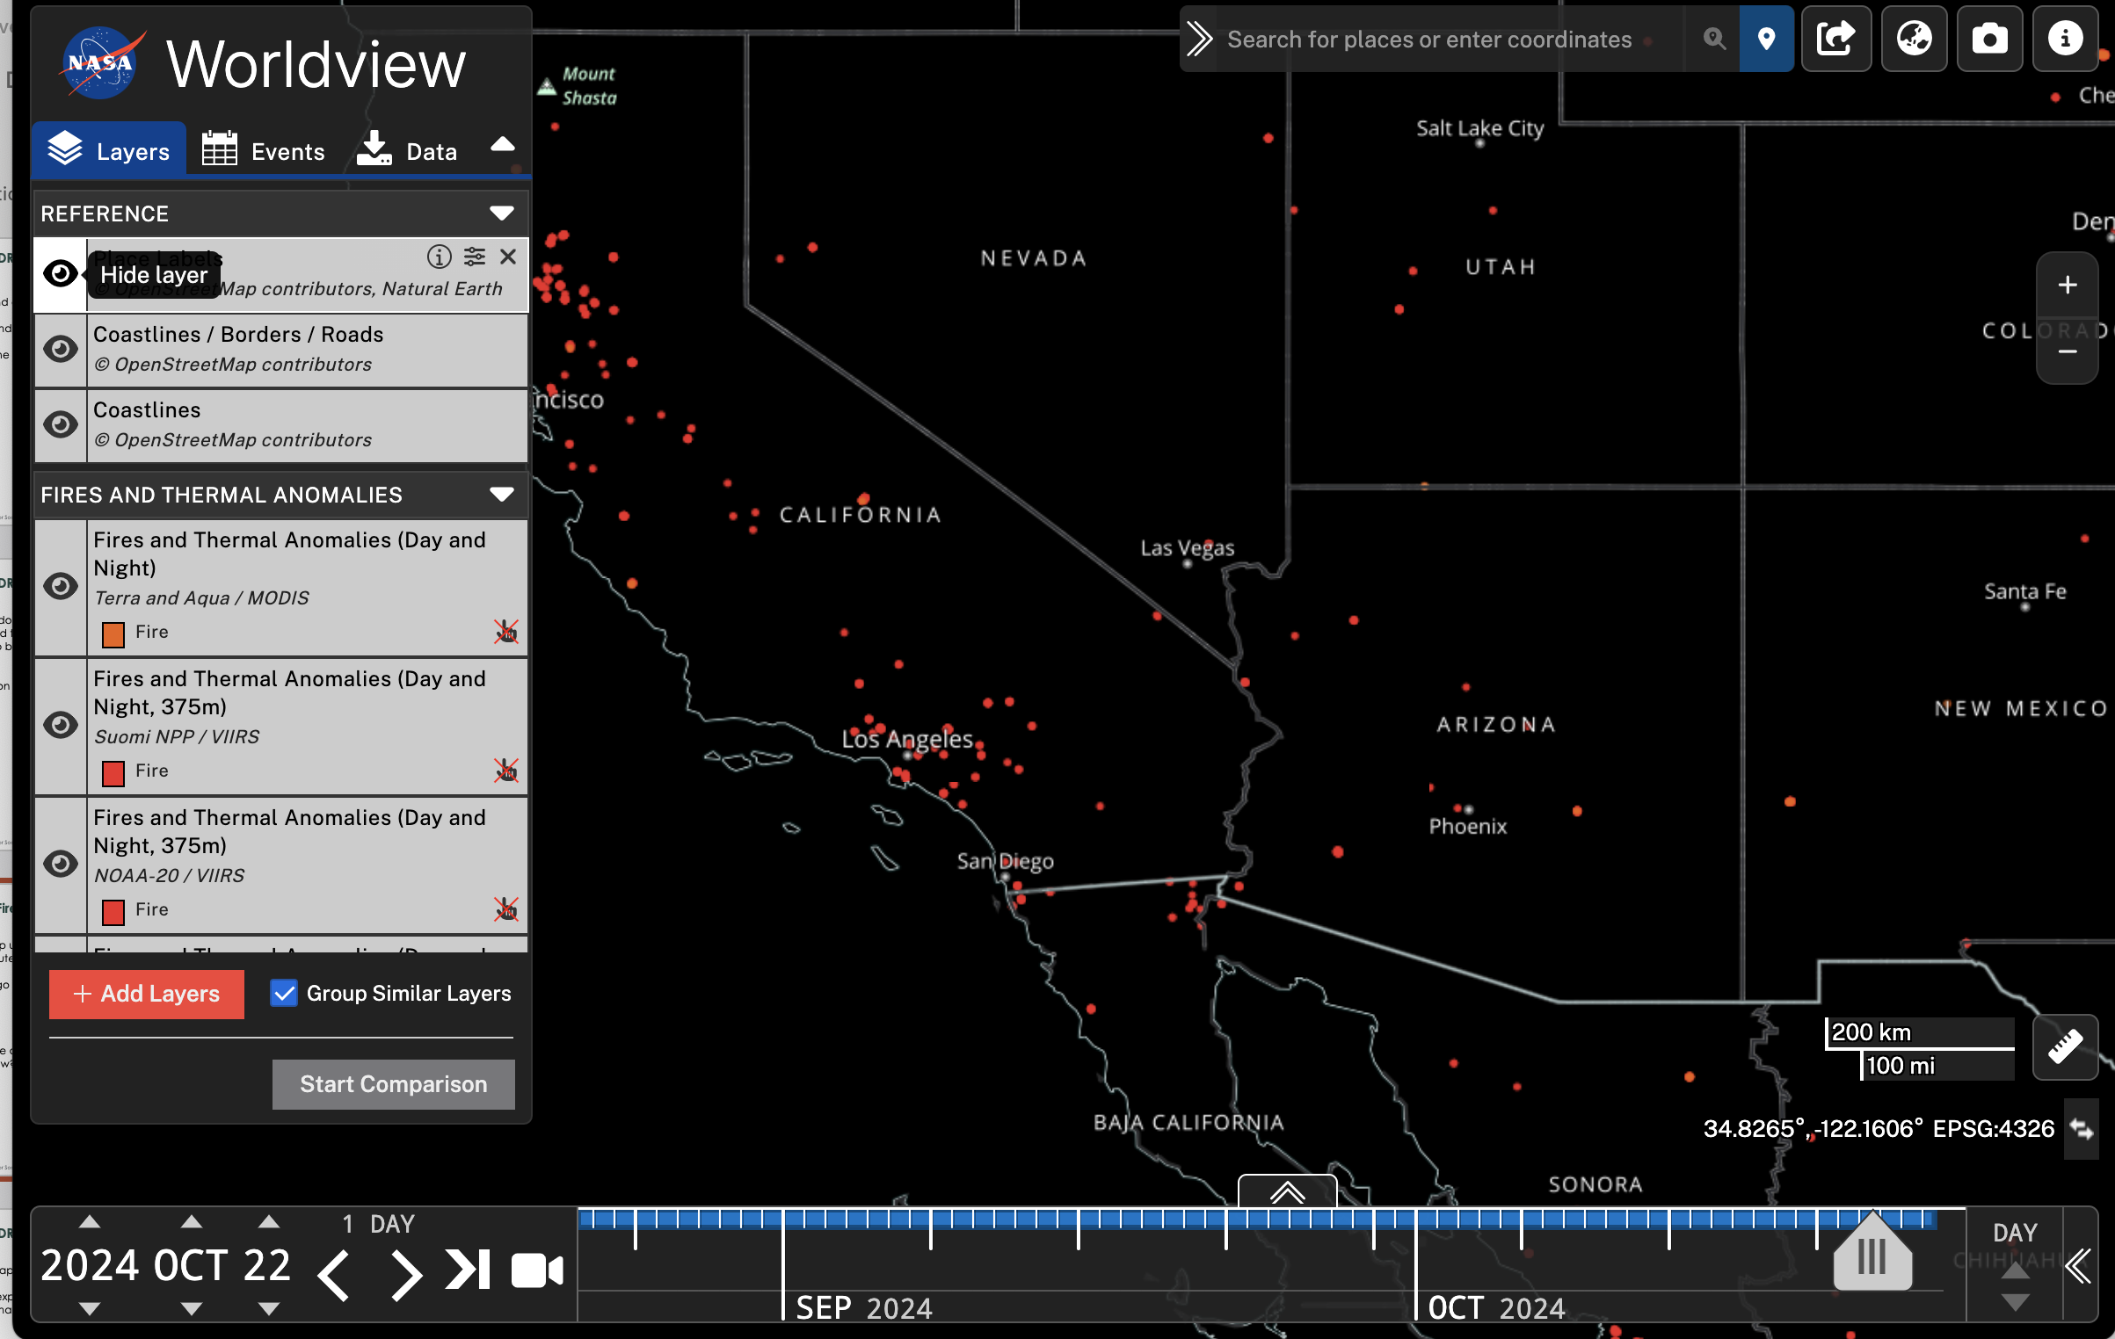
Exercise: Monitor Fires in Uttarakhand
6. Zoom to India on the map using +/_ sign on the
top right and using the computer mouse.
7. In the search window on the top right type
‘That, Uttarakhand’.
Using the time selection bar, go to 1 May
2024.
9. Now zoom in further to the region.
Location Search Window
Drag to move along the timeline

Slide 4
Exercise: Monitor Fires in Uttarakhand
Using the ‘1 Day’ arrows move from 1 to 7 May, one day at a time.
Which day do you see the maximum spread of fires near That?
12. Click on any fire spot (red dot) to see the details
about the fire at that location.
13. Now examine smoke by turning the true color images on
from the BASE LAYERS – for example start
with Suomi NPP VIIRS image on. Explore how Smoke
spreads between 1 to 7 May.

Slide 5
Explore: Monitor fires in the area/time of your interest

