Slide 1
Exercise: Monitor Tropical Cyclone Biparjoy
Biparjoy: June 6-16, 2023
Region: Arabian Sea
Wind speed: max. 194 km/h
Diameter: max. 567 km
Air pressure: below 945 mbar
Saffir-Simpson scale: category 3
Affected regions Western India

Slide 2
Exercise: Tropical Cyclone Biparjoy
This is a two-part exercise using Giovanni:
Part 1: Access and analysis of GPM-IMERG precipitation using Giovanni
Part 2: Access and Analysis of sea level pressure and winds from MERRA-2 using Giovanni

Slide 3
Part 1: GPM-IMERG Data Access and Analysis
Go to Giovanni: http://giovanni.gsfc.nasa.gov/giovanni
On the Giovanni page you will see the following options:
Select Plot: allows selection of analysis options
Select Data Range: allows selection of a time period
Select Region (Bounding Box or Shape): allows selection of a geographic region by latitude-longitude, map, or shapefile
Keyword: allows search of data parameters by keyword
Plot Data: (located on the bottom right of the page) begins the action to make a desired plot

Slide 4
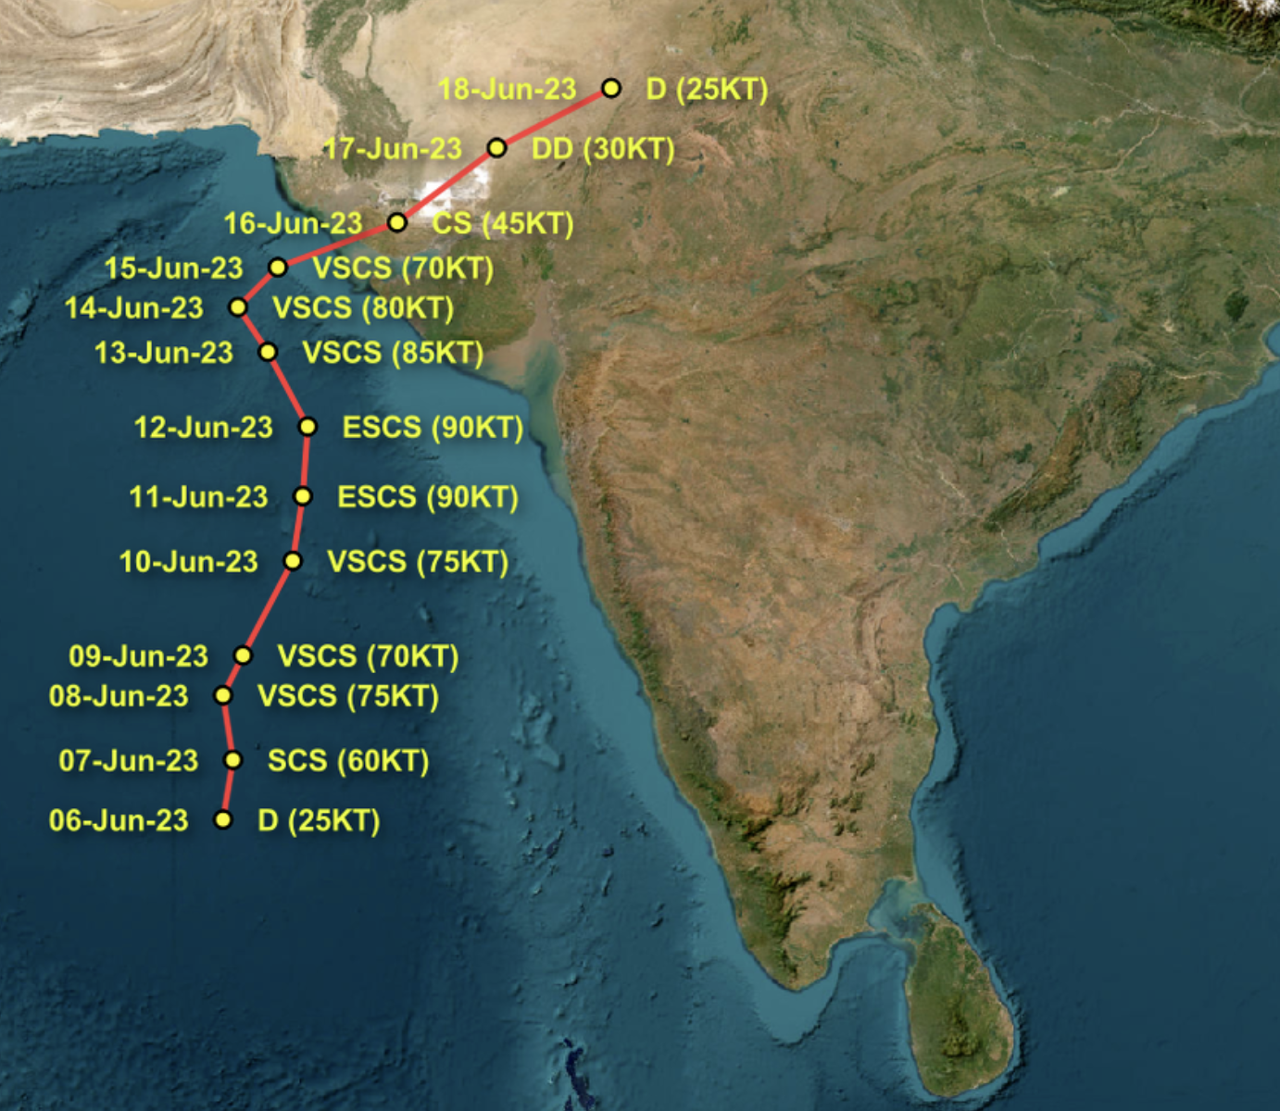
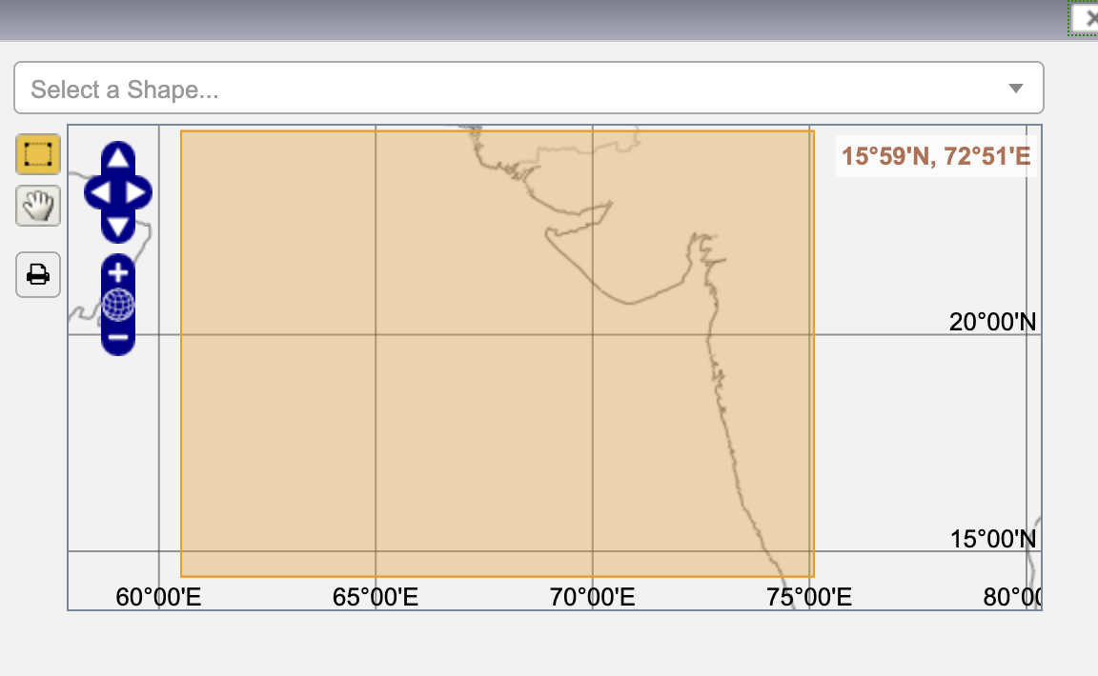
Part 1: IMERG Rainfall Maps
For Keyword: Enter IMERG v07 Final
Select:
Under Select Plot Select: Animation
Under Select Date Range (UTC)
In the YYYY-MM-DD windows,
enter 2023-06-14 to start and
2023-06-16 for the end date
Click on Plot Data (on the bottom right of the screen)
You will get an animation of half-hourly rainfall

Slide 5

Part 2: MERRA-2 Sea Level Pressure and Surface Wind Speed
Click on History → 1. Animation → User Input (Left Menu Bar)
Select
For Keyword: Enter MERRA-2 Hourly, you will see a list of parameters
Select Sea level pressure time average
Keep other options the same
Click on Plot Data (on the bottom right of the screen)
A workflow will start and you will get an animation of Sea Level Pressure for the cyclone.
4. Repeat the above steps but select the following while uncheck the Sea level
pressure

