Slide 1
Recurrent Neural Networks
Master class 2026

Slide 2
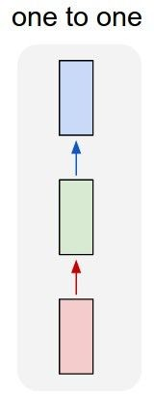
“Vanilla” Neural Network
Vanilla Neural Networks
Master class 2026
June 6, 2026

Slide 3
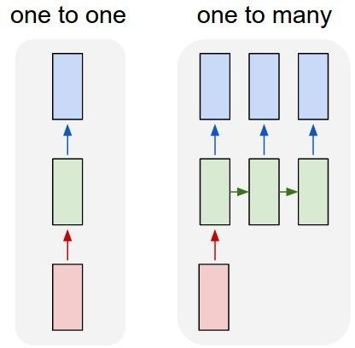
Recurrent Neural Networks: Process Sequences
e.g. Image Captioning
image -> sequence of words
Master class 2026

Slide 4
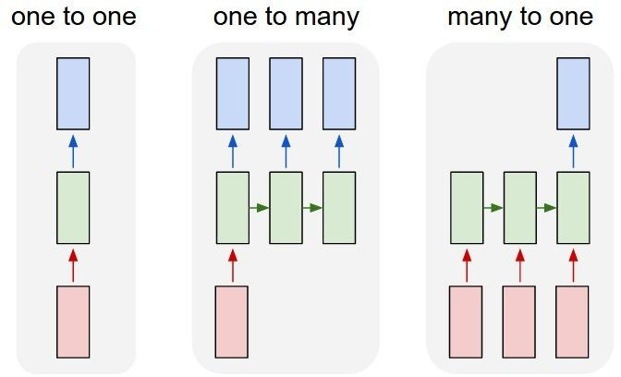
Recurrent Neural Networks: Process Sequences
e.g. action prediction
sequence of video frames -> action class
Master class 2026

Slide 5
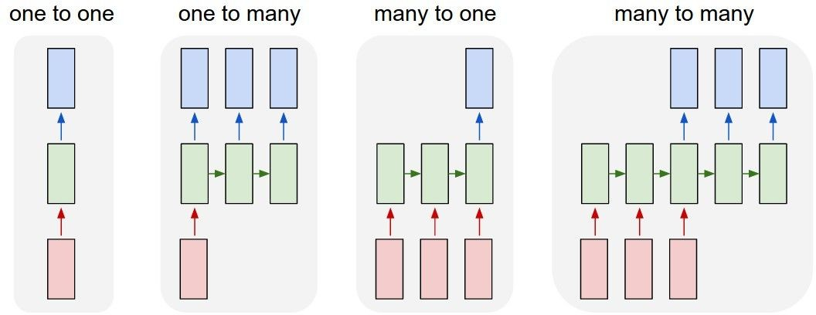
Recurrent Neural Networks: Process Sequences
E.g. Video Captioning
Sequence of video frames -> caption
Fei-Fei Li, Jiajun Wu, Ruohan Gao

Slide 6
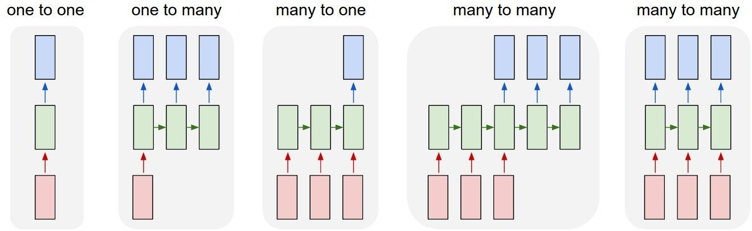
Recurrent Neural Networks: Process Sequences
e.g. Video classification on frame level
Master class 2026

Slide 7
Recurrent Neural Network
y
RNN
x

Slide 8
Recurrent Neural Network
y
Key idea: RNNs have an “internal state” that is updated as a sequence is processed
RNN
x
Master class 2026

Slide 9
Unrolled RNN
y₁
y₂
y₃
y_{t}
RNN
RNN
RNN
RNN
...
x₁
x₂
x₃
x_{t}
Master class 2026

Slide 10

RNN hidden state update
We can process a sequence of vectors x by applying a recurrence formula at every time step:
y
RNN
new state old state input vector at
some time step
x
some function
with parameters W
Master class 2026

Slide 11

RNN output generation
We can process a sequence of vectors x by applying a recurrence formula at every time step:
y
RNN
output
new state
x
another function with parameters W_{o}
Master class 2026

Slide 12
Recurrent Neural Network
y₁
y₂
y₃
y_{t}
h₀
RNN
h₁
RNN
h₂
RNN
h₃
RNN
...
x₁
x₂
x₃
x_{t}

Slide 13
Recurrent Neural Network
We can process a sequence of vectors x by applying a recurrence formula at every time step:
y
RNN
x
Notice: the same function and the same set of parameters are used at every time step.
Master class 2026

Slide 14

(Vanilla) Recurrent Neural Network
The state consists of a single “hidden” vector h:
y
RNN
x
Sometimes called a “Vanilla RNN” or an “Elman RNN” after Prof. Jeffrey Elman

Slide 15
RNN: Computational Graph
h₀
h₁
f_{W}
x₁
Master class 2026

Slide 16
RNN: Computational Graph
h₀
h₁
h₂
f_{W}
f_{W}
x₁
x₂
Master class 2026

Slide 17
RNN: Computational Graph
h₀
h₁
h₂
h₃
…
h_{T}
f_{W}
f_{W}
f_{W}
x₁
x₂
x₃

Slide 18
RNN: Computational Graph
Re-use the same weight matrix at every time-step
h₃
…
h_{T}
h₀
f_{W}
h₁
f_{W}
h₂
f_{W}
x₁
x₂
x₃
W

Slide 19
RNN: Computational Graph: Many to Many
y₁
y₂
y₃
y_{T}
h₃
…
h_{T}
h₀
f_{W}
h₁
f_{W}
h₂
f_{W}
x₁
x₂
x₃
W

Slide 20
RNN: Computational Graph: Many to Many
y₁
y₂
y₃
y_{T}
L₁
L₂
L₃
L_{T}
h₃
…
h_{T}
h₀
f_{W}
h₁
f_{W}
h₂
f_{W}
x₁
x₂
x₃
W
Master class 2026

Slide 21
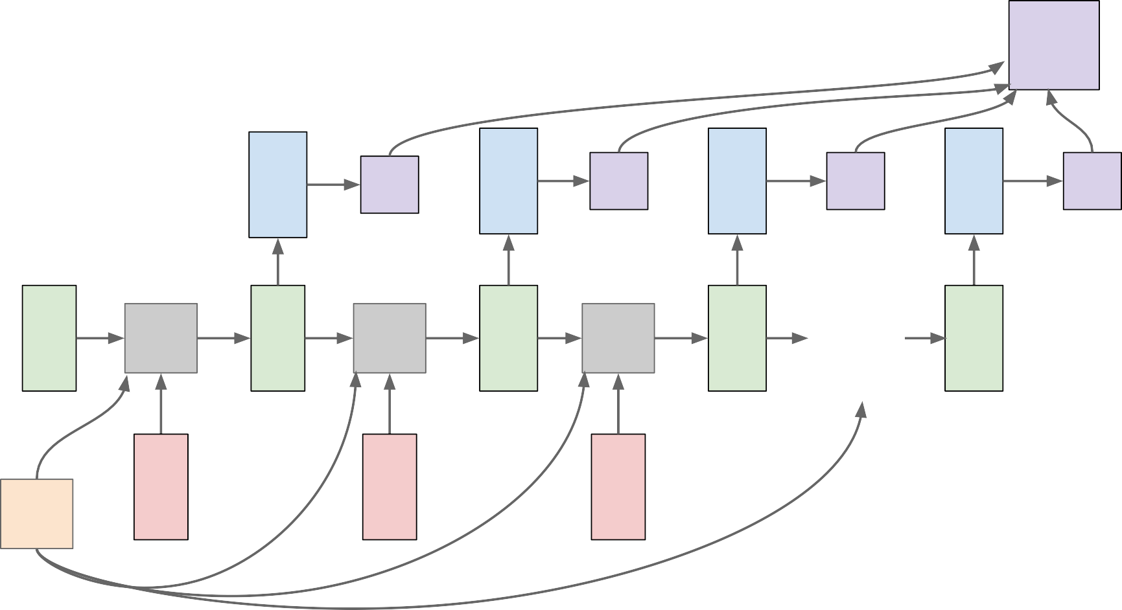
RNN: Computational Graph: Many to Many
L
 | y₁ | L₁ | y₂ | L₂ | y₃ | L₃ | y_{T} | L_{T}
f_{W} x₁ | h₁ | f_{W} x₂ | h₂ | f_{W} x₃ | h₃ | … | h_{T}
h₀
W
Master class 2026

Slide 22
RNN: Computational Graph: Many to One
y
h₃
…
h_{T}
h₀
f_{W}
h₁
f_{W}
h₂
f_{W}
x₁
x₂
x₃
W
Master class 2026

Slide 23
RNN: Computational Graph: Many to One
y
h₃
…
h_{T}
h₀
f_{W}
h₁
f_{W}
h₂
f_{W}
x₁
x₂
x₃
W

Slide 24
RNN: Computational Graph: One to Many
y₁
y₂
y₃
y_{T}
h₃
…
h_{T}
h₀
f_{W}
h₁
f_{W}
h₂
f_{W}
x
W
Master class 2026

Slide 25
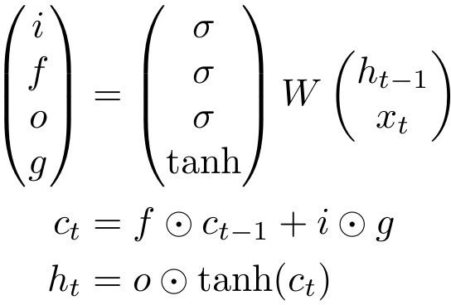
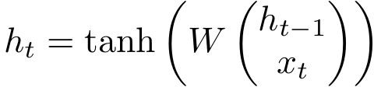
Long Short Term Memory (LSTM)
Vanilla RNN LSTM
Hochreiter and Schmidhuber, “Long Short Term Memory”, Neural Computation 1997
Master class 2026

Slide 26
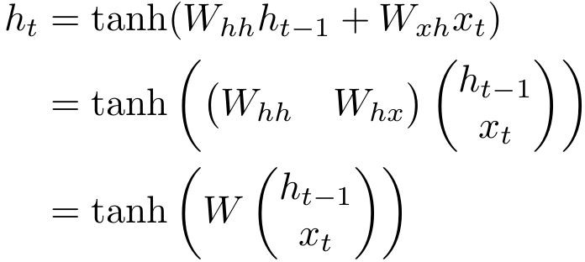
Vanilla RNN Gradient Flow
Bengio et al, “Learning long-term dependencies with gradient descent is difficult”, IEEE Transactions on Neural Networks, 1994
Pascanu et al, “On the difficulty of training recurrent neural networks”, ICML 2013
y_{t}
W
tanh
stack
h_{t}
^{h}t-1
x_{t}

Slide 27
Vanilla RNN Gradient Flow
Bengio et al, “Learning long-term dependencies with gradient descent is difficult”, IEEE Transactions on Neural Networks, 1994
Pascanu et al, “On the difficulty of training recurrent neural networks”, ICML 2013
Backpropagation from h_{t} to h_{t-1} multiplies by W
y
(actually W
T₎
t
hh
W
tanh
stack
h_{t}
^{h}t-1
x_{t}
Master class 2026

Slide 28

Vanilla RNN Gradient Flow
Bengio et al, “Learning long-term dependencies with gradient descent is difficult”, IEEE Transactions on Neural Networks, 1994
Pascanu et al, “On the difficulty of training recurrent neural networks”, ICML 2013
Backpropagation from h_{t} to h_{t-1} multiplies by W
y
(actually W
T₎
t
hh
W
tanh
stack
h_{t}
^{h}t-1
x_{t}
Master class 2026

Slide 29
Do LSTMs solve the vanishing gradient problem?
The LSTM architecture makes it easier for the RNN to preserve information over many timesteps
e.g. if the f = 1 and the i = 0, then the information of that cell is preserved indefinitely.
By contrast, it’s harder for vanilla RNN to learn a recurrent weight matrix Wh that preserves info in hidden state
LSTM doesn’t guarantee that there is no vanishing/exploding gradient, but it does provide an easier way for the model to learn long-distance dependencies
Master class 2026

Slide 30
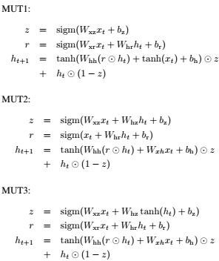
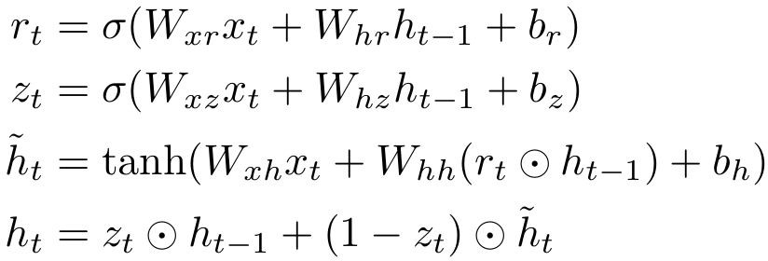
Other RNN Variants
[An Empirical Exploration of Recurrent Network Architectures, Jozefowicz et al., 2015]
GRU [Learning phrase representations using rnn encoder-decoder for statistical machine translation, Cho et al. 2014]
[LSTM: A Search Space Odyssey, Greff et al., 2015]
Master class 2026

Slide 31
Summary
RNNs allow a lot of flexibility in architecture design
Vanilla RNNs are simple but don’t work very well
Common to use LSTM or GRU: their additive interactions improve gradient flow
Backward flow of gradients in RNN can explode or vanish. Exploding is controlled with gradient clipping. Vanishing is controlled with additive interactions (LSTM)
Better/simpler architectures are a hot topic of current research, as well as new paradigms for reasoning over sequences
Better understanding (both theoretical and empirical) is needed.

Slide 32
Attention and Transformers
Master class 2026

Slide 33
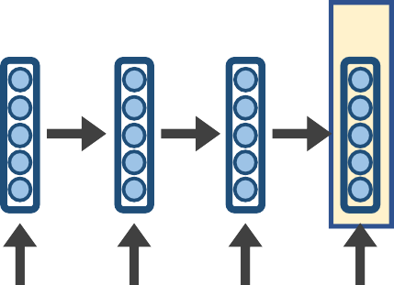
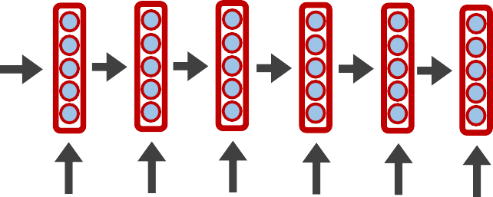
seq2seq models
are a general-purpose encoder-decoder architecture
𝑦"₁
𝑦"₂
𝑦"₃
𝑦"₄
𝑦"₅
𝑦"₆
_{ℎ}𝐸
_{ℎ}𝐸
_{ℎ}𝐸
_{ℎ}𝐸
_{ℎ}𝐷 _{ℎ}𝐷 _{ℎ}𝐷
_{ℎ}𝐷
ℎ^{𝐷} ℎ^{𝐷}
1
2
3
4
1
2
3
4
5
6
Hidden layer
can be implemented with RNNs (or Transformers even)
Input layer
The
brown
dog
ran
<s>
Le
chien
brun
a couru
Allow for n → m predictions
ENCODER RNN
DECODER RNN
Natural approach to Neural MT
If implemented end-to-end can be good but slow
33

Slide 34
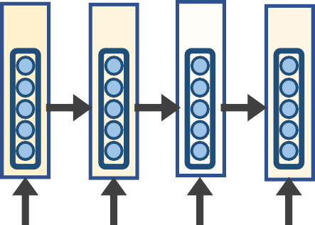
seq2seq models
Attention allows a decoder, at each time step, to focus/use different amounts of the encoder’s hidden states
_{𝒄}𝑫
𝟓
_{𝒂}𝟓
_{𝒂}𝟓
𝑦"₁
𝑦"2 𝑦"₃ 𝑦"4 𝑦"₅ 𝑦"₆
𝐷 𝐷 𝐷 𝐷 𝐷
ℎ₂ ℎ₃ ℎ₄ ℎ₅ ℎ₆
Le chien brun a couru
_{𝒂}𝟓
𝟓
𝟏
𝟐
𝒂_{𝟑}
𝟒
_{ℎ}𝐸
_{ℎ}𝐸
_{ℎ}𝐸
_{ℎ}𝐸
_{ℎ}𝐷
1
2
3
4
1
Hidden layer
Input layer
The
brown
dog
ran
<s>
The resulting context vector 𝑐_{𝑖} is used, with the decoder’s current hidden state ℎ_{𝑖}, to predict 𝑦#_{𝑖}
ENCODER RNN
DECODER RNN
34

Slide 35
Outline
seq2seq + Attention
Self-Attention
35

Slide 36
Outline
seq2seq + Attention
Self-Attention
36

Slide 37








seq2seq + Attention
Q: How do we determine how much to pay attention to each of the encoder’s hidden layers?
A: Let’s base it on our decoder’s current hidden state (our current representation of meaning) and all of the encoder’s hidden layers!
_{ℎ}𝐸
_{ℎ}𝐸
_{ℎ}𝐸
_{ℎ}𝐸
_{ℎ}𝐷
1
4
1
𝑒
1
1.5
2
3
Hidden layer
_{ℎ}𝐸
_{ℎ}𝐷
1
1
Input layer
The
brown
<s>
DECODER RNN
Separate FFNN
dog
ran
ENCODER RNN

Slide 38
seq2seq + Attention
Q: How do we determine how much to pay attention to each of the encoder’s hidden layers?
A: Let’s base it on our decoder’s current hidden state (our current representation of meaning) and all of the encoder’s hidden layers!
_{ℎ}𝐸
_{ℎ}𝐸
_{ℎ}𝐸
_{ℎ}𝐸
_{ℎ}𝐷
1
4
1
𝑒
2
0.9
2
3
Hidden layer
_{ℎ}𝐸
_{ℎ}𝐷
2
1
Input layer
<s>
DECODER RNN
Separate FFNN
The
brown
dog
ran
ENCODER RNN

Slide 39
seq2seq + Attention
Q: How do we determine how much to pay attention to each of the encoder’s hidden layers?
A: Let’s base it on our decoder’s current hidden state (our current representation of meaning) and all of the encoder’s hidden layers!
_{ℎ}𝐸
_{ℎ}𝐸
_{ℎ}𝐸
_{ℎ}𝐸
_{ℎ}𝐷
1
4
1
𝑒
3
0.2
2
3
Hidden layer
_{ℎ}𝐸
_{ℎ}𝐷
3
1
Input layer
The
brown
Separate FFNN
dog
ran
<s>
DECODER RNN
ENCODER RNN

Slide 40
seq2seq + Attention
Q: How do we determine how much to pay attention to each of the encoder’s hidden layers?
A: Let’s base it on our decoder’s current hidden state (our current representation of meaning) and all of the encoder’s hidden layers!
_{ℎ}𝐸
_{ℎ}𝐸
_{ℎ}𝐸
_{ℎ}𝐸
_{ℎ}𝐷
1
2
3
4
1
𝑒4 −0.5
Hidden layer
_{ℎ}𝐸
_{ℎ}𝐷
4
1
Input layer
The
brown
Separate FFNN
dog
ran
<s>
DECODER RNN
ENCODER RNN

Slide 41
seq2seq + Attention
Q: How do we determine how much to pay attention to each of the encoder’s hidden layers?
A: Let’s base it on our decoder’s current hidden state (our current representation of meaning) and all of the encoder’s hidden layers!
Attention (raw scores)
_{ℎ}𝐸 _{ℎ}𝐷
𝑒₁
𝑒
1.5
0.9
0.2
_{ℎ}𝐸 _{ℎ}𝐸 _{ℎ}𝐸
1
2
3
4
1
2
𝑒₃
Hidden layer
𝑒4 −0.5
Input layer
The brown
dog
ran
<s>
ENCODER RNN
DECODER RNN

Slide 42
seq2seq + Attention
Q: How do we determine how much to pay attention to each of the encoder’s hidden layers?
A: Let’s base it on our decoder’s current hidden state (our current representation of meaning) and all of the encoder’s hidden layers!
Attention (raw scores)
_{ℎ}𝐸 _{ℎ}𝐷
𝑒₁
𝑒
1.5
0.9
0.2
_{ℎ}𝐸 _{ℎ}𝐸 _{ℎ}𝐸
1
2
3
4
1
2
𝑒₃
Hidden layer
𝑒4 −0.5
Attention (softmax’d)
exp(𝑒_{𝑖})
Input layer
The brown
dog
ran
<s>
𝑎¹ =
𝑖
∑^{𝑁} exp(𝑒₁)
ENCODER RNN
DECODER RNN
𝑖

Slide 43
seq2seq + Attention
Q: How do we determine how much to pay attention to each of the encoder’s hidden layers?
A: Let’s base it on our decoder’s current hidden state (our current representation of meaning) and all of the encoder’s hidden layers!
Attention (raw scores)
_{ℎ}𝐸 _{ℎ}𝐷
𝑒₁
𝑒
1.5
0.9
0.2
_{ℎ}𝐸 _{ℎ}𝐸 _{ℎ}𝐸
1
2
3
4
1
2
𝑒₃
Hidden layer
𝑒4 −0.5
Attention (softmax’d)
_{𝑎}1
= 0.51
= 0.28
= 0.14
= 0.07
1
Input layer
The
brown
dog
ran
<s>
DECODER RNN
_{𝑎}1
2
_{𝑎}1
ENCODER RNN
3
_{𝑎}1
3

Slide 44



seq2seq + Attention
_{𝑐}𝐷
1
We multiply each encoder’s hidden layer
by its 𝑎¹ attention weights to create a
𝑖
_{𝑎}1
1
context vector 𝑐^{𝐷}
1
𝑎₄
1
1
1
𝑎₃
𝑎₂
_{ℎ}𝐸
_{ℎ}𝐸
_{ℎ}𝐸
_{ℎ}𝐸
_{ℎ}𝐷
1
2
3
4
1
Hidden layer
Attention (softmax’d)
_{𝑎}1
= 0.51
= 0.28
= 0.14
= 0.07
<s>
DECODER RNN
1
Input layer
The
brown
dog
ran
_{𝑎}1
2
ENCODER RNN
_{𝑎}1
3
_{𝑎}1
3

Slide 45
seq2seq + Attention
REMEMBER: each attention weight 𝑎^{j} is based on the decoder’s current hidden state, too.
_{𝑐}𝐷
𝑖
1
Le
𝑦4₁
_{𝑎}1
_{𝑎}1
_{𝑎}1
1
1
𝑎₃
ℎ₂
4
2
_{ℎ}𝐸
𝐸
𝐸
_{ℎ}𝐸
[ℎ^{𝐷}; 𝑐^{𝐷}]
1
ℎ₃
4
1 1
Hidden layer
Input layer
The brown
dog
ran
<s>
DECODER RNN
ENCODER RNN

Slide 46

seq2seq + Attention
REMEMBER: each attention weight 𝑎^{j} is based on the decoder’s current hidden state, too.
_{𝑐}𝐷
𝑖
2
Le chien
𝑦4₁ 𝑦4₂
_{𝑎}2
_{𝑎}2
_{𝑎}2
2
1
𝑎₃
ℎ₂
4
2
_{ℎ}𝐸
𝐸
𝐸
_{ℎ}𝐸
[ℎ^{𝐷}; 𝑐^{𝐷}] [ℎ^{𝐷}; 𝑐^{𝐷}]
1 1 2 2
1
ℎ₃
4
Hidden layer
Input layer
The brown
dog
ran
<s>
Le
ENCODER RNN
DECODER RNN

Slide 47
seq2seq + Attention
REMEMBER: each attention weight 𝑎^{j} is based on the decoder’s current hidden state, too.
_{𝑐}𝐷
𝑖
3
Le chien
𝑦4₁ 𝑦4₂
brun
𝑦4₃
_{𝑎}3
_{𝑎}3
3
1
3
𝑎₃
ℎ₂
4
𝑎₂
_{ℎ}𝐸
𝐸
𝐸
_{ℎ}𝐸
[ℎ^{𝐷}; 𝑐^{𝐷}] [ℎ^{𝐷}; 𝑐^{𝐷}] [ℎ^{𝐷}; 𝑐^{𝐷}]
1 1 2 2 3 3
1
ℎ₃
4
Hidden layer
Input layer
The
brown
dog
ran
<s>
Le
chien
ENCODER RNN
DECODER RNN

Slide 48
seq2seq + Attention
REMEMBER: each attention weight 𝑎^{j} is based on the decoder’s current hidden state, too.
_{𝑐}𝐷
𝑖
4
Le chien
𝑦4₁ 𝑦4₂
brun a
𝑦4₃ 𝑦4₄
_{𝑎}4
_{𝑎}4
_{𝑎}4
4
1
𝑎₃
ℎ₂
4
2
_{ℎ}𝐸
𝐸
𝐸
_{ℎ}𝐸
[ℎ^{𝐷}; 𝑐^{𝐷}] [ℎ^{𝐷}; 𝑐^{𝐷}] [ℎ^{𝐷}; 𝑐^{𝐷}] [ℎ^{𝐷}; 𝑐^{𝐷}]
1 1 2 2 3 3 4 4
1
ℎ₃
4
Hidden layer
Input layer
The
brown
dog
ran
<s>
Le
chien
brun
ENCODER RNN
DECODER RNN

Slide 49
seq2seq + Attention
REMEMBER: each attention weight 𝑎^{j} is based on the decoder’s current hidden state, too.
_{𝑐}𝐷
𝑖
5
Le chien
𝑦4₁ 𝑦4₂
brun
𝑦4₃
a couru
𝑦4₄ 𝑦4₄
_{𝑎}5
_{𝑎}5
5
1
5
𝑎₃
ℎ₂
4
𝑎₂
_{ℎ}𝐸
𝐸
𝐸
_{ℎ}𝐸
[ℎ^{𝐷}; 𝑐^{𝐷}] [ℎ^{𝐷}; 𝑐^{𝐷}] [ℎ^{𝐷}; 𝑐^{𝐷}] [ℎ^{𝐷}; 𝑐^{𝐷}] [ℎ^{𝐷}; 𝑐^{𝐷}]
1
ℎ₃
4
1 1 2 2 3 3 4 4
5 5
Hidden layer
Input layer
The
brown
dog
ran
<s>
Le
chien
brun
a
ENCODER RNN
DECODER RNN

Slide 50
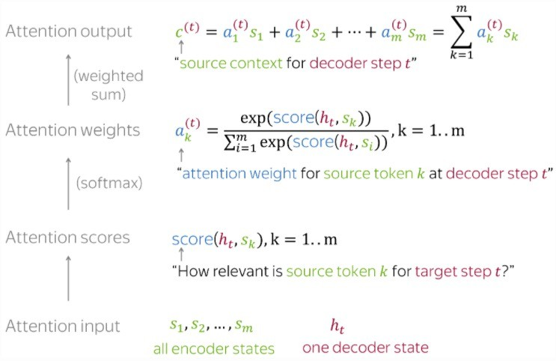
For convenience, here’s the Attention calculation summarized on 1 slide

Slide 51
For convenience, here’s the Attention calculation summarized on 1 slide
The Attention mechanism that produces
scores doesn’t have to be a FFNN like I illustrated. It can be any function you wish.

Slide 52
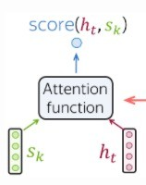
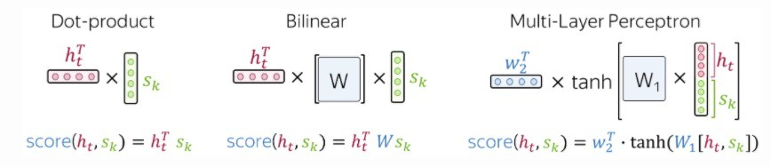
Popular Attention Scoring functions:
Photo credit: https://lena-voita.github.io/nlp_course/seq2seq_and_attention.html

Slide 53
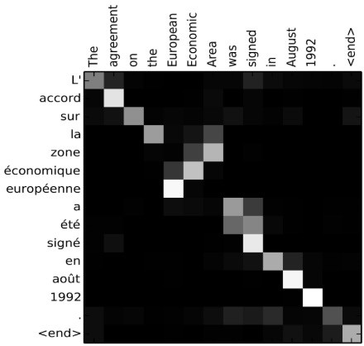
seq2seq + Attention
Attention:
greatly improves seq2seq results
allows us to visualize the contribution each encoding word gave for each decoder’s word
Image source: Fig 3 in Bahdanau et al., 2015

Slide 54

Takeaway:
seq2seq + Attention
Attention:
• greatly improves seq2seq results
• allows us to visualize the contribution each encoding word gave for each decoder’s word
Image source: Fig 3 in Bahdanau et al., 2015
Having a separate encoder and decoder allows for n → m length predictions.
Attention is powerful; allows us to conditionally weight our focus

Slide 55
Outline
seq2seq + Attention
Self-Attention
55

Slide 56
Goals
Each word in a sequence to be transformed into a rich, abstract representation (context embedding) based on the weighted sums of the other words in the same sequence (akin to deep CNN layers)
Inspired by Attention, we want each word to determine, “how much should I be influenced by each of my neighbors”
Want positionality

Slide 57







Self-Attention
z₁
z₂
z₃
z₄
Self-Attention’s goal is to create great representations, z_{i}, of the input
Output representation
??????
Input vectors
The brown
x₁ x₂
dog
x₃
ran
x₄

Slide 58
Self-Attention
z₁
Self-Attention’s goal is to create great representations, z_{i}, of the input
Output representation
_{𝑎}1
_{𝑎}1
z₁ will be based on a weighted
1
1
𝑎₁
𝑎₂
3
4
contribution of x , x , x , x
1 2 3 4
Input vectors
The brown
x₁ x₂
dog
x₃
ran
x₄

Slide 59
Self-Attention
z₁
Self-Attention’s goal is to create great representations, z_{i}, of the input
Output representation
_{𝑎}1
_{𝑎}1
z₁ will be based on a weighted
1
1
𝑎₁
𝑎₂
3
4
contribution of x , x , x , x
1 2 3 4
Input vectors
𝒂^{𝟏} is “just” a weight. More is
𝒊
happening under the hood, but it’s effectively weighting versions of x₁, x₂, x₃, x₄
The brown
x₁ x₂
dog
x₃
ran
x₄

Slide 60
Self-Attention
z₁
Under the hood, each x_{i} has 3 small, associated vectors. For example, x₁ has:
Output representation
Query q_{i}
Key k_{i}
Value v_{i}
_{𝑎}1
_{𝑎}1
1
1
𝑎₁
𝑎₂
3
4
Input vectors
The brown
x₁ x₂
dog
x₃
ran
x₄

Slide 61











Self-Attention
Under the hood, each x_{i} has 3 small, associated vectors. For example, x₁ has:
Step 1:
Our Self-Attention Head has just 3 weight
matrices W_{q}, W_{k}, W_{v} in total.
These same 3 weight
matrices
are multiplied by each x_{i} to create all vectors:
Query q₁
Key k₁
Value v₁
q_{i} = w_{q} x_{i} k_{i} = w_{k} x_{i} v_{i} = w_{v} x_{i}
q₁ k₁
v₁
q₂ k₂
v₂
q₃ k₃ v₃
q₄ k₄
v₄
The
x₁
brown
x₂
dog
x₃
ran
x₄

Slide 62
Self-Attention
Step 2:
For word x₁, let’s calculate the scores s₁, s₂, s₃, s₄, which represent how
much attention to pay to each respective ”word” v_{i}
s₁ = q₁⋅k₁ = 112
q₁ k₁
^{v}1 q2 k2 ^{v}2 q3 k3 ^{v}3 ^{q}4 ^{k}4 ^{v}4
brown dog ran
x₂ x₃ x₄
The
x₁

Slide 63
Self-Attention
Step 2:
For word x₁, let’s calculate the scores s₁, s₂, s₃, s₄, which represent how
much attention to pay to each respective ”word” v_{i}
s₂ = q₁⋅k₂ = 96
s₁ = q₁⋅k₁ = 112
q₁
k₁ v₁ q₂
k₂
v₂ q₃ k₃ v₃ q4 k4 v4
dog ran
x₃ x₄
The
x₁
brown
x₂

Slide 64
Self-Attention
Step 2:
For word x₁, let’s calculate the scores s₁, s₂, s₃, s₄, which represent how
much attention to pay to each respective ”word” v_{i}
s₃ = q₁⋅k₃ = 16 s₂ = q₁⋅k₂ = 96 s₁ = q₁⋅k₁ = 112
q₁
k₁ v₁ q₂ k₂ v2
brown
x₂
q₃
k₃
v₃ q₄ k₄ v4
ran
x₄
The
x₁
dog
x₃

Slide 65
Self-Attention
Step 2:
For word x₁, let’s calculate the scores s₁, s₂, s₃, s₄, which represent how
much attention to pay to each respective ”word” v_{i}
s₄ = q₁⋅k₄ = 8 s₃ = q₁⋅k₃ = 16 s₂ = q₁⋅k₂ = 96
s₁ = q₁⋅k₁ = 112
q₁
k₁ v₁ q₂ k₂ v2 q₃ k₃ v3
brown dog
x₂ x₃
q₄
k₄
v₄
The
x₁
ran
x₄

Slide 66
Self-Attention
Step 3:
Our scores s₁, s₂, s₃, s₄ don’t sum to 1. Let’s divide by √𝑙𝑒𝑛(𝑘_{𝑖}) and softmax it
s₄ = q₁⋅k₄ = 8
s₃ = q₁⋅k₃ = 16
s₂ = q₁⋅k₂ = 96
s₁ = q₁⋅k₁ = 112
a₄ = 𝝈(𝒔_{𝟒}/𝟖) = 0
a₃ = 𝝈(𝒔_{𝟑}/𝟖) = .01
a₂ = 𝝈(𝒔_{𝟐}/𝟖) = .12
a₁ = 𝝈(𝒔_{𝟏}/𝟖) = .87
q₁ k₁
v₁
q2 k2 ^{v}2 q3 k3 ^{v}3 ^{q}4 ^{k}4 ^{v}4
brown dog ran
x₂ x₃ x₄
The
x₁

Slide 67
Self-Attention
Step 3:
Our scores s₁, s₂, s₃, s₄ don’t sum to 1. Let’s divide by √𝑙𝑒𝑛(𝑘_{𝑖}) and softmax it
s₄ = q₁⋅k₄ = 8
s₃ = q₁⋅k₃ = 16
s₂ = q₁⋅k₂ = 96
s₁ = q₁⋅k₁ = 112
a₄ = 𝝈(𝒔_{𝟒}/𝟖) = 0
a₃ = 𝝈(𝒔_{𝟑}/𝟖) = .01
a₂ = 𝝈(𝒔_{𝟐}/𝟖) = .12
a₁ = 𝝈(𝒔_{𝟏}/𝟖) = .87
Instead of these a_{i} values directly weighting our original x_{i} word vectors, they directly weight our v_{i} vectors.
q₁ k₁
v₁
q2 k2 ^{v}2 q3 k3 ^{v}3 ^{q}4 ^{k}4 ^{v}4
brown dog ran
x₂ x₃ x₄
The
x₁

Slide 68
Self-Attention
Step 4:
Let’s weight our v_{i} vectors and simply sum them up!
z₁
z₁ = a₁⋅v₁ + a₂⋅v₂ + a₃⋅v₃ + a₄⋅v₄
= 0.87⋅v₁ + 0.12⋅v₂ + 0.01⋅v₃ + 0⋅v₄
q₁ k₁
The
x₁
v₁
q₂ k₂
brown
x₂
v₂
q₃ k₃
dog
x
v₃
q₄ k₄
ran
x₄
v₄
3

Slide 69
Self-Attention
Step 5:
We repeat this for all other words, yielding us with great, new z_{i} representations!
z₂
z₂ = a₁⋅v₁ + a₂⋅v₂ + a₃⋅v₃ + a₄⋅v₄
q₁ k₁
The
x₁
v₁
q₂ k₂
brown
x₂
v₂
q₃ k₃
dog
x
v₃
q₄ k₄
ran
x₄
v₄
3

Slide 70
Self-Attention
Step 5:
We repeat this for all other words, yielding us with great, new z_{i} representations!
z₃
z₃ = a₁⋅v₁ + a₂⋅v₂ + a₃⋅v₃ + a₄⋅v₄
q₁ k₁
The
x₁
v₁
q₂ k₂
brown
x₂
v₂
q₃ k₃
dog
x
v₃
q₄ k₄
ran
x₄
v₄
3

Slide 71
Self-Attention
Step 5:
We repeat this for all other words, yielding us with great, new z_{i} representations!
z₄
z₄ = a₁⋅v₁ + a₂⋅v₂ + a₃⋅v₃ + a₄⋅v₄
q₁ k₁
The
x₁
v₁
q₂ k₂
brown
x₂
v₂
q₃ k₃
dog
x
v₃
q₄ k₄
ran
x₄
v₄
3

Slide 72
Let’s illustrate another example:
z₂
z₂ = a₁⋅v₁ + a₂⋅v₂ + a₃⋅v₃ + a₄⋅v₄
Remember, we use
the same 3 weight matrices
W_{q}, W_{k}, W_{v} as we did for computing z₁. This gives us q_{2,} k_{2,} v₂

Slide 73
Self-Attention
Under the hood, each x_{i} has 3 small, associated vectors. For example, x₁ has:
Step 1:
Our Self-Attention Head l has just 3 weight
matrices W_{q}, W_{k}, W_{v} in total.
These same 3 weight
matrices
are multiplied by each x_{i} to create all vectors:
Query q₁
Key k₁
Value v₁
q_{i} = w_{q} x_{i} k_{i} = w_{k} x_{i} v_{i} = w_{v} x_{i}
q₁ k₁
v₁
q₂ k₂
v₂
q₃ k₃ v₃
q₄ k₄
v₄
The
x₁
brown
x₂
dog
x₃
ran
x₄

Slide 74
Self-Attention
Step 2:
For word x₂, let’s calculate the scores s₁, s₂, s₃, s₄, which represent how
much attention to pay to each respective ”word” v_{i}
s₁ = q₂⋅k₁ = 92
q₁
k₁
v₁
q₂
k2 ^{v}2 q3 k3 ^{v}3 ^{q}4 ^{k}4 ^{v}4
dog ran
x₃ x₄
The
x₁
brown
x₂

Slide 75
Self-Attention
Step 2:
For word x₂, let’s calculate the scores s₁, s₂, s₃, s₄, which represent how
much attention to pay to each respective ”word” v_{i}
s₂ = q₂⋅k₂ = 124
s₁ = q₂⋅k₁ = 92
q₁
The
x₁
k₁ v₁
q₂ k₂
v₂ q₃ k₃ v₃ q4 k4 v4
dog ran
x₃ x₄
brown
x₂

Slide 76
Self-Attention
Step 2:
For word x₂, let’s calculate the scores s₁, s₂, s₃, s₄, which represent how
much attention to pay to each respective ”word” v_{i}
s₃ = q₂⋅k₃ = 22 s₂ = q₂⋅k₂ = 124 s₁ = q₂⋅k₁ = 92
q₁
The
x₁
k₁ v₁
q₂
k2 ^{v}2 q3
k₃
v₃ q₄ k₄ v4
ran
x₄
brown
x₂
dog
x₃

Slide 77
Self-Attention
Step 2:
For word x₂, let’s calculate the scores s₁, s₂, s₃, s₄, which represent how
much attention to pay to each respective ”word” v_{i}
s₄ = q₂⋅k₄ = 8 s₃ = q₂⋅k₃ = 22 s₂ = q₂⋅k₂ = 124 s₁ = q₂⋅k₁ = 92
q₁ k₁ v₁
The
x₁
q₂
k2 ^{v}2 q3 k3 ^{v}3
dog
x₃
q₄
k₄
v₄
brown
x₂
ran
x₄

Slide 78
Self-Attention
Step 3:
Our scores s₁, s₂, s₃, s₄ don’t sum to 1. Let’s divide by √𝑙𝑒𝑛(𝑘_{𝑖}) and softmax it
s₄ = q₂⋅k₄ = 8
s₃ = q₂⋅k₃ = 22
s₂ = q₂⋅k₂ = 124
s₁ = q₂⋅k₁ = 92
a₄ = 𝝈(𝒔_{𝟒}/𝟖) = 0
a₃ = 𝝈(𝒔_{𝟑}/𝟖) = .01
a₂ = 𝝈(𝒔_{𝟐}/𝟖) = .91
a₁ = 𝝈(𝒔_{𝟏}/𝟖) = .08
q₁ k₁
v₁
q₂ k₂
v₂
q₃ k₃ v₃ q4 k4 v4
dog ran
x₃ x₄
The
x₁
brown
x₂

Slide 79
Self-Attention
Step 3:
Our scores s₁, s₂, s₃, s₄ don’t sum to 1. Let’s divide by √𝑙𝑒𝑛(𝑘_{𝑖}) and softmax it
s₄ = q₂⋅k₄ = 8
s₃ = q₂⋅k₃ = 22
s₂ = q₂⋅k₂ = 124
s₁ = q₂⋅k₁ = 92
a₄ = 𝝈(𝒔_{𝟒}/𝟖) = 0
a₃ = 𝝈(𝒔_{𝟑}/𝟖) = .01
a₂ = 𝝈(𝒔_{𝟐}/𝟖) = .91
a₁ = 𝝈(𝒔_{𝟏}/𝟖) = .08
Instead of these a_{i} values directly weighting our original x_{i} word vectors, they directly weight our v_{i} vectors.
q₁ k₁
v₁
q₂ k₂
v₂
q₃ k₃ v₃ q4 k4 v4
dog ran
x₃ x₄
The
x₁
brown
x₂

Slide 80
Self-Attention
Step 4:
Let’s weight our v_{i} vectors and simply sum them up!
z₂
z₂ = a₁⋅v₁ + a₂⋅v₂ + a₃⋅v₃ + a₄⋅v₄
= 0.08⋅v₁ + 0.91⋅v₂ + 0.01⋅v₃ + 0⋅v₄
q₁ k₁
The
x₁
v₁
q₂ k₂
brown
x₂
v₂
q₃ k₃
dog
x
v₃
q₄ k₄
ran
x₄
v₄
3

Slide 81
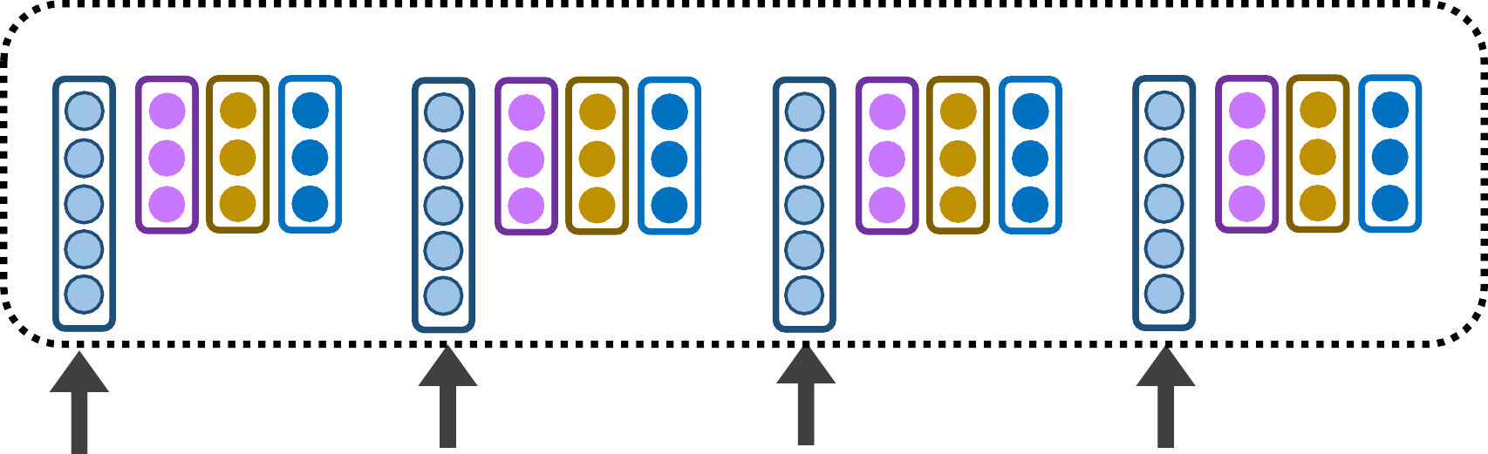
Self-Attention
Tada! Now we have great, new representations z_{i} via a
self-attention head
z₂ z₄
z₁
z₃
Self-attention Head
q₁ k₁
v₁
q₂ k₂
v₂
q₃ k₃ v₃
q₄ k₄
v₄
The
x₁
brown
x₂
dog
x₃
ran
x₄

Slide 82
Self-Attention
Tada! Now we have great, new representations z_{i} via a self-attention head
z₁ z2 z₃ ^{z}4
q₁ k₁ v₁ q₂ k₂ v2 q₃ k₃ v3 q4 k4 v4
The brown dog ran
x₁ x₂ x₃ x₄
Takeaway:
Self-Attention is powerful; allows us to create great, context-aware representations

