Slide 1
Fake News detection using Machine Learning
Group No:: RAIT-IN-BE-PR-14
Presented by
18IN1058- Sairaj Yadav (BE-A1)
16IN1090- Ashutosh Salunkhe (BE-B2)
18IN1001- Saurabh Sawant(BE-A1)
Guide
Prof. Bhavana Garg

Slide 2
outline
1.
1
2
3
4
5
Motivation and objective of project
Tools and Dataset required
Methodology
Block Diagram
Introduction
6
7
8
Expected Outcome
Conclusion
References

Slide 3

INTRODUCTION
Fake news might be a moderately new term yet it isn't really another new phenomenon. However, the advances in technology and the spread of news through various kinds of media have expanded the fake news expansion today.
As such, fake news impacts have expanded exponentially in the past and something must be done to keep this from proceeding later in the future.
This project is expected to be one solution that could be utilized to help people who are attempting to classify fake news.

Slide 4

Motivation and objective of project
The main objective of this project is to study the fake news detection (including tweets, fake posts, subjects) problem in online social networks and make people to easily understand the difference between fake and real news.
Based on various types of information sources, including both textual content/descriptions and the authorship and article subject relationship among them, we aim at identifying fake news from test database simultaneously.

Slide 5





Tools and dataset required
Python integrated development environment.
Sklearn (scikit learn).
Numpy.
NLTK (Natural Language Toolkit).
Jupyter lab.
Anaconda.
Flask

Slide 6
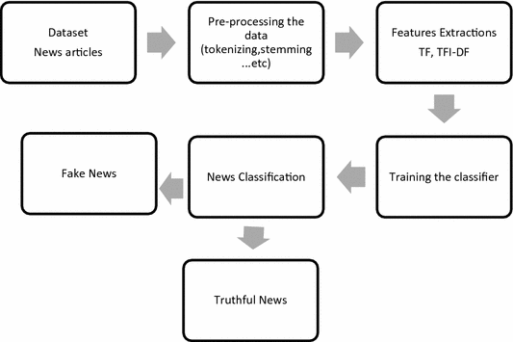
Block Diagram

Slide 7
Methodology
Primarily, we take input in the form of a dataset through the user and then it is handled using the model build based on the count vectorizer or a tf-idf matrix (word tallies how often they are used in other articles in our dataset).
Since this problem is a kind of text classification, implementing combination of Naive Bayes classifier, SVC, MaxEnt algorithm will be optimal as this is standard for text based processing.\
Finally, we are obtaining the accuracy and printing the true and false positives and negatives using confusion matrix. Confusion matrix is nothing but a table used to describe the performance of classification model or classifier on set of data set.
We obtain the accuracy based on how well our classifiers are working with the data set fit in it. Accuracy is calculated based on true and false positives and negatives.
Accuracy = TP+TN/TP+TN+FP+FN

Slide 8
Methodology
> Regex(Regular Expression):
Python has a built-in package called re, which can be used to work with Regular Expressions.
s = re.sub(r'[^\w\s]',‘’,s)
> Tokenization:
Python tokenization basically refers to splitting up a larger body of text into smaller lines, words or even creating words for a non-English language. The various tokenization functions are in-built into the nltk module itself and can be used in programs as shown below.
> StopWords:
A stop word is a commonly used word (such as “the”, “a”, “an”, “in”) that a search engine has been programmed to ignore, both when indexing entries for searching and when retrieving them as the result of a search query.

Slide 9
methodology
> Tf Idf vectorizer:
TFIDF, short for term frequency–inverse document frequency, is a numerical statistic that is intended to reflect how important a word is to a document in a collection or corpus.
>PassiveAggresive algorithm for classification:
are generally used for large-scale learning.
> Flask for handling the backend:
It is a web framework. It provides you with tools, libraries and technologies that allow you to build a web application.

Slide 10
MODEL
Baseline Model 1: SVC: Support vector classifier
We create a baseline classification model with a support vector machine, a good model to handle complex classifications.
What is an SVC model?
The Linear Support Vector Classifier (SVC) method applies a linear kernel function to perform classification and it performs well with a large number of samples.
Baseline Model 2: Naïve Bayes
Naïve Bayes Classifier is one of the simple and most effective Classification algorithms which helps in building the fast machine learning models that can make quick predictions. It is a probabilistic classifier, which means it predicts on the basis of the probability of an object.

Slide 11
Model
Baseline Model 3: MaxEnt Classifier
Maximum entropy (maxent) classifier has been a popular text classifier, by parameterizing the model to achieve maximum categorical entropy, with the constraint that the resulting probability on the training data with the model being equal to the real distribution
Feature Engineering
Explicit POS tagging
TF-IDF weighting
Bigram/Trigram Count Vectorizer

Slide 12
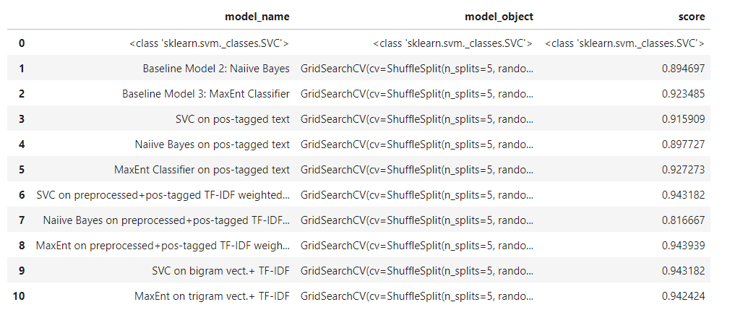
Model results

Slide 13
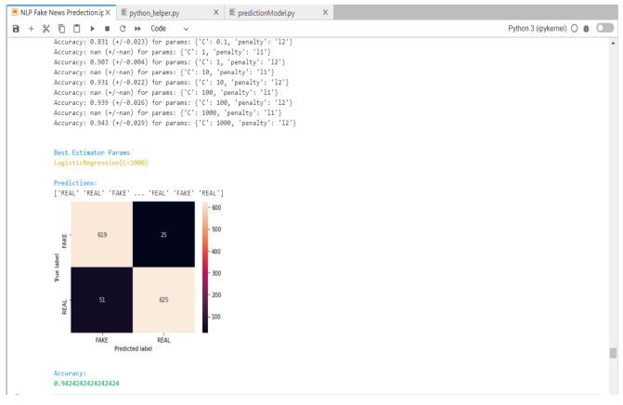
Outcome
The "MaxEnt on trigram vect.+ TF-IDF" is the best model with the highest score with an accuracy of 0.9424242424242424

Slide 14
outcome
Once you locate the python.exe path, you need to write whole path of it and then entire path of project folder with fake_news_detection.py at the end.
After hitting the enter, program will ask for an input which will be a piece of information or news that you want to verify. Once you paste or type news headline, then press enter.
Once you hit the enter, program will take user input (news headline) and will be used by model to classify in one of categories of "Real" and "Spam". It might take few seconds for model to classify the given statement so wait for it.

Slide 15
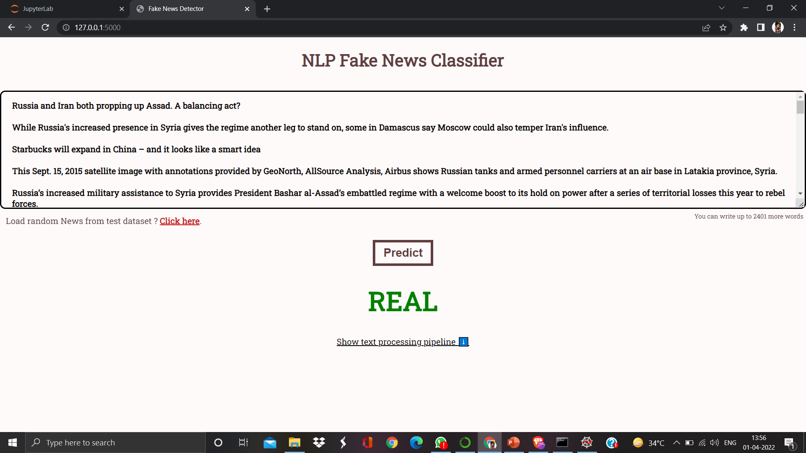
Flask web app – User Interface

Slide 16
Conclusion
However, social media has also been used to spread fake news, which has strong negative impacts on individual users and broader society. The goal of this project is to comprehensively review, summarize, compare and evaluate the current research on fake news.
The outcomes of this project shows the capability of ML to be fruitful in this task. We have tried to build a model that helps in catching many intuitive indications of real and fake news as well as in the visualization of the classification decision.

Slide 17
REFERENCES
[1] Kushal Agarwalla, Shubham Nandan, Varun Anil Nair, D. Deva Hema –“Fake News Detection on Machine Learning and Natural Language Process”.
[2] Kai Shu , Amy Sliva , Suhang Wang , Jiliang Tang and Huan Liu- “Fake News Detection using Data Mining Perspective”.
[3] Study-on-machine-learning-methods - Junaed Younus Khan , Md. Tawkat Islam Khondaker , Anindya Iqbal and Sadia Afroz –“A Benchmark
[4] https://data-flair.training/blogs/advanced-python- project-detecting-fake-news/

